Slide 1
Chapter 9: Graph Database
Machine Learning with Python

Slide 2
Chapter Objectives
In this chapter, we will:
Introduce the concept of Graph databases
Explore Python's networkx package

Slide 3
Chapter Concepts
Graph Databases
NetworkX
Chapter Summary
Notes:
Highlight the topic that follows this page, and place the delta arrow next to it by moving vertically, but maintain the horizontal placement.
If there are too many topics to fit on the page, reduce the line spacing to fit.

Slide 4
Graph Database
Relational databases are useful for storing fields in a tabular format
To show one record is connected to another in some way, you would build a related table and create a foreign key between them
This can get messy to encode complex data with many relationships
Graph databases encode the data in a different manner which places equal weight to the data of the record and the relationship it has with other records
Once data is encoded in a graph database format it is able to be queried in ways that would be difficult and time consuming in a relational database
Graph databases have many use cases
network and social analysis
fraud detection
supply chain transparency
infrastructure monitoring

Slide 5
Terminology
Graph databases are composed of nodes and edges instead of tables made up of rows and columns
A node is like a record in that it stores data, but it is much less structured and more free form
can store any data you like as a key value pair
much like JSON or Python dictionaries
not all nodes have to have the same data
Edges are connections between nodes and are like a relationship between objects
edges themselves can have additional data just like a node
a common data element found in an edge is weight, indicating how strong a relationship there is between the two nodes
edges can be directed or undirected, meaning they flow one way or both ways

Slide 6
Common Queries
There are two categories of queries you can run on graph databases
egocentric answer questions about particular nodes
how many other nodes does it connect to
how important is the node
is it centrally located or near the borders
what other types of nodes is it connected to
how far is it from one node to another
what is the shortest path between two particular nodes
sociocentric answer questions about the network as a whole
are there particular combinations of nodes that are more important
are there natural clusters or communities within the network
are there bottlenecks that could break down the network if they fail
where could we add additional connections to facilitate a more robust network or better connectivity between nodes
do nodes tend to connect to other similar nodes

Slide 7
Chapter Concepts
Graph Databases
NetworkX
Chapter Summary
Notes:
Highlight the topic that follows this page, and place the delta arrow next to it by moving vertically, but maintain the horizontal placement.
If there are too many topics to fit on the page, reduce the line spacing to fit.

Slide 8
Tools
There are many tools for graph databases
Neo4J is a full fledged database cluster for storing and manipulating large graph databases
NetworkX is a Python library that has a lot of features and is suitable for running queries on data that may be stored in regular places such as text files
GraphX is a Spark library that can be used with Python, Scala and Java and works on a cluster to handle larger datasets
All use the same concepts and terminologies and can solve the same problems, they just use different syntax to do it

Slide 9
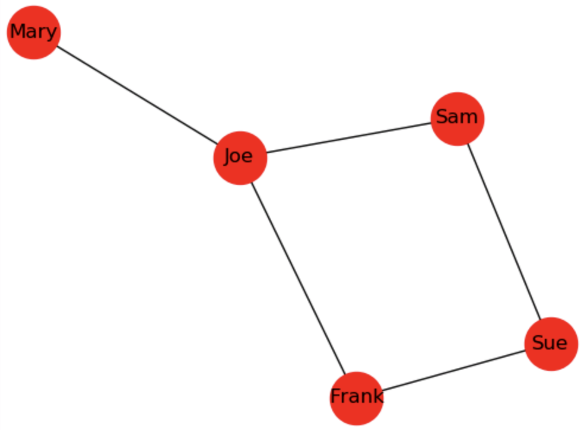
NetworkX
Easy to use Python package that supports creating in memory graph databases that can be analyzed
Integrates nicely with Python plotting packages to make it easy to display graph data
The circles represent nodes
The lines between the nodes are edges
pip install networkx
import networkx as nx
G_names = nx.Graph()
G_names.add_edges_from([("Joe", "Mary"), \ ("Joe", "Frank"), ("Sue", "Frank"), \ ("Sam", "Joe"), ("Sue","Sam")])
nx.draw_networkx(G_names, node_size = 1000)

Slide 10
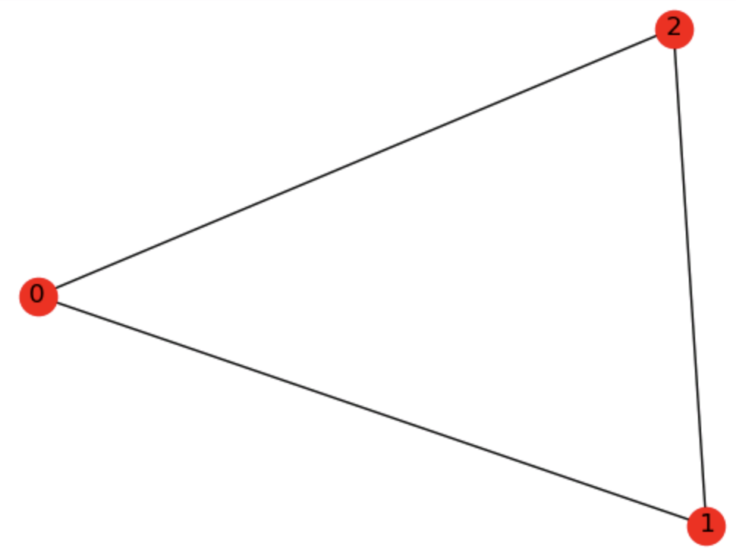
Reading Data from Numpy
Data can be easily read from Numpy arrays
import numpy as np
adj = np.array([[0, 1, 1],
[1, 0, 1],
[1, 1, 0]])
G2 = nx.from_numpy_matrix(adj)
nx.draw_networkx(G2)

Slide 11
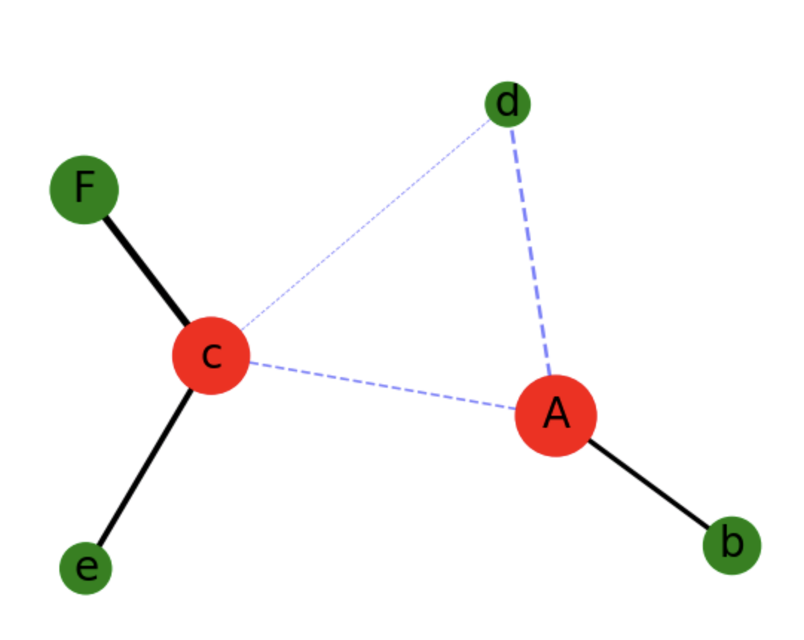
Changing Plot Attributes
Using additional data in the nodes and edges, the plot can customize features such as size, shape, color, line thickness and style to create a visual representation of the features that will help identify meaningful information
eigen = nx.eigenvector_centrality(G)
ns = [15 * x['size'] for _,x in G.nodes(data=True)]
nc = ['r' if x >= .5 else 'g' for x in eigen.values()]
nx.draw_networkx_nodes(G, pos, node_size=ns, node_color=nc)
# edges
nx.draw_networkx_edges(G, pos, \ edgelist=elarge, width=elargeweight)
nx.draw_networkx_edges(G, pos, \ edgelist=esmall, width=esmallweight, \ alpha=0.5, edge_color='b', style='dashed')

Slide 12
Common Functions
Once you have data encoded as nodes and edges, there are tons of functions that can be run on the data to find interesting features that can be used to find particular data or display it by changing various visual atrtibutes
Some common egocentric functions:
degree_centrality - number of links in or out
closeness_centrality – how quickly info can pass to other from here
eigenvector_centrality – how well connected to important nodes
betweenness_centrality - how likely to be in communication path
shortest_path – shortest route between two nodes
diameter – shortest distance between two furthest nodes
Some common sociocentric functions:
degree_assortativity_coefficient – useful in finding how homogeneous the data is
find_cliques – find sections of graph where all nodes are connected to each other
density – describes how many potential connections actually exist

Slide 13
Chapter Concepts
Cluster Analysis
Algorithms
Chapter Summary
Notes:
Highlight the topic that follows this page, and place the delta arrow next to it by moving vertically, but maintain the horizontal placement.
If there are too many topics to fit on the page, reduce the line spacing to fit.

Slide 14
Next Steps
We only had time to explore the tip of the iceberg for graph databases
Learn about use cases and solutions that graph databases can solve and see how companies like Facebook, LinkedIn and more have applied these techniques
Explore technologies such as:
Neo4J
NetworkX
GraphX for Spark
Notes:
Highlight the topic that follows this page, and place the delta arrow next to it by moving vertically, but maintain the horizontal placement.
If there are too many topics to fit on the page, reduce the line spacing to fit.

Slide 15
Chapter Objectives
In this chapter, we will:
Introduce the concept of Graph databases
Explore Python's networkx package

