Slide 1
Chapter 6: Cluster Analysis
Machine Learning with Python

Slide 2
Chapter Objectives
In this chapter, we will:
Explore Cluster Analysis
Compare two algorithms
K-Means
Hierarchical

Slide 3
Chapter Concepts
Cluster Analysis
Algorithms
Chapter Summary
Notes:
Highlight the topic that follows this page, and place the delta arrow next to it by moving vertically, but maintain the horizontal placement.
If there are too many topics to fit on the page, reduce the line spacing to fit.

Slide 4
Cluster Analysis
Analysis tool to help make sense of the data before feeding it into other models
Unsupervised
More about discovering patterns in data
Not about predicting values for unknown values
Looks for natural groupings among the data
Voter groups (is it just left vs. right, or left, right, center, or more)
Species identification (are two groups of organisms different enough to be considered a different species or not)
Identify different types of customers we may have
Often helpful as a preparatory step before classification to determine how many categories we may want to predict

Slide 5
Types of Cluster Analysis
There are two main approaches to solve this
Top down (K-Means)
Bottom up (Hierarchical clustering)
Both rely on the notion of similarity
Objects are similar if they share common attributes to others
The more similar they are, the closer they are to one another
If something is far away in similarity to one thing, it may be closer to something else
Ultimately the goal is to take a large sample of data and break it up into a small number of meaningful groupings that shed insight as to what the data means

Slide 6
Dataset
For these examples let’s generate some random datasets just because it’s easier to analyze
import numpy as np
from sklearn.cluster
import Kmeans
from sklearn.datasets import make_blobs
# Creating a sample dataset with 4 clusters
x, y = make_blobs(n_samples=400, n_features=2, centers=3)
print (x[:5]) # shape location
print (y[:5]) # cluster member
[[-6.10513999 -3.58316594] [-7.6168443 5.40841142] [-2.06235753 -3.92038777] [-1.8104498 -4.1218467 ] [-5.32915489 -6.17092626]]
[2 1 0 0 2]

Slide 7
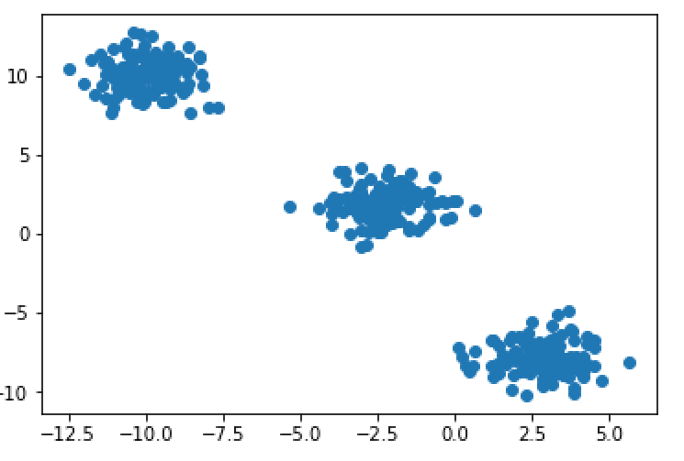
Visualize the Data
It is often helpful to visualize the data by plotting it
There are only two features in this set so it’s easy to plot
You can also plot a 3D graph for three features
Beyond that, it’s hard to visualize more features
import matplotlib.pyplot as plt
plt.rcParams['figure.figsize'] = (16, 9)
plt.plot(x[:,0],x[:,1],'o')
plt.show()

Slide 8
Chapter Concepts
Cluster Analysis
Algorithms
Chapter Summary
Notes:
Highlight the topic that follows this page, and place the delta arrow next to it by moving vertically, but maintain the horizontal placement.
If there are too many topics to fit on the page, reduce the line spacing to fit.

Slide 9
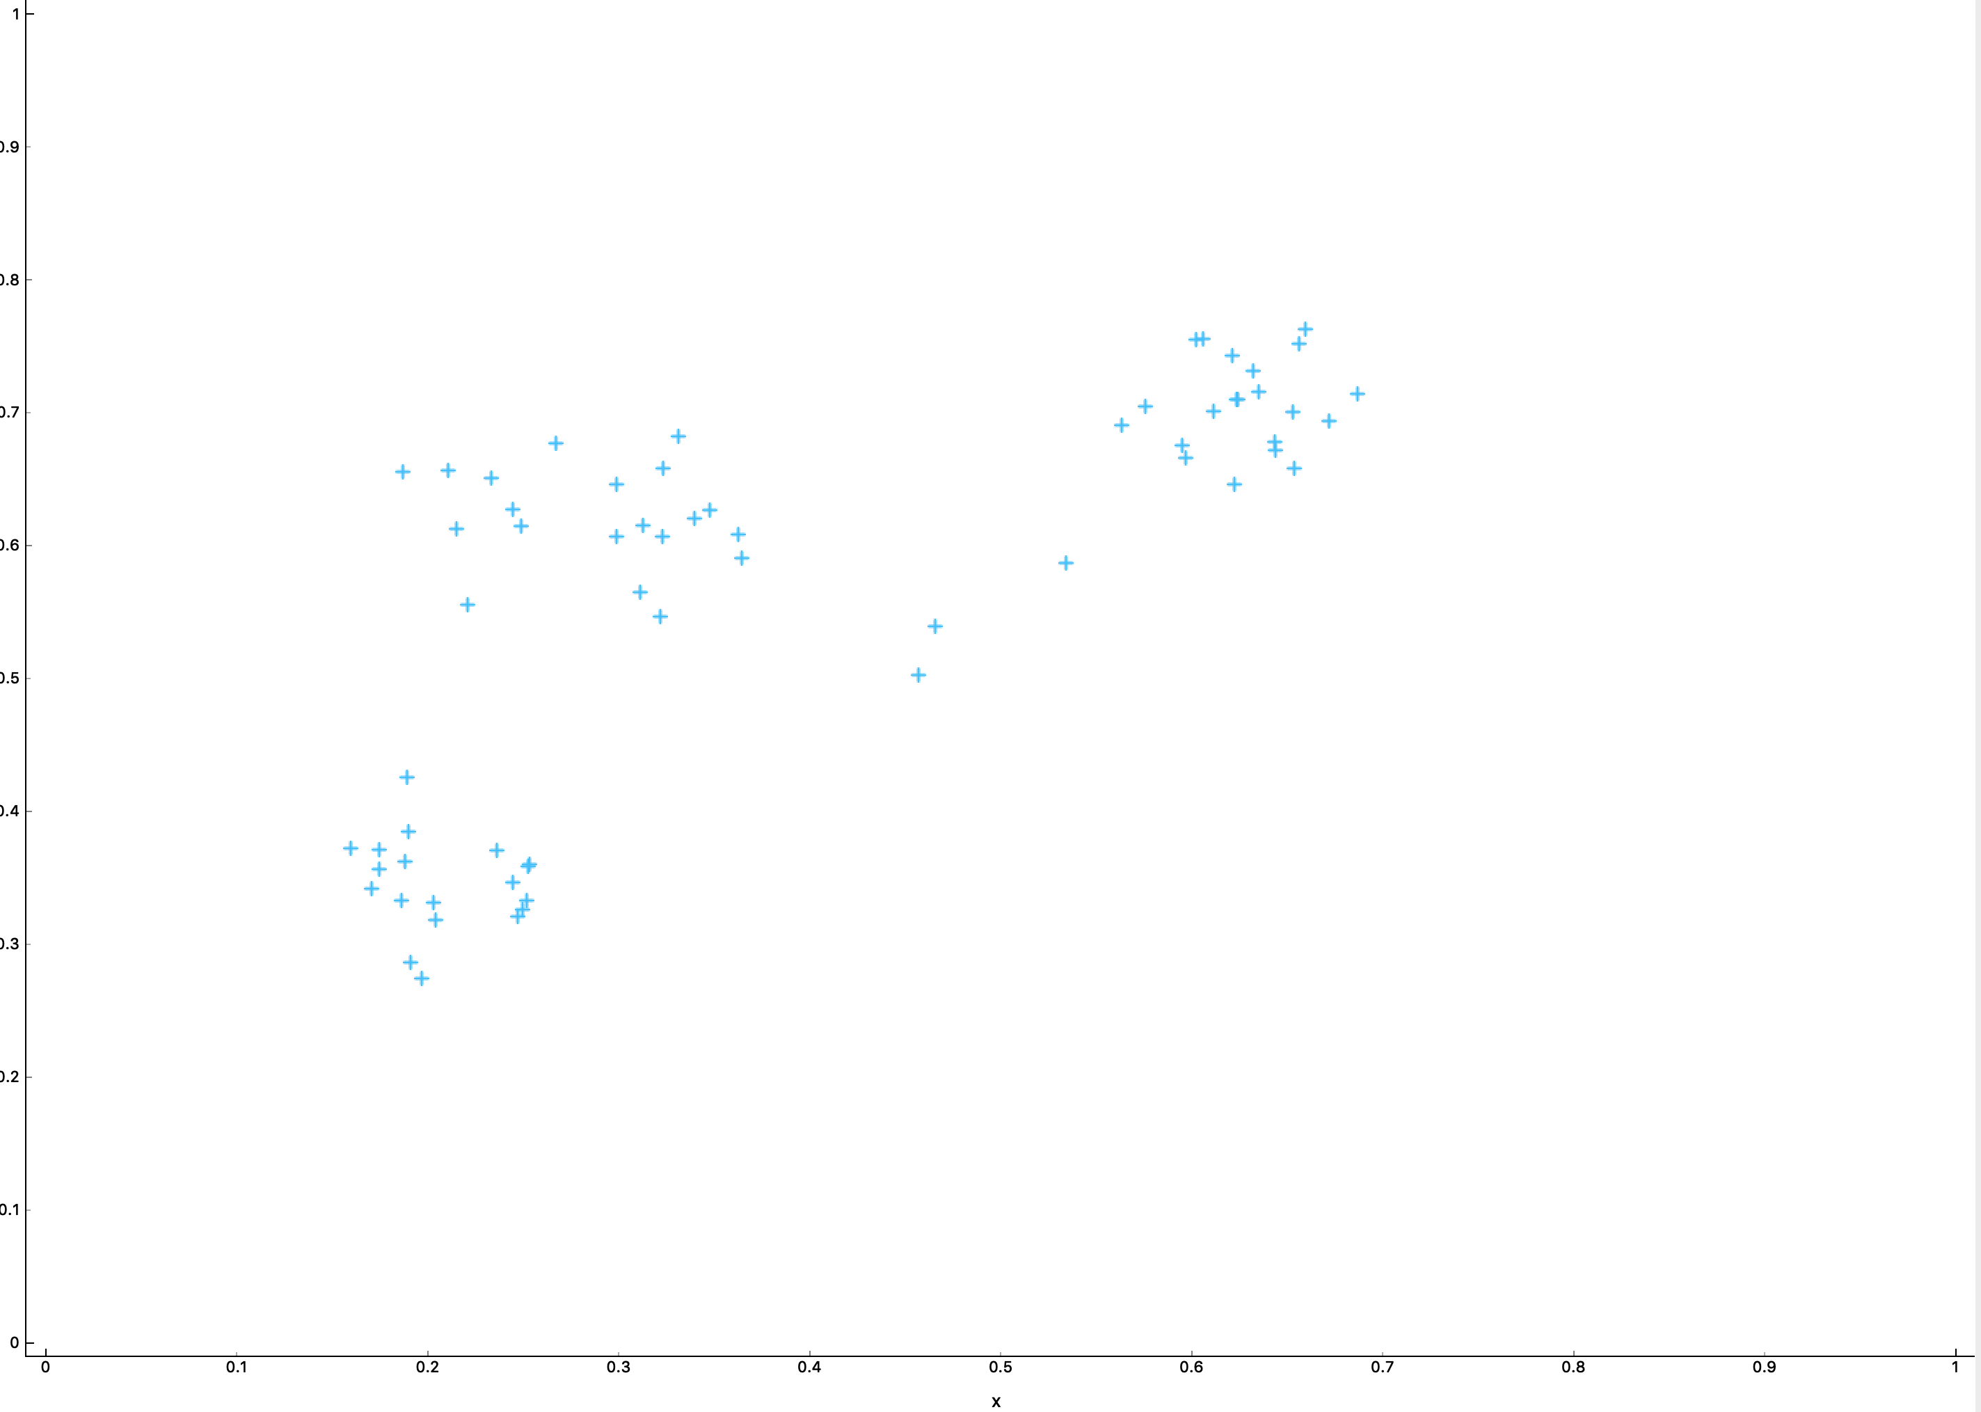
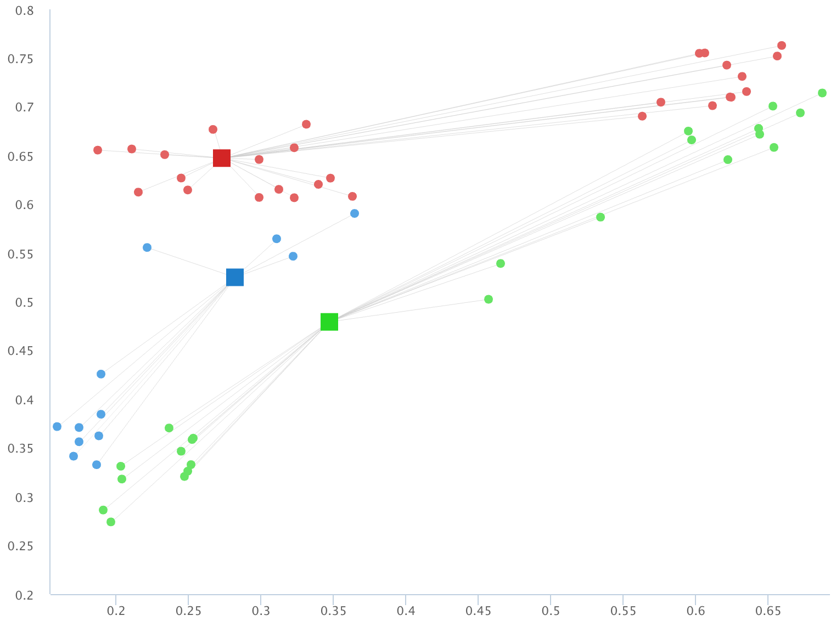
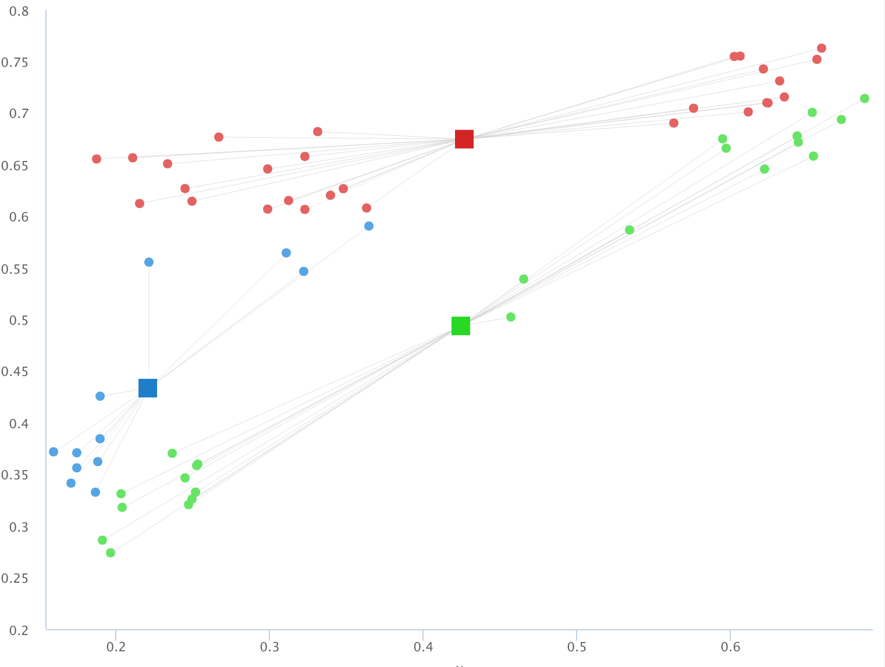
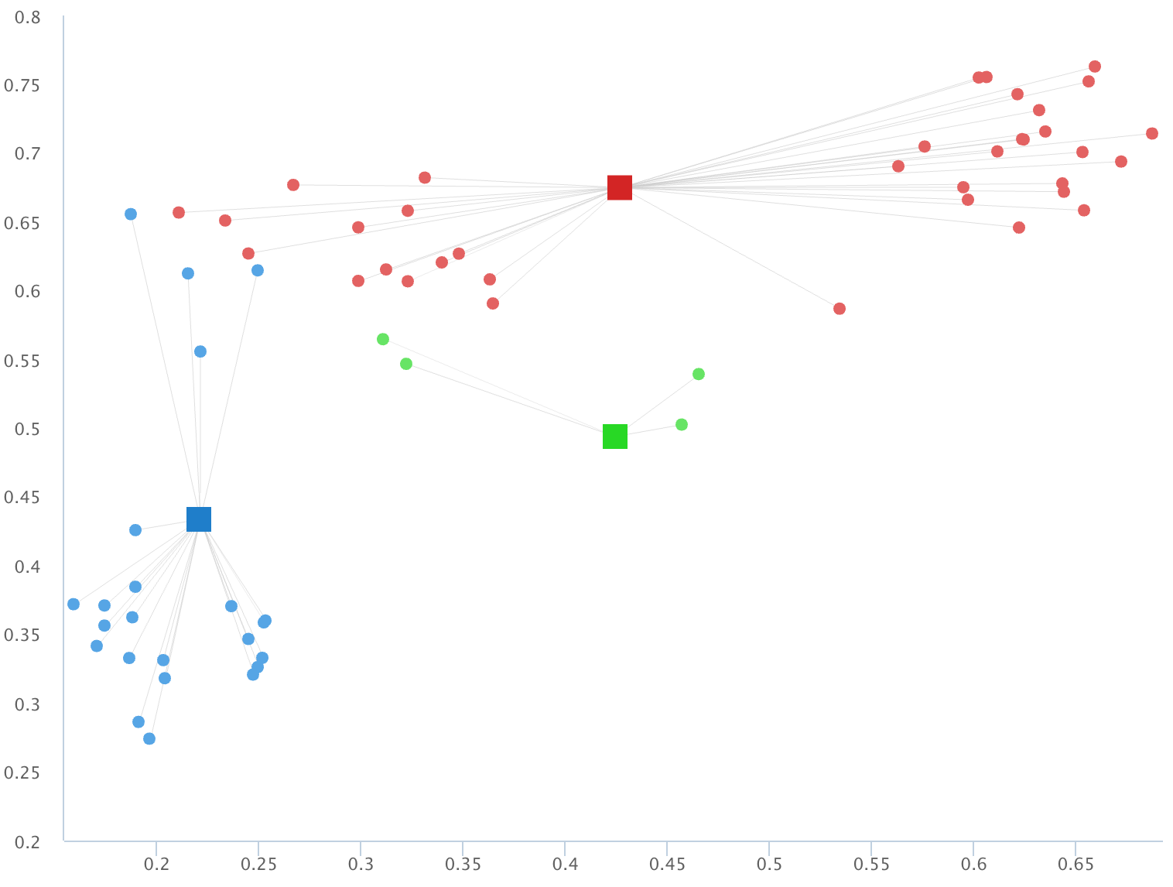
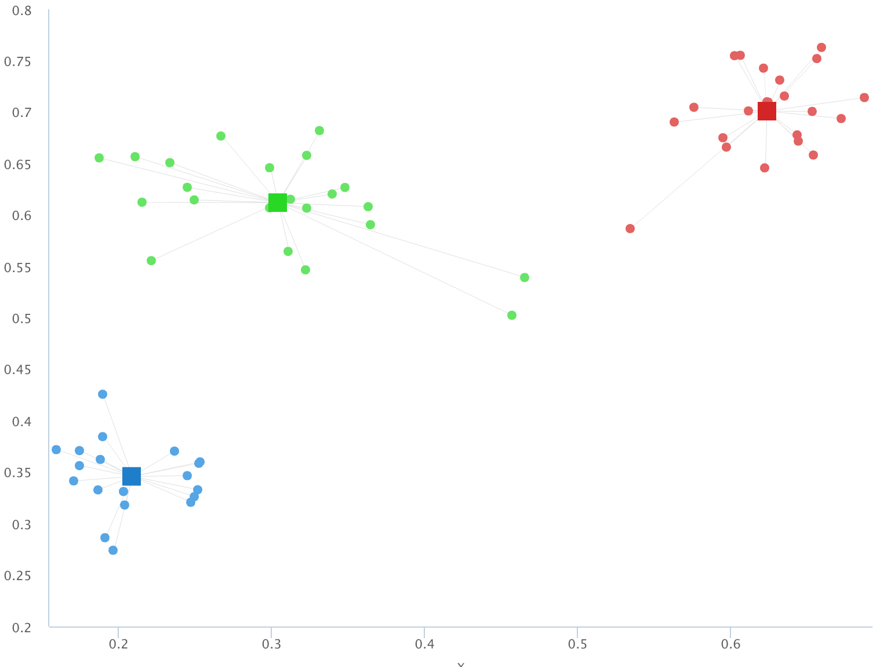
K-Means In Actions
Random Data
Random Centroids
Adjust Centroids
Reassign Membership
Keep Doing Until Stops Changing

Slide 10
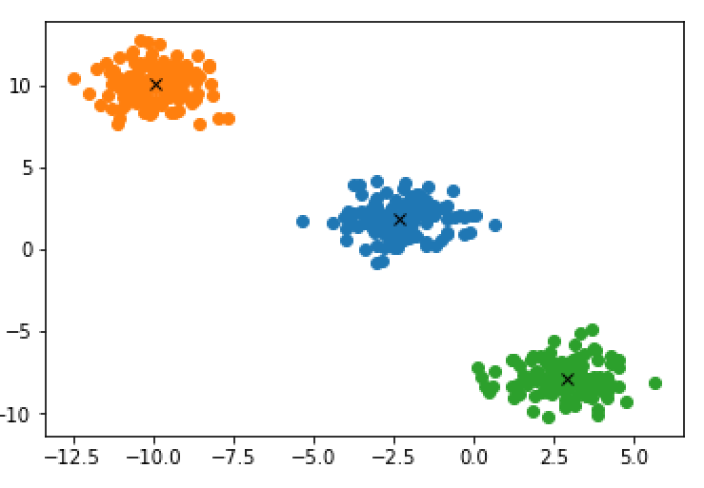
Run K-Means
Just eyeballing it, let’s try out three clusters and plot the results
from sklearn import cluster
CLUSTERS = 3
k_means = cluster.KMeans(n_clusters=CLUSTERS)
k_means.fit(x)
labels = k_means.labels_
centroids = k_means.cluster_centers_
for i in range(CLUSTERS):
ds = x[np.where(labels==i)]
plt.plot(ds[:,0],ds[:,1],'o')
lines = plt.plot(centroids[i,0],
centroids[i,1],'kx')
plt.show()

Slide 11
Elbow Chart
Here the results are very clear cut, but sometimes the data overlap and don’t fit nicely into a particular cluster
It is often helpful to run a chart that helps figure out how many clusters is ideal
Too few and the items are too dissimilar
Too many and the additional distinctions become trivial
Is there much difference between a brown poodle and a chocolate poodle?
def plot_elbow(data, cluster_cnt = 6):
CLUSTERS = range(1, cluster_cnt)
kmeans = [cluster.KMeans(n_clusters=i) for i in CLUSTERS]
score = [kmeans[i].fit(data).score(data) \
for i in range(len(kmeans))]
plt.plot(CLUSTERS ,score)
plt.xlabel('Number of Clusters')
plt.ylabel('Score')
plt.title('Elbow Curve')
plt.show()
plot_elbow(x)

Slide 12
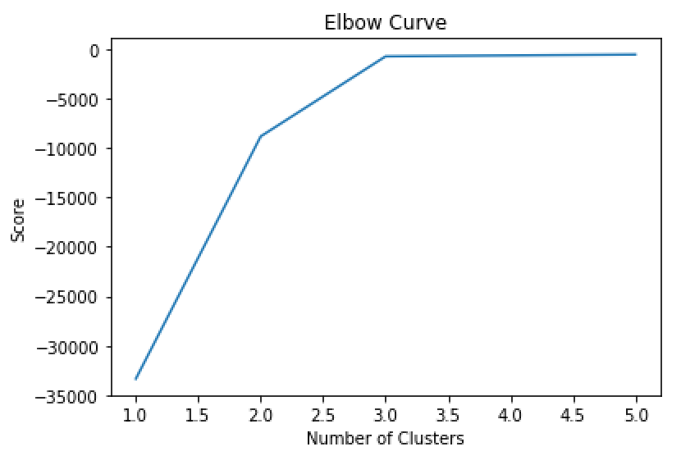
Elbow Chart (continued)
In the chart, we can see there is a bend between two to four clusters
Three feels like the right number to start with in this case

Slide 13
Silhouette Charts
Once you have figured out approximately how many clusters you have, you should run the analysis a few times with different cluster numbers
A silhouette chart helps to visualize how well the clusters are at grouping similar items together
Higher silhouette score (i.e., closer to 1) means in general the cluster does a good job at grouping similar items together
Graphing how similar each item is to its neighbors helps to visualize how good the cluster is also
Ideally, you want to settle upon a number of clusters that has a good mix of:
A high silhouette value
Few members that are far off from the average silhouette value
A number of clusters that are reasonably similar in size
A number of clusters that makes business sense of what you’re trying to describe

Slide 14
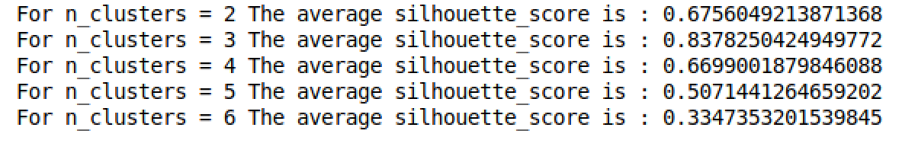
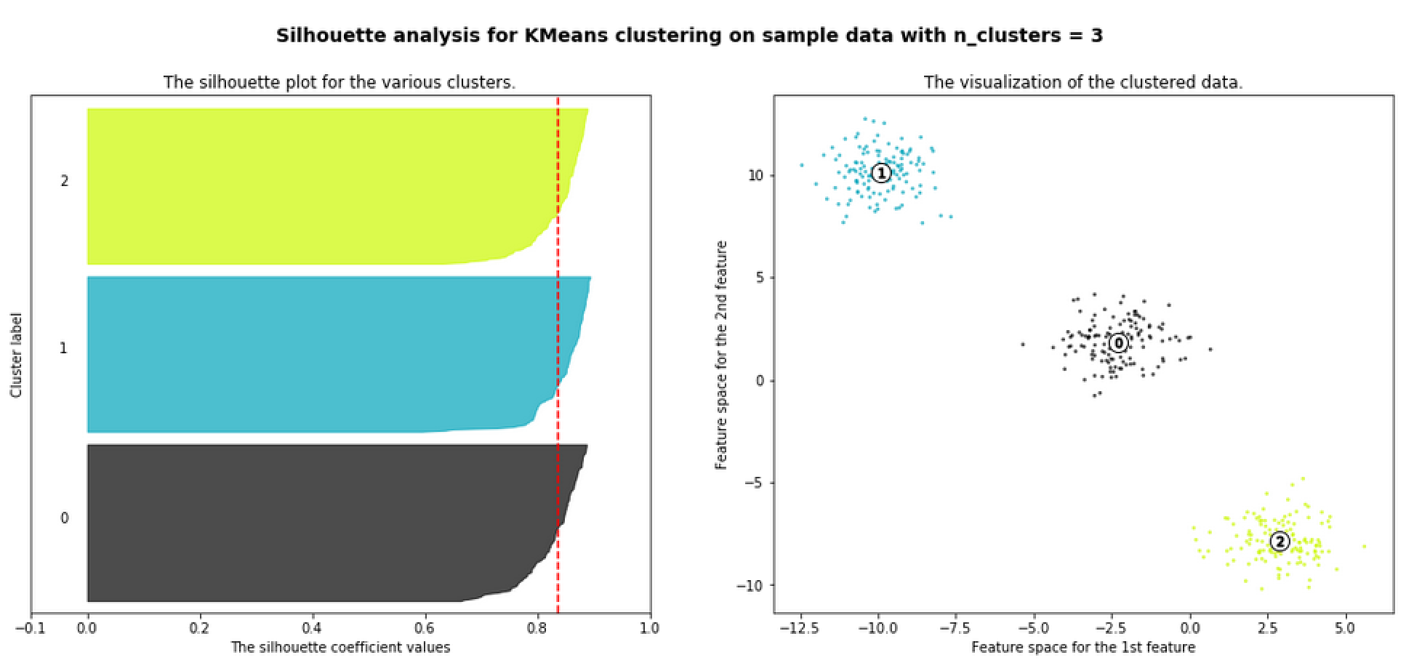
Silhouette Charts (continued)

Slide 15
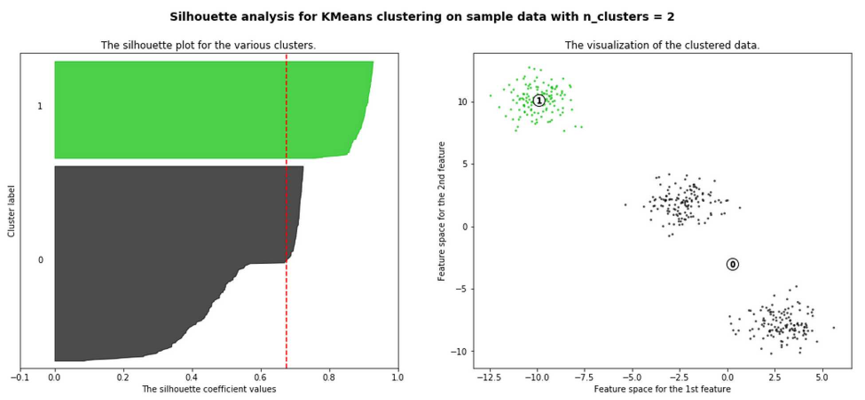
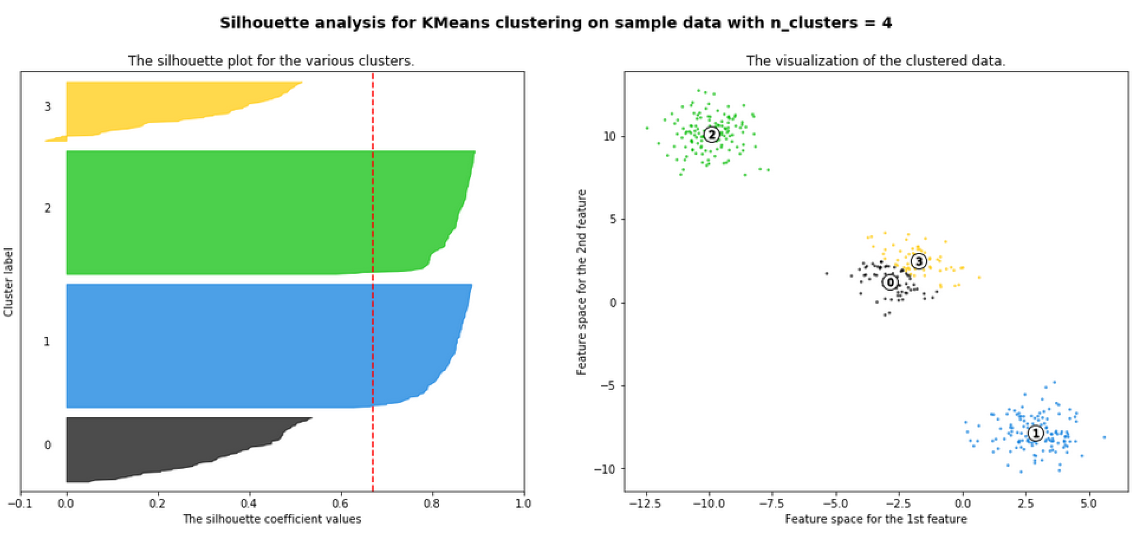
Silhouette Charts (continued)

Slide 16
Hierarchical Clustering
Often called bottom-up
Finds two clusters closest to one another and merges them and keeps doing it until there is one big cluster
Uses distance of the features to determine closeness
Creates a graph called a dendrogram which helps visualize the clusters and how similar they are
Usually a good first step to take before K-Means to get a feel for how many clusters you should start with
x, y = make_blobs(n_samples=10, n_features=2, centers=3)
print (x)
print (y)
from scipy.cluster.hierarchy import dendrogram, linkage
z = linkage(x, 'ward')
dendrogram(z, leaf_rotation = 90, leaf_font_size=12)

Slide 17
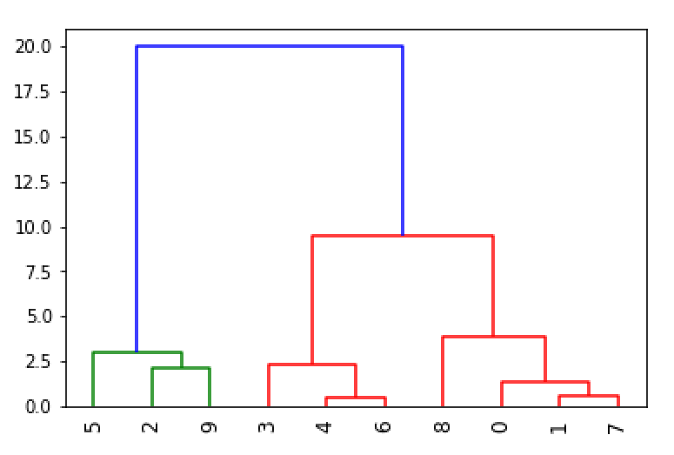
Hierarchical Clustering (continued)

Slide 18
Chapter Concepts
Cluster Analysis
Algorithms
Chapter Summary
Notes:
Highlight the topic that follows this page, and place the delta arrow next to it by moving vertically, but maintain the horizontal placement.
If there are too many topics to fit on the page, reduce the line spacing to fit.

Slide 19
Next Steps
The unsupervised model of clustering doesn’t make predictions so much as it helps understand the data
Another unsupervised model to explore is association rules
Used to describe patterns like “people who like X also like Y”

Slide 20
Chapter Summary
In this chapter, we have:
Explored Cluster Analysis
Compared two algorithms
K-Means
Hierarchical

