Slide 1
Chapter 8: Regression Analysis
Machine Learning with Python

Slide 2
Chapter Objectives
In this chapter, we will:
Introduce Linear Regression
Compare two algorithms
Scikit-Learn
Statsmodel

Slide 3
Chapter Concepts
Regression Analysis
Algorithms
Chapter Summary
Notes:
Highlight the topic that follows this page, and place the delta arrow next to it by moving vertically, but maintain the horizontal placement.
If there are too many topics to fit on the page, reduce the line spacing to fit.

Slide 4
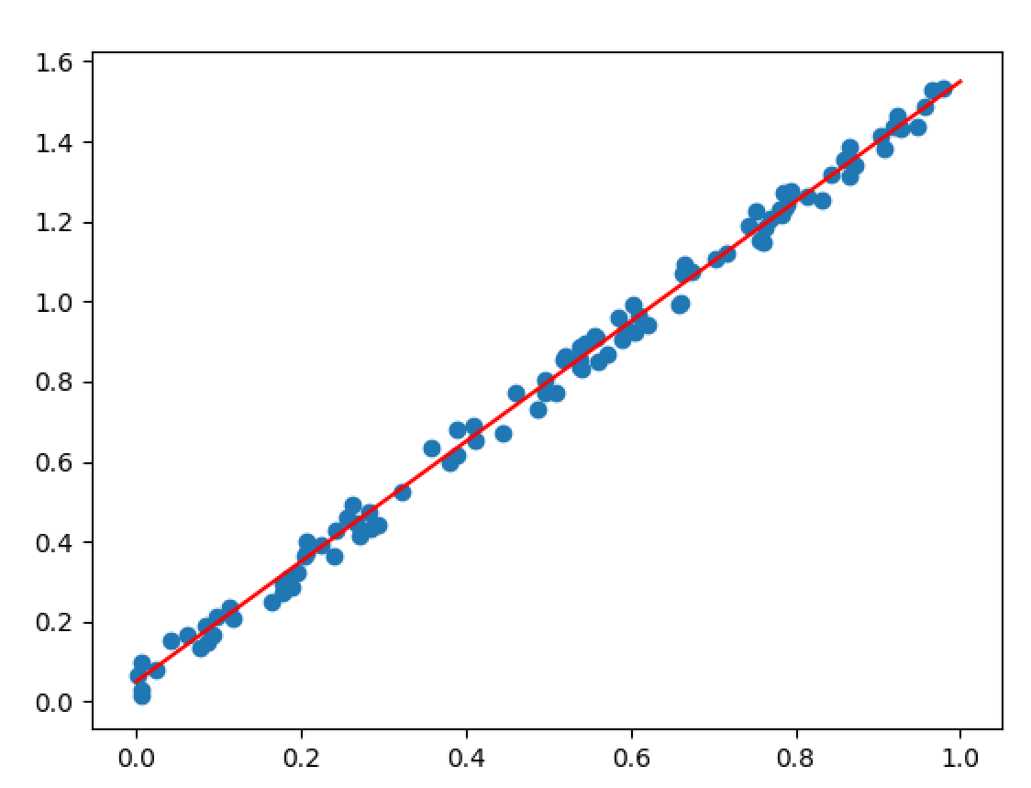
Linear Regression
Given a collection of X, Y points, you could easily see there is a pattern
If you remember enough algebra, you could describe the pattern of dots as roughly following the red line, which could be described with the formula y = 1.5x + .01

Slide 5
Linear Regression (continued)
The idea is that the line that best describes the pattern of dots is the one that has the least distances of the dots from the line
The formula that describes the line could then be used to predict a value that we have not observed
The better the line and formula are at describing that pattern of dots, the more accurate that prediction should be
Extrapolate this idea onto more than just two axes and instead try to find a line that goes through many different dimensions and you have the idea of multiple linear regression
y=α+β1x1 +β2x2 +...+βixi +ε
Has many use cases
Predicting a stock or commodity price
Predicting election results
Predicting crime rate

Slide 6
Linear Regression (continued)
Is a supervised model that requires training from a known set of data and testing to see how good it is at predicting before using it for real predictions
Only works with numeric values
Categorical data needs to be dummy encoded
Does not deal well with missing data, so must be fixed by removing or replacing with central tendency
There are many algorithms to do this, each with its own pros and cons

Slide 7
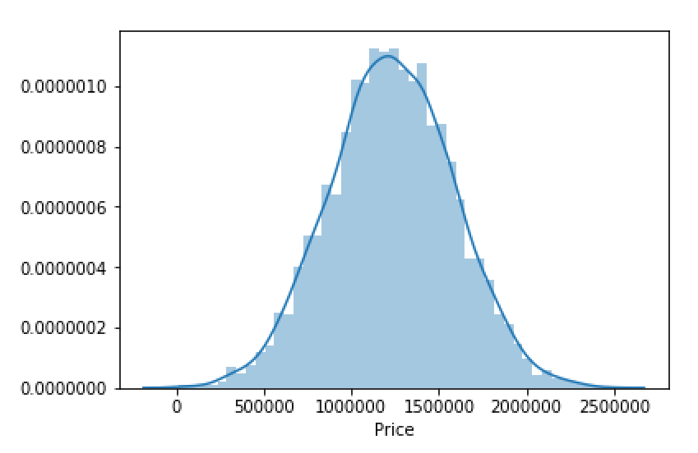
Dataset
For our examples, let's use a public data set of housing data
The data has no categorical columns but does have an address we will ignore
Plotting the distribution of Prices shows that they are normally distributed
import pandas as pd
import matplotlib.pyplot as plt
import seaborn as sns
USAhousing = pd.read_csv('USA_Housing.csv')
print (USAhousing.columns)
print (USAhousing.head())
sns.distplot(USAhousing['Price'])

Slide 8
Chapter Concepts
Cluster Analysis
Algorithms
Chapter Summary
Notes:
Highlight the topic that follows this page, and place the delta arrow next to it by moving vertically, but maintain the horizontal placement.
If there are too many topics to fit on the page, reduce the line spacing to fit.

Slide 9
Create a Scikit Model
Prep the data and fit the model on the training set
from sklearn.model_selection import train_test_split
from sklearn.metrics import mean_squared_error, r2_score
x = USAhousing[['Avg. Area Income', 'Avg. Area House Age', 'Avg. Area Number of Rooms', 'Avg. Area Number of Bedrooms', 'Area Population']]
y = USAhousing['Price']
trainX, testX, trainY, testY = train_test_split(x, y, test_size = 0.4, random_state = 101)
from sklearn.linear_model import LinearRegression
lm = LinearRegression()
lm.fit(trainX, trainY)

Slide 10
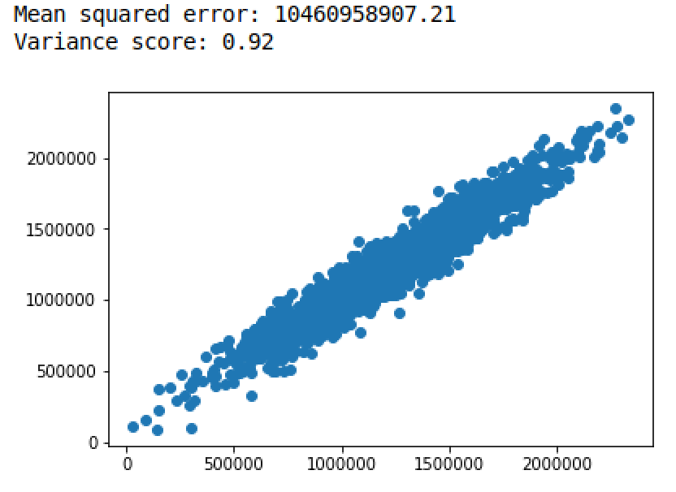
View the Model
Run predictions on the test set and compare them to the real values to see how well the model did at predicting
The variance score, also called R-Squared, indicates how well in general the model fits
Ranges from 0 – 1, the closer to 1 the better
.92 means this model fit reasonably well
predictions = lm.predict(testX)
plt.scatter(testY, predictions)
print("Mean squared error: %.2f" % mean_squared_error(testY, predictions))
print('Variance score: %.2f' % r2_score(testY, predictions))

Slide 11
Create a Stats Model
The stats library offers a different version of the algorithm
Provides a little more information about the accuracy of the model
import statsmodels.api as sm
model = sm.OLS(trainY, trainX).fit()
print (model.summary())
predictions = model.predict(testX)
plt.scatter(testY, predictions)
plt.show()

Slide 12
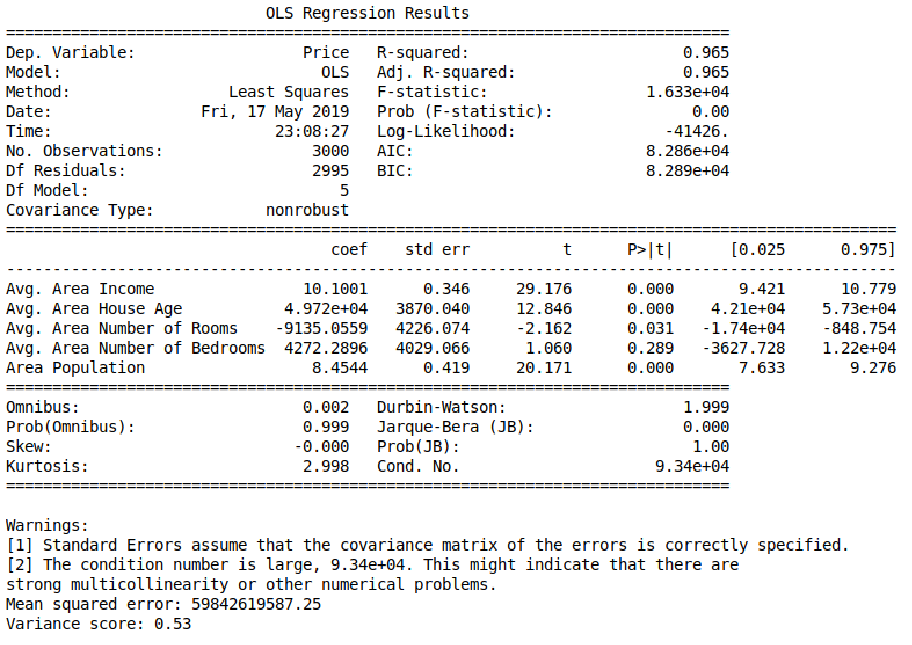
Interpret the Model
You automatically get the R-squared from the summary function
Additionally, the Adjusted R-squared is helpful because it helps to compare models with different numbers of predictor variable
The P factors also identify which features are most significant in influencing the value you are trying to predict

Slide 13
Chapter Concepts
Cluster Analysis
Algorithms
Chapter Summary
Notes:
Highlight the topic that follows this page, and place the delta arrow next to it by moving vertically, but maintain the horizontal placement.
If there are too many topics to fit on the page, reduce the line spacing to fit.

Slide 14
Next Steps
Regression has a lot more complexity to it once you master the basics
Some subjects to explore in this area:
Under- and over-fitting a model
Correlation between the independent variables
Non-linear regression
Notes:
Highlight the topic that follows this page, and place the delta arrow next to it by moving vertically, but maintain the horizontal placement.
If there are too many topics to fit on the page, reduce the line spacing to fit.

Slide 15
Chapter Objectives
In this chapter, we have:
Introduced Linear Regression
Compared two algorithms
Scikit-Learn
Statsmodel

