Slide 1
Chapter 4: Data Preparation
Python Program

Slide 2
Chapter Objectives
In this chapter, we will introduce:
Pandasql
A basic refresher on statistics
Basic ETL (extract, transform, and load) and reshaping data for modeling
Splitting data into training and testing sets
Free-form text

Slide 3
Chapter Concepts
Pandasql
Statistics Primer
Basic ETL and Reshaping
Splitting Data
Free-Form Text
Chapter Summary

Slide 4
Pandasql
Pandasql is a convenient add on to Pandas that lets you use standard SQL queries instead of complex Pandas commands
If you know how to solve a problem with SQL already, it is sometimes a better choice
Once installed and imported, you can basically refer to a variable that holds a Pandas DataFrame as if it were a virtual table
pip install pandasql
import pandas as pd
from pandasql import sqldf
pysqldf = lambda q: sqldf(q, globals())
iris = pd.read_csv('../Day3-Pandas/iris-data-index-column.csv', index_col=0, header=0)
display(iris)
query = 'select upper(Class) as Class, Sepal_Length * 10 as S_Length, Sepal_Width / 10 as S_Width from iris'
iris2 = pysqldf(query)
display(iris2)

Slide 5
Chapter Concepts
Pandasql
Statistics Primer
Basic ETL and Reshaping
Splitting Data
Free-Form Text
Chapter Summary

Slide 6
Statistics
Statistics is a branch of mathematics that deals with collecting, organizing, analyzing, interpreting, and presenting data
The math calculations behind it can be complex and time consuming to do, but there are some basic concepts that can be understood and applied without knowing all the details
Data scientists need to understand a few basic big picture ideas in order to apply the computer models
Statistical features of a dataset (central tendency, min, max, IQR, deviation)
Probability (Normal, Uniform, Poisson, Binomial distributions)
Dimension reduction and sampling
Independent vs. Dependent variables and correlation
Accuracy Analysis

Slide 7
Statistical Features
Sometimes called Descriptive Statistics or Exploratory Data Analysis
Gives us an overview of the range of values we find in a dataset
Central Tendency is a measure of what usually happens and can be expressed with three different measures:
Mean or average is the sum of all the values divided by how many values there are
Median is the value in the middle of the set when all values are lined up in order
Mode is the single value that occurs most often in the set
import pandas as pd
df = pd.DataFrame([9,10,10,11,11,11,12,12,12,13,13,13,13,14], columns=['Age'])
print ("Mean", df.Age.mean(), "Median", df.Age.median(), "Mode", df.Age.mode()[0], "Count", df.Age.count())
print (df.Age.value_counts())
Mean 11.714285714285714 Median 12.0 Mode 13 Count 14
13 4
12 3
11 3
10 2
14 1
9 1

Slide 8
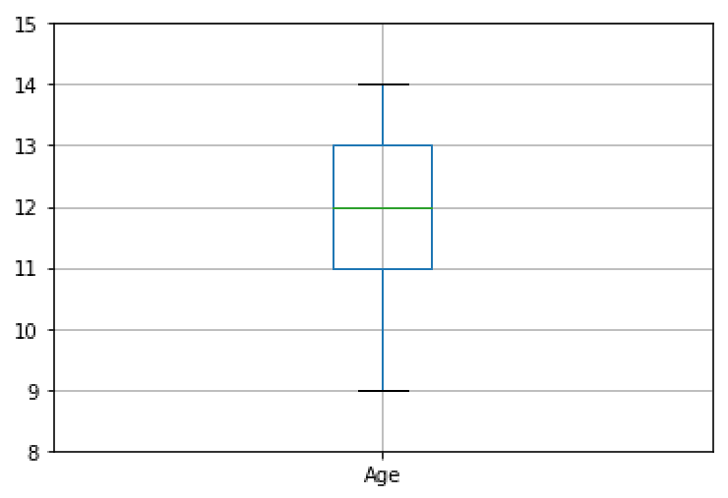
Box Plot
Very often it is helpful to see these numbers plotted graphically instead
import matplotlib as mp
from matplotlib import pyplot as plt
plt.ylim(8,15)
df.boxplot()

Slide 9
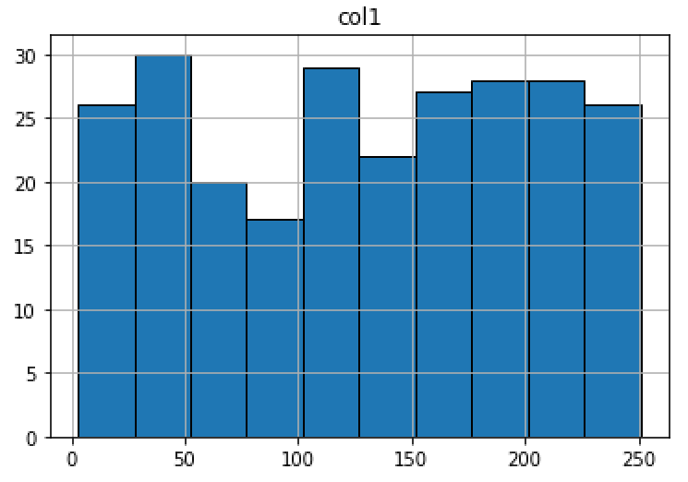
Histogram
Useful way to see each value range and how many items are in that range
import matplotlib as mp
import numpy as np
df = pd.DataFrame(np.random.rand(253, 1) * 254, columns=['col1'])
df.hist(histtype='bar', ec='black')

Slide 10
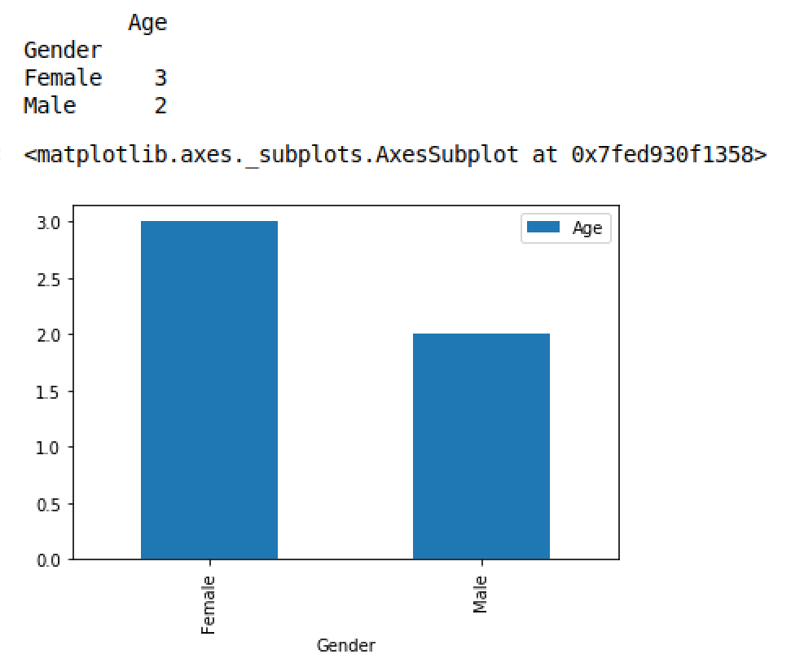
Bar Chart
For categorical data, a bar chart is a good option
df = pd.DataFrame([('Male', 10),('Male', 11), ('Female', 11), ('Female', 12), ('Female', 12)], columns=['Gender','Age'])
x = df.groupby('Gender').count()
print (x)
x.plot(kind='bar')

Slide 11
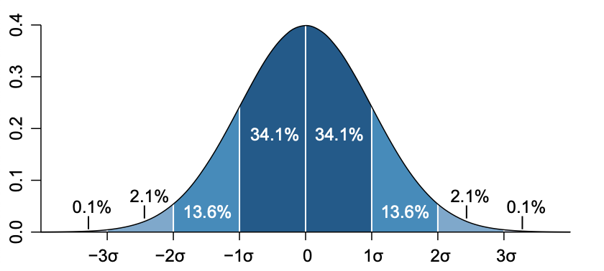
Standard Deviation
Useful for describing how measurements are distributed in the data
The average IQ is 100 and the standard deviation is 15 points
A person with an IQ of 115 is one standard deviation above the mean
A person with an IQ of 85 is one standard deviation below the mean
A person with an IQ of 130 is two standard deviations above the mean
By definition, 68% lie within 1 standard deviation, 95% within 2, and 99% within 3
print (df.std(), df.mean())
1.437336, 11.714286

Slide 12
Chapter Concepts
Pandasql
Statistics Primer
Basic ETL and Reshaping
Splitting Data
Free-Form Text
Chapter Summary

Slide 13
Basic Data Types
Most of the models you will use require data to be perfectly clean
Cannot have null values
Text sometimes needs to be replaced with numbers
Numbers need to be on the same scale
There are some basic data types in machine learning
Numeric
Continuous – decimal numbers (weight or income)
Discreet – whole numbers (number of students)
Binned – numbers grouped together to form a category (18-25) (26-35) (36-45)
Categorical – text or numeric that represents a category (male/female)
Time series – sequence of numbers collected at regular interval (temperature measurement from a weather station)
Text – any free-form text needs to be converted to a numeric document term matrix first

Slide 14
Missing Values
Nulls or missing values can mess up the calculation
Need to remove them or replace them
Usually replace them with the central tendency (mean, median, mode) or zero
NaN is used in Pandas to represent Not a Number
isnull() will return a series of True/False indicating if a value is Null
fillna() replaces nulls with another value
import pandas as pd
fatal = pd.read_csv('2012_Workplace_Fatalities_by_State.csv')
print (fatal.columns)
fatal.columns = ['State', 'NumberOfFatalities', 'RateOfFatalities', 'StateRank', 'NumberOfInjuries', 'InjuriesRate', 'PenaltiesAvg', 'PenaltiesRank', 'Inspectors', 'YearsToInspectEachWorkplaceOnce', 'StateFederal']
print (fatal['PenaltiesRank'].mean())
print (fatal['PenaltiesRank'][48:])
print (fatal['PenaltiesRank'][48:].isnull())
fatal['PenaltiesRank'] = fatal['PenaltiesRank'].fillna(fatal['PenaltiesRank'].mean())
print (fatal['PenaltiesRank'][48:])

Slide 15
Fixing Up DataFrames
insert() can add a new column to a DataFrame
drop() removes a column from a DataFrame
Categorical replaces strings with number placeholders
astype converts the data type of a column
fatal.insert(11, 'Program', pd.Categorical(fatal['StateFederal']).codes)
print (fatal[['Program', 'StateFederal']])
fatal['NumberOfFatalities'].fillna(0).astype(int)
fatal.drop(['StateFederal'], axis=1, inplace=True)

Slide 16
Rescaling
Sometimes numbers in a dataset can be on a different scale in one column vs. another
Weight might be measured in pounds, heights in inches
Value range in different columns can be wildly different
Rescaling them to a common scale can be helpful for understanding how to compare data in different scale
Some algorithms require that all the numbers be on the same scale, others might not care but may perform better if they are rescaled first
Large trial and error to see what works best
from sklearn import preprocessing as pp
x = fatal.NumberOfFatalities
print (x.mean(), x.std(), x.min(), x.max()) → 171 624 0 4628
pp.scale(x, with_mean = False, with_std = False) → [ 60. 218. 149. 88. 137.]
pp.scale(x, with_mean = True, with_std = False) → [-111 46 -22. -83 -34]
pp.scale(x, with_mean = False, with_std = True) → [0.09 0.35 0.24 0.14 0.22]
pp.scale(x, with_mean = True, with_std = True) → [-0.17 0.07 -0.03 -0.13 -0.05]

Slide 17
concat
Often you need to combine two DataFrames into one
Read in separate files and append them together like UNION ALL in SQL
Combine columns from calculation to create a new DataFrame structure
concat is a function that can combine two DataFrames together, either along the row or column axis works best
df1 = pd.DataFrame([('Male', 10),('Male', 11), ('Female', 11), ('Female', 12), ('Female', 12)], columns=['Gender','Age'])
df2 = pd.DataFrame([('Male', 20),('Male', 21), ('Female', 21), ('Female', 22)], columns=['Gender','Age'])
df = pd.concat([df1, df2])
print (df)
df3 = pd.DataFrame([('John', 'Smith'), ('Joe','Average'), ('Jane', 'Doe'), ('Jill', 'Hill')], columns = ['First', 'Last'])
df = pd.concat([df1, df3], axis = 1)
print (df)

Slide 18
merge
When you need a feature like a SQL Join to match two DataFrames on a common column value, use the merge command
person_data = { 'id': ['1', '2', '3', '4', '5'],
'first_name': ['John', 'Sue', 'Jack', 'Alice', 'Joe'],
'last_name': ['Smith', 'Miller', 'Sprat', 'Wonderland', 'Blow']}
df1 = pd.DataFrame(person_data, columns = ['id', 'first_name', 'last_name'])
skill_data = {'id' : ['1', '1', '2', '3', '3', '3', '5', '6'],
'skill' : ['C++', 'Java', 'Java', 'C++', 'Java', 'Python', 'Python', 'Java']}
df2 = pd.DataFrame(skill_data, columns = ['id', 'skill'])
print (pd.merge(df1, df2, on = 'id'))
print (pd.merge(df1, df2, how = 'left'))

Slide 19
Recoding Categorical Data
Sometimes you have a column of categorical data list Status that could have values of Active, Pending, Cancelled
In some cases, you need to re-encode this data as a sequential number
Categorical function will do that
person_data = { 'id': ['1', '2', '3', '4', '5'],
'first_name': ['John', 'Sue', 'Jack', 'Alice', 'Joe'],
'status': ['Active', 'Active', 'Pending', 'Cancelled',
'Cancelled']}
df1 = pd.DataFrame(person_data, columns = ['id', 'first_name',
'status'])
print (df1)
df1.status = pd.Categorical(df1.status).codes
print (df1)

Slide 20
Dummy Coding
Other models require the data be encoded as multiple columns with a 0 or 1 indicating which value it is
Sometimes you skip the first column as a baseline and sometimes not
Also referred to as One Hot Encoding
person_data = { 'id': ['1', '2', '3', '4', '5'],
'first_name': ['John', 'Sue', 'Jack', 'Alice', 'Joe'],
'status': ['Active', 'Active', 'Pending', 'Cancelled',
'Cancelled']}
df1 = pd.DataFrame(person_data, columns = ['id', 'first_name', 'status'])
print (df1)
dummies = pd.get_dummies(df1.status, drop_first = True)
df2 = pd.concat([df1[['id','first_name']], dummies], axis = 1)
print (df2)
dummies = pd.get_dummies(df1.status, drop_first = False)
df3 = pd.concat([df1[['id','first_name']], dummies], axis = 1)
print (df3)

Slide 21
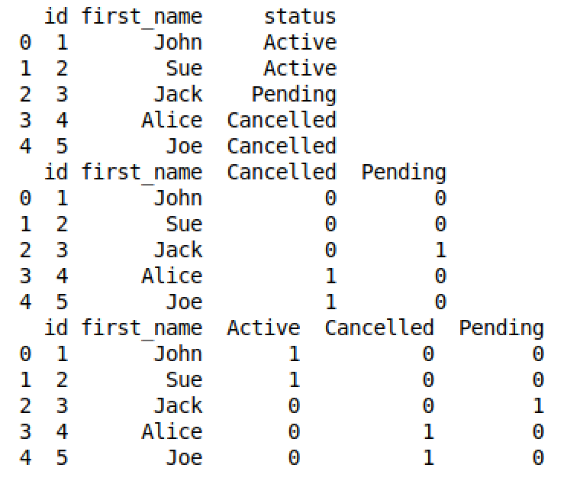
Dummy Coding Example
In the first case, we encoded three values into two columns
Active becomes the baseline as indicated with zeros in Cancelled and Pending
This is usually what we need for regression analysis
In the second case, we encoded the three values into three columns each with a 1 to indicate it is the value
Usually need to do this for Neural Networks
Models like Naive Bayes and Decision Trees that don’t use distance calculations don’t usually need to be dummy coded

Slide 22
Chapter Concepts
Pandasql
Statistics Primer
Basic ETL and Reshaping
Splitting Data
Free-Form Text
Chapter Summary

Slide 23
Splitting Data
Supervised models require that they be trained with a set of data first
After training, you need to test the results using another set of data which has the known values you are trying to predict
By comparing the predicted values to the known values, you can determine how good a model is at predicting
Run the same data through multiple different algorithms with different parameters to tweak the result until you find the combination that yields the best results
Pandas and Scikit-learn offer many ways to split a dataset into a training and testing set
sample
train_test_split
It is important to examine the two sets to make sure they are fairly representative of the whole set and not skewed in some way

Slide 24
Sample
Sample is a method built into DataFrame objects
The following recipe can create a random sample and then return the rest to another set
train = fatal.sample(frac=0.8,random_state=200)
test = fatal[~fatal.index.isin(train.index)]
x0 = fatal.Program
x1 = train.Program
x2 = test.Program
print(x0.value_counts()/x0.count())
print (x1.value_counts()/x1.count())
print (x2.value_counts()/x2.count())
print (fatal.shape, train.shape, test.shape)
1 0.5
0 0.5
1 0.592
0 0.470
1 0.625
0 0.375
(42, 11) (34, 11) (8, 11)

Slide 25
train_test_split
Convenient function to split the sets in one step
The following recipe can create a random sample and then return the rest to another set
from sklearn.model_selection import train_test_split
train, test = train_test_split(fatal, test_size=0.2)
x0 = fatal.Program
x1 = train.Program
x2 = test.Program
print(x0.value_counts()/x0.count())
print (x1.value_counts()/x1.count())
print (x2.value_counts()/x2.count())
print (fatal.shape, train.shape, test.shape)
1 0.5
0 0.5
1 0.515
0 0.484
1 0.555
0 0.444
(42, 11) (33, 11) (9, 11)

Slide 26
Chapter Concepts
Pandasql
Statistics Primer
Basic ETL and Reshaping
Splitting Data
Free-Form Text
Chapter Summary

Slide 27
Text Processing
Raw unformatted text can come in many forms
Emails
Resumes
White Papers
Tweets
Words don’t process well mathematically, so you need to convert the words into a matrix of numbers that can be run through the algorithms
Document Term Matrix (DTM) is a restructuring of text data that describes the frequency that words or terms occur in a collection of documents (often called a corpus)
There are many steps involved in getting the data to this format
Split lines into words (tokenization)
Removing punctuation, numbers, etc.
Standardizing on upper/lower case
Removing trivial words (of, and, or, is, etc.) called stop words
Stemming versions of words (run, running, runs)

Slide 28
Text Processing (continued)
The steps for doing this are formulaic and there are many recipes to get there
The result is a big matrix which can be fed into any of the models just like regular data
Common usages include:
Classify a document into a category (spam/not spam)
Determine the overall sentiment of the document
Plagiarism detection
Finding similar papers for research

Slide 29
Example DTM
import pandas as pd
from sklearn.feature_extraction.text import CountVectorizer
def corpus_from_dir(folder):
import os
ret = dict(docs = [open(os.path.join(folder,f)).read() \
for f in os.listdir(folder)], \
ColNames = map(lambda x: x.split('.')[0], os.listdir(folder)))
return ret
def tdm_df(docs, colNames = None, **kwargs):
vectorizer = CountVectorizer(**kwargs)
x1 = vectorizer.fit_transform(docs)
df = pd.DataFrame(x1.toarray().transpose(), \
index = vectorizer.get_feature_names())
return df
corpus = corpus_from_dir('text')
print (corpus)
df = tdm_df(docs = corpus['docs'], colNames = corpus['ColNames'], \ stop_words = 'english')
print (df)

Slide 30
Chapter Concepts
Pandasql
Statistics Primer
Basic ETL and Reshaping
Splitting Data
Free-Form Text
Chapter Summary

Slide 31
Next Steps
ETL can be done at so many levels
At the source of the data using SQL
There are many ETL tools besides Python
Explore the different ways to rescale and normalize data
Text processing has so much more to it than just Document Term Matrix
Sentiment analysis
Word clouds
Term frequency-inverse document frequency
Even binary data like images and sound can be turned into numeric data that can be run through models
Look for APIs to do things like image and facial recognition

Slide 32
Chapter Summary
In this chapter, we have introduced:
A basic refresher on statistics
Basic ETL (extract, transform, and load) and reshaping data for modeling
Splitting data into training and testing sets
Free-form text

