Slide 1
Chapter 5: Regression Analysis
Python for Data Scientists

Slide 2
Chapter Objectives
In this chapter, we will:
Introduce Linear Regression
Data preparation
Train and test regression model

Slide 3
Chapter Concepts
Regression Analysis
Data Preparation
Algorithms
Chapter Summary
Notes:
Highlight the topic that follows this page, and place the delta arrow next to it by moving vertically, but maintain the horizontal placement.
If there are too many topics to fit on the page, reduce the line spacing to fit.

Slide 4
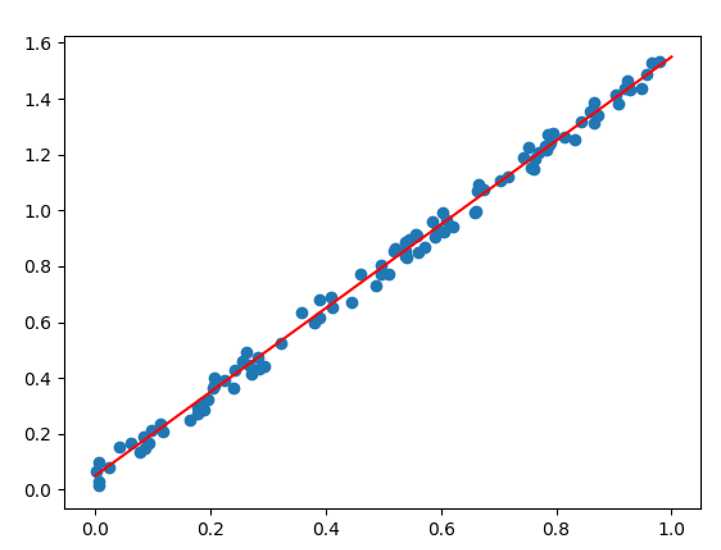
Linear Regression
Given a collection of X, Y points, you could easily see there is a pattern
If you remember enough algebra, you could describe the pattern of dots as roughly following the red line, which could be described with the formula y = 1.5x + .01

Slide 5
Linear Regression (continued)
The idea is that the line that best describes the pattern of dots is the one that has the least distances of the dots from the line
The formula that describes the line could then be used to predict a value that we have not observed
The better the line and formula are at describing that pattern of dots, the more accurate that prediction should be
Extrapolate this idea onto more than just two axes and instead try to find a line that goes through many different dimensions and you have the idea of multiple linear regression
y=α+β1x1 +β2x2 +...+βixi +ε
Has many use cases
Predicting a stock or commodity price
Predicting election results
Predicting crime rate

Slide 6
Linear Regression (continued)
Is a supervised model that requires training from a known set of data and testing to see how good it is at predicting before using it for real predictions
Only works with numeric values
Categorical data needs to be dummy encoded
Does not deal well with missing data, so must be fixed by removing or replacing with central tendency
There are many algorithms to do this, each with its own pros and cons

Slide 7
Chapter Concepts
Regression Analysis
Data Preparation
Algorithms
Chapter Summary
Notes:
Highlight the topic that follows this page, and place the delta arrow next to it by moving vertically, but maintain the horizontal placement.
If there are too many topics to fit on the page, reduce the line spacing to fit.

Slide 8
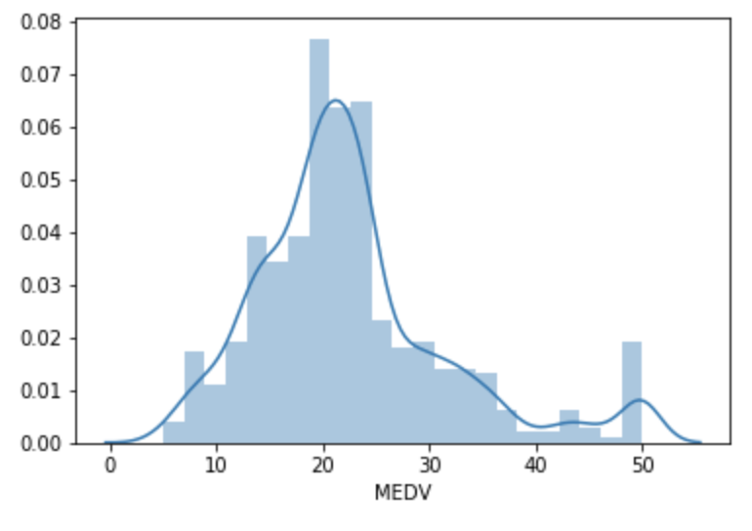
Dataset
For our examples, let’s use a public data set of housing data
Plotting the distribution of Prices shows that they are normally distributed except for some outliers so let’s trying comparing the model with them and then later filtered out
import pandas as pd
import seaborn as sns
sns.distplot(df.toPandas()['MEDV'])
dfRaw = dfRaw.where('MEDV < 48')

Slide 9
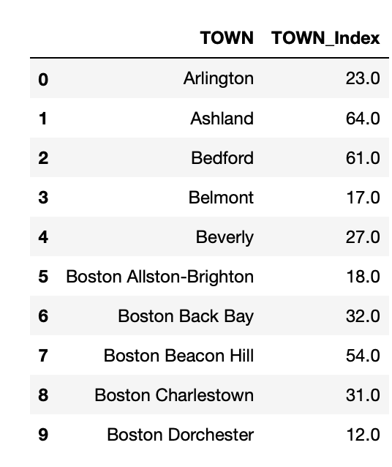
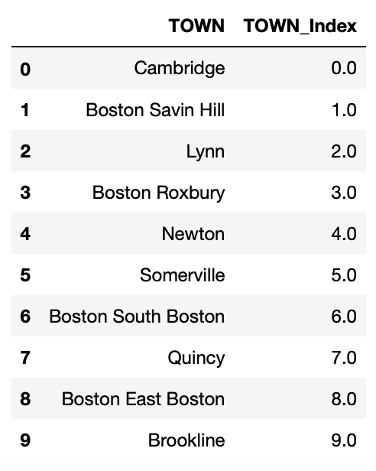
Convert Categorical Features
Categorical data cannot stay as string, so it must be converted to a numeric format and then into a vector format
Pyspark has a class which will transform a column into indexed numbers for each unique string value
For convenience use this helper function we made: display(pyh.StringIndexEncode( df, ['TOWN', 'TRACT']))
from pyspark.ml.feature import StringIndexer
indexer = StringIndexer(inputCol = col, outputCol = col+'_Index')
x = indexer.fit(df).transform(df).select(col, col+'_Index').distinct()
display(x.orderBy(col))
display(x.orderBy(col+'_Index'))

Slide 10
One Hot Encoding
Numerical indexes are good for some algorithms such as Naïve Bayes and Decision Trees, but ones that use distance calculations would get distored
Need to re-encode this as One Hot Encoding which creates a separate column for each unique value and fills the columns with zeros and ones
In Spark this column needs to be a single Vector column unlike Pandas which makes a lot of unique columns.
Sparse vectors are hard to interpret visually, but they are not meant for human eyes
Must first re-encode data with StringIndexer
from pyspark.ml.feature import OneHotEncoderEstimator
encoder = OneHotEncoderEstimator(inputCols=[col + '_Index'], outputCols=[col+'_Vector'])
display(encoder.fit(df).transform(df))

Slide 11
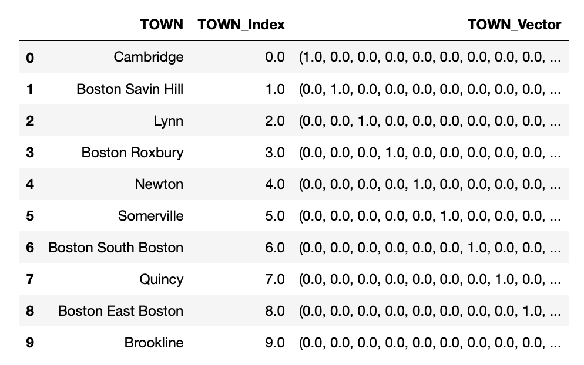
One Hot Encoding cont'd
SparseVector version
Helper Function to call StringIndexer then OneHotEncoder
display(pyh.OneHotEncode(df, ['TOWN', 'TRACT']))

Slide 12
Put it All Together
You have to OneHotEncode all categorical data then assemble all the features into one vector and the target variable into another
Spark provides the VectorAssembler class to do this
Our helper function makes the whole process more convenient
Just pass in a DataFrame, list of categorical, numeric and target columns and it returns a DataFrame with the two columns needed for machine learning algorithms
dfML = pyh.AssembleFeatures(df, categorical_features, numeric_features, target_label = 'target', target_is_categorical = False))

Slide 13
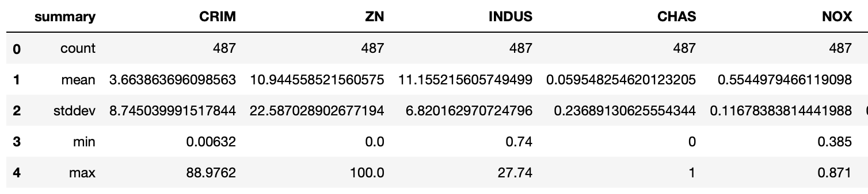
Explore Numerical Features
Generally you want to take a look at the numerical features and get standard measurements like min, max, mean, std
DataFrames have a describe method which makes that easy
The provided helper functions make that easier
numeric_features = ['totalvolume','PLU4046', 'PLU4225', 'PLU4770', 'smallbags', 'largebags', 'xlargebags']
display(df.select(numeric)describe())

Slide 14
Prepare the Data
Data must be in a DataFrame of two vectorized objects.
features will contain all the independent variables
target will be the dependent variable we are trying to predict
The provided helper functions make that easier
Then split the data into a train and test set with the randomSplit function
import pyspark_helpers as pyh
numeric_features = ['CRIM', 'ZN', 'INDUS', 'CHAS', 'NOX', \ 'RM', 'AGE', 'DIS', 'RAD', 'TAX', 'PTRATIO']
categorical_features = ['TOWN', 'TRACT']
target_label = 'MEDV'
df = dfRaw.select(categorical_features + numeric_features + [target_label])
dfML = pyh.MakeMLDataFrame(df, categorical_features, \ numeric_features, target_label, False)
train, test = dfML.randomSplit([.7,.3], seed = 1000)

Slide 15
Chapter Concepts
Regression Analysis
Data Preparation
Algorithms
Chapter Summary
Notes:
Highlight the topic that follows this page, and place the delta arrow next to it by moving vertically, but maintain the horizontal placement.
If there are too many topics to fit on the page, reduce the line spacing to fit.

Slide 16
Run the Model
Create and instance of the regression class
There are several to choose from
LinearRegression
GeneralizedLinearRegression
DecisionTreeRegressor
RandomForestRegressor
GBTRegressor
AFTSurvivalRegression
IsotonicRegression
from pyspark.ml.regression import LinearRegression
lr = LinearRegression(featuresCol = 'features', labelCol='target', \ maxIter=10, regParam=0.3, elasticNetParam=0.8)
lrModel = lr.fit(train)
print("Coefficients: " + str(lrModel.coefficients))
print("Intercept: " + str(lrModel.intercept))
print("Root Mean Squared Error: {}\nR Squared (R2) {}" \ .format(lrModel.summary.rootMeanSquaredError, lrModel.summary.r2))

Slide 17
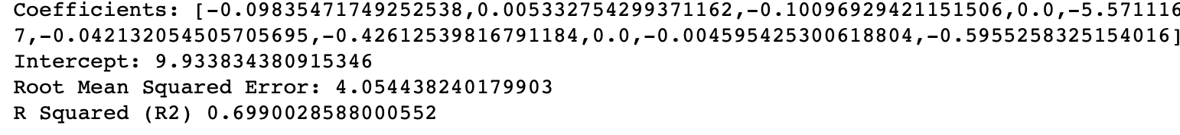
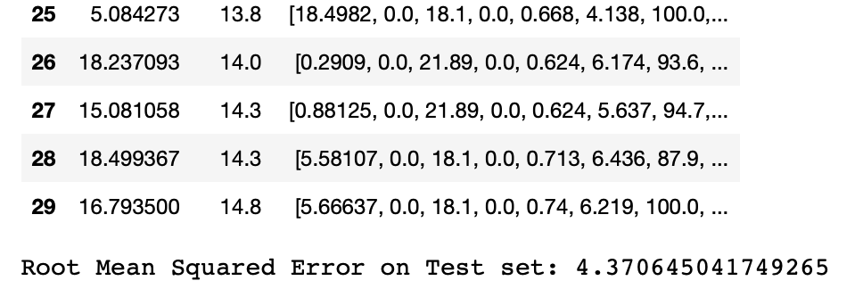
Run the Test
lrPredictions = lrModel.transform(test)
display(lrPredictions.select("prediction","target","features"), 30)
from pyspark.ml.evaluation import RegressionEvaluator
lrEvaluator = RegressionEvaluator(predictionCol="prediction", \ labelCol="target",metricName="r2")
testResult = lrModel.evaluate(test)
print("Root Mean Squared Error on Test set: {}" \ .format(testResult.rootMeanSquaredError))

Slide 18
Chapter Concepts
Regression Analysis
Data Preparation
Algorithms
Chapter Summary
Notes:
Highlight the topic that follows this page, and place the delta arrow next to it by moving vertically, but maintain the horizontal placement.
If there are too many topics to fit on the page, reduce the line spacing to fit.

Slide 19
Next Steps
Regression has a lot more complexity to it once you master the basics
Some subjects to explore in this area:
Under- and over-fitting a model
Correlation between the independent variables
Notes:
Highlight the topic that follows this page, and place the delta arrow next to it by moving vertically, but maintain the horizontal placement.
If there are too many topics to fit on the page, reduce the line spacing to fit.

Slide 20
Chapter Objectives
In this chapter, we have:
Introduced Linear Regression
Compared two algorithms
Scikit-learn
Statsmodel

