Slide 1
Chapter 4: Cluster Analysis
Python for Data Scientists

Slide 2
Chapter Objectives
In this chapter, we will:
Explore Cluster Analysis
Compare two algorithms
K-Means
Hierarchical

Slide 3
Chapter Concepts
Cluster Analysis
Algorithms
Chapter Summary

Slide 4
Cluster Analysis
Analysis tool to help make sense of the data before feeding it into other models
Unsupervised
More about discovering patterns in data
Not about predicting values for unknown values
Looks for natural groupings among the data
Voter groups (is it just left vs. right, or left, right, center, or more)
Species identification (are two groups of organisms different enough to be considered a different species or not)
Identify different types of customers we may have
Often helpful as a preparatory step before classification to determine how many categories we may want to predict

Slide 5
Types of Cluster Analysis
There are two main approaches to solve this
Top down (K-Means)
Bottom up (Hierarchical clustering)
Both rely on the notion of similarity
Objects are similar if they share common attributes to others
The more similar they are, the closer they are to one another
If something is far away in similarity to one thing, it may be closer to something else
Ultimately the goal is to take a large sample of data and break it up into a small number of meaningful groupings that shed insight as to what the data means

Slide 6
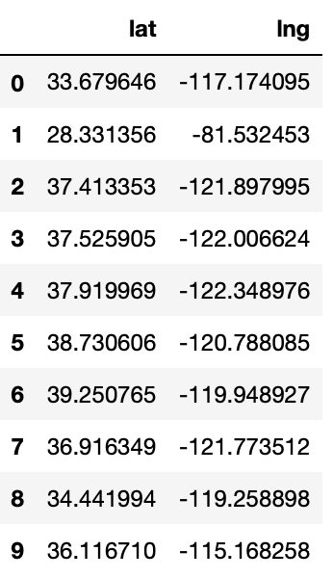
Dataset
For this example we have a small easy to follow dataset of the latitude and longitudes of a few Tesla superchargers
filename = 'superchargers.csv'
df = spark.read.csv(f'/home/student/ROI/Spark/{filename}', header = True, inferSchema = True)
display(df)

Slide 7
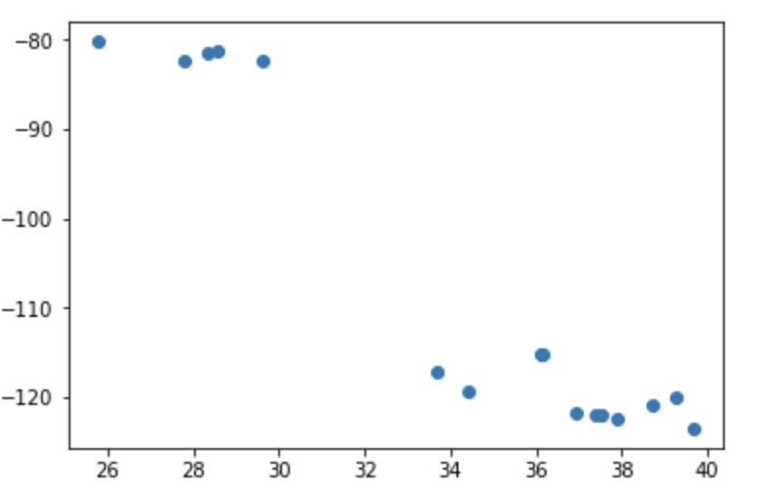
Visualize the Data
It is often helpful to visualize the data by plotting it
There are only two features in this set so it’s easy to plot
You can also plot a 3D graph for three features
Beyond that, it’s hard to visualize more features
p = df.toPandas()
import matplotlib.pyplot as plt
plt.plot(p.loc[:,'lat'],p.loc[:,'lng'],'o')

Slide 8
Chapter Concepts
Cluster Analysis
Algorithms
Chapter Summary

Slide 9
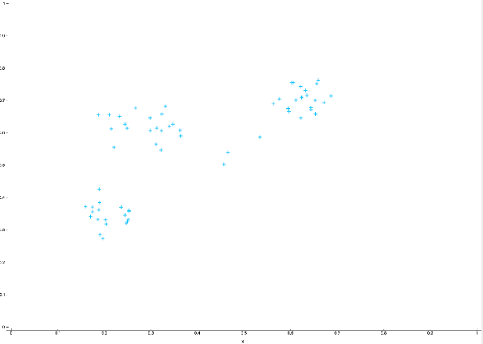
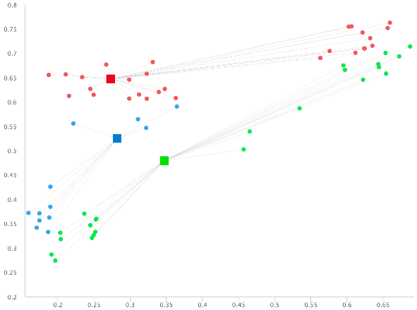
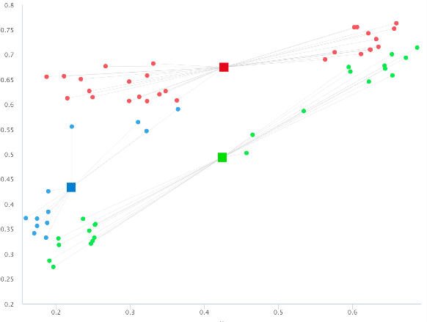
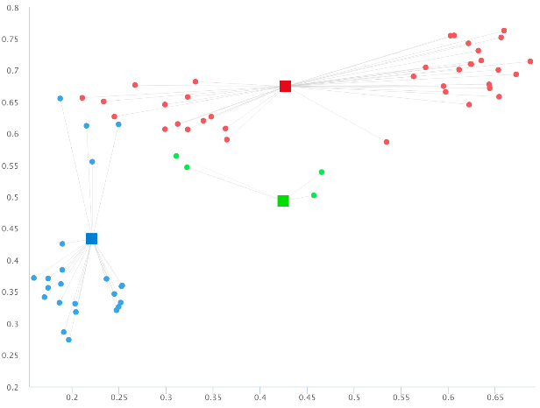
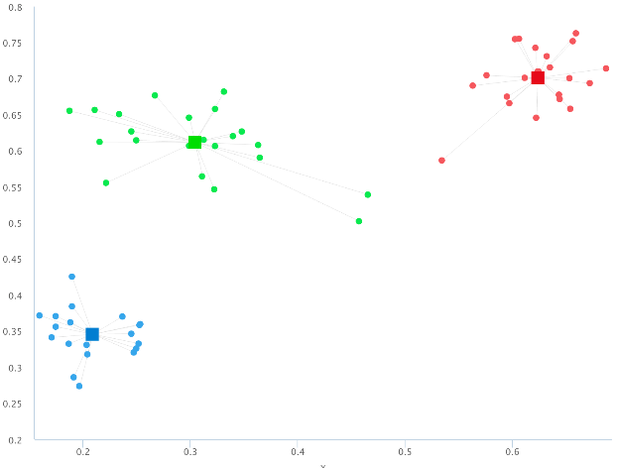
K-Means in Actions
Random Data
Random Centroids
Adjust Centroids
Reassign Membership
Keep Doing Until Stops Changing

Slide 10
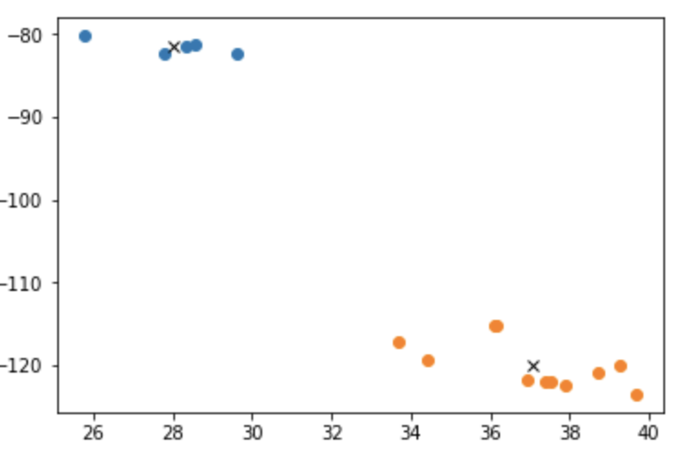
Run K-Means
Just eyeballing it, let’s try out two clusters and plot the results
import matplotlib.pyplot as plt
CLUSTERS = 2
kmeans = KMeans().setK(CLUSTERS).setSeed(1)
model = kmeans.fit(dfML.select('features'))
predictions = model.transform(dfML)
centroids = model.clusterCenters()
for i in range(CLUSTERS):
p = predictions.select('lat', 'lng') \ .where(f'prediction = {i}').toPandas()
plt.plot(p.loc[:,'lat'],p.loc[:,'lng'],'o')
plt.plot(centroids[i][0],
centroids[i][1],'kx')

Slide 11
Evaluate K-Means
With many features and rows it is difficult to visualize how many clusters if right.
There are two measures that are helpful, lower numbers are better
Within set sum of squared errors
Silhouette with squared Euclidean distance
But it's not just about a lower number, it's about finding the marginal difference between each number until more clusters don't add any more distinctions
Use the helper functions to view these numbers and the centroids
For the small set of data we have, there is a big gain going from 2 to 3 clusters, but not much more going from 3 to 4, so 3 clusters is probably the right value

Slide 12
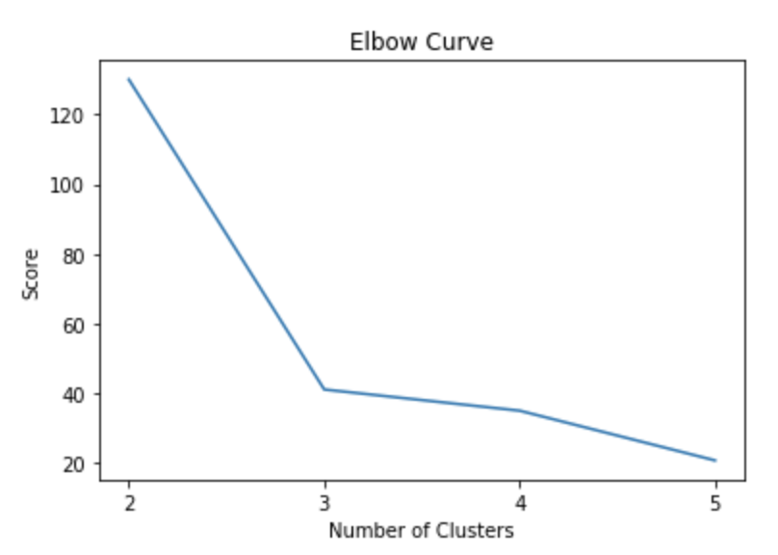
Elbow Chart
Here the results are very clear cut, but sometimes the data overlap and don’t fit nicely into a particular cluster
It is often helpful to run a chart that helps figure out how many clusters is ideal
Too few and the items are too dissimilar
Too many and the additional distinctions become trivial
Is there much difference between a brown poodle and a chocolate poodle?

Slide 13
Chapter Concepts
Cluster Analysis
Algorithms
Chapter Summary

Slide 14
Next Steps
The unsupervised models of clustering do not make predictions so much as they helps understand the data
Another unsupervised model to explore is association rules
Used to describe patterns like "people who like X also like Y"
Principal Component Analysis
Dimension Reduction

Slide 15
Chapter Summary
In this chapter, we have:
Explored Cluster Analysis
Compared two algorithms
K-Means
Hierarchical

