Slide 1

Claude Certified Developer - Foundations: Hands-On Exam Prep Workshop
Chapter 1: Claude Certified Developer - Foundations Overview
Claude Certified Developer - Foundations: Hands-On Exam Prep Workshop
© 2026 Copyright ROI Training, Inc.
All rights reserved. Not to be reproduced without prior written consent.
1 of 15

Slide 2

Chapter 1: Objectives
Review the CCDV-F exam format, scoring, and domain weights
Evaluate the Minimally Qualified Candidate developer profile
Analyze canonical CCDV-F sample question patterns
Deconstruct multi-constraint exam scenarios and apply a weighted study plan
Claude Certified Developer - Foundations: Hands-On Exam Prep Workshop
© 2026 Copyright ROI Training, Inc.
All rights reserved. Not to be reproduced without prior written consent.
2 of 15

Slide 3
Chapter 1
Understanding the Exam
Preparing to Pass the Exam
Claude Certified Developer - Foundations: Hands-On Exam Prep Workshop
© 2026 Copyright ROI Training, Inc.
All rights reserved. Not to be reproduced without prior written consent.
3 of 15

Slide 4
Exam Details at a Glance (CCDV-F)
Format and Time Limit
Scoring Standard
The CCDV-F exam contains 53 multiple-choice and multiple-response items completed within 120 minutes.
Criterion-referenced assessment reported on a scaled range from 100 to 1,000 with a passing cut score of 720.
Each multiple-response item states explicitly how many answer choices to select.
Your pass or fail status is determined by your total scaled score, accompanied by domain-level percentage breakdowns.
Exam Fee and Validity
Delivery Environment
The exam fee is $125 USD, and the credential is valid for 12 months from the date awarded.
Delivered via Pearson VUE (online proctored or test center) under strict non-disclosure and clear-workspace rules.
On-time renewal requires completing a free, non-proctored assessment on the Anthropic Partner Academy.
Claude Certified Developer - Foundations: Hands-On Exam Prep Workshop
© 2026 Copyright ROI Training, Inc.
All rights reserved. Not to be reproduced without prior written consent.
4 of 15

Slide 5
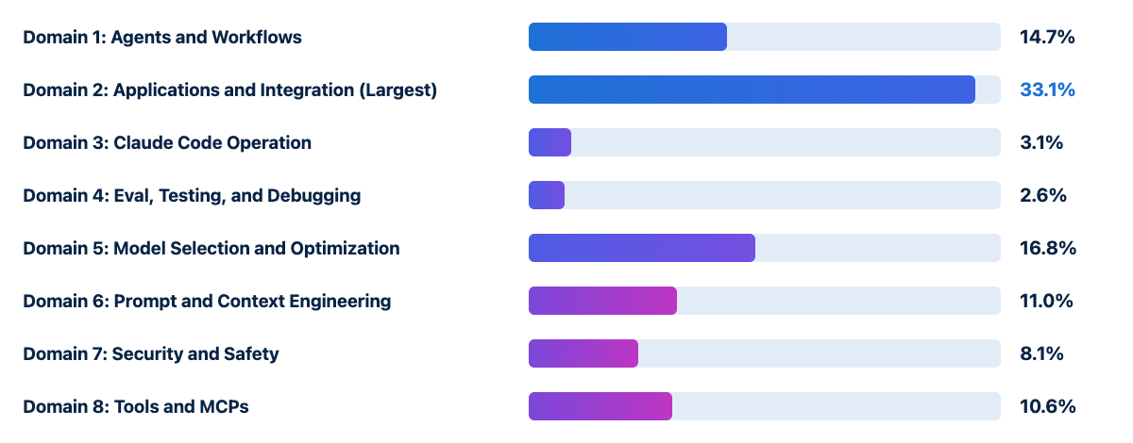
Exam Blueprint Across Eight Domains
Domain 2: Applications and Integration (33.1%) is by far the largest section, accounting for roughly one-third of all scored items
Domain 5: Model Selection and Optimization (16.8%) and Domain 1: Agents and Workflows (14.7%) together represent nearly another third
Prompt and Context Engineering (11.0%), Tools and MCPs (10.6%), Security and Safety (8.1%), Claude Code (3.1%), and Eval, Testing, and Debugging (2.6%) complete the blueprint
Claude Certified Developer - Foundations: Hands-On Exam Prep Workshop
© 2026 Copyright ROI Training, Inc.
All rights reserved. Not to be reproduced without prior written consent.
5 of 15

Slide 6
Minimally Qualified Candidate (MQC) Profile
Software Engineering Profile
Core Developer Competencies
1 to 5 years of software engineering experience with proficiency in Python and/or TypeScript
Building custom agent loops and workflows with the Claude Agent SDK and agentic frameworks (PydanticAI, LangGraph, Strands)
At least 6 months of hands-on experience building with Claude or comparable LLM systems
Integrating the Messages API and Message Batches API across direct and cloud-provider SDKs
Fluency with REST APIs, JSON schemas, asynchronous programming, version control, and CLI tools
Operating Claude Code (CLAUDE.md, settings.json, Rules, Skills, Commands, headless mode)
Implementing custom tools, MCP servers (stdio and Streamable HTTP), prompt caching, and security hooks
Claude Certified Developer - Foundations: Hands-On Exam Prep Workshop
© 2026 Copyright ROI Training, Inc.
All rights reserved. Not to be reproduced without prior written consent.
6 of 15

Slide 7
Chapter 1
Understanding the Exam
Preparing to Pass the Exam
Claude Certified Developer - Foundations: Hands-On Exam Prep Workshop
© 2026 Copyright ROI Training, Inc.
All rights reserved. Not to be reproduced without prior written consent.
7 of 15

Slide 8
Three Canonical CCDV-F Sample Question Patterns
1. Realtime vs Message Batches API (Domain 2)
2. Defending Against Prompt Injection (Domain 7)
3. Reusable Internal Tooling with MCP (Domain 8)
Scenario: Process 10,000 documents overnight for a non-urgent morning analytics report with cost as the primary concern.
Scenario: An agent summarizes user-submitted web pages; one page contains hidden text instructing the model to reveal its system prompt.
Scenario: Expose an internal inventory REST API so multiple Claude applications can share it and maintain it independently.
Correct Choice: Use the Message Batches API, which processes large asynchronous workloads within a 24-hour window at a 50% cost reduction.
Correct Choice: Build an MCP server that exposes the inventory operations as tools so multiple Claude applications can connect to it.
Correct Choice: Treat retrieved page content as untrusted input, keep it separate from trusted instructions, and use guardrails or hooks so injected instructions cannot trigger sensitive actions.
Claude Certified Developer - Foundations: Hands-On Exam Prep Workshop
© 2026 Copyright ROI Training, Inc.
All rights reserved. Not to be reproduced without prior written consent.
8 of 15

Slide 9
Eliminating Developer Exam Distractors
Common Distractor Traps
Winning Developer Habits
Sending 10,000 synchronous requests in parallel or lowering max_tokens when an overnight batch workload can use the Message Batches API
Match synchronous vs batch APIs to latency tolerance and cost goals
Enforce trust boundaries (XML tags + hooks + least-privilege tools) around all untrusted external content
Raising model temperature, switching to a larger model, or asking users politely in the system prompt to mitigate prompt injection
Choose the right customization primitive: Built-in Tools vs Custom Tools vs Skills vs MCP Servers
Hard-coding API logic into system prompts, pasting live inventory into every context window, or assuming built-in tools can reach arbitrary internal REST APIs
Inspect execution traces to isolate integration-layer bugs from model output errors
Blaming the model when an integration layer bug (bad parser, retired model ID, or truncated payload) caused the failure
Claude Certified Developer - Foundations: Hands-On Exam Prep Workshop
© 2026 Copyright ROI Training, Inc.
All rights reserved. Not to be reproduced without prior written consent.
9 of 15

Slide 10
How to Dissect a Scenario Question on Exam Day
1. Highlight the Hard Constraint
2. Identify the Architectural Layer
3. Check Paired-Claim Options Carefully
Look for words like “guaranteed”, “deterministic”, “real-time”, “overnight”, “shared across 4 applications”, or “inside the customer’s AWS VPC”.
If the stem says “guaranteed enforcement regardless of model reasoning”, eliminate every prompt-only, few-shot, or model-tier option and look for PreToolUse hooks or settings.json deny rules.
On multi-part options, verify both halves of the statement: distractors frequently pair one true best practice with one subtle anti-pattern.
If the trace shows “valid tool output returned, wrong number in final answer”, eliminate network/auth/schema fixes and look for model-layer prompt or validation fixes.
Claude Certified Developer - Foundations: Hands-On Exam Prep Workshop
© 2026 Copyright ROI Training, Inc.
All rights reserved. Not to be reproduced without prior written consent.
10 of 15

Slide 11
Weighted Study Plan Across the Eight Domains
Priority Tier | Domains Covered | Share of Exam (~Items) | High-Yield Focus Areas
Tier 1 (Core ~65%) | D2: Applications and Integration (33.1%), D5: Model Selection and Optimization (16.8%), D1: Agents and Workflows (14.7%) | ~34 of 53 items | Messages API vs Batches (custom_id), SSE streaming, Files API + citations, Prompt Caching (tools -> system -> messages), Opus/Sonnet/Haiku + effort, Workflow vs Agent vs Subagent, PreToolUse / PostToolUse
Tier 2 (Core ~30%) | D6: Prompt and Context (11.0%), D8: Tools and MCPs (10.6%), D7: Security and Safety (8.1%) | ~16 of 53 items | Context editing + <case_facts>, structured outputs + stop_reason checks, strict: true tools + is_error: true, MCP Tools vs Resources vs Prompts (stdio vs Streamable HTTP), prompt injection + least privilege
Tier 3 (Targeted ~6%) | D3: Claude Code (3.1%), D4: Eval, Testing, and Debugging (2.6%) | ~3 of 53 items | CLAUDE.md hierarchy, .claude/rules/ globs, settings.json deny precedence, claude -p, trace isolation, two-stage eval suites
Claude Certified Developer - Foundations: Hands-On Exam Prep Workshop
© 2026 Copyright ROI Training, Inc.
All rights reserved. Not to be reproduced without prior written consent.
11 of 15

Slide 12
Exam-Day Pacing and Logistics
Generous time per question: 53 items in 120 minutes gives you roughly 2 minutes 15 seconds per item
Allocate extra focus to Domain 2 (33.1%): expect roughly 17 to 18 questions on API mechanics, application design, SDLC integration, and configuration management
Retake policy: 14 days after the 1st failed attempt, 30 days after the 2nd, and 90 days after the 3rd (up to 4 attempts in a rolling 12-month period)
Claude Certified Developer - Foundations: Hands-On Exam Prep Workshop
© 2026 Copyright ROI Training, Inc.
All rights reserved. Not to be reproduced without prior written consent.
12 of 15

Slide 13
Demo: Using the Claude API
If you already finished Lab 0, open ccdvf-labs with the virtual environment activated and skip to Step 6.
Step 1. Create the ccdvf-labs folder
macOS:
cd ~
mkdir ccdvf-labs
cd ccdvf-labs
Windows (PowerShell):
cd $HOME
mkdir ccdvf-labs
cd ccdvf-labs
Claude Certified Developer - Foundations: Hands-On Exam Prep Workshop
© 2026 Copyright ROI Training, Inc.
All rights reserved. Not to be reproduced without prior written consent.
13 of 15
Step 2. Create a virtual environment and activate it

Slide 14
What You Learned
Reviewed the CCDV-F exam format, scoring, and domain weights
Evaluated the Minimally Qualified Candidate developer profile
Analyzed canonical CCDV-F sample question patterns
Deconstructed multi-constraint exam scenarios and applied a weighted study plan
Claude Certified Developer - Foundations: Hands-On Exam Prep Workshop
© 2026 Copyright ROI Training, Inc.
All rights reserved. Not to be reproduced without prior written consent.
14 of 15

Slide 15

Questions and Answers
Claude Certified Developer - Foundations: Hands-On Exam Prep Workshop
© 2026 Copyright ROI Training, Inc.
All rights reserved. Not to be reproduced without prior written consent.
15 of 15

