Slide 1

Claude Certified Developer - Foundations: Hands-On Exam Prep Workshop
Chapter 3: Applications and Integration
Claude Certified Developer - Foundations: Hands-On Exam Prep Workshop
© 2026 Copyright ROI Training, Inc.
All rights reserved. Not to be reproduced without prior written consent.
1 of 38

Slide 2

Chapter 3: Objectives
Translate business needs into functional and infrastructure requirements across the SDLC
Construct stateless Messages API requests, multi-turn tool round trips, and thinking histories
Implement SSE streaming, vision, PDF documents, Files API uploads, and citations
Process bulk asynchronous workloads with the Message Batches API and custom_id correlation
Apply AsyncAnthropic concurrency, resilient retries, idempotency keys, and Claude-assisted SDLC workflows
Enforce multi-tenant session boundaries, pinned configurations, and Claude Code plugins
Claude Certified Developer - Foundations: Hands-On Exam Prep Workshop
© 2026 Copyright ROI Training, Inc.
All rights reserved. Not to be reproduced without prior written consent.
2 of 38

Slide 3
Domain 2: Applications and Integration (33.1% of Exam)
Task # | Task Statement
2.1 | Understanding Requirements: Functional and infrastructure requirements based on business and solution architecture
2.2 | Systems Life Cycle: Concepts and frameworks to develop, implement, operate, and maintain IT systems
2.3 | Claude API Mechanics: Messages, tools, streaming, vision, thinking, caching, third-party vendors, and Realtime vs Batch APIs
2.4 | Software Engineering Foundations: REST APIs, JSON, async programming, version control, SDLC, code review, and refactoring
2.5 | Claude Application Design: Instruction interpretation across interfaces, content boundaries, schema design, and session hygiene
2.6 | Configuration Management: CLAUDE.md, settings.json, model version pinning, prompt versioning, and plugin dependencies
Claude Certified Developer - Foundations: Hands-On Exam Prep Workshop
© 2026 Copyright ROI Training, Inc.
All rights reserved. Not to be reproduced without prior written consent.
3 of 38

Slide 4
Chapter 3
Requirements and Systems Life Cycle
Claude API Mechanics
Software Engineering Foundations
Application Design and Configuration
Claude Certified Developer - Foundations: Hands-On Exam Prep Workshop
© 2026 Copyright ROI Training, Inc.
All rights reserved. Not to be reproduced without prior written consent.
4 of 38

Slide 5
Functional and Non-Functional Requirements
Functional Requirements
Non-Functional Requirements
Define what the AI application must accomplish: supported input formats (text, images, PDFs), tool integrations, output schemas, citation rules, and human escalation triggers.
Define how the system must perform and operate: latency SLAs (time-to-first-token vs end-to-end completion), concurrency and rate-limit capacity, VPC egress rules, data residency, and secret storage.
Claude Certified Developer - Foundations: Hands-On Exam Prep Workshop
© 2026 Copyright ROI Training, Inc.
All rights reserved. Not to be reproduced without prior written consent.
5 of 38

Slide 6
Systems Life Cycle (SDLC) Phases
Planning and Discovery
Development and Integration
Clarify measurable SLAs and build the initial golden evaluation dataset.
Implement stateless API handlers, typed schemas, and deterministic hooks.
Testing and Deployment
Operations and Maintenance
Gate CI/CD merges on automated evaluations and roll out via feature flags or canary stages.
Monitor token usage, cache hit rates, latency p95, drift, and model deprecation timelines.
Claude Certified Developer - Foundations: Hands-On Exam Prep Workshop
© 2026 Copyright ROI Training, Inc.
All rights reserved. Not to be reproduced without prior written consent.
6 of 38

Slide 7
Worked Example: Deconstructing a Stakeholder Request
Stakeholder Prompt
Translating to Engineering Specs
“We need Claude to review incoming vendor contracts, flag risky indemnity clauses for our legal team in the portal, and also re-score all 40,000 archived contracts before next quarter’s audit. All data must remain inside our AWS account.”
Functional specs:
Input: multi-page PDF contracts (text + tables)
Output: strict JSON schema (risk_level, clauses[]) plus verifiable page citations (citations: {"enabled": true})
Escalation: route high risk flags to human legal review queue
Infrastructure and API specs:
Interactive portal review: Realtime Messages API with SSE streaming for responsive UX
40,000 archived contracts: Message Batches API (asynchronous, 24-hour window, 50% cost discount)
Claude Certified Developer - Foundations: Hands-On Exam Prep Workshop
© 2026 Copyright ROI Training, Inc.
All rights reserved. Not to be reproduced without prior written consent.
7 of 38
AWS boundary: invoke via Amazon Bedrock (AnthropicBedrockMantle) using IAM roles and regional endpoints

Slide 8
Operating Across the Systems Life Cycle (Task 2.2)
Every stage of an AI application’s life cycle has a specific engineering artifact and gate:
Life Cycle Phase | Primary Engineering Artifact | Failure Mode If Skipped
1. Requirements and Discovery | Written SLA spec (TTFT, throughput, residency, retention) + golden test cases | Choosing synchronous Opus calls for a 500ms high-volume classifier
2. Design and Prototyping | Pinned model ID, prompt templates in Git, strict JSON schemas, hook guardrails | Unpinned aliases or regex parsers that break under edge cases
3. Testing and CI Gate | Automated offline evaluation suite (deterministic code checks + LLM-as-judge rubric) | Merging a prompt edit that fixes one bug but breaks 15% of existing cases
4. Staged Rollout | Feature flags, canary traffic split, and rollback runbook | Deploying a breaking model or prompt change to 100% of users at once
5. Operations and Maintenance | OpenTelemetry traces, cache-hit and refusal alerts, model retirement calendar | Total production outage when a pinned legacy model reaches its retirement date
Claude Certified Developer - Foundations: Hands-On Exam Prep Workshop
© 2026 Copyright ROI Training, Inc.
All rights reserved. Not to be reproduced without prior written consent.
8 of 38

Slide 9
From Requirement to Design Choice
Requirement in the Scenario | Design Choice the Exam Expects
Users watch the answer appear; low perceived latency | Stream the response (SSE); consider Haiku 5.5 for simple fast-path tasks
Thousands of non-urgent jobs; cost is the priority | Message Batches API (50% discount, completes within 24 hours)
Same long system prompt or document on every call | Prompt caching on the stable prefix (cache_control: {"type": "ephemeral"})
Data must stay in a region or cloud account | inference_geo, or Claude via Amazon Bedrock, Vertex AI, or Microsoft Foundry
Strict data retention rules | Check zero data retention (ZDR) eligibility per model and endpoint before committing
Outputs feed a database or downstream API | Structured outputs (output_config.format / messages.parse()), check stop_reason, then validate
Agent must act on private internal systems | Self-hosted harness (Agent SDK / Tool Runner) or a secured remote MCP server
Claude Certified Developer - Foundations: Hands-On Exam Prep Workshop
© 2026 Copyright ROI Training, Inc.
All rights reserved. Not to be reproduced without prior written consent.
9 of 38

Slide 10
Chapter 3
Requirements and Systems Life Cycle
Claude API Mechanics
Software Engineering Foundations
Application Design and Configuration
Claude Certified Developer - Foundations: Hands-On Exam Prep Workshop
© 2026 Copyright ROI Training, Inc.
All rights reserved. Not to be reproduced without prior written consent.
10 of 38

Slide 11
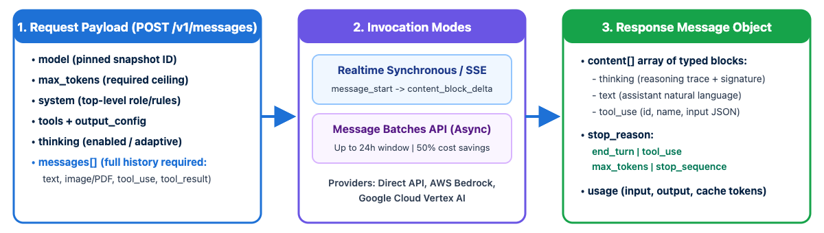
Claude Messages API Mechanics
Stateless API contract: POST /v1/messages stores zero conversation state on the server; your application must pass the required conversation history in the messages array on every request
Top-level system parameter: put persistent role and policy instructions in the top-level system field; newer models also accept a mid-conversation {"role": "system"} message to add operator instructions without breaking the cache (never as messages[0])
Multi-format content blocks: a single message’s content is an array of typed blocks (text, image, document, tool_use, tool_result, thinking)
Claude Certified Developer - Foundations: Hands-On Exam Prep Workshop
© 2026 Copyright ROI Training, Inc.
All rights reserved. Not to be reproduced without prior written consent.
11 of 38

Slide 12
Anatomy of a Messages API Request and Response
Request Payload (POST /v1/messages)
Response Payload (200 OK)
{
"model": "claude-sonnet-5-5",
"max_tokens": 4096,
"system": "You are a support triage assistant.",
"thinking": {"type": "adaptive"},
"output_config": {"effort": "medium"},
"tools": [
{
"name": "get_order",
"description": "Fetch order by ID (ORD-NNNNN).",
"strict": true,
"input_schema": {
"type": "object",
"properties": {"order_id": {"type": "string"}},
"required": ["order_id"],
"additionalProperties": false
}
}
],
"messages": [
{"role": "user", "content": "Where is ORD-44210?"}
]
}
{
"id": "msg_01Xz9...",
"type": "message",
"role": "assistant",
"model": "claude-sonnet-5-5",
"content": [
{
"type": "thinking",
"thinking": "The user asked for ORD-44210...",
"signature": "ErUBCkY..."
},
{
"type": "tool_use",
"id": "toolu_01AbC...",
"name": "get_order",
"input": {"order_id": "ORD-44210"}
}
],
"stop_reason": "tool_use",
"usage": {
"input_tokens": 412,
"output_tokens": 89,
"cache_creation_input_tokens": 0,
"cache_read_input_tokens": 0
}
}
Claude Certified Developer - Foundations: Hands-On Exam Prep Workshop
© 2026 Copyright ROI Training, Inc.
All rights reserved. Not to be reproduced without prior written consent.
12 of 38

Slide 13
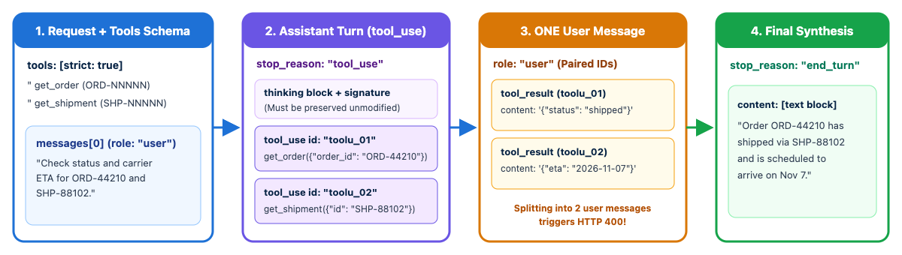
Multi-Turn Tool-Use Round Trip Rules
Rule 1 - Preserve the full assistant content: append resp.content (including thinking and tool_use blocks) as the assistant message
Rule 2 - Pair every tool_use_id in the very next user message: if Claude emits two tool_use blocks in one turn, both tool_result blocks must go into a single user message immediately following the assistant turn
Rule 3 - Put tool_result blocks first: if the user message also includes extra text blocks, the tool_result blocks must appear at the start of the content array
Claude Certified Developer - Foundations: Hands-On Exam Prep Workshop
© 2026 Copyright ROI Training, Inc.
All rights reserved. Not to be reproduced without prior written consent.
13 of 38

Slide 14
Code: Preserving Thinking and Returning Parallel tool_result Blocks
Common exam bug: sending two separate {"role": "user"} messages for two parallel tool calls, or stripping thinking blocks before appending resp.content, causes HTTP 400 invalid_request_error
# Assistant turn emitted TWO tool_use blocks (toolu_01 and toolu_02)
messages.append({"role": "assistant", "content": resp.content}) # keeps thinking + tool_use blocks
tool_uses = [b for b in resp.content if b.type == "tool_use"]
results = await asyncio.gather(*(execute_tool(b.name, b.input) for b in tool_uses))
# ALL tool_result blocks go into ONE user message immediately after the assistant turn
messages.append({
"role": "user",
"content": [
{"type": "tool_result", "tool_use_id": b.id, "content": out}
for b, out in zip(tool_uses, results)
],
})
Claude Certified Developer - Foundations: Hands-On Exam Prep Workshop
© 2026 Copyright ROI Training, Inc.
All rights reserved. Not to be reproduced without prior written consent.
14 of 38

Slide 15
Thinking Blocks Across Multi-Turn Tool Loops
Why thinking Blocks Carry a signature
What Breaks If You Strip or Edit Them
When adaptive thinking is active, Claude emits {type: "thinking", thinking: "...", signature: "..."} (and occasionally redacted_thinking) before its tool_use or text blocks
Modifying the text inside a thinking block invalidates its signature and returns HTTP 400 invalid_request_error
Stripping thinking blocks client-side in the middle of a tool loop invalidates cached prefixes and forces the model to re-derive its plan
The cryptographic signature proves the thinking block came from Claude unmodified
Best practice: always append resp.content as-is (messages.append({"role": "assistant", "content": resp.content})); use server-side clear_thinking_20251015 if older turns must be cleared
During a multi-turn tool loop, passing the assistant’s prior thinking blocks back unmodified preserves reasoning continuity and keeps the prompt cache intact
Claude Certified Developer - Foundations: Hands-On Exam Prep Workshop
© 2026 Copyright ROI Training, Inc.
All rights reserved. Not to be reproduced without prior written consent.
15 of 38

Slide 16
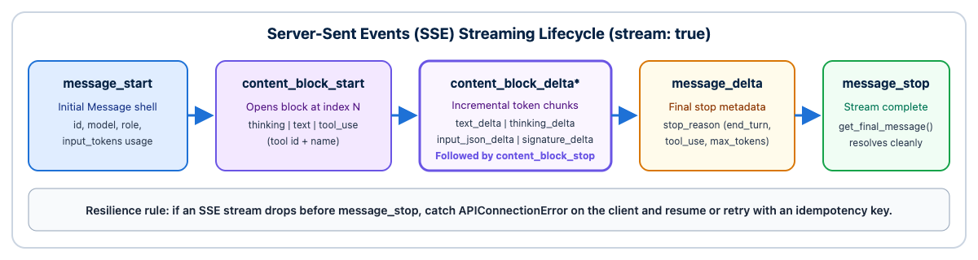
SSE Streaming Event Lifecycle and Interruption Recovery
Why stream: delivers incremental tokens via Server-Sent Events (stream: true) to lower perceived latency (time-to-first-token), and is required by the SDKs for very large max_tokens requests to avoid HTTP socket timeouts
Deterministic event sequence: message_start -> (content_block_start -> content_block_delta* -> content_block_stop)+ -> message_delta (carries final stop_reason and cumulative usage) -> message_stop
Handling mid-stream disconnects: SSE streams can drop over mobile or proxy networks; catch stream errors on the client, record partial state or idempotency keys, and retry or resume cleanly
Claude Certified Developer - Foundations: Hands-On Exam Prep Workshop
© 2026 Copyright ROI Training, Inc.
All rights reserved. Not to be reproduced without prior written consent.
16 of 38

Slide 17
Demo: Watching a Reply Stream
In ccdvf-labs, with the virtual environment still active:
Step 1. Create demo_03_stream.py
Step 2. Paste this code
# demo_03_stream.py - print each text delta, then read the finished message
from dotenv import load_dotenv
import anthropic
load_dotenv()
client = anthropic.Anthropic()
with client.messages.stream(
model="claude-haiku-5-5",
max_tokens=1028,
output_config={"effort": "low"},
messages=[{
"role": "user",
"content": "In two sentences, explain what a stop_reason is.",
}],
) as stream:
for text in stream.text_stream:
print(text, end="", flush=True)
print()
final = stream.get_final_message()
print("stop_reason:", final.stop_reason)
print("input_tokens:", final.usage.input_tokens)
print("output_tokens:", final.usage.output_tokens)
Claude Certified Developer - Foundations: Hands-On Exam Prep Workshop
© 2026 Copyright ROI Training, Inc.
All rights reserved. Not to be reproduced without prior written consent.
17 of 38

Slide 18
AsyncAnthropic and Handling Dropped Streams
Use client.messages.stream() and wrap long streams in error-recovery logic so dropped connections do not leave the UI hung
client = AsyncAnthropic() # async client required for "async with"
partial_chunks: list[str] = []
try:
async with client.messages.stream(
model="claude-sonnet-5-5", max_tokens=16000,
system="You are a production log analyzer.",
messages=[{"role": "user", "content": "Summarize this stack trace."}],
) as stream:
async for text in stream.text_stream:
partial_chunks.append(text)
await websocket.send_text(text)
final = await stream.get_final_message() # full Message, usage, stop_reason
except anthropic.APIConnectionError:
await notify_client_stream_interrupted("".join(partial_chunks))
Claude Certified Developer - Foundations: Hands-On Exam Prep Workshop
© 2026 Copyright ROI Training, Inc.
All rights reserved. Not to be reproduced without prior written consent.
18 of 38

Slide 19
Vision, Documents, and Files API Data Access
Images (Vision)
PDFs and Documents
Send image blocks as base64, URL, or Files API file_id (JPEG, PNG, GIF, WebP).
Send a document block (base64, URL, or file_id) placed before the question text.
Current models read up to 2576 px on the long edge, which can cost several thousand tokens per image: downsample when high resolution is not needed.
Claude reads both the extracted text and the rendered page images of a PDF, so charts, diagrams, and tables are understood.
Files API (GA)
Source Citations
Upload once with client.files.upload(...), then reference the returned file_id across many requests instead of re-sending bytes on every turn.
Set citations: {"enabled": true} on document blocks to receive structured cited_text and page or character locations for each claim.
The content block type must match the file’s MIME type (document for PDF, image for images).
Use citations when answers must be auditable against source documents.
Claude Certified Developer - Foundations: Hands-On Exam Prep Workshop
© 2026 Copyright ROI Training, Inc.
All rights reserved. Not to be reproduced without prior written consent.
19 of 38

Slide 20
Code: Uploading with Files API and Enabling Citations
Upload a regulatory PDF once, query it 30 times with verifiable page citations:
# 1. Upload once via the Files API
uploaded = await client.files.upload(file=Path("regulatory_handbook.pdf"))
# 2. Reference file_id in a document block BEFORE the question, with citations enabled
response = await client.messages.create(
model="claude-sonnet-5-5",
max_tokens=2048,
messages=[{
"role": "user",
"content": [
{
"type": "document",
"source": {"type": "file", "file_id": uploaded.id},
"title": "Regulatory Handbook v4",
"citations": {"enabled": True},
},
{"type": "text", "text": "What are the breach notification timelines?"},
],
}],
)
Claude Certified Developer - Foundations: Hands-On Exam Prep Workshop
© 2026 Copyright ROI Training, Inc.
All rights reserved. Not to be reproduced without prior written consent.
20 of 38

Slide 21
Invoking Claude via First-Party and Cloud Vendors
Claude API (Anthropic)
Amazon Bedrock
Anthropic() or AsyncAnthropic() authenticated with ANTHROPIC_API_KEY (or workload identity).
AnthropicBedrockMantle(aws_region=...) for the Messages API endpoint (AnthropicBedrock for legacy InvokeModel); model IDs take an anthropic. prefix (such as anthropic.claude-sonnet-5-5).
First access to new features such as fast mode, Managed Agents, and new beta tools.
Authenticates via AWS IAM roles/credentials and keeps traffic and billing inside AWS (AnthropicAWS is used for Claude Platform on AWS).
Google Cloud Vertex AI
Microsoft Foundry
AnthropicVertex(project_id=..., region="global") with Google Application Default Credentials (AnthropicGoogleCloud for the Anthropic-managed GCP offering).
AnthropicFoundry(...) with an Azure resource; billed through the Microsoft Marketplace.
Exam rule across all vendors: feature availability and retirement dates can differ by platform; verify a beta feature is supported on your target cloud before designing around it.
Keeps traffic, IAM governance, and billing inside the GCP project.
Claude Certified Developer - Foundations: Hands-On Exam Prep Workshop
© 2026 Copyright ROI Training, Inc.
All rights reserved. Not to be reproduced without prior written consent.
21 of 38

Slide 22
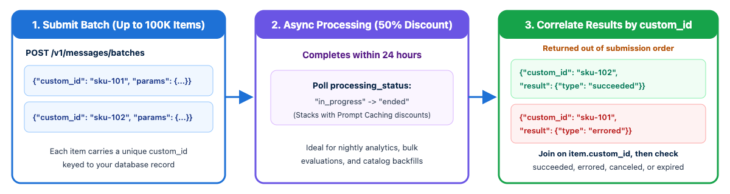
Realtime Messages API vs Message Batches API
Realtime Messages API: synchronous request/response (or SSE stream) for live user sessions and blocking CI checks
Message Batches API: asynchronous processing of up to 100,000 requests per batch; completes within 24 hours at a 50% cost discount
Order is not preserved: batch results complete out of order; you must set a unique custom_id on every request and join results back by custom_id
Claude Certified Developer - Foundations: Hands-On Exam Prep Workshop
© 2026 Copyright ROI Training, Inc.
All rights reserved. Not to be reproduced without prior written consent.
22 of 38

Slide 23
Code: Creating, Polling, and Joining a Message Batch
Never map batch results by array index: always match item.custom_id and inspect item.result.type ("succeeded", "errored", "canceled", "expired")
batch = await client.messages.batches.create(requests=[
{
"custom_id": f"sku-{sku_id}",
"params": {
"model": "claude-haiku-5-5", "max_tokens": 512,
"messages": [{"role": "user", "content": prompt}],
},
}
for sku_id, prompt in catalog_rows.items()
])
# Poll until processing_status == "ended", then stream results and join by custom_id
async for item in await client.messages.batches.results(batch.id):
if item.result.type == "succeeded":
await db.save_enrichment(sku_id=item.custom_id, message=item.result.message)
else:
await db.log_batch_failure(sku_id=item.custom_id, result_type=item.result.type)
Claude Certified Developer - Foundations: Hands-On Exam Prep Workshop
© 2026 Copyright ROI Training, Inc.
All rights reserved. Not to be reproduced without prior written consent.
23 of 38

Slide 24
Chapter 3
Requirements and Systems Life Cycle
Claude API Mechanics
Software Engineering Foundations
Application Design and Configuration
Claude Certified Developer - Foundations: Hands-On Exam Prep Workshop
© 2026 Copyright ROI Training, Inc.
All rights reserved. Not to be reproduced without prior written consent.
24 of 38

Slide 25
Software Engineering Foundations for AI Apps
Asynchronous Programming (AsyncAnthropic)
Resilient REST Integration
The official SDKs already retry 408, 409, 429, and 5xx twice by default with exponential backoff and jitter, and honor the retry-after header.
LLM calls are network I/O bound (seconds to minutes per call).
Use AsyncAnthropic with asyncio.gather (or Promise.all in TypeScript) and an asyncio.Semaphore so concurrent requests never block the event loop or trip rate limits.
Tune max_retries and timeout on the SDK client instead of wrapping the SDK in a custom immediate-retry loop.
Idempotent Side-Effecting Tools
SDLC and Code Review Integration
If a network blip or agent retry re-runs a turn, a non-idempotent tool can charge a card or issue a ledger credit twice.
Treat prompts, tool schemas, CLAUDE.md files, and evaluation datasets as version-controlled code artifacts reviewed in pull requests alongside application code.
Pass a deterministic idempotency_key (for example, f"{ticket_id}:{action}") into every state-changing tool call.
Claude Certified Developer - Foundations: Hands-On Exam Prep Workshop
© 2026 Copyright ROI Training, Inc.
All rights reserved. Not to be reproduced without prior written consent.
25 of 38

Slide 26
Code: Async Concurrency and Idempotent Tool Calls
Bound concurrent in-flight requests with a semaphore and guard side effects with an idempotency key:
sem = asyncio.Semaphore(25) # cap concurrent in-flight API calls
client = AsyncAnthropic(max_retries=3, timeout=60.0)
async def analyze_ticket_safe(ticket: Ticket) -> AnalysisResult:
async with sem:
resp = await client.messages.parse(
model="claude-sonnet-5-5",
max_tokens=2048,
output_format=AnalysisResult,
messages=[{"role": "user", "content": ticket.body}],
)
return resp.parsed_output
async def issue_ledger_credit(ticket_id: str, amount_cents: int) -> dict:
# Deterministic key prevents duplicate credits when a turn is retried
idem_key = f"credit:{ticket_id}:{amount_cents}"
return await payments_api.post("/credits", json={"amount": amount_cents},
headers={"Idempotency-Key": idem_key})
Claude Certified Developer - Foundations: Hands-On Exam Prep Workshop
© 2026 Copyright ROI Training, Inc.
All rights reserved. Not to be reproduced without prior written consent.
26 of 38

Slide 27
Version Control, Code Review, and Refactoring
Version Control and Code Review
Small- vs Large-Scale Refactoring
Roll out new Claude integrations on feature branches behind feature flags so a regression can be disabled or reverted without redeploying the monolith
Small-scale refactoring: a well-scoped fix or single-file rename where the stack trace or target is obvious; use direct execution (Edit) and verify with existing unit tests
Keep human peer review on every pull request, including AI-authored code and prompt changes
Large-scale refactoring: migrating 40+ files across modules with competing architectural choices; start in Plan Mode to map dependencies and agree on the design, then split execution across modules or subagents while keeping tests green at each step
Run claude -p or the Claude Code GitHub Actions integration in CI for automated PR review comments, and /security-review for vulnerability checks
Claude Certified Developer - Foundations: Hands-On Exam Prep Workshop
© 2026 Copyright ROI Training, Inc.
All rights reserved. Not to be reproduced without prior written consent.
27 of 38

Slide 28
Chapter 3
Requirements and Systems Life Cycle
Claude API Mechanics
Software Engineering Foundations
Application Design and Configuration
Claude Certified Developer - Foundations: Hands-On Exam Prep Workshop
© 2026 Copyright ROI Training, Inc.
All rights reserved. Not to be reproduced without prior written consent.
28 of 38

Slide 29
How Claude Interprets Instructions Across Interfaces
Claude Code (CLI / IDE)
Claude Desktop and claude.ai
Automatically loads the CLAUDE.md hierarchy, .claude/rules/ path globs, settings.json, and configured MCP servers.
Claude Desktop connects to local MCP servers configured in claude_desktop_config.json and adds its own desktop system context.
Operates directly on the local workspace with built-in file and bash tools.
claude.ai uses Project instructions, uploaded knowledge files, and Artifacts within a managed web session.
API and Client SDKs
Why Behavior Differs Across Surfaces
Completely stateless and zero-magic: Claude sees only the exact system string, tools list, and messages array you send in that HTTP request.
If a prompt works in claude.ai or Claude Code but behaves differently on the direct API, check for missing harness system instructions, tool descriptions, or content boundaries that the client surface was adding for you.
Does not automatically read CLAUDE.md or .claude/settings.json unless your application code explicitly reads and injects them.
Claude Certified Developer - Foundations: Hands-On Exam Prep Workshop
© 2026 Copyright ROI Training, Inc.
All rights reserved. Not to be reproduced without prior written consent.
29 of 38

Slide 30
Session Hygiene and Mid-Conversation Steering
Never share a mutable messages list across requests or tenants: load and persist conversation history keyed by (tenant_id, session_id)
Mid-conversation operator steering: when your backend needs to inject a runtime policy reminder on turn 8 without altering the top-level system prefix (which would invalidate the prompt cache), insert a {"role": "system"} message inside messages after messages[0]
messages = await session_store.load(tenant_id=auth.tenant_id, session_id=req.session_id)
if req.flagged_high_value_account:
# Mid-conversation system message (never at messages[0]) keeps the cached prefix intact
messages.append({
"role": "system",
"content": "Operator note: this account requires dual approval for credits above $250.",
})
messages.append({"role": "user", "content": f"<user_query>{req.text}</user_query>"})
Claude Certified Developer - Foundations: Hands-On Exam Prep Workshop
© 2026 Copyright ROI Training, Inc.
All rights reserved. Not to be reproduced without prior written consent.
30 of 38

Slide 31
Configuration Management and Version Pinning
Pinning Models, SDKs, and API Versions
Versioning Prompts and Config in Git
Pin an explicit model ID in version-controlled config (every Claude model ID is a pinned snapshot, such as claude-sonnet-5-5 or claude-haiku-4-5-20251001)
Store system prompts, JSON schemas, CLAUDE.md, .claude/rules/, and .claude/settings.json in Git alongside application code
Require pull request review and a passing evaluation suite before bumping a pinned model ID or merging a prompt change
Pin your SDK major version: the SDK sets the anthropic-version header (2026-10-21 in SDK v2.0+)
Track retirement dates: query the Models API (client.models.list()) or maintain a deprecation calendar; a retired model ID fails every production call with HTTP 400/404
Claude Certified Developer - Foundations: Hands-On Exam Prep Workshop
© 2026 Copyright ROI Training, Inc.
All rights reserved. Not to be reproduced without prior written consent.
31 of 38

Slide 32
What a Plugin Is, and Where It Comes From
A plugin is a versioned bundle of Skills, subagents, hooks, MCP servers, and slash commands, described by one manifest: .claude-plugin/plugin.json
It is installed from a marketplace, a catalog of plugins. Add the catalog with /plugin marketplace add <repo-or-url>, then install one plugin with /plugin install <name>@<marketplace>
Use a plugin when the same bundle must be shared across many repositories. Keep ordinary .claude/ files in the repo when the configuration belongs to that one project
Claude Certified Developer - Foundations: Hands-On Exam Prep Workshop
© 2026 Copyright ROI Training, Inc.
All rights reserved. Not to be reproduced without prior written consent.
32 of 38

Slide 33
Public Plugins and Internal Plugins
Public Plugins
Internal Plugins
Come from Anthropic’s official marketplace, or from any public Git repository someone publishes as a marketplace
Come from a private marketplace, usually a private Git repository your company controls
Carry house Skills, security hooks, and MCP servers that talk to systems inside your network
Fit general Skills and commands that contain no company secrets, internal URLs, or private credentials
A repository still opts in. Listing the plugin in .claude/settings.json is what turns it on for that project
Anyone who adds that marketplace can install the plugin
Claude Certified Developer - Foundations: Hands-On Exam Prep Workshop
© 2026 Copyright ROI Training, Inc.
All rights reserved. Not to be reproduced without prior written consent.
33 of 38

Slide 34
Example: An Internal Security Plugin
The security team publishes corp-sec-baseline to the private marketplace. Each application repo installs it and records that requirement in Git.
/plugin marketplace add git@github.com:acme/claude-marketplace.git
/plugin install corp-sec-baseline@internal-marketplace
// .claude-plugin/plugin.json inside the plugin repository
{
"name": "corp-sec-baseline",
"version": "2.4.0",
"description": "Shared security hooks, PR review skill, and SAST MCP server"
}
// Application repository: .claude/settings.json
{
"enabledPlugins": {
"corp-sec-baseline@internal-marketplace": true
}
}
Claude Certified Developer - Foundations: Hands-On Exam Prep Workshop
© 2026 Copyright ROI Training, Inc.
All rights reserved. Not to be reproduced without prior written consent.
34 of 38

Slide 35
Demo: Exploring a Public Plugin
Step 1. Open Anthropic’s example plugin
plugins/example-plugin
Step 2. Read the folder list before opening any file
Look for .claude-plugin/, skills/, commands/, and .mcp.json.
Step 3. Open these files
.claude-plugin/plugin.json
skills/example-skill/SKILL.md
skills/example-command/SKILL.md
commands/example-command.md
.mcp.json
Claude Certified Developer - Foundations: Hands-On Exam Prep Workshop
© 2026 Copyright ROI Training, Inc.
All rights reserved. Not to be reproduced without prior written consent.
35 of 38

Slide 36
Domain 2 Quiz: Applications and Integration
Open Quiz
Claude Certified Developer - Foundations: Hands-On Exam Prep Workshop
© 2026 Copyright ROI Training, Inc.
All rights reserved. Not to be reproduced without prior written consent.
36 of 38

Slide 37
What You Learned
Translated business needs into functional and infrastructure requirements across the SDLC
Constructed stateless Messages API requests, multi-turn tool round trips, and thinking histories
Implemented SSE streaming, vision, PDF documents, Files API uploads, and citations
Processed bulk asynchronous workloads with the Message Batches API and custom_id correlation
Applied AsyncAnthropic concurrency, resilient retries, idempotency keys, and Claude-assisted SDLC workflows
Enforced multi-tenant session boundaries, pinned configurations, and Claude Code plugins
Claude Certified Developer - Foundations: Hands-On Exam Prep Workshop
© 2026 Copyright ROI Training, Inc.
All rights reserved. Not to be reproduced without prior written consent.
37 of 38

Slide 38

Questions and Answers
Claude Certified Developer - Foundations: Hands-On Exam Prep Workshop
© 2026 Copyright ROI Training, Inc.
All rights reserved. Not to be reproduced without prior written consent.
38 of 38

