Slide 1

GitHub Copilot for Credit Analytics and Risk Modeling
Chapter 1: Copilot Fundamentals and Secure Context-Setting
GitHub Copilot for Credit Analytics and Risk Modeling
© 2026 Copyright ROI Training, Inc.
All rights reserved. Not to be reproduced without prior written consent.
1 of 42

Slide 2

Chapter 1: Objectives
Use Copilot from VS Code, the website, and the Copilot app
Write safe prompts and control prompt context
Select Inline, Chat, or Agent modes when generating code
Store team defaults, slash commands, and domain playbooks in .github/copilot-instructions.md, prompt files, and Agent Skills
GitHub Copilot for Credit Analytics and Risk Modeling
© 2026 Copyright ROI Training, Inc.
All rights reserved. Not to be reproduced without prior written consent.
2 of 42

Slide 3
Chapter Concepts
Where Copilot Runs
Prompting in VS Code
Context, Instructions, and Reuse
GitHub Copilot for Credit Analytics and Risk Modeling
© 2026 Copyright ROI Training, Inc.
All rights reserved. Not to be reproduced without prior written consent.
3 of 42

Slide 4
Where the Work Belongs
VS Code
Web
Apps
Inline completions, Chat, and Agent mode
github.com/copilot for quick questions
Desktop and mobile for a draft thought
Diffs, tests, and file-scoped edits
Useful before you open the repo
No test run, no diff, no approval
Where production changes land
Not a place to merge code
Paste the idea into VS Code before you trust it
Note
GitHub docs call these places “Surfaces”
GitHub Copilot for Credit Analytics and Risk Modeling
© 2026 Copyright ROI Training, Inc.
All rights reserved. Not to be reproduced without prior written consent.
4 of 42

Slide 5
Demo: Using the Copilot Website
Open github.com/copilot.
Paste the following prompt, and read the results.
What is the difference between Copilot Chat and inline suggestions in VS Code?
At the bottom of the chat, open the model menu and choose a different model.
Paste this prompt:
I have a CSV of credit accounts with balance, utilization, and delinquency_days. Which summary statistics should I compute first, and what would a bad value look like?
Note
Compare the two answers. The second one should include count, missing values, min, max, and mean, and flag blank utilization or delinquency_days values that are obviously wrong or unusually long.
GitHub Copilot for Credit Analytics and Risk Modeling
© 2026 Copyright ROI Training, Inc.
All rights reserved. Not to be reproduced without prior written consent.
5 of 42

Slide 6
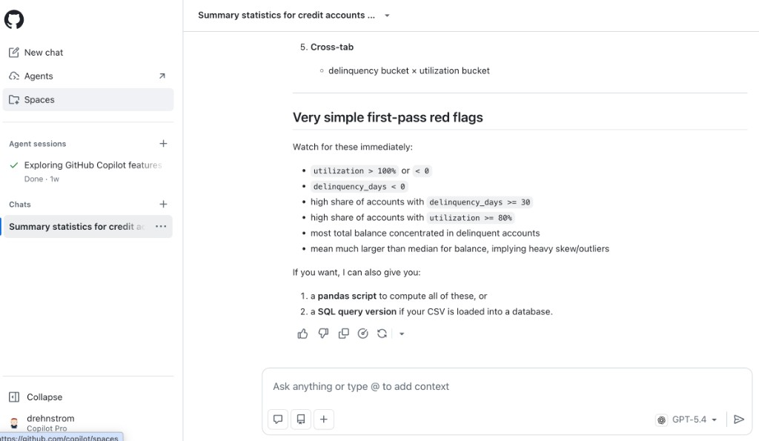
GitHub Copilot Website
GitHub Copilot for Credit Analytics and Risk Modeling
© 2026 Copyright ROI Training, Inc.
All rights reserved. Not to be reproduced without prior written consent.
6 of 42

Slide 7
Demo: Using Copilot in Visual Studio Code
Open Visual Studio Code. Choose File> Open Folder, then open an empty folder. Just create an empty folder anywhere on your computer.
Open Copilot Chat from the Copilot icon in the title bar. Notice that </> Agent is selected at the bottom of the chat input box by default.
Paste the prompt below and press ENTER. If asked, allow Copilot to create the files requested in the prompt.
Create two files in this folder.
sample_accounts.csv
- Columns: account_id, balance, utilization, delinquency_days
- 12 realistic credit-card rows
- Leave utilization blank on 2 rows
- Set one delinquency_days value to 9999
stats.html
- One page I can open in a browser. No server and no install.
- An Upload CSV button
- After upload, show the row count
- For every column, show how many values are missing
- For every numeric column, show min, max, and mean
- Make the results a clear table
GitHub Copilot for Credit Analytics and Risk Modeling
© 2026 Copyright ROI Training, Inc.
All rights reserved. Not to be reproduced without prior written consent.
7 of 42

Slide 8
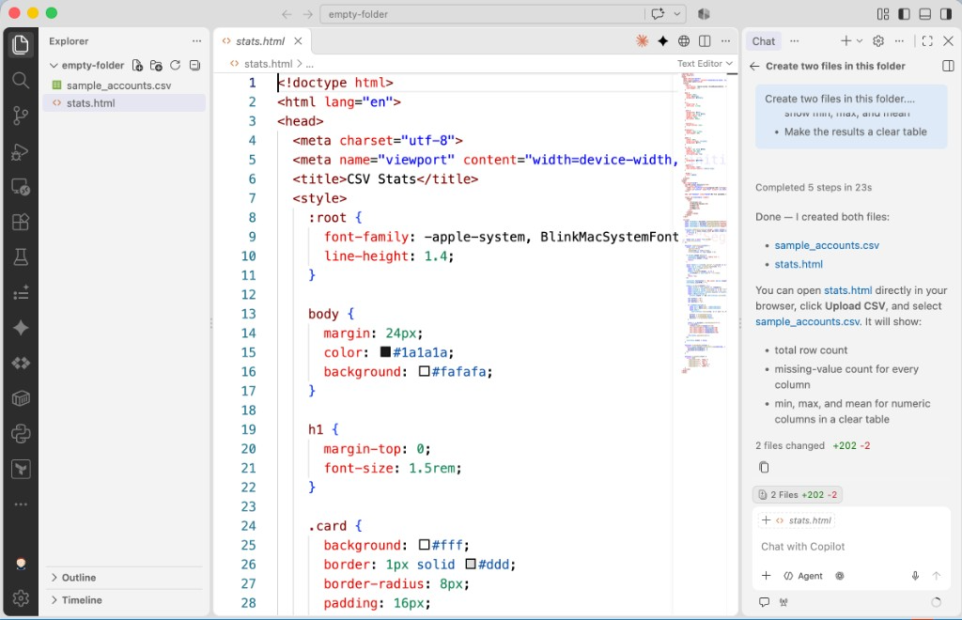
Visual Studio Code with Copilot
GitHub Copilot for Credit Analytics and Risk Modeling
© 2026 Copyright ROI Training, Inc.
All rights reserved. Not to be reproduced without prior written consent.
8 of 42

Slide 9
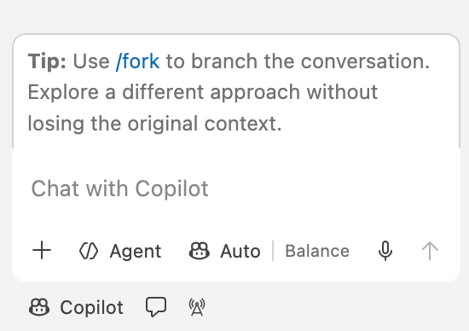
Inside the Copilot Chat Box in VS Code
+ (Add Context): Attach #file references, folders, or symbols to your prompt
</> Agent (SHIFT+CMD+I / CTRL+SHIFT+I): Unified workspace agent that can answer questions, edit files, and run terminal commands
Auto | Balance: Selects the underlying model (or lets Copilot pick automatically)
Bottom toolbar icons: Switch between the Harness (Copilot), Agent Mode (speech bubble), and live session tools
GitHub Copilot for Credit Analytics and Risk Modeling
© 2026 Copyright ROI Training, Inc.
All rights reserved. Not to be reproduced without prior written consent.
9 of 42

Slide 10
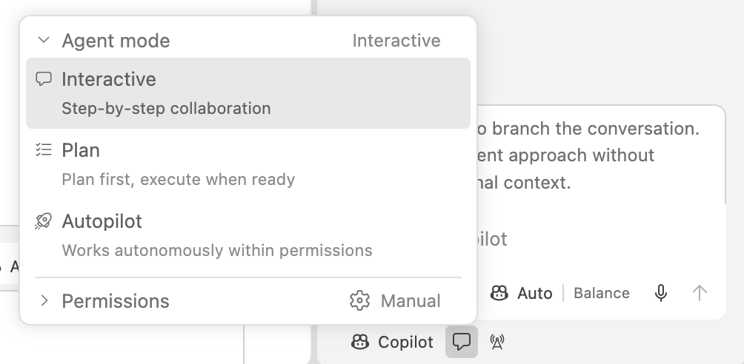
Choosing an Agent Mode: Interactive, Plan, or Autopilot
Click the speech bubble icon below the chat input box to control how Agent mode collaborates with you:
Interactive (Default): Step-by-step collaboration where you review diffs and approve actions as Copilot works
Plan: Builds a step-by-step plan first and waits to execute until you are ready
Autopilot: Works autonomously across steps within the permissions you set
Permissions (Manual): Keep set to Manual for credit analytics so Copilot always asks before running terminal commands or touching sensitive files
GitHub Copilot for Credit Analytics and Risk Modeling
© 2026 Copyright ROI Training, Inc.
All rights reserved. Not to be reproduced without prior written consent.
10 of 42

Slide 11
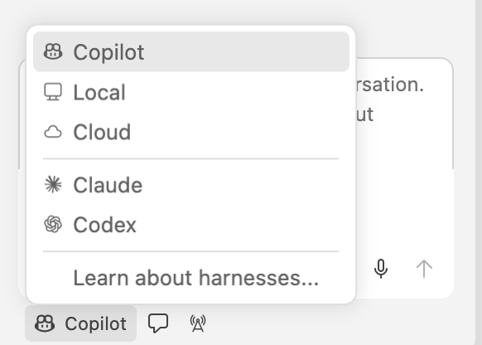
Selecting a Harness in VS Code
Click Copilot in the bottom-left corner of the chat panel to choose where and how the agent runs:
Copilot/Local/Cloud: Run with GitHub Copilot in your local VS Code session or in a cloud workspace
Claude/Codex: Switch to alternative agent harnesses if enabled for your organization
For all exercises in this course, keep the harness set to Copilot and Agent mode set to Interactive or Plan
GitHub Copilot for Credit Analytics and Risk Modeling
© 2026 Copyright ROI Training, Inc.
All rights reserved. Not to be reproduced without prior written consent.
11 of 42

Slide 12

Prevent Data Leakage in Prompts
A prompt leaves your computer. Copilot sends it to the model and stores it with the chat.
Do not paste names, account IDs, Social Security numbers, or real customer rows.
Do paste column names, a few rows you invented, and the cutoff as a parameter.
If you would not email it outside the company, do not paste it into Copilot.
GitHub Copilot for Credit Analytics and Risk Modeling
© 2026 Copyright ROI Training, Inc.
All rights reserved. Not to be reproduced without prior written consent.
12 of 42

Slide 13
Risky Ask vs Safe Ask
Risky
Safe
“Here are our customers’ names, account numbers, and Social Security numbers. Find who is behind on payments.”
“Here are the column names and 10 rows I made up. Draft code that scores accounts.”
“Keep the cutoff as a number I can change.”
“This spreadsheet is a real export from our system. Tell me which accounts to close.”
“List what you assumed. Do not invent columns.”
“Use last month’s customer list and decide who we should turn down.”
GitHub Copilot for Credit Analytics and Risk Modeling
© 2026 Copyright ROI Training, Inc.
All rights reserved. Not to be reproduced without prior written consent.
13 of 42

Slide 14
Demo: Inline Completion
In VS Code, create a file named fizz_buzz.py.
Type this line, press ENTER, and pause.
def fizz_buzz(n):
Wait for the gray ghost text.
Press TAB to accept it.
Read the inserted code. Undo it if it is not the loop you wanted.
Note
Ghost text requires Copilot completions. If nothing appears, check the Copilot icon in the status bar.
GitHub Copilot for Credit Analytics and Risk Modeling
© 2026 Copyright ROI Training, Inc.
All rights reserved. Not to be reproduced without prior written consent.
14 of 42

Slide 15
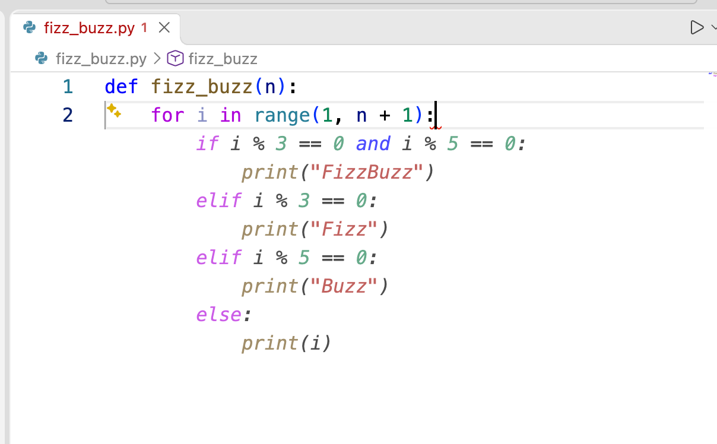
Accepting an Inline Suggestion
Read the gray text before you press a key
Press TAB only when you understand it and it is what you meant to write
Press ESC when it is wrong, or when you do not understand it
If only the start is right, accept that part. On a Mac, press CMD+Right; on Windows, press CTRL+Right
To ask for an edit right inside the file, select the lines and press CMD+I (Mac) or CTRL+I (Windows) to open Inline Chat
GitHub Copilot for Credit Analytics and Risk Modeling
© 2026 Copyright ROI Training, Inc.
All rights reserved. Not to be reproduced without prior written consent.
15 of 42

Slide 16
Chapter Concepts
Where Copilot Runs
Prompting in VS Code
Context, Instructions, and Reuse
GitHub Copilot for Credit Analytics and Risk Modeling
© 2026 Copyright ROI Training, Inc.
All rights reserved. Not to be reproduced without prior written consent.
16 of 42

Slide 17
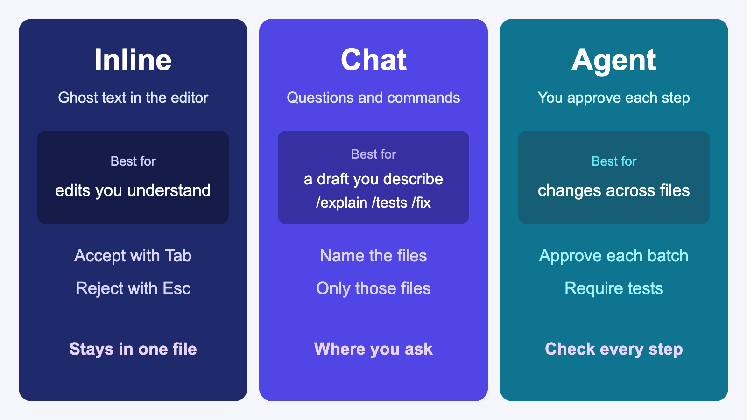
Inline, Chat, or Agent
GitHub Copilot for Credit Analytics and Risk Modeling
© 2026 Copyright ROI Training, Inc.
All rights reserved. Not to be reproduced without prior written consent.
17 of 42

Slide 18
Three Slash Commands Worth Memorizing
/explain
/tests
/fix
Select a function and ask what it assumes, including how it treats blank values.
Name the cases, including an empty input, a missing column, and which accounts count.
Paste the error and ask it to change only the lines that failed.
Note
Copilot slash commands may not appear when you type / in Chat. Availability depends on version, surface, and context. Typing a slash command (or the same request in plain English) still works. The AI treats it as a normal prompt.
GitHub Copilot for Credit Analytics and Risk Modeling
© 2026 Copyright ROI Training, Inc.
All rights reserved. Not to be reproduced without prior written consent.
18 of 42

Slide 19
Common Slash Commands in VS Code
Command | What it does | When to use it
/explain | Explains how selected code works and what it assumes | Before editing unfamiliar Python, SQL, or legacy SAS
/tests | Generates unit tests for the selected function or file | Adding pytest coverage for normal and edge cases
/fix | Proposes a targeted fix for an error or failing block | Pasting a traceback or fixing a broken calculation
/doc | Generates docstrings and inline comments | Documenting inputs, outputs, and rules on a function
/clear | Clears the current chat history and starts fresh | Switching tasks so old context does not pollute the next prompt
/new | Scaffolds a new workspace, file, or notebook | Starting a new project structure or Jupyter notebook
/help | Lists all available slash commands and chat participants | Checking exact command names and syntax in VS Code
GitHub Copilot for Credit Analytics and Risk Modeling
© 2026 Copyright ROI Training, Inc.
All rights reserved. Not to be reproduced without prior written consent.
19 of 42

Slide 20
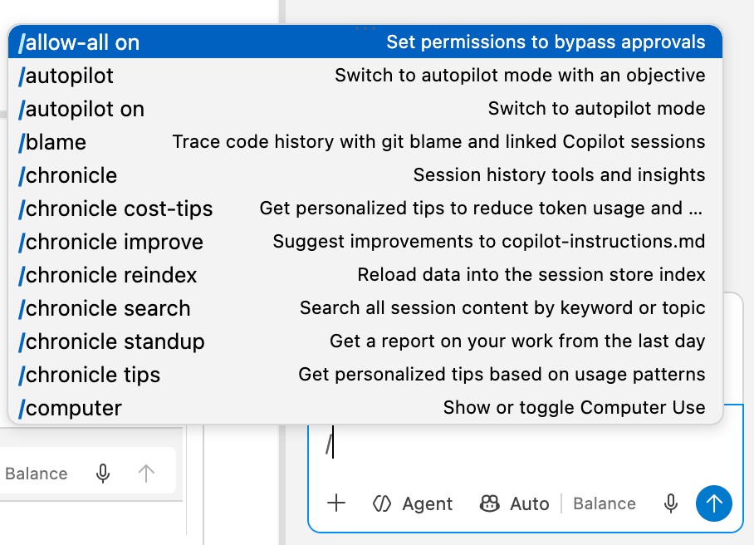
Type / to Browse Available Commands
You do not have to memorize every slash command
Type / in the Copilot Chat input box to open the autocomplete menu with each command and its description
Keep typing to filter the list, or use the Up and Down arrow keys and press TAB or ENTER to select one
Custom team prompt files (in .github/prompts/) also appear right in this / menu
GitHub Copilot for Credit Analytics and Risk Modeling
© 2026 Copyright ROI Training, Inc.
All rights reserved. Not to be reproduced without prior written consent.
20 of 42

Slide 21
Weak Prompt vs Strong Prompt
Weak
Strong
“Analyze this data.”
“Read sample_accounts.csv. Each row is one credit account. Print the average of balance, and skip blank utilization rows.”
“Make a chart.”
“Fix the bug.”
“Bar chart of delinquent accounts by risk_band. Put risk_band on the x-axis and account count on the y-axis.”
“average() crashes on an empty list. Return None for an empty list, and do not change any other function.”
GitHub Copilot for Credit Analytics and Risk Modeling
© 2026 Copyright ROI Training, Inc.
All rights reserved. Not to be reproduced without prior written consent.
21 of 42

Slide 22
File-Scoped Prompt You Will Reuse
Task: Add a delinquency trend helper.
Use:
- #file src/analytics/delinquency.py
- #file tests/test_delinquency.py
Output:
- Edit only those two files.
- Add tests for an empty frame and a missing risk_band.
Stop:
- If you are not sure what one row represents, list assumptions and do not edit.
GitHub Copilot for Credit Analytics and Risk Modeling
© 2026 Copyright ROI Training, Inc.
All rights reserved. Not to be reproduced without prior written consent.
22 of 42

Slide 23
When Another Prompt Will Not Help
You left out a rule
It edited the wrong file
It made a business decision
Copilot chose which accounts count, because you did not say.
It changed a file you did not name.
It recommended a cutoff or who to decline.
Write that rule, then prompt again.
Send the prompt again with the file names.
That choice stays with you.
Warning
The human always has to understand and be in charge of all code changes.
GitHub Copilot for Credit Analytics and Risk Modeling
© 2026 Copyright ROI Training, Inc.
All rights reserved. Not to be reproduced without prior written consent.
23 of 42

Slide 24
Demo: Explain, Tests, and Fix
In VS Code, create a file named average.py. Then, paste this code and save the file.
def average(numbers):
total = 0
for n in numbers:
total = total + n
return total / len(numbers)
print(average([]))
Select the average function. Then, open Copilot Chat and paste the following prompt.
/explain What does this function assume, and what happens when the list is empty?
Read the reply before you continue, and then paste this prompt.
GitHub Copilot for Credit Analytics and Risk Modeling
© 2026 Copyright ROI Training, Inc.
All rights reserved. Not to be reproduced without prior written consent.
24 of 42
/tests Include a normal list and an empty list.

Slide 25
Chapter Concepts
Where Copilot Runs
Prompting in VS Code
Context, Instructions, and Reuse
GitHub Copilot for Credit Analytics and Risk Modeling
© 2026 Copyright ROI Training, Inc.
All rights reserved. Not to be reproduced without prior written consent.
25 of 42

Slide 26
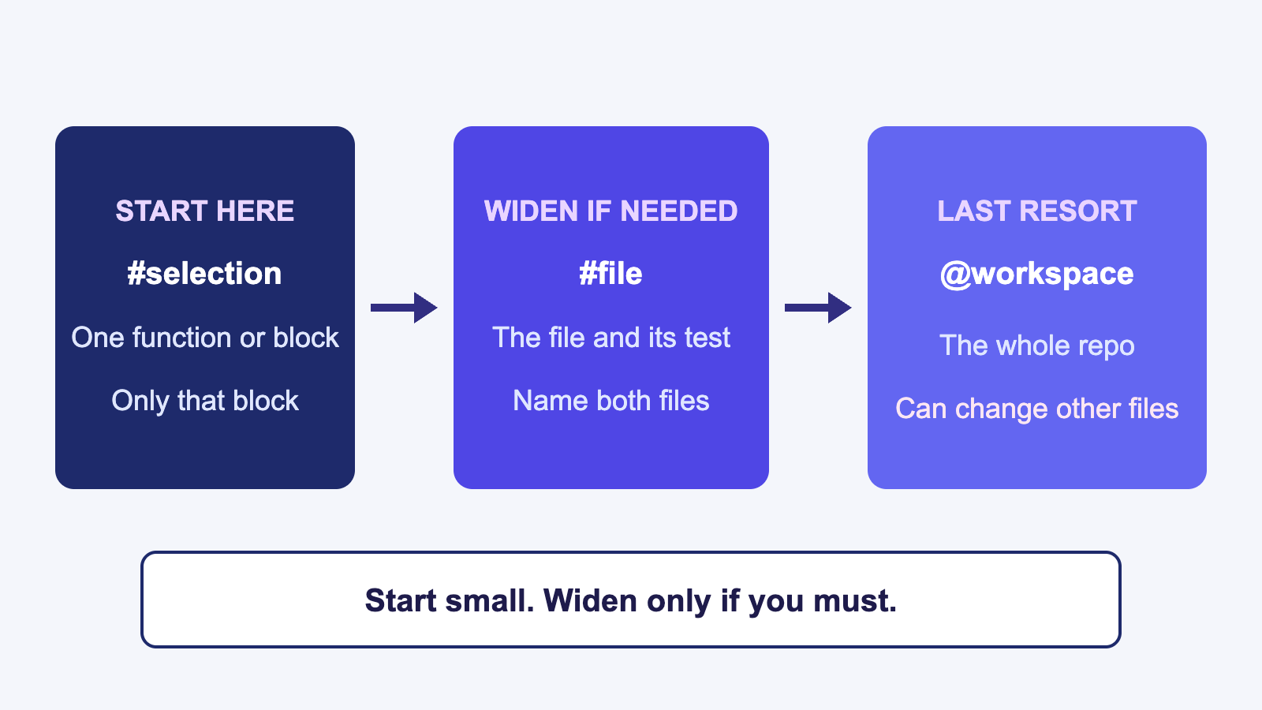
Start with the Smallest Context
GitHub Copilot for Credit Analytics and Risk Modeling
© 2026 Copyright ROI Training, Inc.
All rights reserved. Not to be reproduced without prior written consent.
26 of 42

Slide 27
How You Point Copilot at Code
Select the function. Chat uses that selection.
Type #file and choose the file. Add the test file when you want tests.
Type @workspace only when the question or change spans multiple files across the repo.
Broad workspace context can lead Copilot to touch files you did not name. Name the exact files with #file when you can.
GitHub Copilot for Credit Analytics and Risk Modeling
© 2026 Copyright ROI Training, Inc.
All rights reserved. Not to be reproduced without prior written consent.
27 of 42

Slide 28
What copilot-instructions.md Is For
The file
Rules that belong there
It lives at .github/copilot-instructions.md
Write tests with the change
Copilot adds it to every chat in that repo
Do not use real customer data in examples
You do not paste it into the prompt
State assumptions before editing
It holds rules for the whole team, not today’s task
Leave out one-off questions, secrets, and live data
GitHub Copilot for Credit Analytics and Risk Modeling
© 2026 Copyright ROI Training, Inc.
All rights reserved. Not to be reproduced without prior written consent.
28 of 42

Slide 29
Example: .github/copilot-instructions.md
Create .github/copilot-instructions.md at the root of your repository so Copilot applies these rules automatically:
# Credit Analytics Team Copilot Instructions
## Coding Standards
- Use Python 3.11, pandas, and pytest for all analytics scripts.
- Add type hints and a short docstring to every new function.
## Data and Domain Rules
- Never include real customer PII, names, or production account IDs.
- Exclude rows where status == 'charged_off' from delinquency rate denominators.
- Treat delinquency_days > 365 as a data error flag, not a valid observation.
## Verification Rules
- Write pytest unit tests for every new or modified function, including empty inputs and nulls.
- State assumptions and wait for approval before editing multiple files.
GitHub Copilot for Credit Analytics and Risk Modeling
© 2026 Copyright ROI Training, Inc.
All rights reserved. Not to be reproduced without prior written consent.
29 of 42

Slide 30
Instructions vs Prompt Files vs Agent Skills
.github/copilot-instructions.md
.github/prompts/ name.prompt.md
.github/skills/name/ SKILL.md
Loaded on every chat in the repo
Single Markdown file for one repeatable task
Folder bundling SKILL.md plus templates or scripts
Standing coding and credit domain rules
Triggered manually by typing /name in Chat
Copilot reads YAML description and loads on demand
Keep concise so it never crowds context
Ideal for standardized prompts like /add-tests
Ideal for multi-step domain playbooks
GitHub Copilot for Credit Analytics and Risk Modeling
© 2026 Copyright ROI Training, Inc.
All rights reserved. Not to be reproduced without prior written consent.
30 of 42

Slide 31
Example: .github/prompts/add-tests.prompt.md
Save repeatable tasks under .github/prompts/ and run them in Chat by typing /add-tests:
# Prompt File: .github/prompts/add-tests.prompt.md
Write pytest unit tests for the selected function or attached #file:
1. Use synthetic credit account rows only (no real customer data).
2. Test normal inputs across Prime, Near-Prime, and Subprime risk_band values.
3. Test edge cases: empty DataFrame, missing utilization values, and delinquency_days = 9999.
4. Do not modify the production function unless I explicitly ask.
GitHub Copilot for Credit Analytics and Risk Modeling
© 2026 Copyright ROI Training, Inc.
All rights reserved. Not to be reproduced without prior written consent.
31 of 42

Slide 32
What an Agent Skill Bundles (.github/skills/)
Progressive Disclosure
Supporting Files in the Folder
Lives in .github/skills/<skill-name>/SKILL.md with a YAML header (name and description) at the top of the file
Reference templates (for example, a standard Model Card skeleton or MRM checklist)
Validation scripts or lookup tables that Agent mode can run or inspect
Copilot scans only the lightweight description at session start
Keeps heavy domain playbooks out of .github/copilot-instructions.md
Loads the full SKILL.md instructions only when your prompt matches that domain workflow
GitHub Copilot for Credit Analytics and Risk Modeling
© 2026 Copyright ROI Training, Inc.
All rights reserved. Not to be reproduced without prior written consent.
32 of 42

Slide 33
Example: .github/skills/credit-data-audit/SKILL.md
Package a multi-step domain playbook and its reference files inside .github/skills/credit-data-audit/SKILL.md:
--- # YAML header at top of file (loaded at startup)
name: credit-data-audit
description: Audits credit datasets for sentinel codes, charged-off denominator leaks, and vintage grain errors. Use when profiling or validating credit tables.
--- # Full playbook below (loaded on demand)
# Credit Data Audit Skill
1. Verify primary grain is unique on `(account_id, perf_month)`.
2. Flag sentinel values (`9999`, `-1`, `999`) in `delinquency_days` and `utilization` before computing means.
3. Confirm `status == 'charged_off'` is excluded from active delinquency rate denominators.
4. Format the output report using `./audit-report-template.md` in this skill folder.
GitHub Copilot for Credit Analytics and Risk Modeling
© 2026 Copyright ROI Training, Inc.
All rights reserved. Not to be reproduced without prior written consent.
33 of 42

Slide 34
Chapter 1: Hands-On Lab
Lab: Effective Prompting and Context Engineering
Time: 30 minutes
GitHub Copilot for Credit Analytics and Risk Modeling
© 2026 Copyright ROI Training, Inc.
All rights reserved. Not to be reproduced without prior written consent.
34 of 42

Slide 35
What You Learned
Used Copilot from VS Code, the website, and the Copilot app
Wrote safe prompts and controlled prompt context
Selected inline, Chat, or Agent modes when generating code
Stored team defaults, slash commands, and domain playbooks in .github/copilot-instructions.md, prompt files, and Agent Skills
GitHub Copilot for Credit Analytics and Risk Modeling
© 2026 Copyright ROI Training, Inc.
All rights reserved. Not to be reproduced without prior written consent.
35 of 42

Slide 36
Quiz 1 of 3
You need Copilot to change one function in VS Code. What context should you give it?
A. @workspace, so it can see the whole repo
B. The selected function, or #file on that file and its test
C. Every file in the repo, pasted into the chat
D. The website, with the repo described from memory
GitHub Copilot for Credit Analytics and Risk Modeling
© 2026 Copyright ROI Training, Inc.
All rights reserved. Not to be reproduced without prior written consent.
36 of 42

Slide 37
Quiz 1: Answer
You need Copilot to change one function in VS Code. What context should you give it?
Correct: B. Start with the selection or the named files.
Select the function when the change stays in that block
Add the test file with #file when you want tests
Use @workspace only when the change needs other files
Broad @workspace context can lead Copilot to touch files you did not name
GitHub Copilot for Credit Analytics and Risk Modeling
© 2026 Copyright ROI Training, Inc.
All rights reserved. Not to be reproduced without prior written consent.
37 of 42

Slide 38
Quiz 2 of 3
The team wants the same rules on every chat, without pasting them each time. Where do the rules go?
A. In a prompt file that someone runs with /
B. In .github/copilot-instructions.md
C. In the ghost text, so TAB inserts the rules
D. In one chat. Later chats will remember it
GitHub Copilot for Credit Analytics and Risk Modeling
© 2026 Copyright ROI Training, Inc.
All rights reserved. Not to be reproduced without prior written consent.
38 of 42

Slide 39
Quiz 2: Answer
The team wants the same rules on every chat, without pasting them each time. Where do the rules go?
Correct: B. Copilot adds copilot-instructions.md to every chat in that repo.
A prompt file (.github/prompts/*.prompt.md) is one job you trigger manually with /
An Agent Skill (.github/skills/<name>/SKILL.md) is a domain playbook loaded on demand when your task matches its description
Ghost text is an inline suggestion, not a store for team rules
Keep copilot-instructions.md focused on standing rules that apply to every chat
GitHub Copilot for Credit Analytics and Risk Modeling
© 2026 Copyright ROI Training, Inc.
All rights reserved. Not to be reproduced without prior written consent.
39 of 42

Slide 40
Quiz 3 of 3: Discussion
Prompt
Discuss
A teammate runs /fix on a function that crashes. They keep the edit without reading it. Copilot also rewrote a function that already worked.
What should they have included with /fix?
What should they check before keeping the edit?
Which command comes first if they do not yet understand the function?
GitHub Copilot for Credit Analytics and Risk Modeling
© 2026 Copyright ROI Training, Inc.
All rights reserved. Not to be reproduced without prior written consent.
40 of 42

Slide 41
Quiz 3: Discussion Points
A teammate runs /fix on a function that crashes. They keep the edit without reading it. Copilot also rewrote a function that already worked.
Strong Answers Mention
Watch For
The error, and a limit to the lines that failed
Keeping the edit because it looks finished
Keep the edit only if the crash is fixed and the other function is unchanged
Using /fix to rewrite the whole file
Skipping /explain when the function is unclear
/explain first, when they cannot say what the function does
/tests for the failing case, such as an empty list
GitHub Copilot for Credit Analytics and Risk Modeling
© 2026 Copyright ROI Training, Inc.
All rights reserved. Not to be reproduced without prior written consent.
41 of 42

Slide 42

Questions and Answers
GitHub Copilot for Credit Analytics and Risk Modeling
© 2026 Copyright ROI Training, Inc.
All rights reserved. Not to be reproduced without prior written consent.
42 of 42

