Slide 1

GitHub Copilot for Credit Analytics and Risk Modeling
Chapter 2: AI-Assisted Data Exploration and Analytics
GitHub Copilot for Credit Analytics and Risk Modeling
© 2026 Copyright ROI Training, Inc.
All rights reserved. Not to be reproduced without prior written consent.
1 of 32

Slide 2

Chapter 2: Objectives
Attach schema context with #file so Copilot writes Python code without guessing column names
Prompt Copilot Chat and Inline Chat to generate code
Feed table definitions to Copilot to generate SQL queries
Translate legacy SAS blocks to Python using /explain, scoped prompts, and /tests
Use comment-driven inline completions to build feature engineering pipelines
GitHub Copilot for Credit Analytics and Risk Modeling
© 2026 Copyright ROI Training, Inc.
All rights reserved. Not to be reproduced without prior written consent.
2 of 32

Slide 3
Chapter Concepts
Prompting for Data Profiling
Generating Charts with Copilot
SQL, SAS Migration Pipelines
GitHub Copilot for Credit Analytics and Risk Modeling
© 2026 Copyright ROI Training, Inc.
All rights reserved. Not to be reproduced without prior written consent.
3 of 32

Slide 4
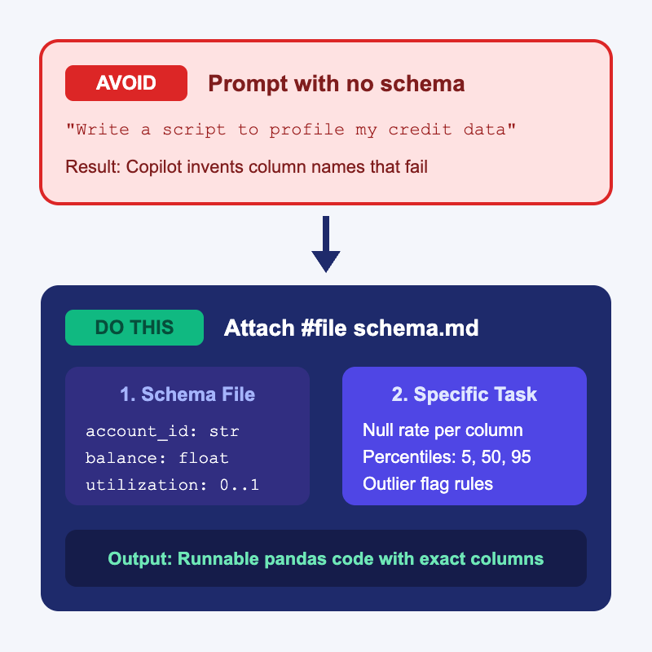
Give Copilot the Schema, Not the Data
Copilot cannot see your DataFrame columns unless you put their names in context
If you prompt “profile my credit data,” Copilot invents column names that fail at runtime
Create a short schema.md file or header sample and attach it with #file in Chat
You get runnable pandas code while keeping real customer records out of the prompt
GitHub Copilot for Credit Analytics and Risk Modeling
© 2026 Copyright ROI Training, Inc.
All rights reserved. Not to be reproduced without prior written consent.
4 of 32

Slide 5
Three Ways to Generate Profiling Code
Ghost Text (TAB)
Inline Chat (CMD+I / CTRL+I)
Copilot Chat (#file)
Write a descriptive comment above a line in your .py file
Select existing DataFrame lines and press CMD+I (Mac) or CTRL+I (Windows)
Open the Chat sidebar and attach #file schema.md
Best for one check, such as a single groupby or null count
Ask for a reusable profiling module with multiple functions
Ask Copilot to add a column check or summary right in the editor
Fastest when the DataFrame is already in the file
Best when starting a brand-new script
Shows an inline diff you can Accept or Discard
GitHub Copilot for Credit Analytics and Risk Modeling
© 2026 Copyright ROI Training, Inc.
All rights reserved. Not to be reproduced without prior written consent.
5 of 32

Slide 6
Weak vs Strong Profiling Prompts
Weak Prompt
Strong Prompt
“Write a Python script to explore my credit card dataset and check for bad values.”
“Using #file schema.md, write profile_accounts(df) in pandas.”
Leaves column names, library choice, and output format up to guesswork
“Return a summary DataFrame with row count, null percent per column, and 5th, 50th, and 95th percentiles for numeric columns.”
Often produces generic df.describe() boilerplate with made-up column names
“Add a separate function flag_outliers(df) that returns rows where utilization > 1.0 or delinquency_days < 0.”
GitHub Copilot for Credit Analytics and Risk Modeling
© 2026 Copyright ROI Training, Inc.
All rights reserved. Not to be reproduced without prior written consent.
6 of 32

Slide 7
Iterating on groupby Logic with Inline Chat
Start with a working function, then use Inline Chat to add segmentation without rewriting the file
Highlight the function in VS Code, press CMD+I (Mac) or CTRL+I (Windows), and state the exact grouping columns and metrics
Modify this function to group by risk_band and vintage_quarter.
Calculate account count, mean balance, and the share of rows where delinquency_days >= 30.
Keep the existing null check unchanged.
Tip
Naming the function part to keep (“Keep the existing null check unchanged”) stops Copilot from deleting working code during an edit.
GitHub Copilot for Credit Analytics and Risk Modeling
© 2026 Copyright ROI Training, Inc.
All rights reserved. Not to be reproduced without prior written consent.
7 of 32

Slide 8
Demo: Profiling a Dataset with #file Schema Context
In VS Code, open your workspace folder and create a file named schema.md with these contents:
# Credit Accounts Schema (sample_accounts.csv)
- `account_id` (string): unique account identifier
- `risk_band` (string): Prime, Near-Prime, or Subprime
- `balance` (float): current balance in USD
- `credit_limit` (float): credit limit in USD
- `utilization` (float): ratio from 0.0 to 1.0 (may contain blanks)
- `delinquency_days` (int): days past due (9999 indicates a data error)
Open Copilot Chat (</> Agent in Interactive mode), attach #file schema.md, and run this prompt:
Using #file schema.md, create two files:
1. make_sample_data.py: generates sample_accounts.csv with 50 synthetic rows across all three risk_band values, including 4 blank utilization rows and 2 rows with delinquency_days = 9999.
2. profile_accounts.py: loads sample_accounts.csv with pandas and prints:
- Null count and null percentage for every column
- 5th, 50th, and 95th percentiles for balance and utilization
- Count of error rows where delinquency_days > 365
- A groupby summary by risk_band showing account count and mean balance
GitHub Copilot for Credit Analytics and Risk Modeling
© 2026 Copyright ROI Training, Inc.
All rights reserved. Not to be reproduced without prior written consent.
8 of 32

Slide 9
Chapter Concepts
Prompting for Data Profiling
Generating Charts with Copilot
SQL, SAS Migration Pipelines
GitHub Copilot for Credit Analytics and Risk Modeling
© 2026 Copyright ROI Training, Inc.
All rights reserved. Not to be reproduced without prior written consent.
9 of 32

Slide 10
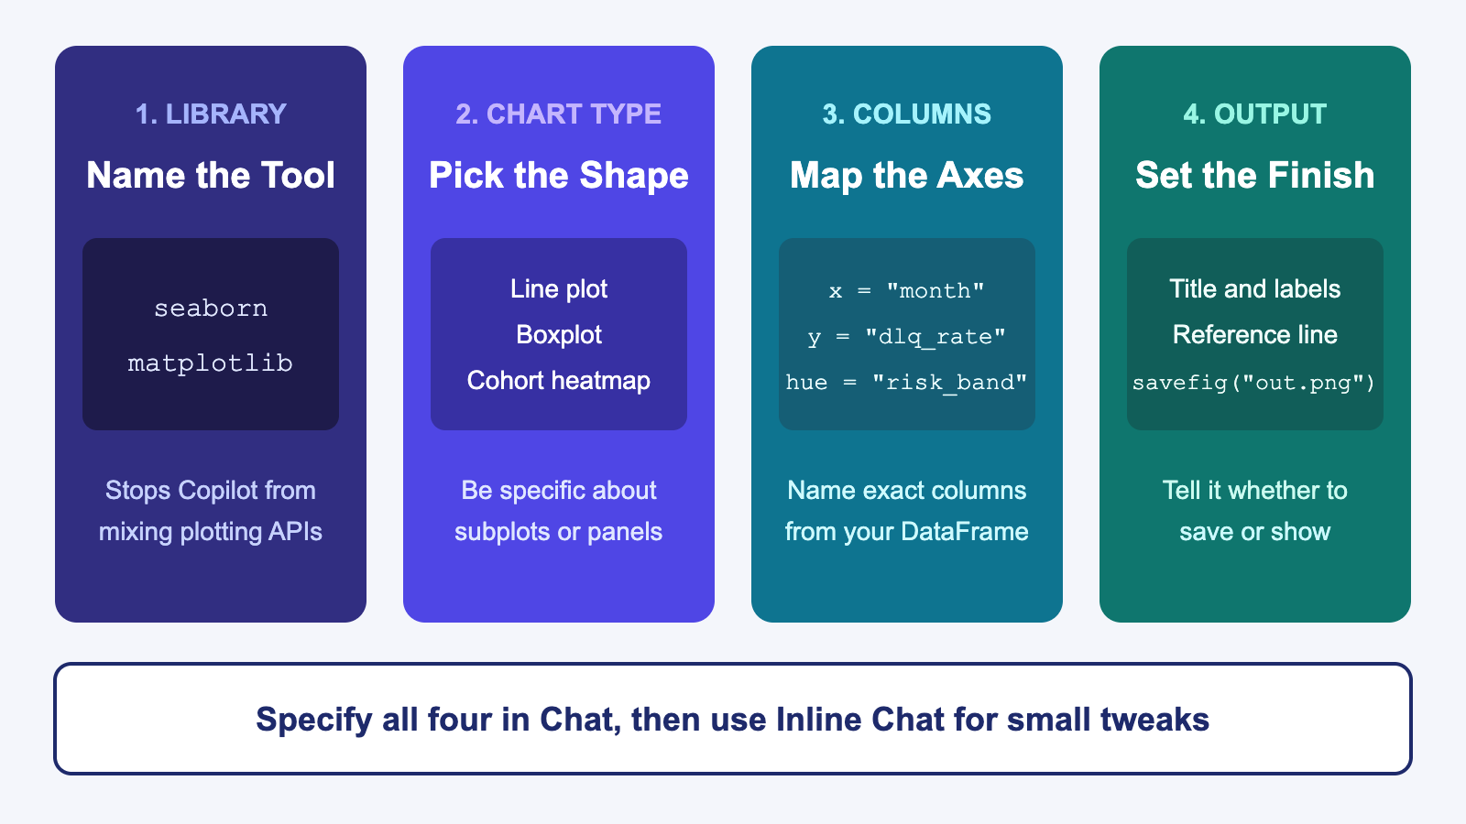
Four Parts of a Chart Prompt
GitHub Copilot for Credit Analytics and Risk Modeling
© 2026 Copyright ROI Training, Inc.
All rights reserved. Not to be reproduced without prior written consent.
10 of 32

Slide 11
Prompt Patterns for Common Analytics Plots
Multi-Line Trend Chart
Distribution and Outlier Boxplot
Cohort Heatmap
Name the library (seaborn), the time column on x, the rate column on y, and hue="risk_band".
Ask Copilot to build a pandas.pivot_table first, then pass it to sns.heatmap.
Ask for a seaborn.boxplot with x="risk_band" and y="utilization".
Specify annot=True and fmt=".1%" so every cell displays its value clearly.
Ask Copilot to sort the date axis and format y as percentages.
Tell Copilot to add a red dashed reference line at y=1.0 using ax.axhline.
GitHub Copilot for Credit Analytics and Risk Modeling
© 2026 Copyright ROI Training, Inc.
All rights reserved. Not to be reproduced without prior written consent.
11 of 32

Slide 12
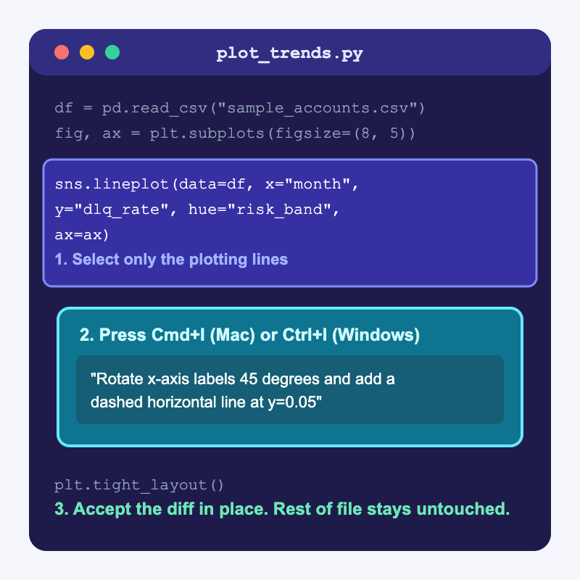
Use Inline Chat to Tweak a Chart in Place
Pasting a whole script back into the Chat sidebar just to rotate labels wastes time and can alter your data prep
Highlight only the plotting lines in the editor and press CMD+I (Mac) or CTRL+I (Windows)
Ask for the exact visual adjustment and review the highlighted diff before pressing Accept
GitHub Copilot for Credit Analytics and Risk Modeling
© 2026 Copyright ROI Training, Inc.
All rights reserved. Not to be reproduced without prior written consent.
12 of 32

Slide 13
Sidebar Chat vs Inline Chat for Plots
Use Copilot Chat Sidebar When
Use Inline Chat (CMD+I / CTRL+I) When
Creating a brand-new plotting script from #file schema.md
Rotating overlapping x-axis date labels by 45 degrees
Adding a horizontal threshold line or data callout to an existing axis
Combining multiple charts into a new multi-panel plt.subplots(1, 2) layout
Switching a color palette or moving a legend outside the plot box
Asking /explain what a complex matplotlib formatting block does
GitHub Copilot for Credit Analytics and Risk Modeling
© 2026 Copyright ROI Training, Inc.
All rights reserved. Not to be reproduced without prior written consent.
13 of 32

Slide 14
Fixing Broken Plot Code with /fix
matplotlib and seaborn often fail when column types are strings instead of dates or numbers, or when nulls break an axis
Select the failing plot block, open Chat, and pair /fix with the traceback or visual symptom
Problem You See | Prompt to Send Copilot
TypeError or ValueError traceback | /fix + paste the error line + “Cast perf_month to datetime before plotting.”
Overlapping x-axis labels | Select the plot block in Inline Chat: “Rotate x-axis labels 45 degrees and call plt.tight_layout().”
Blank window or script hangs in terminal | Inline Chat: “Save the figure to charts/delinquency_by_band.png with dpi=150 instead of plt.show().”
GitHub Copilot for Credit Analytics and Risk Modeling
© 2026 Copyright ROI Training, Inc.
All rights reserved. Not to be reproduced without prior written consent.
14 of 32

Slide 15
Demo: Generating and Refining a Two-Panel Chart
In VS Code, open Copilot Chat (</> Agent in Interactive mode) and attach #file schema.md and #file profile_accounts.py from the previous demo.
Send this prompt to create a visualization script:
Using #file schema.md, create plot_portfolio.py using matplotlib and seaborn.
Load sample_accounts.csv, filter out rows where delinquency_days > 365, and create a 1x2 subplot figure (figsize 12x5):
- Left panel: bar chart of account count by risk_band
- Right panel: boxplot of utilization by risk_band
Save the figure to portfolio_summary.png and close the plot.
Run python plot_portfolio.py and open portfolio_summary.png in VS Code to inspect the chart.
Open plot_portfolio.py, select the right-panel boxplot code, press CMD+I (Mac) or CTRL+I (Windows), and type:
GitHub Copilot for Credit Analytics and Risk Modeling
© 2026 Copyright ROI Training, Inc.
All rights reserved. Not to be reproduced without prior written consent.
15 of 32
Add a horizontal red dashed line at y=0.80 labeled "High Utilization Threshold" and add data labels on top of the left panel bars.

Slide 16
Chapter Concepts
Prompting for Data Profiling
Generating Charts with Copilot
SQL, SAS Migration Pipelines
GitHub Copilot for Credit Analytics and Risk Modeling
© 2026 Copyright ROI Training, Inc.
All rights reserved. Not to be reproduced without prior written consent.
16 of 32

Slide 17
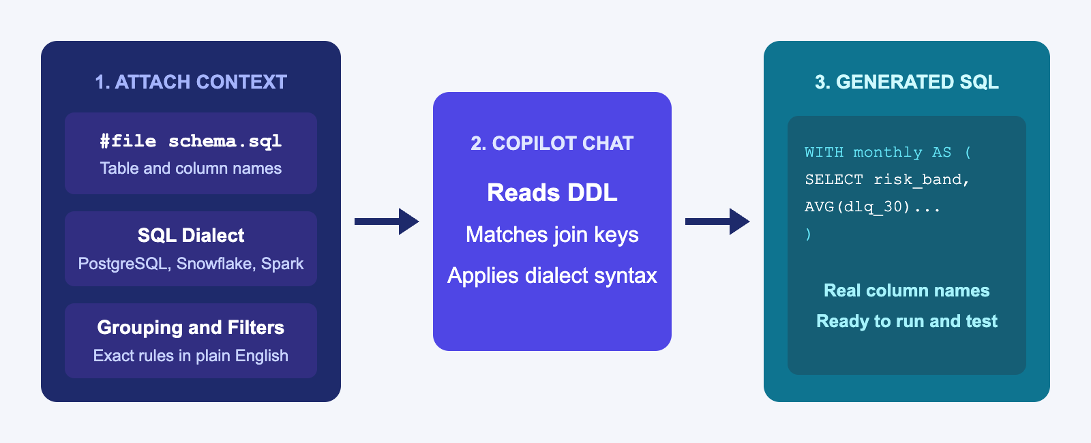
Attach Table Definitions Before You Ask for SQL
Copilot writes broken SQL when it has to guess table names, join keys, or SQL dialects
Keep a schema.sql file with your CREATE TABLE definitions in the project and attach it with #file schema.sql
Name the target SQL dialect (PostgreSQL, Snowflake, T-SQL, or Spark SQL) in the prompt so date functions work on the first run
GitHub Copilot for Credit Analytics and Risk Modeling
© 2026 Copyright ROI Training, Inc.
All rights reserved. Not to be reproduced without prior written consent.
17 of 32

Slide 18
Prompting Copilot for Multi-Step SQL Queries
Break complex analytical SQL prompts into named Common Table Expressions (CTEs) so the generated query is easy to read and verify
Using #file schema.sql, write a Snowflake SQL query with two CTEs:
1. active_accounts: filter monthly_performance to status != 'charged_off'
2. band_summary: group active_accounts by perf_month and risk_band, calculating account count and average 30-day delinquency rate (dpd >= 30)
In the final SELECT, use LAG() over risk_band ordered by perf_month to show month-over-month delinquency change.
Do not invent columns not in schema.sql.
Tip
Store your target SQL dialect in .github/copilot-instructions.md (for example, “Default SQL dialect is Snowflake SQL; prefer CTEs over nested subqueries”) so you do not have to repeat it in every prompt.
GitHub Copilot for Credit Analytics and Risk Modeling
© 2026 Copyright ROI Training, Inc.
All rights reserved. Not to be reproduced without prior written consent.
18 of 32

Slide 19
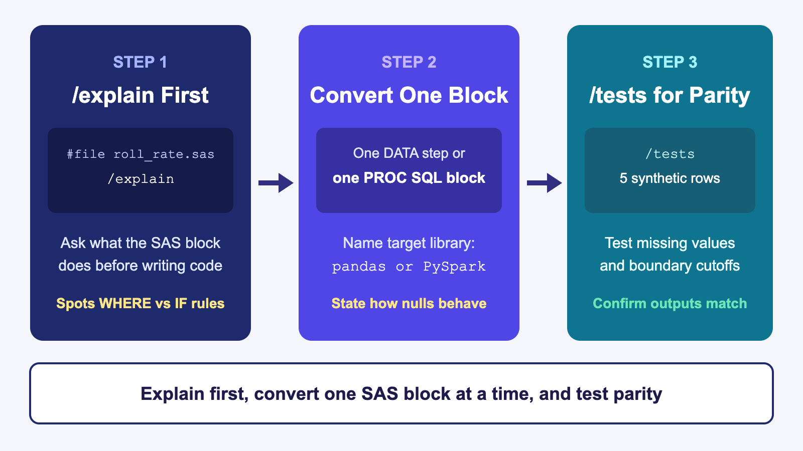
Translate Legacy SAS in Three Copilot Steps
GitHub Copilot for Credit Analytics and Risk Modeling
© 2026 Copyright ROI Training, Inc.
All rights reserved. Not to be reproduced without prior written consent.
19 of 32

Slide 20
SAS to Python: Explain First, Then Translate
Legacy SAS (#file roll_rate.sas)
Two-Step Copilot Chat Sequence
data acct_flags;
set credit.monthly_perf;
where status ne 'CHARGED_OFF';
util_ratio = balance / credit_limit;
if dpd >= 30 then dlq_flag = 1;
else dlq_flag = 0;
run;
Step 1:
/explain #file roll_rate.sas
List how SAS handles missing values in balance / credit_limit and in dpd >= 30.
Step 2:
Translate #file roll_rate.sas into a pandas function build_acct_flags(df).
Ensure null dpd values produce dlq_flag = 0 (matching SAS where missing is less than 0), and add a docstring noting the SAS parity rules.
Important
In SAS, a missing numeric value (.) evaluates as less than any number, while in pandas NaN comparisons return False. Asking /explain about missing values before translating catches this difference every time.
GitHub Copilot for Credit Analytics and Risk Modeling
© 2026 Copyright ROI Training, Inc.
All rights reserved. Not to be reproduced without prior written consent.
20 of 32

Slide 21
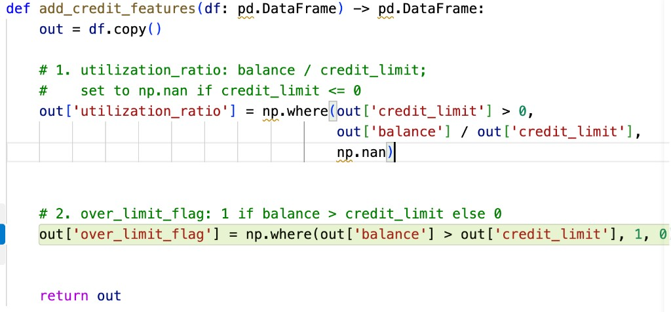
Comment-Driven Code
Inline ghost text is often faster than the Chat
Start with a function signature that includes type hints so Copilot knows you are working on
Write a numbered comment for each step in a function
Press ENTER after each comment, read the gray ghost text, and press TAB to accept
GitHub Copilot for Credit Analytics and Risk Modeling
© 2026 Copyright ROI Training, Inc.
All rights reserved. Not to be reproduced without prior written consent.
21 of 32

Slide 22
What You Type vs What Copilot Completes
What You Type (Comments Only)
After Pressing Tab (Completed Code)
def add_credit_features(df: pd.DataFrame) -> pd.DataFrame:
out = df.copy()
# 1. utilization_ratio: balance / credit_limit;
# set to np.nan if credit_limit <= 0
# 2. over_limit_flag: 1 if balance > credit_limit else 0
return out
def add_credit_features(df: pd.DataFrame) -> pd.DataFrame:
out = df.copy()
# 1. utilization_ratio: balance / credit_limit;
# set to np.nan if credit_limit <= 0
out["utilization_ratio"] = np.where(
out["credit_limit"] > 0,
out["balance"] / out["credit_limit"],
np.nan,
)
# 2. over_limit_flag: 1 if balance > credit_limit else 0
out["over_limit_flag"] = (
out["balance"] > out["credit_limit"]
).astype(int)
return out
GitHub Copilot for Credit Analytics and Risk Modeling
© 2026 Copyright ROI Training, Inc.
All rights reserved. Not to be reproduced without prior written consent.
22 of 32

Slide 23
Demo: Comment-Driven Feature Engineering
In VS Code, create a new file named features.py and type only the imports, function header, and comments below:
import numpy as np
import pandas as pd
def engineer_features(df: pd.DataFrame) -> pd.DataFrame:
out = df.copy()
# Calculate available_credit as credit_limit minus balance, floored at 0
# Create is_delinquent_30 as 1 when delinquency_days >= 30 and delinquency_days <= 365, else 0
# Bucket utilization into 'Low' (<0.3), 'Medium' (0.3 to 0.7), and 'High' (>0.7) using np.select
return out
GitHub Copilot for Credit Analytics and Risk Modeling
© 2026 Copyright ROI Training, Inc.
All rights reserved. Not to be reproduced without prior written consent.
23 of 32
Place your cursor on the blank line below the first comment, wait for Copilot’s gray ghost text, read it, and press TAB to accept.

Slide 24
Chapter 2: Hands-On Lab
Lab: Copilot-Assisted Data Profiling and Hypothesis Generation
Time: 30 minutes
GitHub Copilot for Credit Analytics and Risk Modeling
© 2026 Copyright ROI Training, Inc.
All rights reserved. Not to be reproduced without prior written consent.
24 of 32

Slide 25
What You Learned
Attached schema context with #file so Copilot writes Python code without guessing column names
Prompted Copilot Chat and Inline Chat to generate code
Fed table definitions to Copilot to generate SQL queries
Translated legacy SAS blocks to Python using /explain, scoped prompts, and /tests
Used comment-driven inline completions to build feature engineering pipelines
GitHub Copilot for Credit Analytics and Risk Modeling
© 2026 Copyright ROI Training, Inc.
All rights reserved. Not to be reproduced without prior written consent.
25 of 32

Slide 26
Quiz 1 of 3
When you ask Copilot Chat to write a Python profiling script or SQL query, it keeps inventing column names that do not exist in your dataset. What is the best fix?
A. Paste 10,000 rows of real customer production data into the Chat window
B. Attach a schema file (#file schema.md or #file schema.sql) with the exact column names and types
C. Repeatedly click Regenerate until Copilot guesses the right column names
D. Turn off Copilot Chat and only use inline ghost text
GitHub Copilot for Credit Analytics and Risk Modeling
© 2026 Copyright ROI Training, Inc.
All rights reserved. Not to be reproduced without prior written consent.
26 of 32

Slide 27
Quiz 1: Answer
When you ask Copilot Chat to write a Python profiling script or SQL query, it keeps inventing column names that do not exist in your dataset. What is the best fix?
Correct: B. Attach a schema file (#file schema.md or #file schema.sql) with the exact column names and types.
Copilot cannot guess column names that are not in its active context
A lightweight schema file gives Copilot exact names, types, and value ranges without exposing customer PII
Regenerating without schema context just produces a different set of guessed names
GitHub Copilot for Credit Analytics and Risk Modeling
© 2026 Copyright ROI Training, Inc.
All rights reserved. Not to be reproduced without prior written consent.
27 of 32

Slide 28
Quiz 2 of 3
You already have a working 60-line Python script that loads data and builds a seaborn chart. You only want to rotate the x-axis labels 45 degrees and add a horizontal reference line. Which Copilot workflow is best?
A. Ask the Chat sidebar to rewrite the entire 60-line file from scratch
B. Select just the plotting lines in the editor, press CMD+I or CTL+I for Inline Chat, and ask for those two changes
C. Delete the plotting code and wait for ghost text to guess the new layout
D. Copy the script into the Copilot mobile app
GitHub Copilot for Credit Analytics and Risk Modeling
© 2026 Copyright ROI Training, Inc.
All rights reserved. Not to be reproduced without prior written consent.
28 of 32

Slide 29
Quiz 2: Answer
You already have a working 60-line Python script that loads data and builds a seaborn chart. You only want to rotate the x-axis labels 45 degrees and add a horizontal reference line. Which Copilot workflow is best?
Correct: B. Select just the plotting lines in the editor, press CMD+I or CTRL+I for Inline Chat, and ask for those two changes.
Inline Chat scopes the edit to your highlighted lines and shows a clean in-place diff
Data loading and filtering above the selection stay untouched
Regenerating the whole file in the sidebar risks breaking working code above or below the plot
GitHub Copilot for Credit Analytics and Risk Modeling
© 2026 Copyright ROI Training, Inc.
All rights reserved. Not to be reproduced without prior written consent.
29 of 32

Slide 30
Quiz 3 of 3: Discussion
Prompt
Discuss
A teammate needs to migrate a 400-line legacy SAS script with six DATA steps and two PROC SQL blocks into Python pandas. They paste the entire file into Copilot Chat with the prompt: “Convert this to Python.”
What typically goes wrong when you ask Copilot to translate a 400-line SAS file in a single prompt?
How should they use #file, /explain, and /tests to migrate the script safely?
Which SAS-to-pandas behavior differences should they explicitly mention in their prompt?
GitHub Copilot for Credit Analytics and Risk Modeling
© 2026 Copyright ROI Training, Inc.
All rights reserved. Not to be reproduced without prior written consent.
30 of 32

Slide 31
Quiz 3: Discussion Points
A teammate needs to migrate a 400-line legacy SAS script with six DATA steps and two PROC SQL blocks into Python pandas. They paste the entire file into Copilot Chat with the prompt: “Convert this to Python.”
Strong Answers Mention
Watch For
Run /explain on #file first to map inputs, outputs, and macro variables before generating Python
Accepting a 400-line one-shot translation because the Python syntax looks clean
Translate one DATA step or PROC SQL block at a time into its own function
Ignoring how NaN comparisons in pandas differ from . comparisons in SAS
State how SAS missing values (. evaluating as less than any number) and WHERE vs IF filtering should behave in pandas
Skipping unit tests until all six steps are merged together
Use /tests with synthetic rows after each step to verify parity before moving to the next block
GitHub Copilot for Credit Analytics and Risk Modeling
© 2026 Copyright ROI Training, Inc.
All rights reserved. Not to be reproduced without prior written consent.
31 of 32

Slide 32

Questions and Answers
GitHub Copilot for Credit Analytics and Risk Modeling
© 2026 Copyright ROI Training, Inc.
All rights reserved. Not to be reproduced without prior written consent.
32 of 32

