Slide 1

GitHub Copilot for Credit Analytics and Risk Modeling
Chapter 3: Modeling and Strategy Validation
GitHub Copilot for Credit Analytics and Risk Modeling
© 2026 Copyright ROI Training, Inc.
All rights reserved. Not to be reproduced without prior written consent.
1 of 30

Slide 2

Chapter 3: Objectives
Prompt Copilot Chat to scaffold scikit-learn feature and model pipelines
Use Inline Chat and ghost text to add custom transformers and estimators
Direct Copilot to generate validation scripts, then verify them with /tests
Audit AI-generated modeling code for bugs using /explain and /fix
Extract Jupyter notebook cells into reusable Python modules
GitHub Copilot for Credit Analytics and Risk Modeling
© 2026 Copyright ROI Training, Inc.
All rights reserved. Not to be reproduced without prior written consent.
2 of 30

Slide 3
Chapter Concepts
Generating Model Pipelines
Prompting for Validation and Tests
From Notebooks to Modules
GitHub Copilot for Credit Analytics and Risk Modeling
© 2026 Copyright ROI Training, Inc.
All rights reserved. Not to be reproduced without prior written consent.
3 of 30

Slide 4
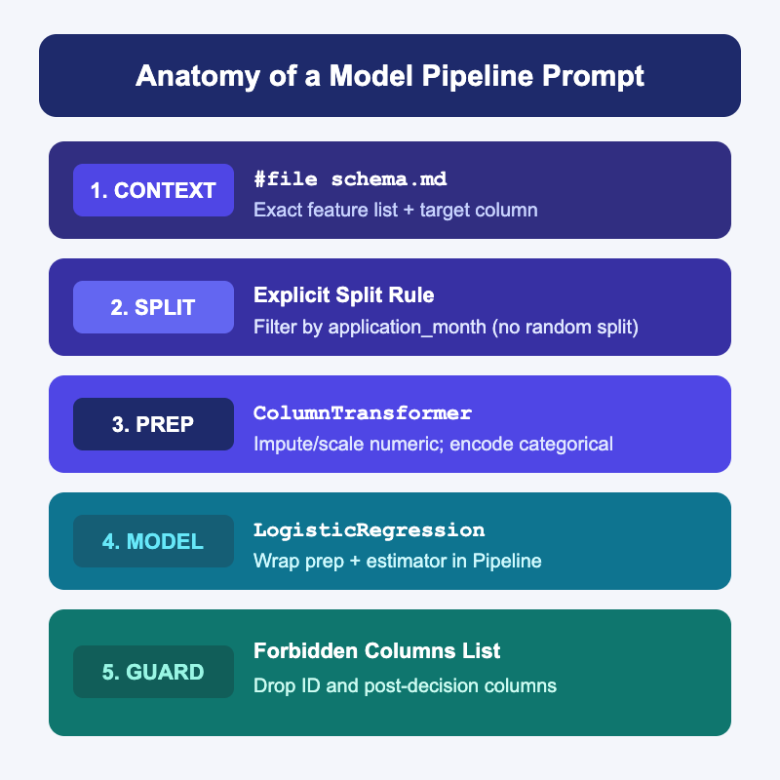
Why Generic Model Prompts Fail in Copilot
Asking Copilot “build a credit risk model” produces a flat script that calls train_test_split randomly and runs fit_transform on the whole table
Copilot defaults to generic Kaggle-style tutorials unless you name the scikit-learn objects and split rules you want
Attach #file schema.md and specify the exact target column, allowed feature list, and date-based split rule
Require a scikit-learn Pipeline and ColumnTransformer so preprocessing only fits on the training fold
GitHub Copilot for Credit Analytics and Risk Modeling
© 2026 Copyright ROI Training, Inc.
All rights reserved. Not to be reproduced without prior written consent.
4 of 30

Slide 5
Weak vs Strong Model Pipeline Prompts
Weak Prompt
Strong Prompt
“Train a logistic regression model on my credit dataset to predict default.”
“Using #file schema.md, create train_pipeline.py with scikit-learn.”
Copilot guesses column names and includes ID or post-decision columns as features
“Split df on application_month < '2025-10' for train and >= '2025-10' for test. Drop account_id and delinquency_days.”
Uses a random split instead of an out-of-time split
“Build a ColumnTransformer (median impute + StandardScaler on numeric; OneHotEncoder(handle_unknown='ignore') on risk_band) inside a Pipeline with LogisticRegression.”
GitHub Copilot for Credit Analytics and Risk Modeling
© 2026 Copyright ROI Training, Inc.
All rights reserved. Not to be reproduced without prior written consent.
5 of 30

Slide 6
Three Copilot Tools for Feature and Model Code
Copilot Chat (#file)
Inline Chat (CMD+I / CTRL+I)
Ghost Text (TAB)
Best for scaffolding a new Pipeline and ColumnTransformer from #file schema.md
Highlight the Pipeline block and press CMD+I (Mac) or CTRL+I (Windows)
Write a comment above a dictionary of hyperparameters or a custom feature formula
Ask to add a FunctionTransformer step or swap LogisticRegression for HistGradientBoostingClassifier
Press Tab to accept the boilerplate lines without leaving the editor
Generates the full training script and file structure in one pass
GitHub Copilot for Credit Analytics and Risk Modeling
© 2026 Copyright ROI Training, Inc.
All rights reserved. Not to be reproduced without prior written consent.
6 of 30

Slide 7
Adding a Custom Feature Step with Inline Chat
Once your baseline Pipeline runs, use Inline Chat to insert custom feature transformers without rewriting the script
Select the code block in the editor and describe the exact transformation to add
Add a FunctionTransformer step before scaling that caps utilization at 1.0
and creates a binary column util_missing_flag before median imputation.
Keep the existing OneHotEncoder step unchanged.
Tip
Tell Copilot which pipeline steps must stay unchanged so your diff stays limited to the new logic.
GitHub Copilot for Credit Analytics and Risk Modeling
© 2026 Copyright ROI Training, Inc.
All rights reserved. Not to be reproduced without prior written consent.
7 of 30

Slide 8
Demo: Building a Baseline Pipeline via Copilot Chat
In VS Code, create or update schema.md so it includes a binary target column and an application month:
# Credit Modeling Schema (modeling_accounts.csv)
- `account_id` (string): unique identifier (exclude from features)
- `application_month` (string): YYYY-MM format from 2025-01 to 2025-12
- `risk_band` (string): Prime, Near-Prime, or Subprime
- `balance` (float): balance at application in USD
- `credit_limit` (float): credit limit at application in USD
- `utilization` (float): ratio 0.0 to 1.0 (may contain nulls)
- `default_60d` (int): 1 if 60+ days past due within 12 months, else 0 (target)
Open Copilot Chat (</> Agent in Interactive mode), attach #file schema.md, and run this prompt:
Using #file schema.md, create train_baseline.py.
1. Include a helper make_synthetic_modeling_data() that generates modeling_accounts.csv with 300 rows across 2025-01 to 2025-12, including 15 null utilization values.
2. Split rows where application_month < '2025-10' into train and >= '2025-10' into test.
3. Exclude account_id, application_month, and default_60d from the feature list.
4. Build a scikit-learn Pipeline with ColumnTransformer (SimpleImputer(strategy='median') and StandardScaler for numeric columns; OneHotEncoder(handle_unknown='ignore') for risk_band) and LogisticRegression().
5. Fit on train, predict probabilities on test, and print train/test row counts and test ROC AUC.
GitHub Copilot for Credit Analytics and Risk Modeling
© 2026 Copyright ROI Training, Inc.
All rights reserved. Not to be reproduced without prior written consent.
8 of 30

Slide 9
Chapter Concepts
Generating Model Pipelines
Prompting for Validation and Tests
From Notebooks to Modules
GitHub Copilot for Credit Analytics and Risk Modeling
© 2026 Copyright ROI Training, Inc.
All rights reserved. Not to be reproduced without prior written consent.
9 of 30

Slide 10
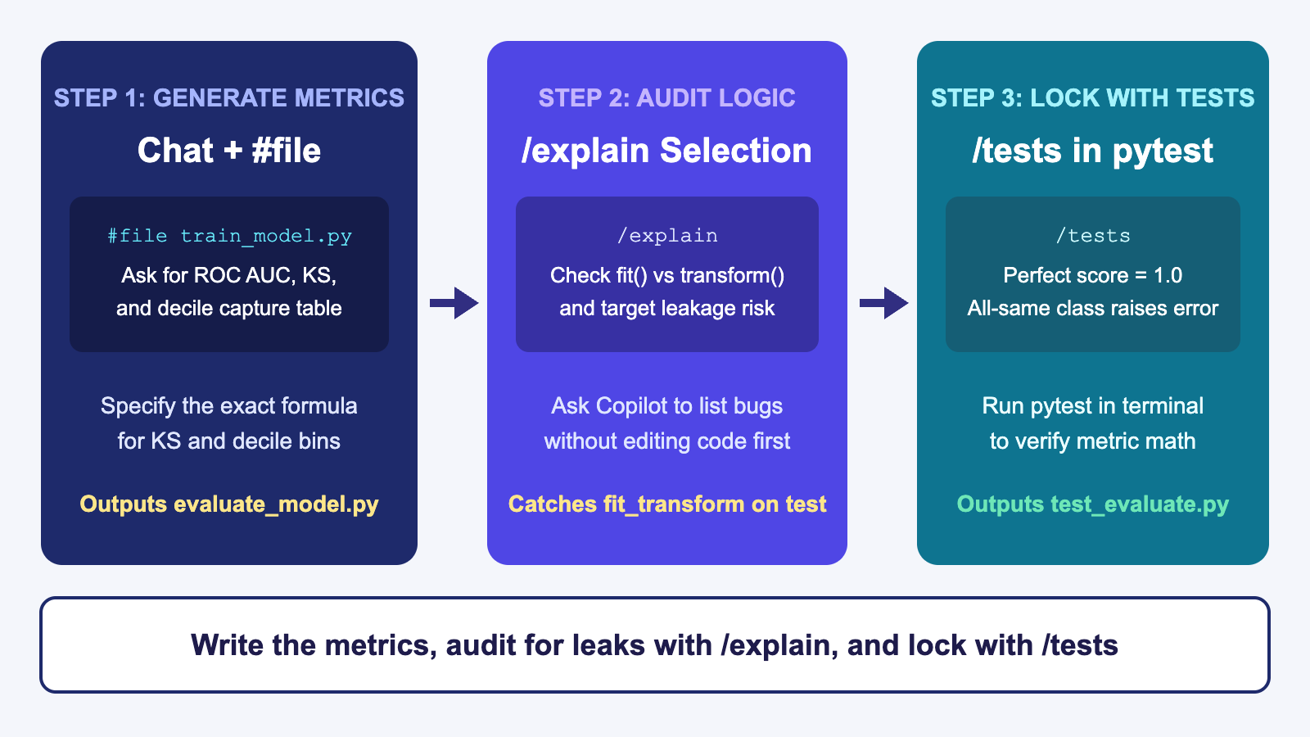
Three-Step Copilot Workflow for Validation
GitHub Copilot for Credit Analytics and Risk Modeling
© 2026 Copyright ROI Training, Inc.
All rights reserved. Not to be reproduced without prior written consent.
10 of 30

Slide 11
Prompting Copilot for Credit Validation Metrics
If you ask Copilot to “evaluate the model,” it defaults to accuracy_score and a confusion matrix at a 0.50 threshold
Credit risk validation uses rank-ordering and probability calibration (ROC AUC, KS statistic, Brier score, and decile capture tables)
Spell out the exact formula for custom metrics like KS so Copilot does not guess or import a library you do not have installed
Using #file train_baseline.py, create evaluate_model.py with two functions:
1. compute_ks(y_true, y_prob): sort by y_prob descending and return the maximum absolute difference between cumulative bad rate and cumulative good rate.
2. build_decile_table(y_true, y_prob): bin predictions into 10 equal-sized deciles (1 = highest predicted risk) and return a DataFrame with account_count, bad_count, actual_bad_rate, mean_predicted_prob, and cumulative_bad_capture.
GitHub Copilot for Credit Analytics and Risk Modeling
© 2026 Copyright ROI Training, Inc.
All rights reserved. Not to be reproduced without prior written consent.
11 of 30

Slide 12
Using /tests to Verify Validation Math
Perfect Separation Check
Decile Row and Order Check
Edge-Case Input Check
Select compute_ks and run /tests in Chat.
Select build_decile_table and run /tests.
Ask Copilot to add pytest cases for an empty array, NaN probabilities, and a holdout set with zero defaults (y_true all zeros).
Ask for a synthetic test where all bad accounts have y_prob = 0.9 and all good accounts have y_prob = 0.1, asserting KS == 1.0.
Assert that the output has exactly 10 rows, decile 1 has the highest mean_predicted_prob, and account_count.sum() == len(y_true).
Verify that the function raises a clear ValueError instead of returning silent NaN values.
GitHub Copilot for Credit Analytics and Risk Modeling
© 2026 Copyright ROI Training, Inc.
All rights reserved. Not to be reproduced without prior written consent.
12 of 30

Slide 13
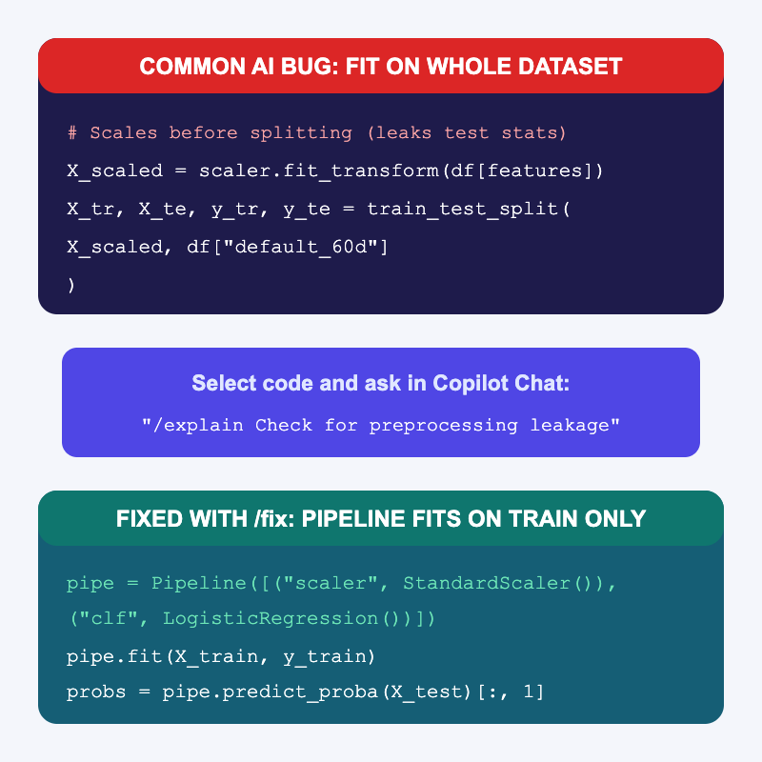
Auditing Copilot Code with /explain and /fix
Even when AI-generated model code runs without errors, it can hide target leakage or silent row drops
Select the pipeline and split code, then use /explain with a targeted audit checklist before running /fix
GitHub Copilot for Credit Analytics and Risk Modeling
© 2026 Copyright ROI Training, Inc.
All rights reserved. Not to be reproduced without prior written consent.
13 of 30

Slide 14
Four Audit Questions to Paste into Copilot Chat
Bug to Catch | Prompt to Run on #selection or #file
Preprocessing leakage | /explain Does any imputer, scaler, or encoder call fit or fit_transform before the train/test split?
Feature leakage | /explain List every column passed into X_train and flag any ID, date, or post-decision outcome column.
Random split on time data | /explain How are train and test split? Could rows from a later application_month appear in X_train?
Silent row drops | /explain Does the script drop rows with nulls in y_test or X_test without reporting how many were dropped?
Important
Ask Copilot to report only first (“List any issues; do not edit code yet”). Once you confirm the bug, highlight the offending lines and use /fix or Inline Chat for a surgical fix.
GitHub Copilot for Credit Analytics and Risk Modeling
© 2026 Copyright ROI Training, Inc.
All rights reserved. Not to be reproduced without prior written consent.
14 of 30

Slide 15
Demo: Auditing a Leaky Model Script with Copilot
In VS Code, create leaky_model.py and paste this intentionally flawed script:
import pandas as pd
from sklearn.linear_model import LogisticRegression
from sklearn.metrics import roc_auc_score
from sklearn.model_selection import train_test_split
from sklearn.preprocessing import StandardScaler
df = pd.read_csv("modeling_accounts.csv").dropna()
features = ["balance", "credit_limit", "utilization", "default_60d"]
scaler = StandardScaler()
X_scaled = scaler.fit_transform(df[features])
X_train, X_test, y_train, y_test = train_test_split(X_scaled, df["default_60d"], test_size=0.2)
clf = LogisticRegression().fit(X_train, y_train)
print("AUC:", roc_auc_score(y_test, clf.predict_proba(X_test)[:, 1]))
GitHub Copilot for Credit Analytics and Risk Modeling
© 2026 Copyright ROI Training, Inc.
All rights reserved. Not to be reproduced without prior written consent.
15 of 30

Slide 16
Chapter Concepts
Generating Model Pipelines
Prompting for Validation and Tests
From Notebooks to Modules
GitHub Copilot for Credit Analytics and Risk Modeling
© 2026 Copyright ROI Training, Inc.
All rights reserved. Not to be reproduced without prior written consent.
16 of 30

Slide 17
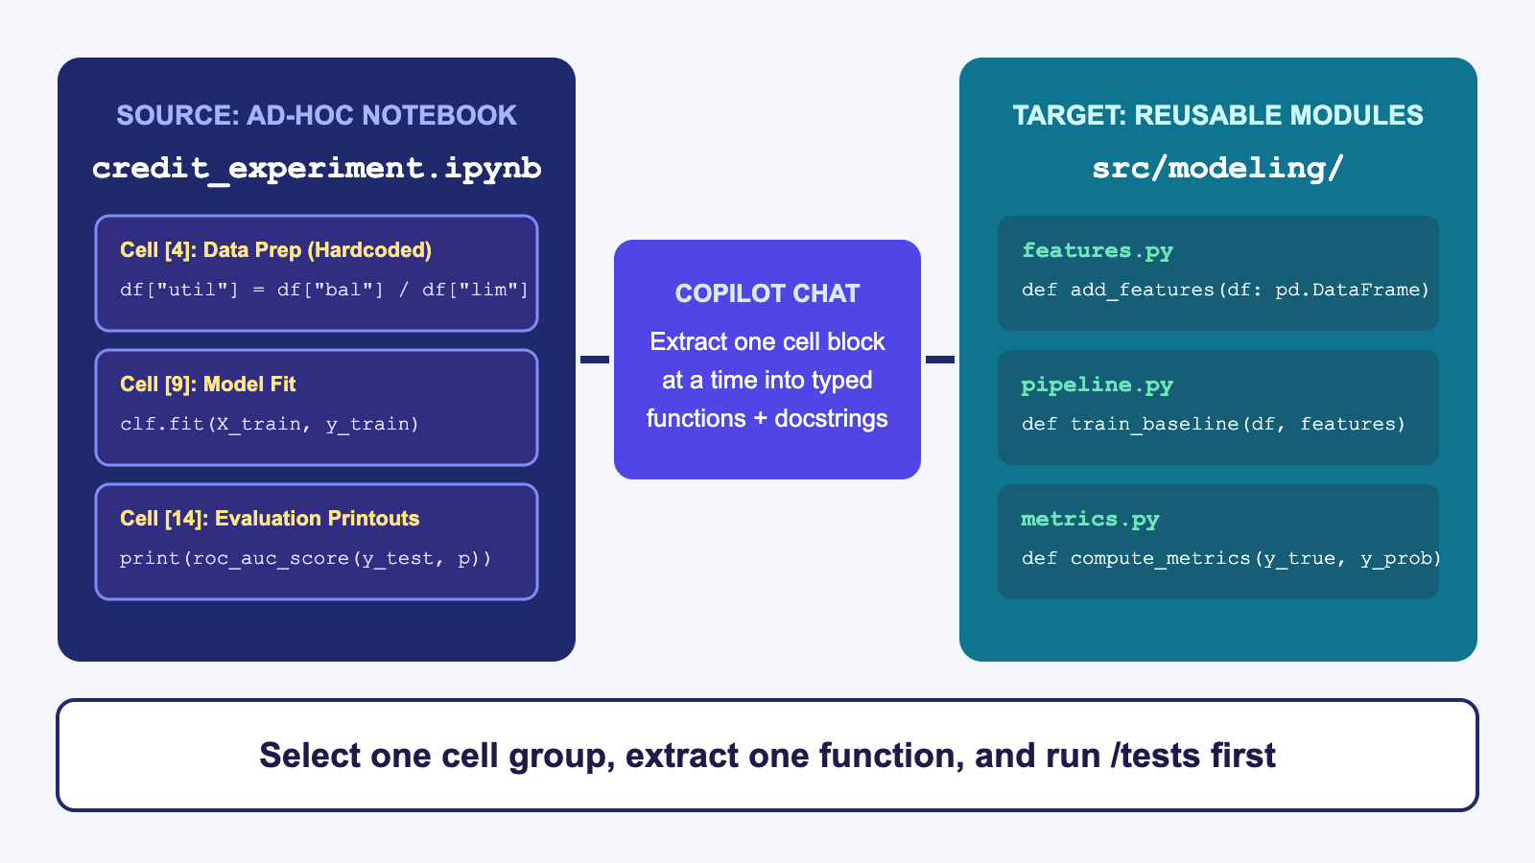
Extracting Notebooks into Modules One Block at a Time
GitHub Copilot for Credit Analytics and Risk Modeling
© 2026 Copyright ROI Training, Inc.
All rights reserved. Not to be reproduced without prior written consent.
17 of 30

Slide 18
How to Refactor a Notebook with Copilot
What Happens When You Prompt All at Once
The Staged Copilot Workflow
“Convert #file notebook.ipynb into a Python package”
Step 1: Attach #file notebook.ipynb in Chat (or press CMD+I / CTRL+I inside an individual notebook cell) and ask for a module extraction plan (no code yet)
Copilot merges cells, renames variables mid-flight, and drops filter steps
Gives you a 300-line diff that is impossible to verify against the notebook
Step 2: Select one logical cell group (such as feature prep) and prompt Chat to extract it into src/features.py with type hints
Step 3: Run /tests on src/features.py and verify output parity before extracting the next cell group
GitHub Copilot for Credit Analytics and Risk Modeling
© 2026 Copyright ROI Training, Inc.
All rights reserved. Not to be reproduced without prior written consent.
18 of 30

Slide 19
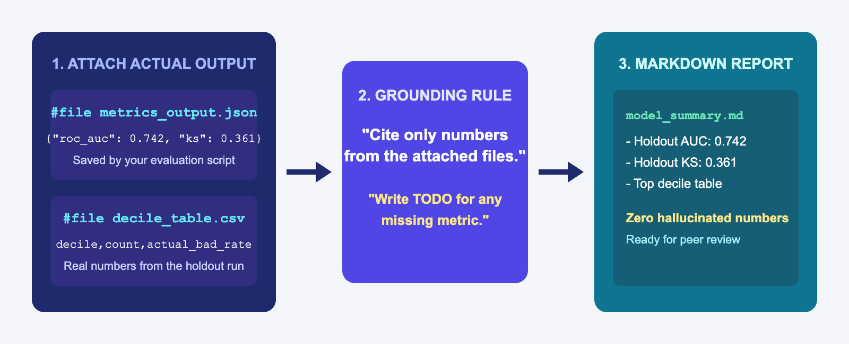
Grounding Copilot When Summarizing Model Output
If you ask Copilot to “write a validation summary report” with no data attached, it invents plausible-sounding AUC and KS numbers
Always save your script’s actual metrics to a file (metrics_output.json or decile_table.csv) and attach that file with #file
Add an explicit grounding constraint: “Use only numbers present in #file metrics_output.json; mark any missing item as TODO”
GitHub Copilot for Credit Analytics and Risk Modeling
© 2026 Copyright ROI Training, Inc.
All rights reserved. Not to be reproduced without prior written consent.
19 of 30

Slide 20
Prompting for a Grounded Validation Summary
Using #file metrics_output.json, #file decile_table.csv, and #file train_baseline.py,
create validation_summary.md with these sections:
1. Model Overview (target column, train/test split dates, and feature list read from train_baseline.py)
2. Holdout Metrics (exact ROC AUC and KS from metrics_output.json)
3. Decile Capture Table (formatted as a Markdown table from decile_table.csv)
4. Open Questions / TODOs (leave threshold selection and business sign-off as TODO)
Rule: Do not invent any metric values. If a metric is not in metrics_output.json, write TODO.
Warning
Always compare every number in the generated Markdown table against metrics_output.json and decile_table.csv before sharing the file.
GitHub Copilot for Credit Analytics and Risk Modeling
© 2026 Copyright ROI Training, Inc.
All rights reserved. Not to be reproduced without prior written consent.
20 of 30

Slide 21
Demo: Generate and Summarize Validation Output
In VS Code, open Copilot Chat (</> Agent in Interactive mode) and attach #file train_baseline.py from earlier.
Prompt Copilot to add evaluation output saving at the bottom of train_baseline.py:
Update #file train_baseline.py so that after scoring the test set, it:
1. Computes test ROC AUC, KS statistic, and a 10-bin decile table.
2. Writes train_rows, test_rows, roc_auc, and ks to metrics_output.json.
3. Writes the decile table to decile_table.csv.
Run python train_baseline.py so metrics_output.json and decile_table.csv are created on disk.
In Copilot Chat, attach #file metrics_output.json and #file decile_table.csv, and prompt Copilot to generate validation_summary.md using only the numbers in those two files.
GitHub Copilot for Credit Analytics and Risk Modeling
© 2026 Copyright ROI Training, Inc.
All rights reserved. Not to be reproduced without prior written consent.
21 of 30

Slide 22
Chapter 3: Hands-On Lab
Lab: AI-Assisted Model and Strategy Validation
Time: 30 minutes
GitHub Copilot for Credit Analytics and Risk Modeling
© 2026 Copyright ROI Training, Inc.
All rights reserved. Not to be reproduced without prior written consent.
22 of 30

Slide 23
What You Learned
Prompted Copilot Chat to scaffold scikit-learn feature and model pipelines
Used Inline Chat and ghost text to add custom transformers and estimators
Directed Copilot to generate validation scripts, then verify them with /tests
Audited AI-generated modeling code for bugs using /explain and /fix
Extracted Jupyter notebook cells into reusable Python modules
GitHub Copilot for Credit Analytics and Risk Modeling
© 2026 Copyright ROI Training, Inc.
All rights reserved. Not to be reproduced without prior written consent.
23 of 30

Slide 24
Quiz 1 of 3
When you ask Copilot Chat to generate a model training script with a vague prompt like “Train a model on my dataset,” what does Copilot typically generate?
A. An out-of-time split with a ColumnTransformer tailored to your exact credit policy
B. A generic script with a random train_test_split, guessed column names, and risk of fitting preprocessors on the full dataset
C. A syntax error, because Copilot cannot write scikit-learn code
D. A pre-populated metrics_output.json file from your production database
GitHub Copilot for Credit Analytics and Risk Modeling
© 2026 Copyright ROI Training, Inc.
All rights reserved. Not to be reproduced without prior written consent.
24 of 30

Slide 25
Quiz 1: Answer
When you ask Copilot Chat to generate a model training script with a vague prompt like “Train a model on my dataset,” what does Copilot typically generate?
Correct: B. A generic script with a random train_test_split, guessed column names, and risk of fitting preprocessors on the full dataset.
Without #file schema.md and explicit split instructions, Copilot falls back to generic tutorial patterns
Naming the date-split column, forbidden columns, and scikit-learn Pipeline structure in your prompt prevents preprocessing leakage
You can then use /explain to audit the generated script before trusting its output
GitHub Copilot for Credit Analytics and Risk Modeling
© 2026 Copyright ROI Training, Inc.
All rights reserved. Not to be reproduced without prior written consent.
25 of 30

Slide 26
Quiz 2 of 3
You want Copilot Chat to draft a Markdown summary of your model’s holdout performance (ROC AUC, KS, and decile table) without hallucinating any numbers. How should you prompt it?
A. Ask Copilot to estimate typical credit card AUC and KS values for a baseline logistic regression model
B. Attach #file train_baseline.py only and ask Copilot to predict what the metrics will be when the code runs
C. Save the actual run metrics to metrics_output.json and decile_table.csv, attach both files with #file, and instruct Copilot to cite only numbers from those files (marking missing items as TODO)
D. Use inline ghost text inside an empty Markdown file with no context files open
GitHub Copilot for Credit Analytics and Risk Modeling
© 2026 Copyright ROI Training, Inc.
All rights reserved. Not to be reproduced without prior written consent.
26 of 30

Slide 27
Quiz 2: Answer
You want Copilot Chat to draft a Markdown summary of your model’s holdout performance (ROC AUC, KS, and decile table) without hallucinating any numbers. How should you prompt it?
Correct: C. Save the actual run metrics to metrics_output.json and decile_table.csv, attach both files with #file, and instruct Copilot to cite only numbers from those files (marking missing items as TODO).
Copilot cannot execute your model in its head; if no output file is in context, it will invent placeholder numbers
Attaching the saved JSON and CSV files gives Copilot the exact figures from your test run
Instructing Copilot to write TODO for missing items stops it from guessing uncomputed metrics
GitHub Copilot for Credit Analytics and Risk Modeling
© 2026 Copyright ROI Training, Inc.
All rights reserved. Not to be reproduced without prior written consent.
27 of 30

Slide 28
Quiz 3 of 3: Discussion
Prompt
Discuss
A teammate has a 25-cell Jupyter notebook (experiment.ipynb) that loads data, engineers features, fits a gradient boosting model, and prints validation metrics. They want to use Copilot to turn it into clean, tested Python modules under src/.
Why is pasting the whole notebook with “Convert this to a Python package” risky?
How should they sequence Copilot Chat, #file, and /tests to extract the code safely?
How can they verify that the extracted functions produce the exact same outputs as the notebook cells?
GitHub Copilot for Credit Analytics and Risk Modeling
© 2026 Copyright ROI Training, Inc.
All rights reserved. Not to be reproduced without prior written consent.
28 of 30

Slide 29
Quiz 3: Discussion Points
A teammate has a 25-cell Jupyter notebook (experiment.ipynb) that loads data, engineers features, fits a gradient boosting model, and prints validation metrics. They want to use Copilot to turn it into clean, tested Python modules under src/.
Strong Answers Mention
Watch For
Ask Copilot Chat to read #file experiment.ipynb and propose an extraction plan before writing any code
Extracting all 25 cells in a single prompt and trying to debug a giant multi-file diff at the end
Allowing Copilot to change feature formulas or imputation rules while refactoring notebook code into functions
Extract one cell group at a time (for example, features.py first, then pipeline.py, then evaluate.py)
Deleting notebook cells before verifying that the new module produces identical results
Run /tests after each extracted module to lock behavior with unit tests before moving to the next cell group
GitHub Copilot for Credit Analytics and Risk Modeling
© 2026 Copyright ROI Training, Inc.
All rights reserved. Not to be reproduced without prior written consent.
29 of 30
Compare row counts, feature values, and metric outputs between the notebook and the new module to confirm parity

Slide 30

Questions and Answers
GitHub Copilot for Credit Analytics and Risk Modeling
© 2026 Copyright ROI Training, Inc.
All rights reserved. Not to be reproduced without prior written consent.
30 of 30

