Slide 1

GitHub Copilot for Credit Analytics and Risk Modeling
Chapter 4: Agentic Governance and Code Lifecycle
GitHub Copilot for Credit Analytics and Risk Modeling
© 2026 Copyright ROI Training, Inc.
All rights reserved. Not to be reproduced without prior written consent.
1 of 28

Slide 2

Chapter 4: Objectives
Refactor, modularize, and vectorize slow Python analytics scripts
Prompt Copilot to add defensive assertions and pytest suites
Use plan-first prompts, single-step approvals, and VS Code diff reviews
Build reusable .github/prompts/*.prompt.md templates and .github/skills/ governance playbooks
Generate grounded Model Cards, technical specifications, and docstrings
GitHub Copilot for Credit Analytics and Risk Modeling
© 2026 Copyright ROI Training, Inc.
All rights reserved. Not to be reproduced without prior written consent.
2 of 28

Slide 3
Chapter Concepts
AI-Powered Code Maintenance
Human-in-the-Loop
Automated Documentation
GitHub Copilot for Credit Analytics and Risk Modeling
© 2026 Copyright ROI Training, Inc.
All rights reserved. Not to be reproduced without prior written consent.
3 of 28

Slide 4
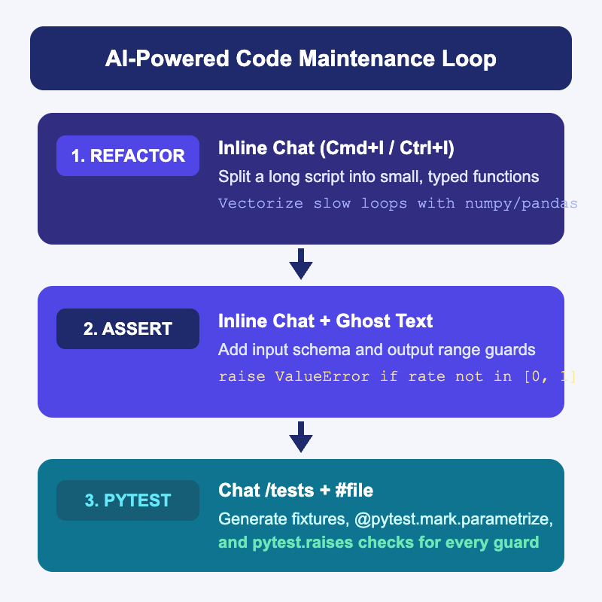
Three Copilot Workflows for Code Maintenance
Analytical scripts often start as long, single-file prototypes with slow row loops, no runtime checks, and zero tests
Use Inline Chat to split monolithic functions and replace loops with vectorized pandas or numpy
Use Inline Chat or ghost text to insert defensive ValueError guards right above and below numerical calculations
Use Copilot Chat to generate a complete pytest suite that tests both normal math and every new assertion
GitHub Copilot for Credit Analytics and Risk Modeling
© 2026 Copyright ROI Training, Inc.
All rights reserved. Not to be reproduced without prior written consent.
4 of 28

Slide 5
Refactoring and Optimizing with Inline Chat
Splitting a Long Function
Vectorizing a Slow Loop
Highlight the 80-line function in VS Code and press CMD+I (Mac) or CTRL+I (Windows)
Highlight a slow for idx, row in df.iterrows(): block and open Inline Chat
Prompt: “Split this into filter_active_accounts(df) and compute_band_rates(df) with type hints. Do not change the math or column names.”
Prompt: “Replace this iterrows() loop with vectorized np.select or pandas operations that produce identical values, including for NaN rows.”
Ask /tests for a parity test comparing the old function and new function on 20 synthetic rows
Review the side-by-side diff in the editor before clicking Accept
GitHub Copilot for Credit Analytics and Risk Modeling
© 2026 Copyright ROI Training, Inc.
All rights reserved. Not to be reproduced without prior written consent.
5 of 28

Slide 6
Prompting Copilot for Defensive Assertions
Input Schema Guard
Grain and Denominator Guard
Statistical Output Guard
Select the top of your function in Inline Chat and ask Copilot to check required columns.
Place your cursor after the rate calculation and write a comment for ghost text.
Ask Copilot to assert that (account_id, perf_month) has no duplicate rows.
Raise a ValueError listing any missing column names before running calculations.
Raise a ValueError if any computed delinquency or loss rate is NaN, below 0.0, or above 1.0.
Raise a ValueError if filtering out charged_off rows leaves an empty denominator (len(active) == 0).
GitHub Copilot for Credit Analytics and Risk Modeling
© 2026 Copyright ROI Training, Inc.
All rights reserved. Not to be reproduced without prior written consent.
6 of 28

Slide 7
Generating Comprehensive pytest Suites with /tests
Typing /tests alone often produces only one happy-path test; always pair /tests with explicit edge cases and pytest features
/tests #file src/monitoring/risk_rollup.py
Create tests/test_risk_rollup.py using pytest:
1. Add a @pytest.fixture with 8 synthetic account rows covering Prime, Near-Prime, and Subprime, including 1 charged_off row and 1 null balance.
2. Use @pytest.mark.parametrize to test normal rate calculations across risk bands.
3. Use pytest.raises(ValueError) to test missing required columns, duplicate (account_id, perf_month) keys, an all-charged-off denominator, and a rate outside [0, 1].
Tip
Add “Use @pytest.fixture with synthetic rows and pytest.raises for all ValueError guards” to .github/copilot-instructions.md so /tests follows this standard automatically.
GitHub Copilot for Credit Analytics and Risk Modeling
© 2026 Copyright ROI Training, Inc.
All rights reserved. Not to be reproduced without prior written consent.
7 of 28

Slide 8
Demo: Refactoring, Asserting, and Testing with Copilot
In VS Code, create risk_rollup.py and paste this unguarded, loop-heavy function:
import pandas as pd
def calc_delinquency(df):
rates = {}
for band in df["risk_band"].unique():
sub = df[df["risk_band"] == band]
active = 0
bad = 0
for _, row in sub.iterrows():
if row["status"] != "charged_off":
active += 1
if row["dpd"] >= 30:
bad += 1
rates[band] = bad / active
return pd.Series(rates, name="dlq_30_rate")
GitHub Copilot for Credit Analytics and Risk Modeling
© 2026 Copyright ROI Training, Inc.
All rights reserved. Not to be reproduced without prior written consent.
8 of 28

Slide 9
Chapter Concepts
AI-Powered Code Maintenance
Human-in-the-Loop
Automated Documentation
GitHub Copilot for Credit Analytics and Risk Modeling
© 2026 Copyright ROI Training, Inc.
All rights reserved. Not to be reproduced without prior written consent.
9 of 28

Slide 10
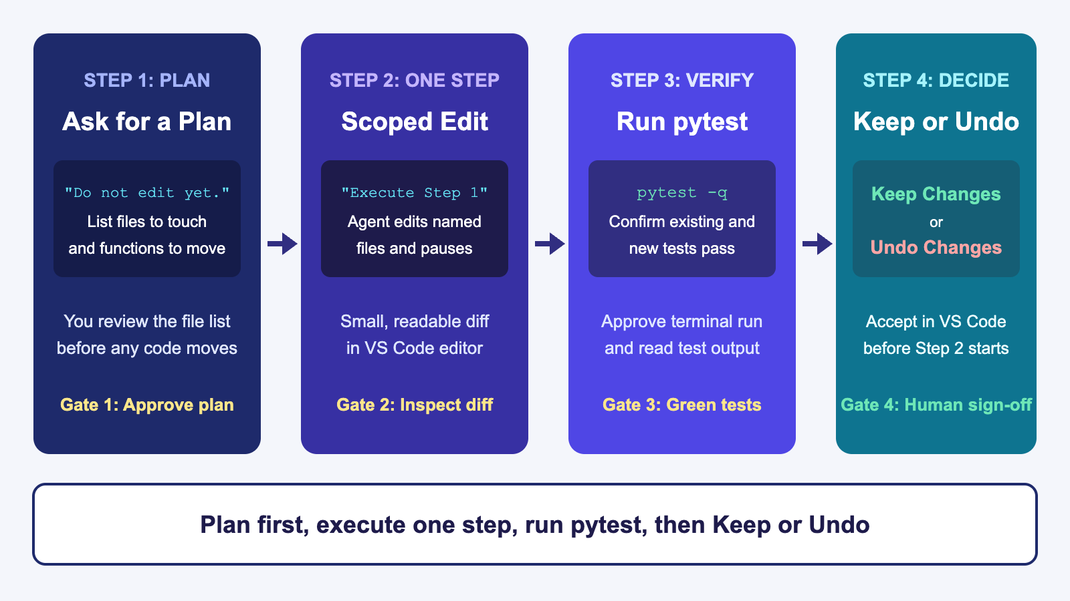
Driving Copilot Agent Mode with Human Gates
GitHub Copilot for Credit Analytics and Risk Modeling
© 2026 Copyright ROI Training, Inc.
All rights reserved. Not to be reproduced without prior written consent.
10 of 28

Slide 11
Autopilot Prompt vs Plan Mode + Interactive Prompt
Unconstrained Autopilot Prompt (Risky)
Plan Mode + Interactive Prompt (Controlled)
“Clean up our monitoring scripts, reorganize the files, and fix any issues you see.”
Switch the Agent mode menu (speech bubble icon) to Plan (or keep Interactive with Manual permissions)
Edits 6 files at once, renames public functions, and alters metric filters without pausing
Prompt: “Read #file risk_rollup.py and #file test_risk_rollup.py. Propose a 3-step plan to extract validation guards into validators.py. List the files each step touches and wait for my approval.”
Leaves you with a sprawling diff where a formula bug can hide inside formatting changes
Review the plan, then execute one step at a time and run pytest
GitHub Copilot for Credit Analytics and Risk Modeling
© 2026 Copyright ROI Training, Inc.
All rights reserved. Not to be reproduced without prior written consent.
11 of 28

Slide 12
Using VS Code’s Review Controls in Agent Mode
When Copilot Agent edits files in your workspace, VS Code displays inline diffs and an action bar (Keep or Undo) for every modified file
Never click Keep All before expanding each modified file and running pytest
VS Code Agent Control | How to Use It During Review
Agent mode menu (Interactive / Plan) | Use Plan to review the step list before any edits, and Interactive for step-by-step collaboration.
Permissions (Manual) | Keep set to Manual so Copilot must ask before running terminal commands or modifying outside files.
File change list and inline diffs (Keep / Undo) | Click each modified file to inspect the side-by-side diff; click Undo on any file you did not authorize Copilot to touch.
Important
If Agent mode modifies a test just to make a broken formula pass, click Undo on the test file immediately and narrow your prompt.
GitHub Copilot for Credit Analytics and Risk Modeling
© 2026 Copyright ROI Training, Inc.
All rights reserved. Not to be reproduced without prior written consent.
12 of 28

Slide 13
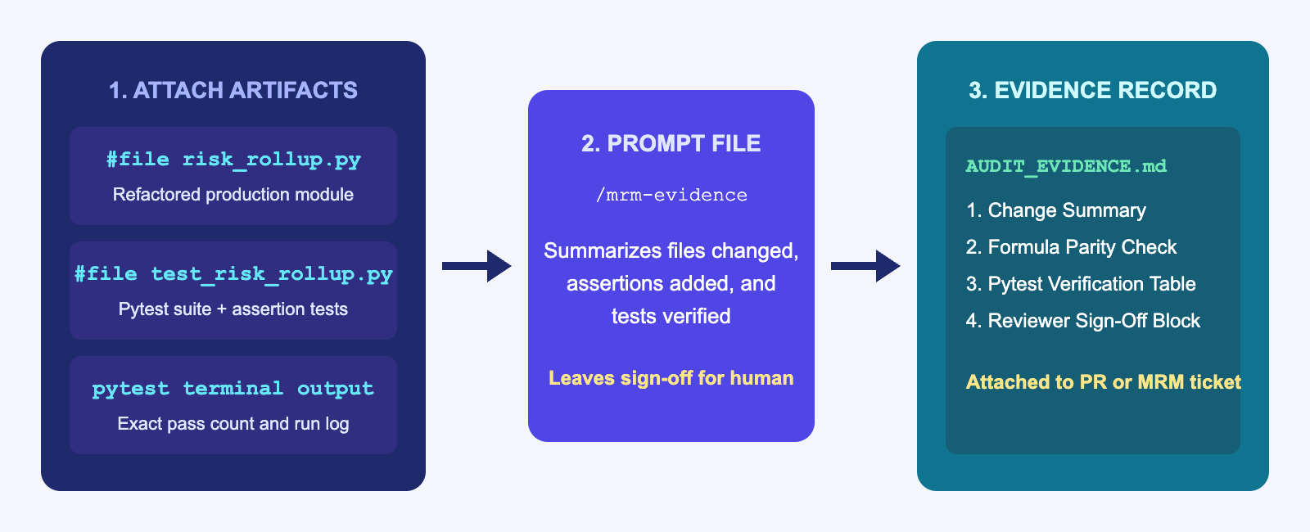
Generating MRM Audit Evidence with a Prompt File
Model Risk Management (MRM) reviewers need a clear record of what changed, whether business formulas moved, and which tests verified the change
Instead of writing audit notes from scratch, store a reusable prompt template at .github/prompts/mrm-evidence.prompt.md
Attach the code file, test file, and pytest output, then run /mrm-evidence in Copilot Chat
GitHub Copilot for Credit Analytics and Risk Modeling
© 2026 Copyright ROI Training, Inc.
All rights reserved. Not to be reproduced without prior written consent.
13 of 28

Slide 14
Creating .github/prompts/mrm-evidence.prompt.md
Save this reusable prompt file in .github/prompts/mrm-evidence.prompt.md and run it by typing /mrm-evidence in Chat:
# Prompt File: .github/prompts/mrm-evidence.prompt.md
Using the attached code file, test file, and pytest terminal output, generate `AUDIT_EVIDENCE.md` with:
1. **Scope of Change**: List every function modified or added.
2. **Formula and Denominator Parity**: State whether any filter, grain, or rate formula changed.
3. **Runtime Assertions Added**: List each `ValueError` check and the condition that triggers it.
4. **Test Verification**: Table of `pytest` test names, what each verifies, and pass/fail status from the attached run.
5. **Human Sign-Off Checklist**: Leave reviewer name, date, and approval decision as `TODO`.
Rule: Do not invent test results or claim a model is "Approved."
Tip
GitHub Copilot for Credit Analytics and Risk Modeling
© 2026 Copyright ROI Training, Inc.
All rights reserved. Not to be reproduced without prior written consent.
14 of 28
When an MRM workflow needs bundled Markdown templates, checklists, or validation scripts alongside instructions, package it as an Agent Skill in .github/skills/mrm-governance/SKILL.md so Copilot loads the playbook and templates automatically.

Slide 15
Chapter Concepts
AI-Powered Code Maintenance
Human-in-the-Loop
Automated Documentation
GitHub Copilot for Credit Analytics and Risk Modeling
© 2026 Copyright ROI Training, Inc.
All rights reserved. Not to be reproduced without prior written consent.
15 of 28

Slide 16
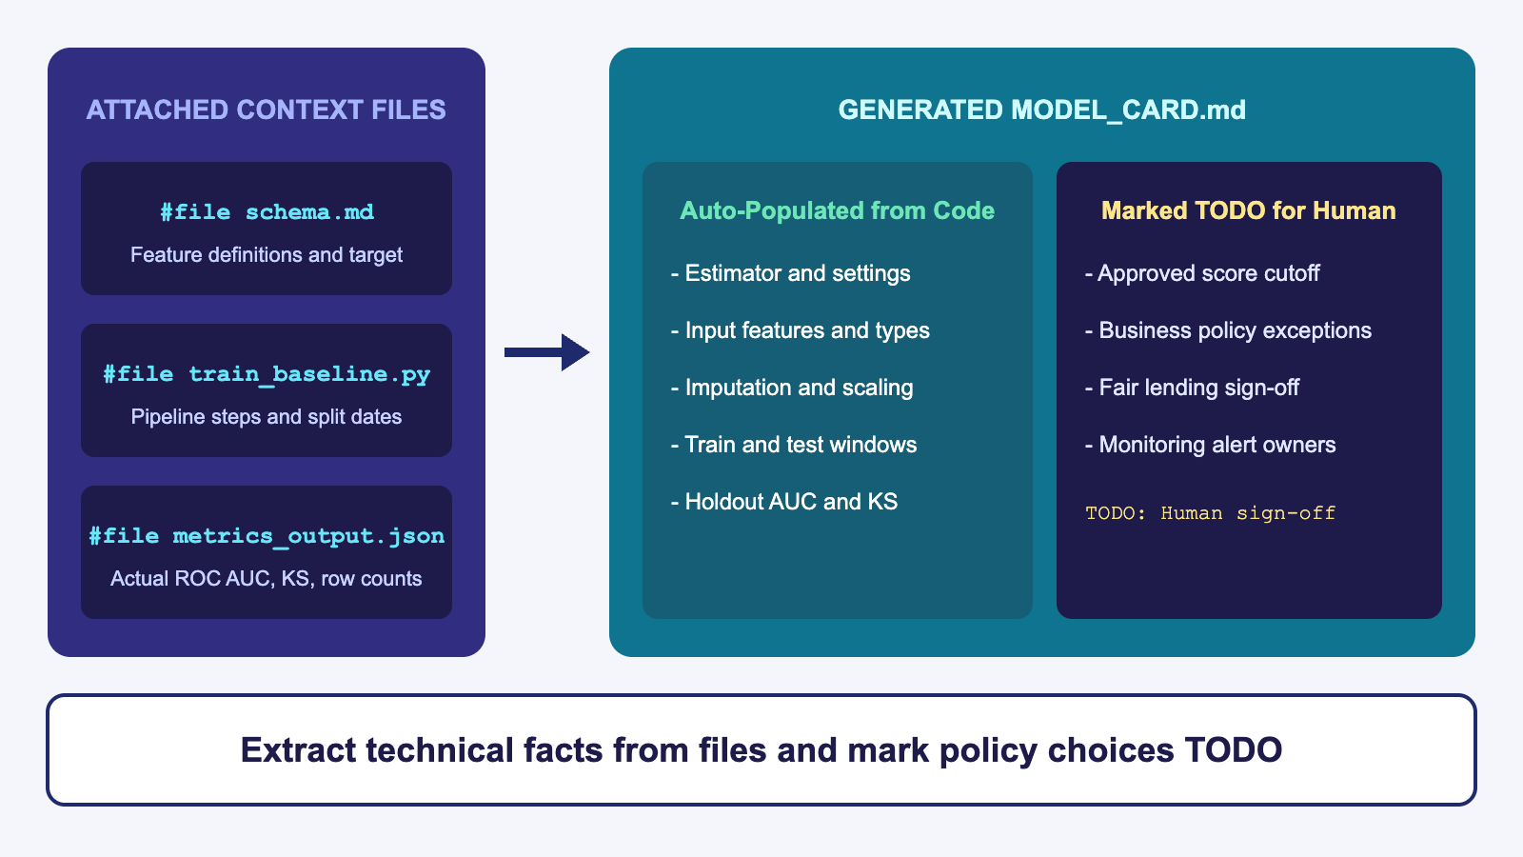
Generating Grounded Model Cards from Code and Output
GitHub Copilot for Credit Analytics and Risk Modeling
© 2026 Copyright ROI Training, Inc.
All rights reserved. Not to be reproduced without prior written consent.
16 of 28

Slide 17
Prompting Copilot for a Model Card
If you ask Copilot to “write a model card for our delinquency model” with no files attached, it invents feature lists, training dates, and validation numbers
Attach #file schema.md, #file train_baseline.py, and #file metrics_output.json so every technical section comes straight from your repo
Using #file schema.md, #file train_baseline.py, and #file metrics_output.json,
create MODEL_CARD.md with these sections:
1. Model Architecture and Hyperparameters (read from train_baseline.py)
2. Feature List and Preprocessing Pipeline (from schema.md and ColumnTransformer)
3. Training and Holdout Split Window (from train_baseline.py)
4. Holdout Performance Metrics (exact numbers from metrics_output.json)
5. Governance, Cutoffs, and Policy Limitations (mark every item in this section as TODO for human completion)
Do not invent any metric, date, or policy rule not present in the attached files.
GitHub Copilot for Credit Analytics and Risk Modeling
© 2026 Copyright ROI Training, Inc.
All rights reserved. Not to be reproduced without prior written consent.
17 of 28

Slide 18
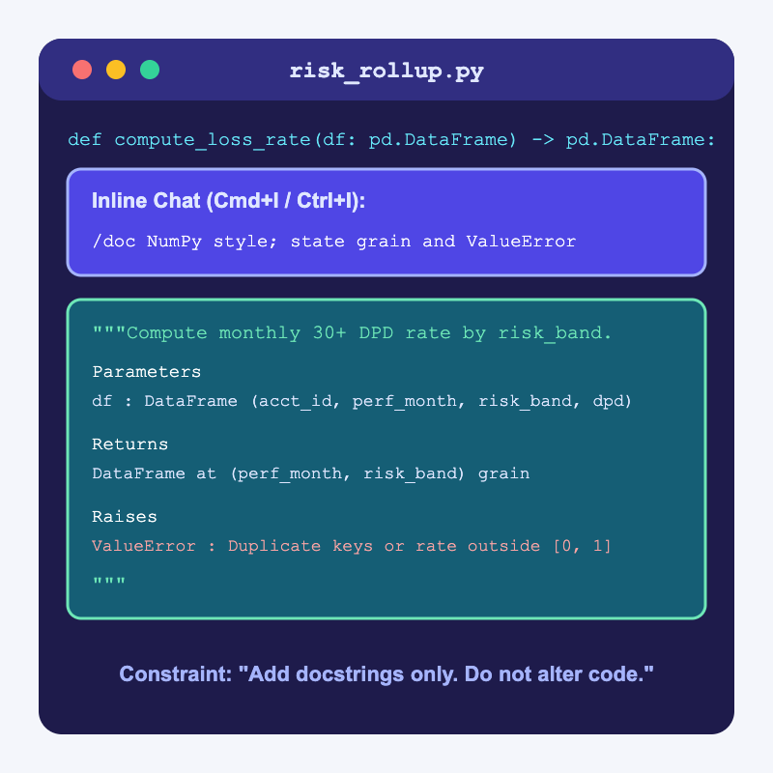
Using /doc and /explain to Document Complex Scripts
Highlight any function and press CMD+I (Mac) or CTRL+I (Windows), then type /doc to generate a structured docstring in place
Specify your team’s docstring format (NumPy or Google style) and require grain, exclusions, and raised exceptions
Add the guardrail “Add docstrings and comments only; do not modify any executable code” so Copilot never alters a formula while documenting it
GitHub Copilot for Credit Analytics and Risk Modeling
© 2026 Copyright ROI Training, Inc.
All rights reserved. Not to be reproduced without prior written consent.
18 of 28

Slide 19
Demo: Document and Package Code for Review
In VS Code, open risk_rollup.py from the earlier demo, select calc_delinquency, press CMD+I (Mac) or CTRL+I (Windows), and run:
/doc Add a NumPy-style docstring stating required columns, the charged_off exclusion rule, output Series format, and all ValueError conditions. Do not change any executable lines.
Accept the docstring diff and run pytest in the terminal to confirm all tests still pass.
In Copilot Chat, attach #file risk_rollup.py and #file test_risk_rollup.py, paste your pytest terminal output, and run:
Generate AUDIT_EVIDENCE.md with:
1. Functions changed and vectorized
2. Runtime ValueError assertions added
3. Table of pytest tests in test_risk_rollup.py and pass count
4. Human sign-off section marked TODO
GitHub Copilot for Credit Analytics and Risk Modeling
© 2026 Copyright ROI Training, Inc.
All rights reserved. Not to be reproduced without prior written consent.
19 of 28

Slide 20
Chapter 4: Hands-On Lab
Lab: Agentic Governance and Automated Code Cleanup
Time: 30 minutes
GitHub Copilot for Credit Analytics and Risk Modeling
© 2026 Copyright ROI Training, Inc.
All rights reserved. Not to be reproduced without prior written consent.
20 of 28

Slide 21
What You Learned
Refactored, modularized, and vectorized slow Python analytics scripts
Prompted Copilot to add defensive assertions and pytest suites
Used plan-first prompts, single-step approvals, and VS Code diff reviews
Built reusable .github/prompts/*.prompt.md templates and .github/skills/ governance playbooks
Generated grounded Model Cards, technical specifications, and docstrings
GitHub Copilot for Credit Analytics and Risk Modeling
© 2026 Copyright ROI Training, Inc.
All rights reserved. Not to be reproduced without prior written consent.
21 of 28

Slide 22
Quiz 1 of 3
You want to use Copilot Agent mode in VS Code to refactor a 300-line monitoring script into separate modules (validators.py, metrics.py, and test_metrics.py). How should you start the session?
A. Prompt Agent mode to “Clean up and reorganize the whole repo however you think is best” and click Keep All
B. Ask Agent mode for a step-by-step plan listing which files each step will touch (“Do not edit files yet”), then approve and test one step at a time
C. Delete all existing unit tests first so Agent mode is not slowed down by test failures
D. Paste the 300-line script into the Copilot mobile app
GitHub Copilot for Credit Analytics and Risk Modeling
© 2026 Copyright ROI Training, Inc.
All rights reserved. Not to be reproduced without prior written consent.
22 of 28

Slide 23
Quiz 1: Answer
You want to use Copilot Agent mode in VS Code to refactor a 300-line monitoring script into separate modules (validators.py, metrics.py, and test_metrics.py). How should you start the session?
Correct: B. Ask Agent mode for a step-by-step plan listing which files each step will touch (“Do not edit files yet”), then approve and test one step at a time.
A plan-first prompt lets you verify the file list and module boundaries before Agent mode edits code
Executing one step at a time keeps each VS Code diff small enough to inspect line by line
Running pytest between steps catches any accidental formula or denominator change immediately
GitHub Copilot for Credit Analytics and Risk Modeling
© 2026 Copyright ROI Training, Inc.
All rights reserved. Not to be reproduced without prior written consent.
23 of 28

Slide 24
Quiz 2 of 3
When you use Copilot Inline Chat (/doc) to add docstrings and comments to an existing credit calculation function, what instruction should you include in your prompt?
A. “Also rewrite the formula if you think of a different way to calculate the rate.”
B. “Add NumPy-style docstrings covering inputs, exclusions, and ValueError conditions; do not modify any executable code.”
C. “Invent a realistic holdout ROC AUC score and put it in the docstring.”
D. “Remove all ValueError checks so the function is shorter.”
GitHub Copilot for Credit Analytics and Risk Modeling
© 2026 Copyright ROI Training, Inc.
All rights reserved. Not to be reproduced without prior written consent.
24 of 28

Slide 25
Quiz 2: Answer
When you use Copilot Inline Chat (/doc) to add docstrings and comments to an existing credit calculation function, what instruction should you include in your prompt?
Correct: B. “Add NumPy-style docstrings covering inputs, exclusions, and ValueError conditions; do not modify any executable code.”
Explicitly telling Copilot not to touch executable lines prevents silent formula changes during a documentation pass
Always inspect the inline diff in VS Code to verify that only docstring or comment lines were added
Rerun pytest after accepting the docstring to be 100% certain runtime behavior is unchanged
GitHub Copilot for Credit Analytics and Risk Modeling
© 2026 Copyright ROI Training, Inc.
All rights reserved. Not to be reproduced without prior written consent.
25 of 28

Slide 26
Quiz 3 of 3: Discussion
Prompt
Discuss
A teammate needs to prepare a Model Card (MODEL_CARD.md) and an MRM audit summary (AUDIT_EVIDENCE.md) for a model pipeline they built with Copilot. They open an empty chat window with no files attached and type: “Write a complete Model Card and MRM audit report for our new credit card delinquency model.”
What will Copilot put into MODEL_CARD.md when no code, schema, or metrics files are attached?
Which exact files should they attach with #file before prompting?
Which sections of a Model Card can Copilot populate from code, and which sections must be marked TODO for a human?
GitHub Copilot for Credit Analytics and Risk Modeling
© 2026 Copyright ROI Training, Inc.
All rights reserved. Not to be reproduced without prior written consent.
26 of 28

Slide 27
Quiz 3: Discussion Points
A teammate needs to prepare a Model Card (MODEL_CARD.md) and an MRM audit summary (AUDIT_EVIDENCE.md) for a model pipeline they built with Copilot. They open an empty chat window with no files attached and type: “Write a complete Model Card and MRM audit report for our new credit card delinquency model.”
Strong Answers Mention
Watch For
Without attached files, Copilot will hallucinate feature names, split dates, hyperparameter values, and validation metrics
Treating fluent, AI-invented AUC or KS numbers in a Model Card as real validation results
Letting Copilot write “Status: Approved for Production” in the generated document
Attach #file schema.md, #file train_baseline.py, #file test_risk_rollup.py, and #file metrics_output.json (plus the pytest terminal output)
Forgetting to create a reusable .github/prompts/mrm-evidence.prompt.md file for the team
Copilot can extract the exact feature list, preprocessing steps, estimator settings, and JSON metrics from those files
GitHub Copilot for Credit Analytics and Risk Modeling
© 2026 Copyright ROI Training, Inc.
All rights reserved. Not to be reproduced without prior written consent.
27 of 28

Slide 28

Questions and Answers
GitHub Copilot for Credit Analytics and Risk Modeling
© 2026 Copyright ROI Training, Inc.
All rights reserved. Not to be reproduced without prior written consent.
28 of 28

