Slide 1



Using Human Microbial Data to Predict Geographical Location
Alex Rojas
Notes:
Hi. My name is Alex Rojas, and I’m a 17 year old high school student here in Bethesda.
My internship was at the J. Craig Venter Institute in Rockville, Maryland where I worked with Dr. Harinder Singh.

Slide 2
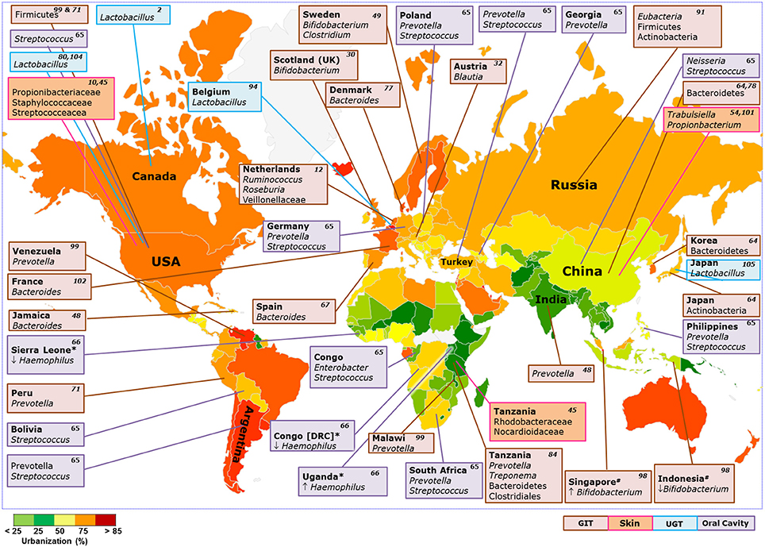
Project Goal: Forensic Microbiome
16s rRNA Illumina and 454 sequence reads
UPARSE- clustering to OTU’s
Mothur- assignment of taxonomy using the SILVA Database
Notes:
A microbiota is a community of microorganisms that live inside a host all over the body, and the composition of such a community can include viruses, bacteria, fungi, and other microbes.
The “microbiome” refers to the collective genome of these species, and it can be read using sequencing technology such as illumina.
The goal of my project was to identify whether the sequencing data of the microbiome in different parts of the body can be applied by a machine learning model to accurately predict the geographical provenance of a test subject, with scope of geography including city, state, and country.
Why would we want to do this? Well, as you can see based on these graphics, the abundance of different genera in the human microbiome vary from place to place based on numerous factors (?)... Being able to differentiate between such compositions in predicting the geographical provenance of a sample can be useful in the field of forensics, where would certainly be useful to apply to investigations information about suspects.
UPARSE Pipeline: A clustering method that allows us to take 16s rRNA illumina sequence reads and assign Operational Taxonomic Units, and then Mothur was used to assign taxonomy to the samples through the Silva Database.

Slide 3
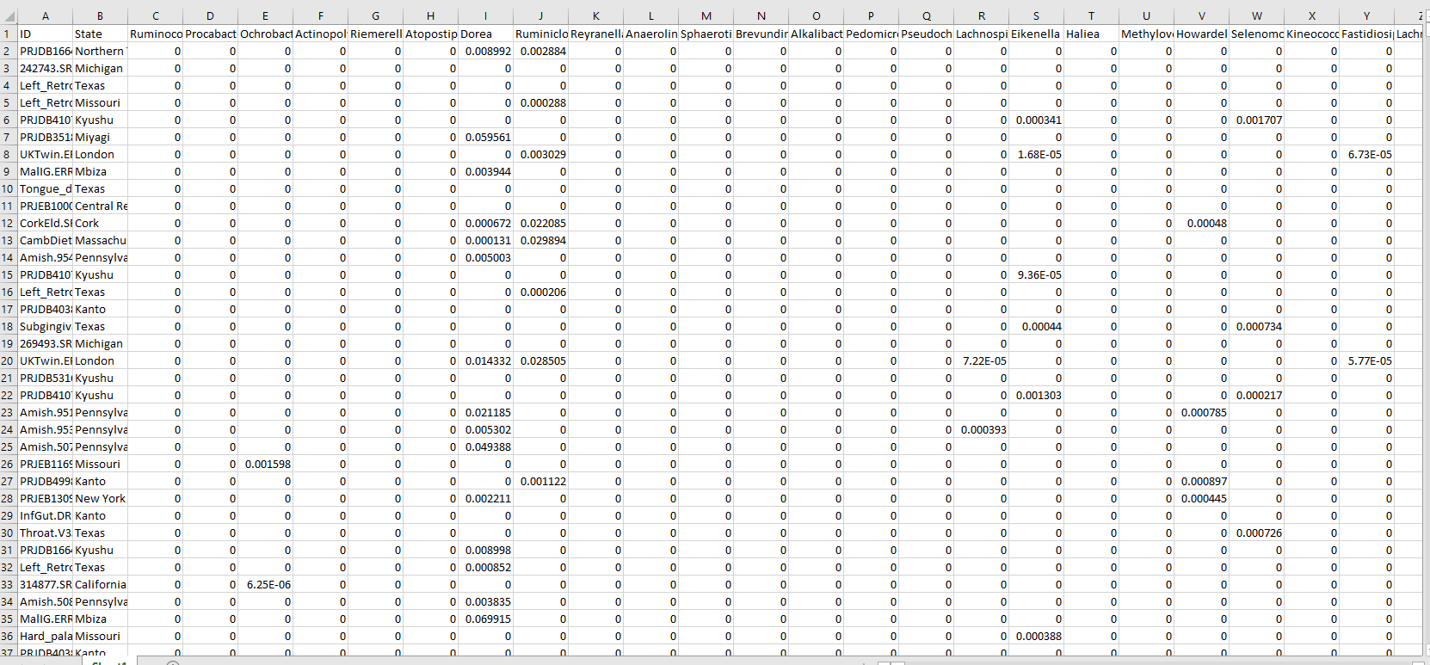
Data
Dimensions of 16s rRNA file:
20905 samples
993 different genera
35 countries
91 provinces/states
139 cities
Notes:
Here is what the data that I worked with looks like in an Excel workbook.
We have the identification of different microbiota as the first column, with the label of the geographical provenance of the subject in regards to state in the second column.
Corresponding to every row is 993 different genera that were present in the microbiome, and the relative abundance in every sample has been mapped to values between 0 and 1. This was acquired by implementing a UPARSE pipeline, which outputted different numbers starting at 0 to indicate how abundant genera were in a sample. To normalize this, these outputs were summed together and then each individual integer was divided by the sum, giving values from 0 to 1. The program repeated this process for every sample.
Based on the file I had, this geographical label was either more specific, such as a city like Houston, or more abstract, such as “United States of America.”
Now that we had our data, it was time to apply it to the models that we built.

Slide 4

Machine Learning (ML)
ML is a subset of the Artificial Intelligence field.
Supervised learning: train models to make accurate predictions based on input data and labeled output data.
These are statistical/mathematical models in nature.
Classification ML is for categorized output data. Models we used include:
Random Forest
Artificial Neural Network
Support Vector Machine
Notes:
What is machine learning?
Machine learning is a type of artificial intelligence. To make machines “learn,” you feed models with enough data that they are able to recognize certain patters and train themselves to classify inputted data.
Classic example: dog vs cat
As the data that we are implementing here includes labels as the “target” of our prediction, we will use classification.
Here are some of the models that we applied.
A neural network is a type of model that is designed to mimic the connections that neurons make in our minds. Each model has an input layer, where the data is fed, and hidden layers, which contain many neurons with attached weights, a number that is used for a calculated sum in decision making.
A random forest builds thousands of randomly made decision trees, and it passes in the data to every tree. The number of predictions of every category are tallied up and the highest tally is the prediction.
A support vector machine maps the data onto a graph and attempts to create a margin that will (often) maximize the separation using a decision line between the classes of data. Really cool: because not all data is 2 dimensional nor does it always allow for a decision boundary to be drawn, a ‘kernel trick’ is implemented by the SVM. It manipulates the data into another dimension so that a hyperplane can be created.
To avoid bias, which is a common problem in ML, we implemented a strategy known as 5 Fold Cross Validaiton.
You divide the samples into 5 categories 5 times like the image indicates. Every division you have, you hold out a different subset of the data to test the model against. In every iteration, you train the model on all of the data except that which was held out, and this just provides a less biased solution to training a model.

Slide 5
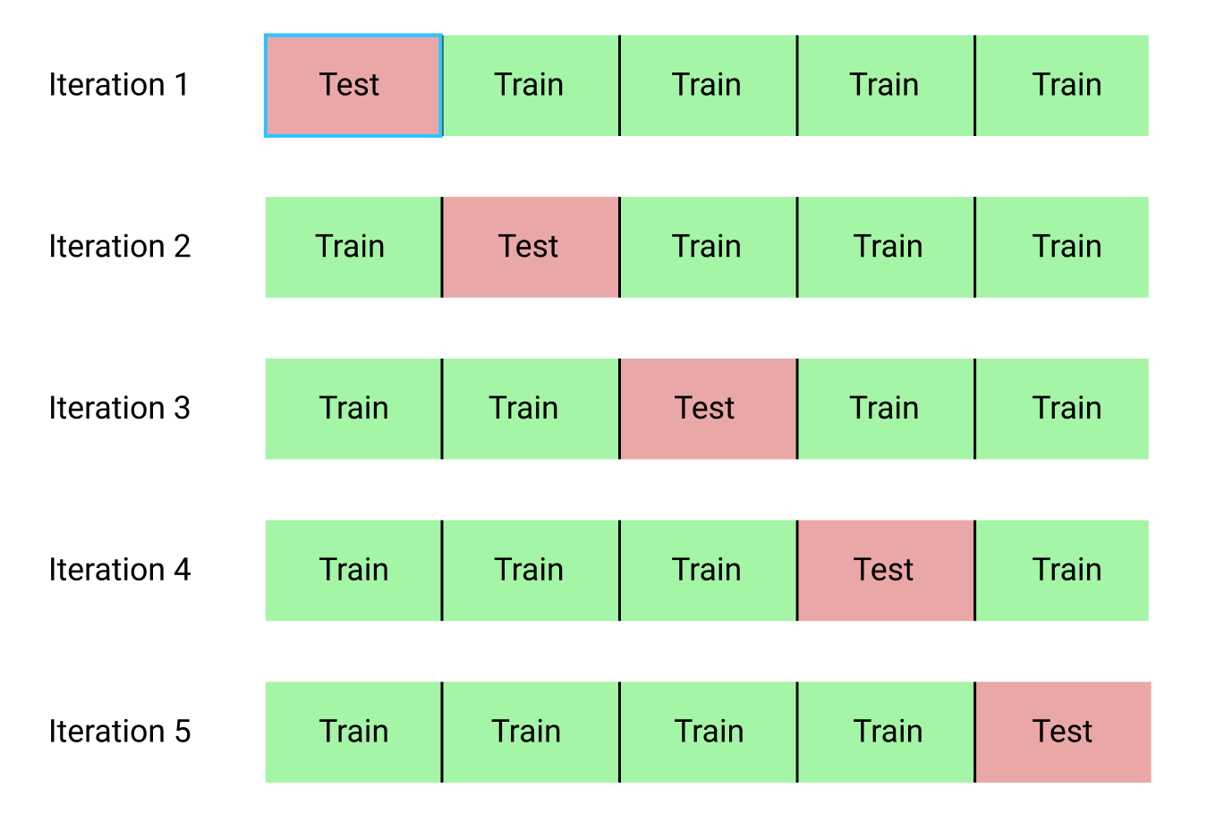
ML Methods
5 Fold Cross Validation during training to avoid bias
Gridsearch for model parameter optimization
Notes:
In a 5 fold cross validation, data is randomly split up into 5 categories that have NO overlaps, like so. For every division, the model is trained based on 4 of these subsets, with one being held out. This ‘testing’ category is inputted after the training, and predictions are made based on this. That process repeats, and it is a more unbiased way of getting a mean accuracy of the model rather than doing this proces once and not taking chance into account.

Slide 6
Country Predictions Heatmap (RF)
Actual Country Labels
 | Tanzania | Thailand | USA | Uganda | UK
Tanzania | 0.9 | 0 | 0.0002 | 0 | 0
Thailand | 0 | 0.6642 | 0.0032 | 0 | 0
USA | 0 | 0 | 0.9995 | 0 | 0
Uganda | 0 | 0 | 0.0003 | 0.84 | 0
UK | 0 | 0 | 0 | 0 | 1
Country Predictions
Overall F1 Score: 0.9404
Notes:
Figure A: PCA Plot shows the similarity of samples based on how they are clustered. In the case of the city of Houston, we can see that microbiome data is quite similar.
Figure B: Box and Whisker Plot showing the relative abundance of different genera between the cities of Houston and St. Louis

Slide 7
State Predictions Heatmap(RF)
Actual State Labels
 | Uttarakhand | West Bengal | Western Cape | Xinjang Uygur | Yunnan
Uttarakhand | 0.5455 | 0 | 0 | 0 | 0
West Bengal | 0 | 0.9286 | 0 | 0 | 0
Western Cape | 0 | 0 | 1 | 0 | 0
Xinjang Uygur | 0 | 0 | 0 | 0.7727 | 0
Yunnan | 0 | 0 | 0 | 0 | 0.8378
State Predictions
Overall F1 Score: 0.8683
Notes:
Figure A: PCA Plot shows the similarity of samples based on how they are clustered. In the case of the city of Houston, we can see that microbiome data is quite similar.
Figure B: Box and Whisker Plot showing the relative abundance of different genera between the cities of Houston and St. Louis

Slide 8
City Predictions Heatmap (RF)
Actual City Labels
 | Yangpyeong | Yili Prefecture | Yogjakarta | Yokohama | Zhenzhou
Yangpyeong | 0.9417 | 0 | 0 | 0 | 0
Yili Prefecture | 0 | 1 | 0 | 0 | 0
Yogjakarta | 0 | 0 | 0.9643 | 0 | 0
Yokohama | 0 | 0 | 0 | 0.9934 | 0
Zhenzhou | 0 | 0 | 0 | 0 | 0.6667
City Predictions
Overall F1 Score: 0.8881
Notes:
Figure A: PCA Plot shows the similarity of samples based on how they are clustered. In the case of the city of Houston, we can see that microbiome data is quite similar.
Figure B: Box and Whisker Plot showing the relative abundance of different genera between the cities of Houston and St. Louis

Slide 9

Conclusions and Future Directions
Predicting location based on microbial data?

Slide 10
Acknowledgements
The STEP-UP HS program is supported by the National Institute of Diabetes and Digestive and Kidney Diseases of the National Institutes of Health, Grant number: R25DK113659
My PI, Dr. Harinder Singh and the J. Craig Venter Institute

Slide 11
Image Sources
https://miro.medium.com/max/1184/1*i0o8mjFfCn-uD79-F1Cqkw.png
http://res.cloudinary.com/dyd911kmh/image/upload/f_auto,q_auto:best/v1526288453/index3_souoaz.png
https://miro.medium.com/max/1200/1*DW0Ccmj1hZ0OvSXi7Kz5MQ.jpeg
https://miro.medium.com/max/1400/1*rgba1BIOUys7wQcXcL4U5A.png
https://stats.stackexchange.com/questions/208449/hyper-parameter-optimization-grid-search-issues

Slide 12
Clarification

Slide 13
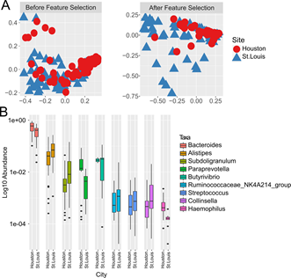
Geographic Clustering of Microbiome Data
PCA Plot using bray-curtis distance matrix
Differentially abundant genera between St. Louis and Houston
Notes:
Figure A: PCA Plot shows the similarity of samples based on how they are clustered. In the case of the city of Houston, we can see that microbiome data is quite similar.
Figure B: Box and Whisker Plot showing the relative abundance of different genera between the cities of Houston and St. Louis

