Slide 1


BIG MOUNTAIN RESORT
TICKET PRICES PREDICTION

Slide 2
Context
Big Mountain Resort is located in northwestern Montana and
originally opened in 1947.Big Mountain Resort offers access to 105
named trails and vast bowl and tree skiing. Recently it has installed
an additional chair lift to increase the distribution of visitors across
the mountain. This additional chair increases their operating costs
by $1,540,000 this season. Investors would like to keep their margin
profit level at 9.2% through lifting the ticket price or increasing more
resort days on recouping the increased operating costs from the new
chair this season.

Slide 3
PROBLEM IDENTIFICATION
What recommendations does Big Mountain resort have to keep their margin profit at 9.2% after the increased operating costs from the additional new chair through lifting their ticket price or increasing the more resort opening days?

Slide 4
Recommendations
● Increase our weekend ticket price to the price $89 (suggested by the model)
● Extend open days to the number 130 days suggested by the model, to efficiently increase the total revenue.

Slide 5
Key findings
Montana was in 23rd place of ticket prices meaning that is not the most expensive tickets.
Montana have 12 resort making the top 15 of the most resort per region and state.
Montana is in the top list in the following areas:
• Vertical drops
• Area covered by snow makers
• Number of share distribution
• Number of run
• Skiable terrain

Slide 6

Modeling
Built 3 different prediction models model 1,model 2,model 3 by choosing different features.
We built Model 1 which includes all the features
In Model 2 ,we dropped1 feature that are not actionable
In model 3 we dropped 3 features that are not actionable
Compared the performance of each model and the metrics used to check performance are MSE and explained variance score, we noticed the metrics of the model 2 are very close, in the end we chose model 2, which has one unactionable feature.
Used the features of Big Mountain and model 2 to predict the weekend ticket price and got the result of $83; used model 2 to predict the open days for this season and got the result of 130 days. Current weekend ticket price: 81 and days opened in last season: 123 days.

Slide 7
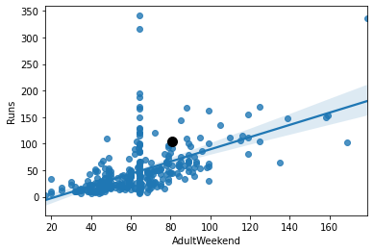
Analysis
By comparing the number of runs with the other competitor resorts we can see resorts that have about the same number of runs as BIg Mountain has, normally price their weekend day ticket higher than $81.

Slide 8
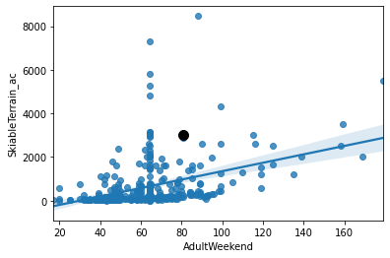
By comparing skiable areas in the resort with other competitor resorts we can see some of the resorts that have about the same skiable area as Big Mountain has (or even slightly less than Big Mountain) price their weekend ticket price higher than $81

Slide 9
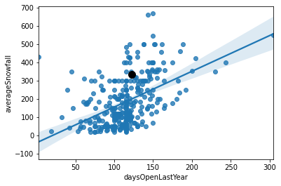
By comparing average snowfall in the resort with other competitor resorts we can see some of the resorts that have about the same average snowfall as Big Mountain has (or even slightly less than Big Mountain) have longer open days than Big Mountain

Slide 10
SUMMARY AND CONCLUSION
The best prediction model indicates the Big Mountain Resort displayed the best price at $83, and the actual cost is $81.00. The model suggested an incrementation because Big Mountain Resort is very competitive in some areas that justified the increasing price

