Slide 1








EDT HMI STUDIO
Build the screen
that runs your machine.
No code.
Not one line.
The next-generation no-code HMI studio — point, click, and your touchscreen comes to life.
COMING NOVEMBER 2026
WIN
OSX
LINUX
GUI Design
Logic Graph
Protocol
Preview
Deploy
Drag buttons, dials and lights onto your screen. As easy as arranging photos.
Draw lines between boxes to say what happens. “When this is pressed, do that.”
It talks to your machine all by itself. Modbus, serial and more — built in.
Watch it work on your computer first. Try every button before it’s real.
One click sends it to your device. That’s it. You’re done.
EDT HMI Studio · v1.0 — from idea to a running touchscreen, without writing a single line of code.

Slide 2
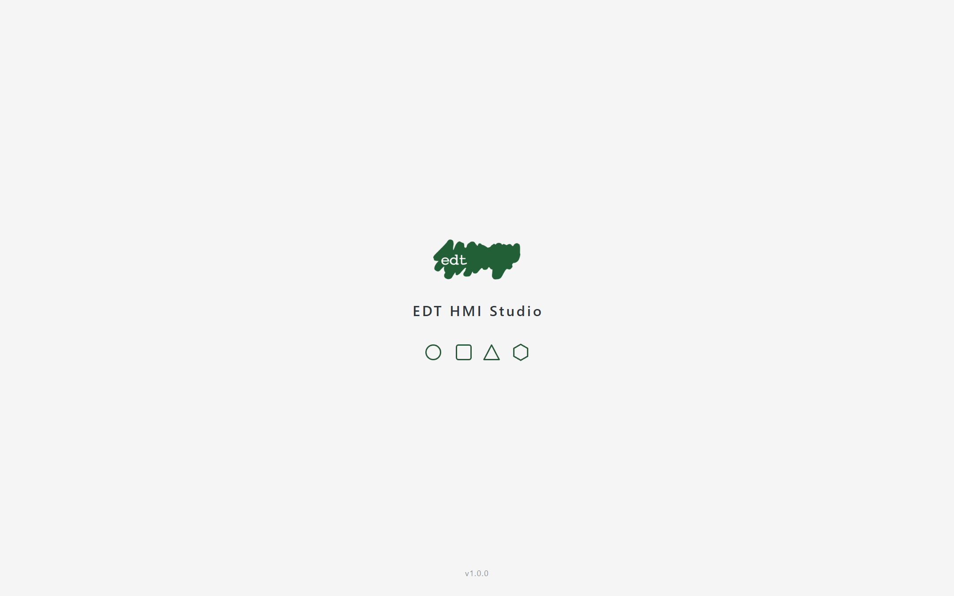
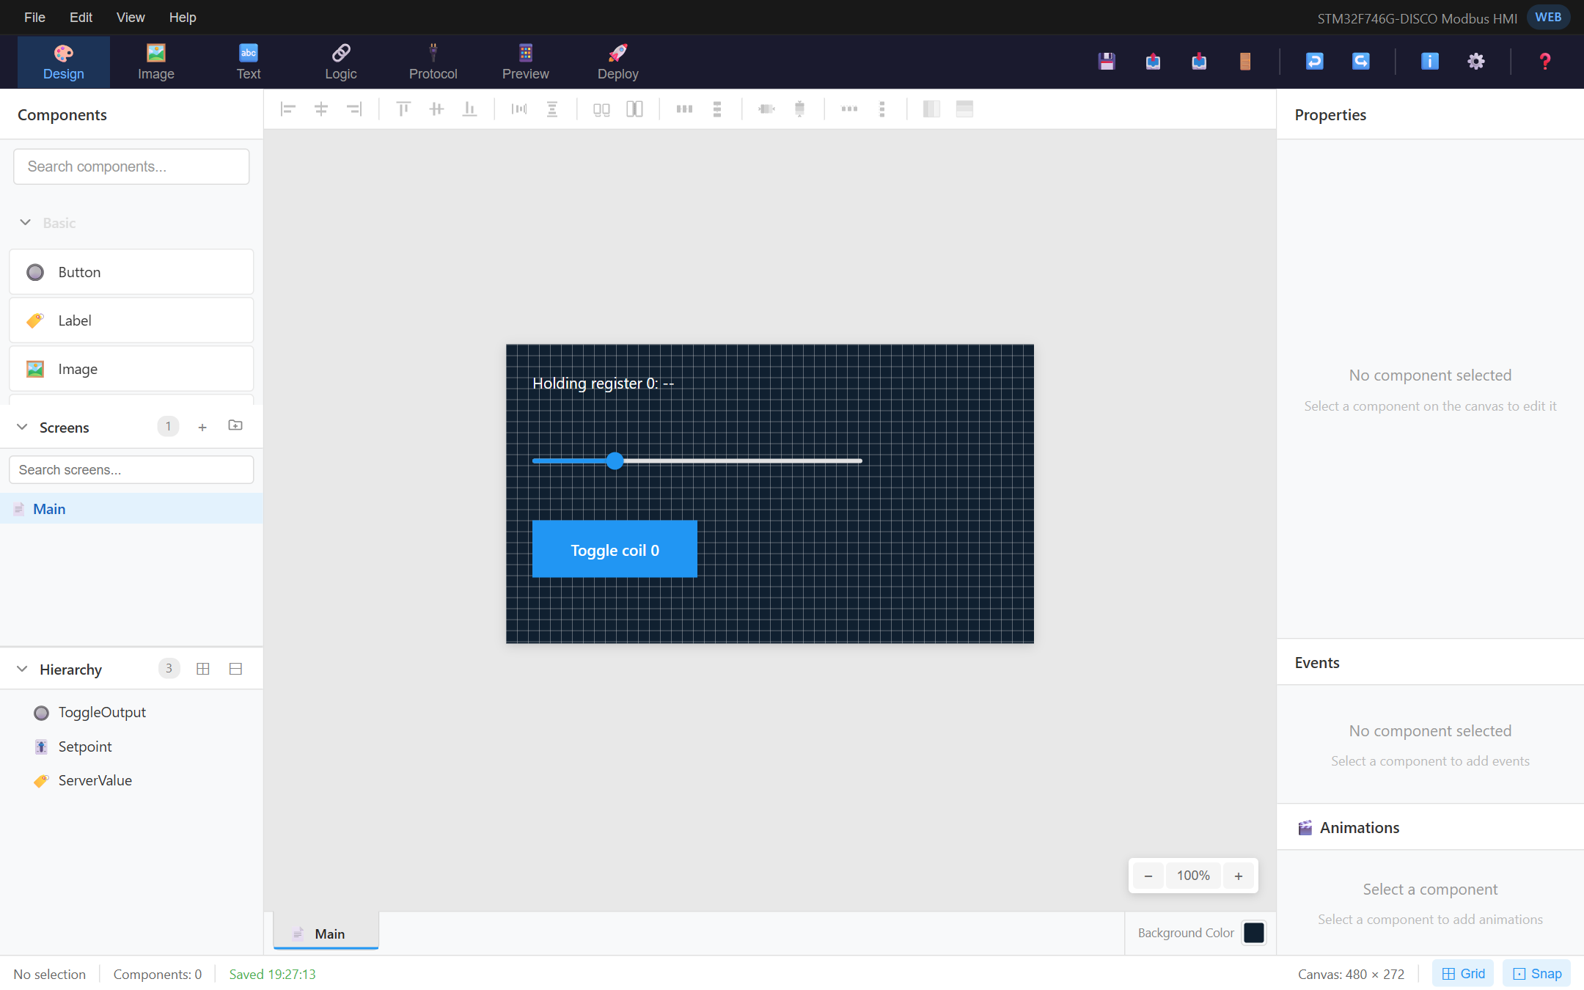
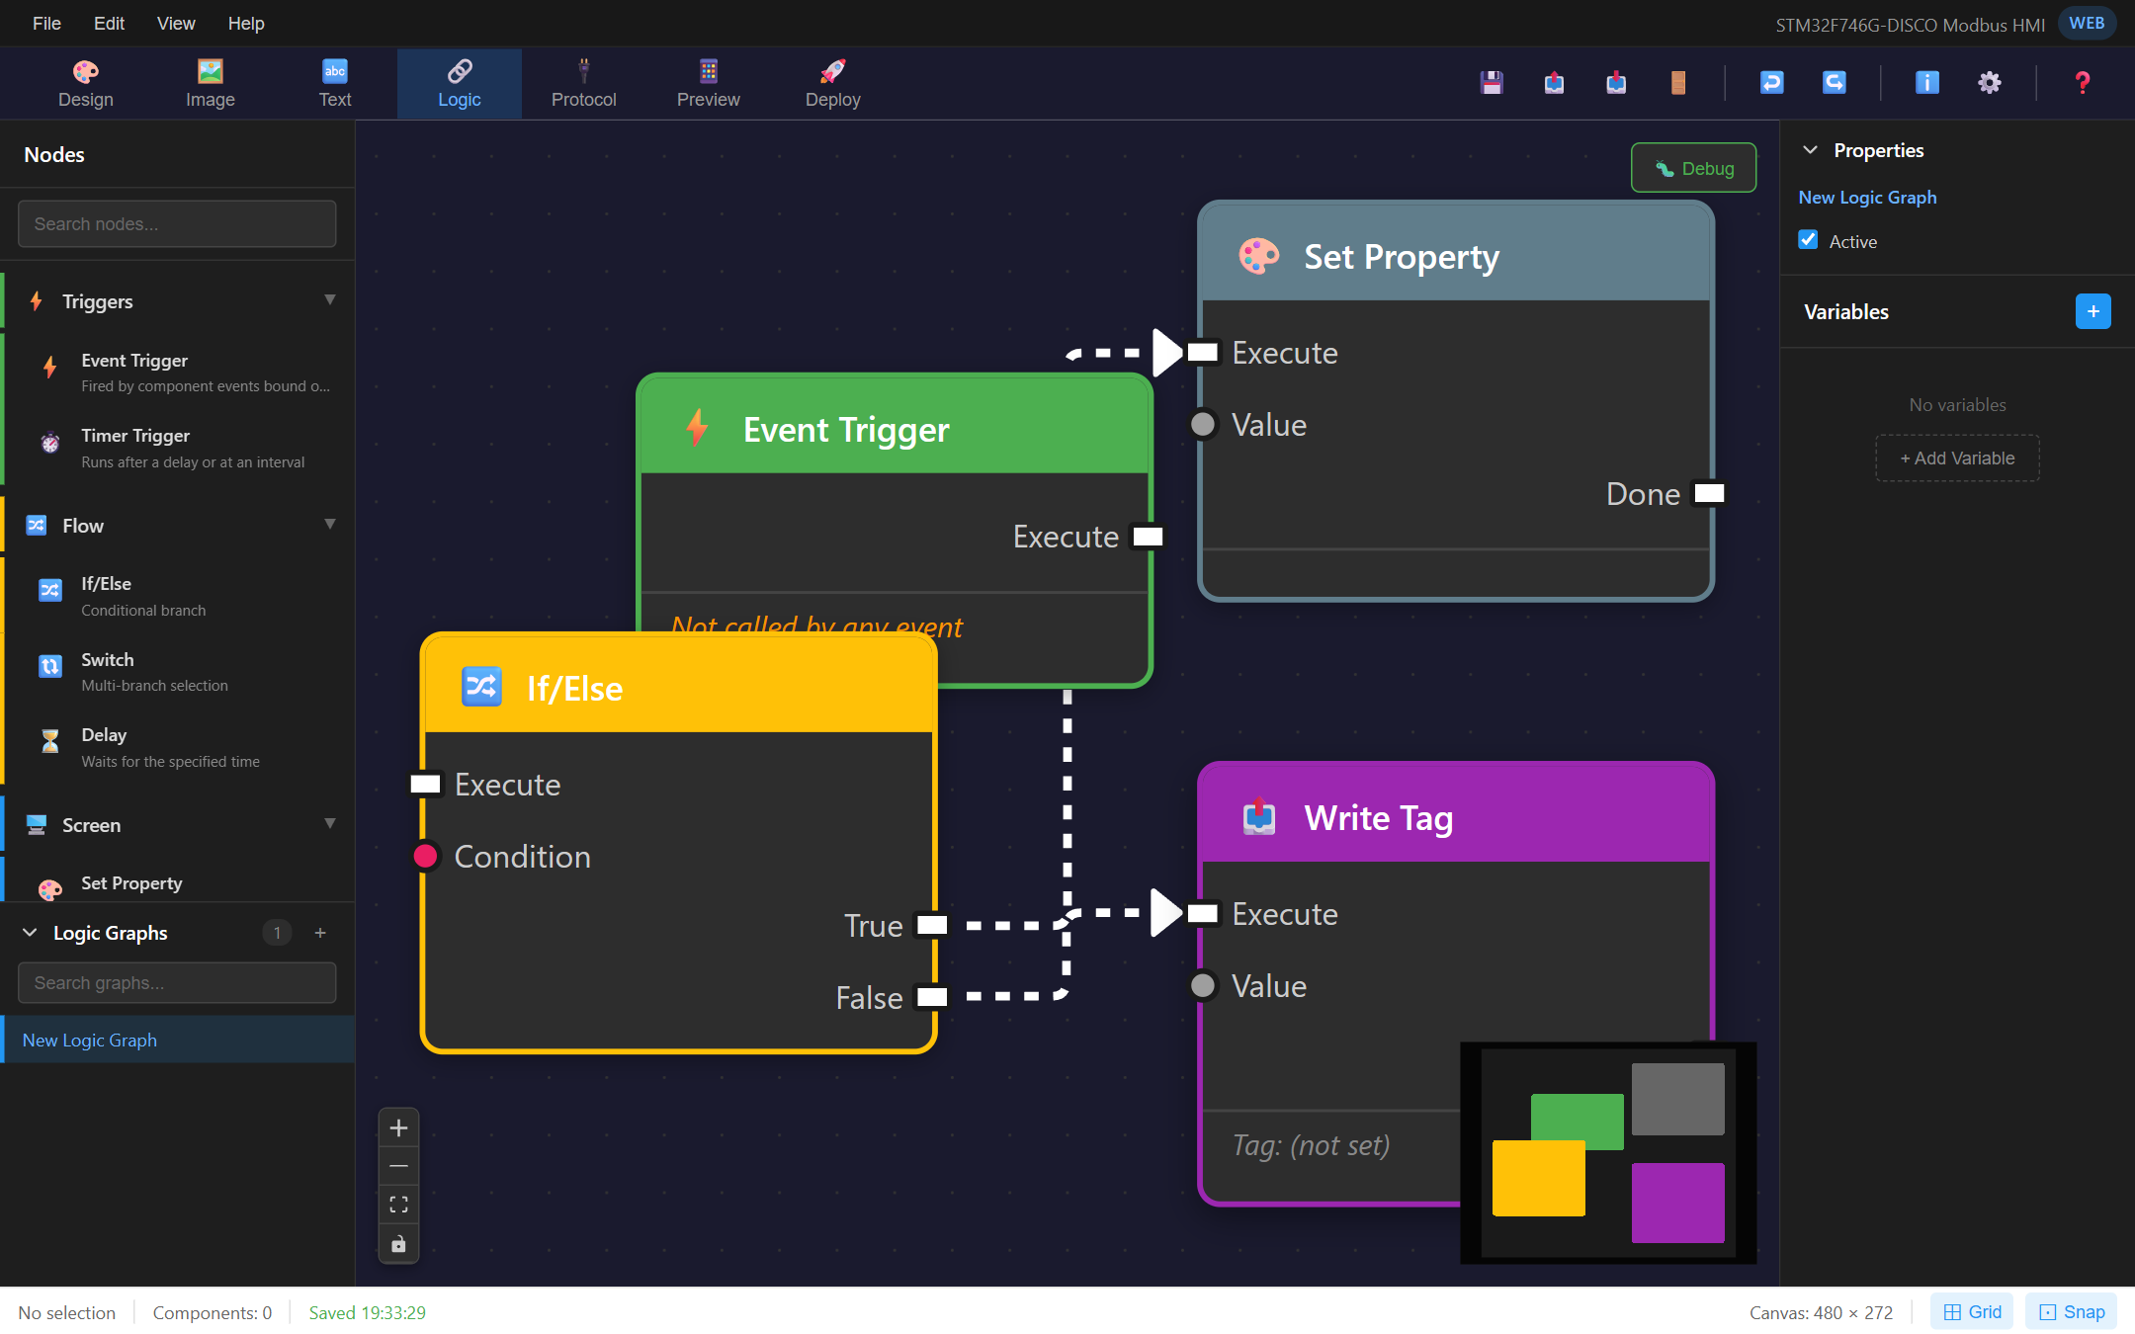
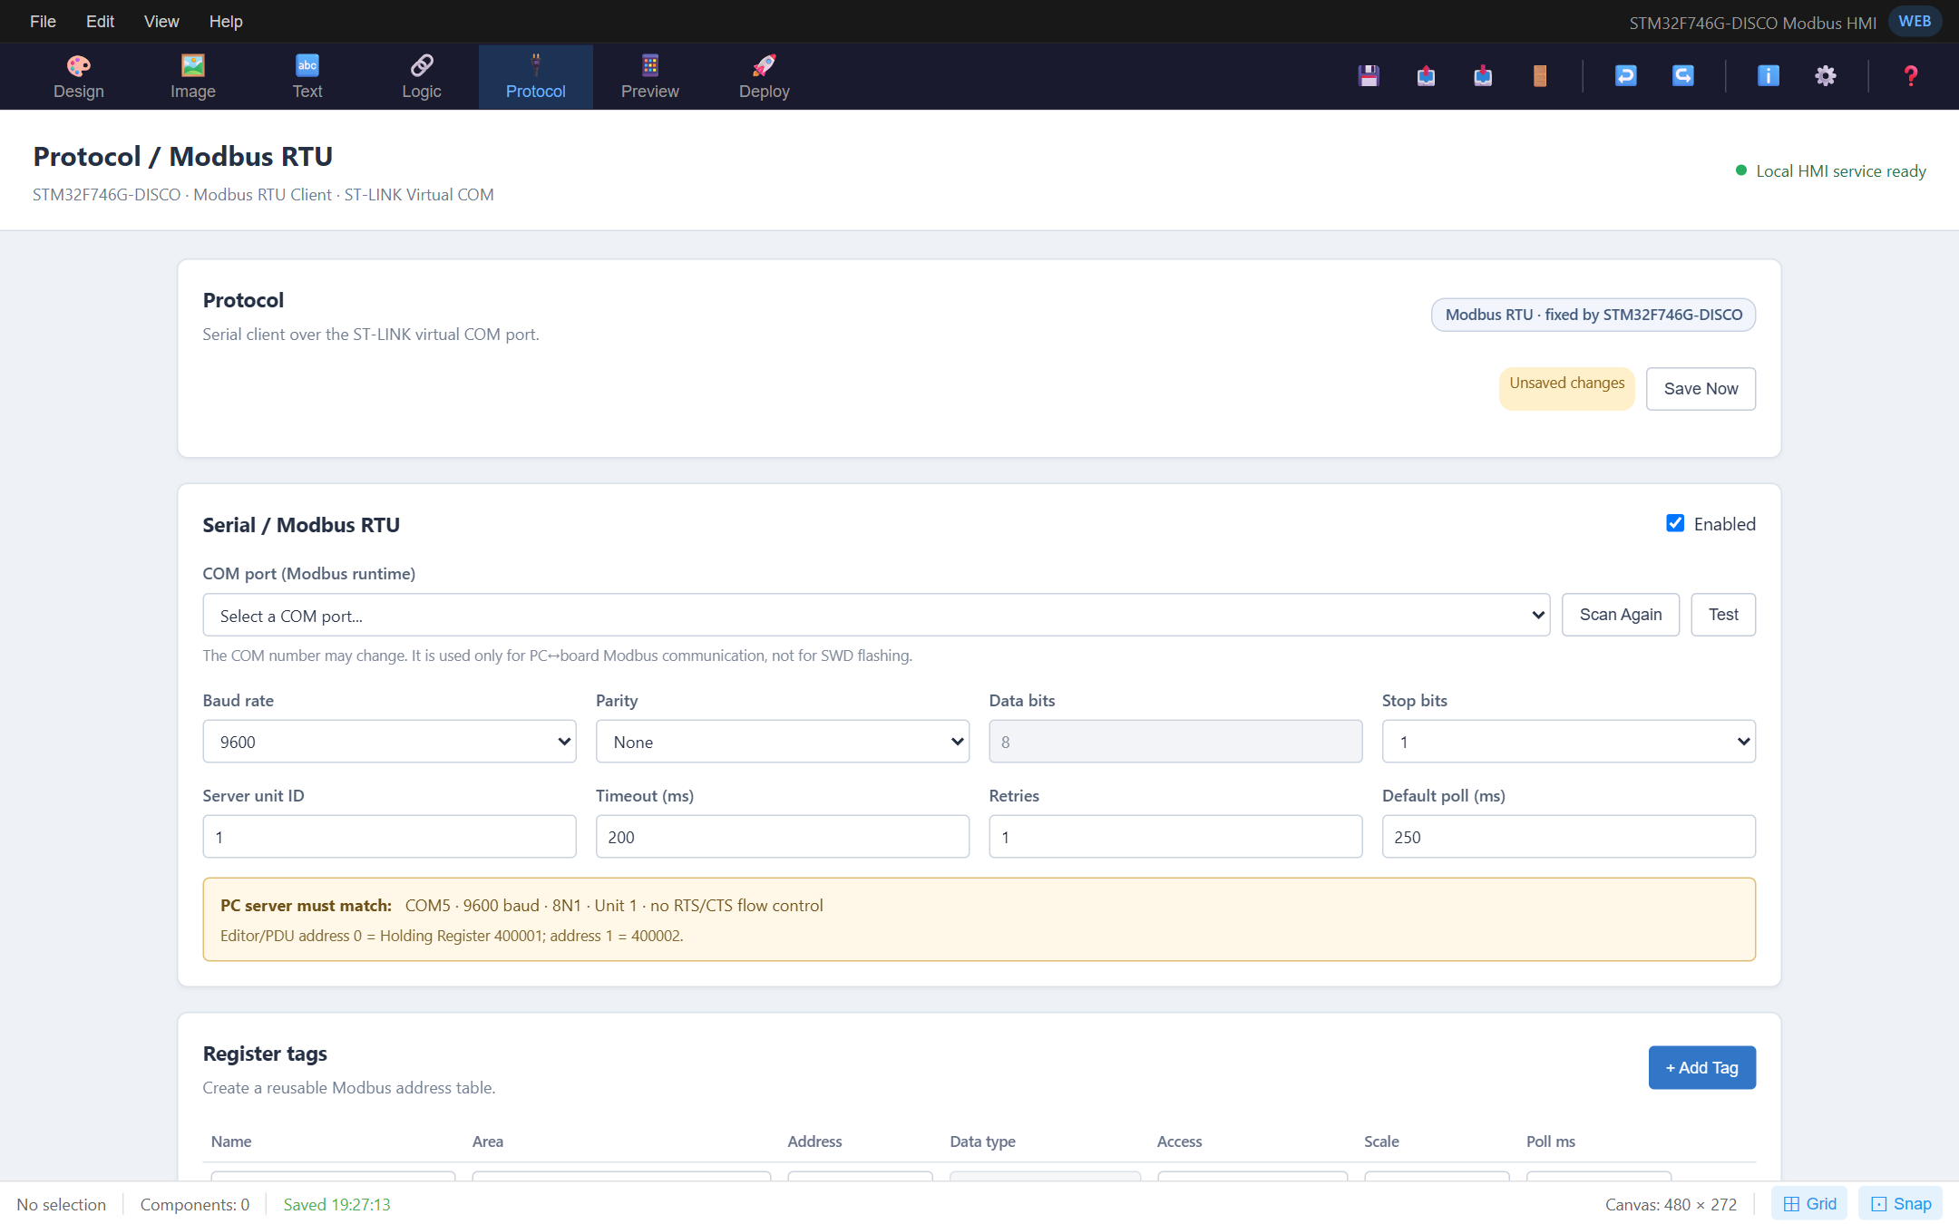
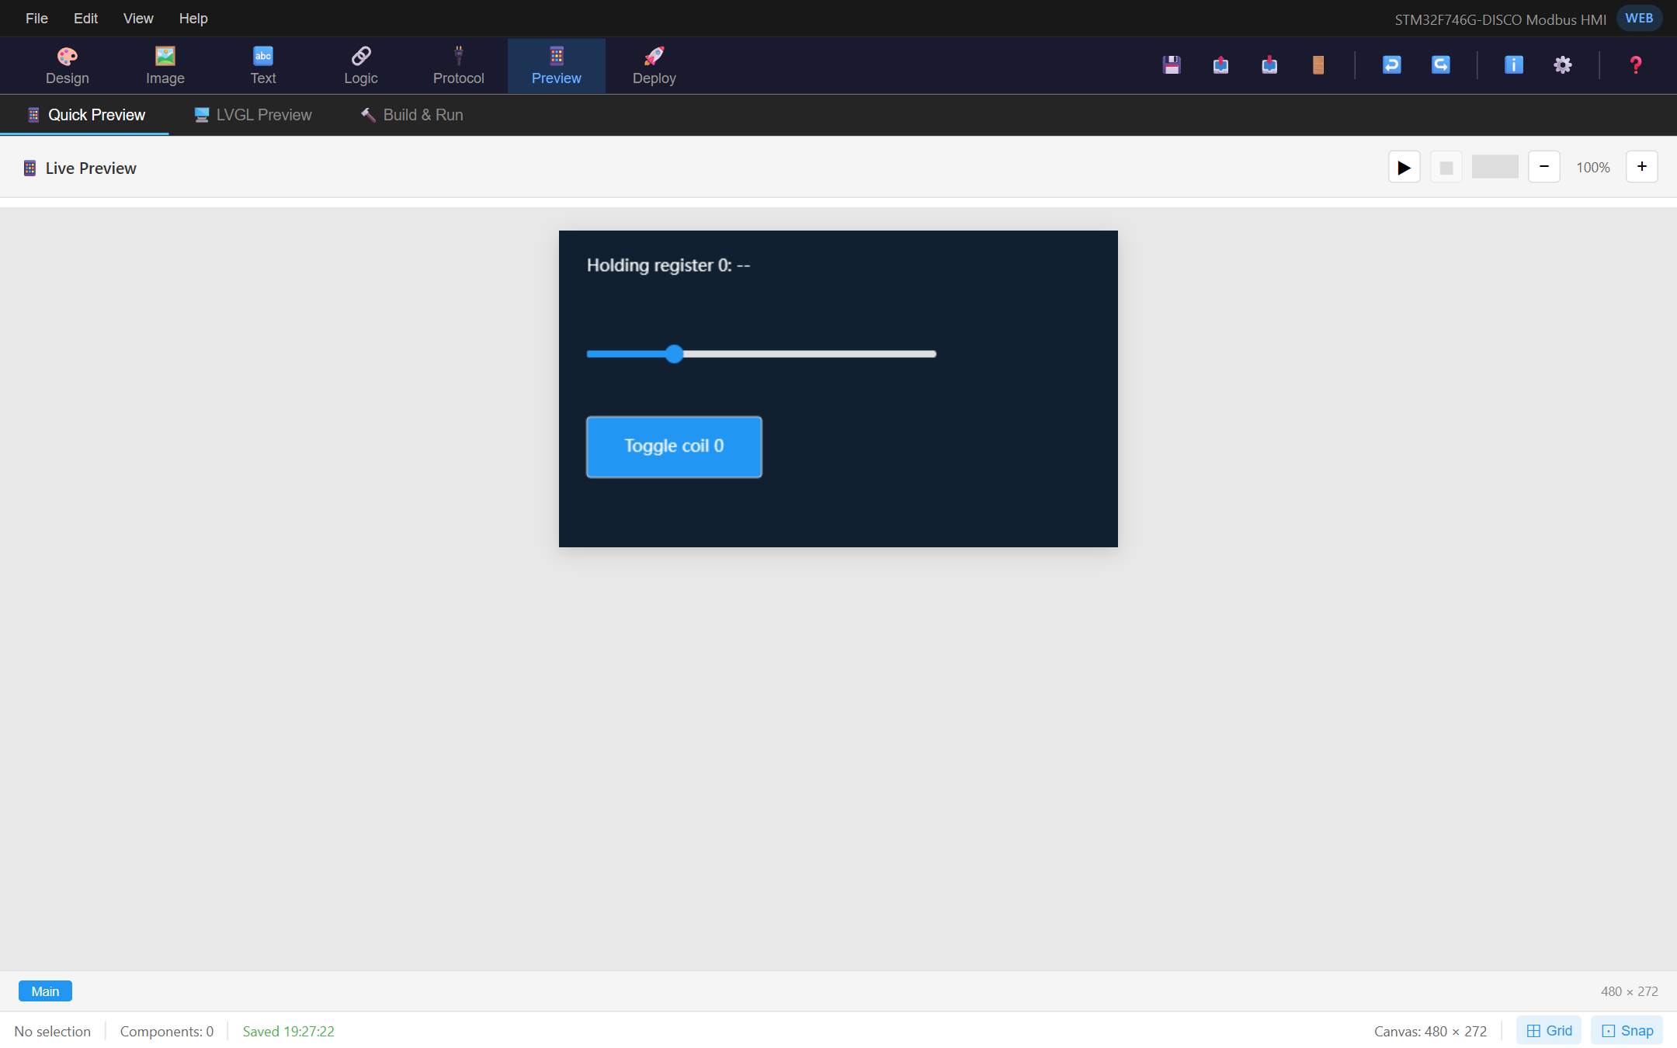
EDT HMI STUDIO
COMING SOON
November 2026
One studio for your whole HMI — design it, wire it, connect it, try it, ship it. No code anywhere.
WIN
OSX
LINUX
Free to try on all three platforms.
GUI Design
Logic Graph
Protocol
Live Preview
Screenshots show a development build — features and appearance may change before release.

