Slide 1
Generalized Linear Models
CS 506

Slide 2
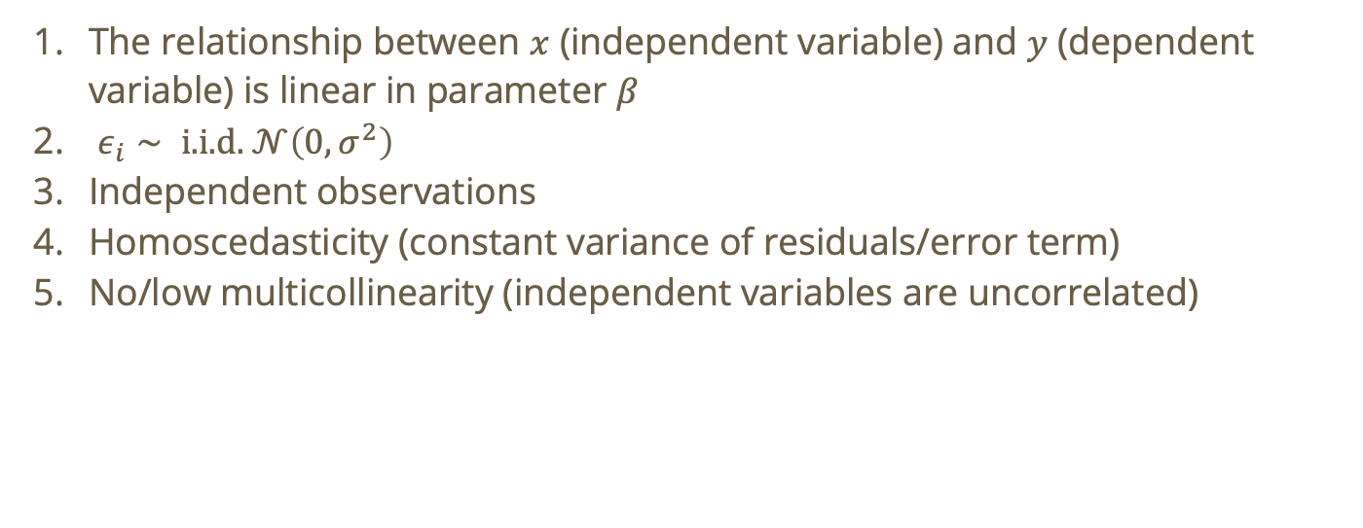
Recall: assumptions for linear regression
The relationship between $x$ (independent variable) and $y$ (dependent variable) is linear in parameter $β$
$ε_{i}∼ \text{i}\text{.}\text{i}\text{.}\text{d}\text{. }𝒩\left(0,σ^{2}\right)$
Independent observations
Homoscedasticity (constant variance of residuals/error term)
No/low multicollinearity (independent variables are uncorrelated)

Slide 3
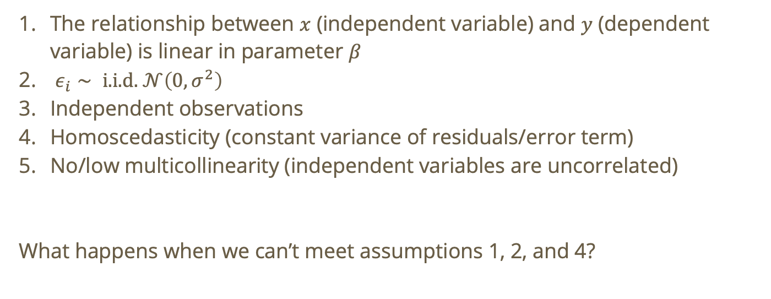
Recall: assumptions for linear regression
The relationship between $x$ (independent variable) and $y$ (dependent variable) is linear in parameter $β$
$ε_{i}∼ \text{i}\text{.}\text{i}\text{.}\text{d}\text{. }𝒩\left(0,σ^{2}\right)$
Independent observations
Homoscedasticity (constant variance of residuals/error term)
No/low multicollinearity (independent variables are uncorrelated)
What happens when we can’t meet assumptions 1, 2, and 4?

Slide 4
Enter… generalized linear models (GLMs)!
If one or more of these conditions apply, then GLMs may be for you!

Slide 5
Enter… generalized linear models (GLMs)!
If one or more of these conditions apply, then GLMs may be for you!
Residuals are non-normal

Slide 6
Enter… generalized linear models (GLMs)!
If one or more of these conditions apply, then GLMs may be for you!
Residuals are non-normal
Data is non-linear

Slide 7
Enter… generalized linear models (GLMs)!
If one or more of these conditions apply, then GLMs may be for you!
Residuals are non-normal
Data is non-linear
Heteroscedasticity

Slide 8
Enter… generalized linear models (GLMs)!
If one or more of these conditions apply, then GLMs may be for you!
Residuals are non-normal
Data is non-linear
Heteroscedasticity
Outcome is non-normally distributed

Slide 9
Components of a GLM
Random component:

Slide 10
Components of a GLM
Random component: what is the distribution of the response variable?

Slide 11
Components of a GLM
Random component: what is the distribution of the response variable?
Typically, from the exponential family: normal, bernoulli, binomial, poisson, gamma, etc.

Slide 12

Components of a GLM
Random component: what is the distribution of the response variable?
Systematic component: the linear combination of predictors ($β_{0}+β_{1}x_{1}+β_{2}x_{2}+…)$

Slide 13

Components of a GLM
Random component: what is the distribution of the response variable?
Systematic component: the linear combination of predictors ($β_{0}+β_{1}x_{1}+β_{2}x_{2}+…)$
Link function: connects the response to the systematic component.

Slide 14

Note: linear regression is a GLM!
Random component: $Y_{i}∼𝒩\left(μ_{i},σ^{2}\right)$

Slide 15

Note: linear regression is a GLM!
Random component: $Y_{i}∼𝒩\left(μ_{i},σ^{2}\right)$
Systematic component: $Y_{i}=x_{i}^{T}β$

Slide 16

Note: linear regression is a GLM!
Random component: $Y_{i}∼𝒩\left(μ_{i},σ^{2}\right)$
Systematic component: $Y_{i}=x_{i}^{T}β$
Link function: identity

Slide 17

Note: linear regression is a GLM!
Random component: $Y_{i}∼𝒩\left(μ_{i},σ^{2}\right)$
Systematic component: $Y_{i}=x_{i}^{T}β$
Link function: identity
Result:
$$Y_{i}=x_{i}^{T}β+ε_{i}$$

Slide 18
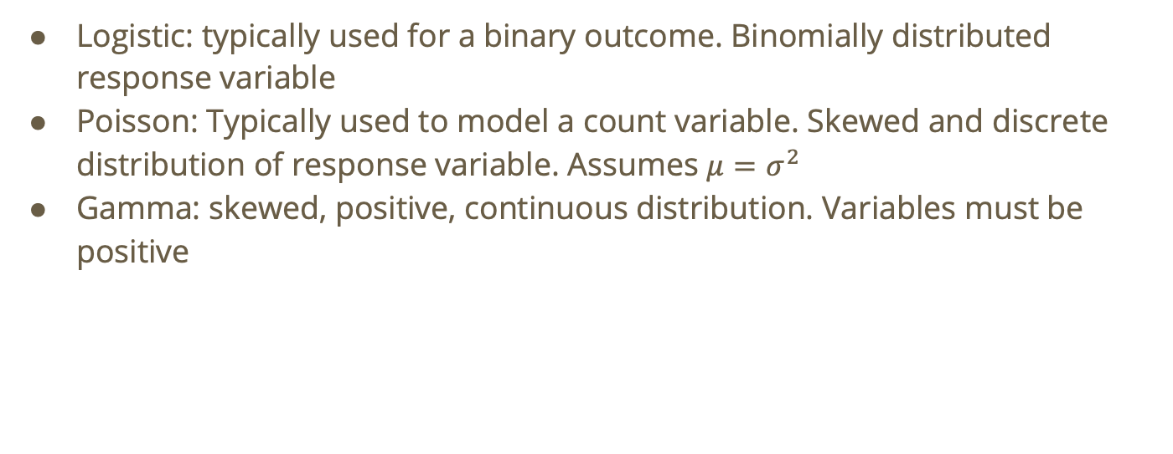
Some example GLMs
Logistic: typically used for a binary outcome. Binomially distributed response variable
Poisson: Typically used to model a count variable. Skewed and discrete distribution of response variable. Assumes $μ=σ^{2}$
Gamma: skewed, positive, continuous distribution. Variables must be positive

Slide 19
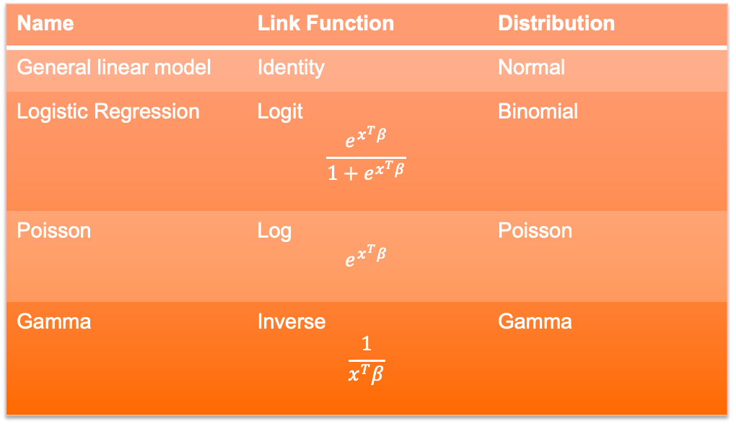
Some example GLMs
Name | Link Function | Distribution
General linear model | Identity | Normal
Logistic Regression | Logit $$\frac{e^{x^{T}β}}{1+e^{x^{T}β}}$$ | Binomial
Poisson | Log $$e^{x^{T}β}$$ | Poisson
Gamma | Inverse $$\frac{1}{x^{T}β}$$ | Gamma

Slide 20
Worksheet 1-4

Slide 21
Do not edit How to change the design
Recall: Which of the following assumptions does a residual NQQ plot allow us to test for an ordinary linear regression?
The Slido app must be installed on every computer you’re presenting from

Slide 22
Do not edit How to change the design
True or false: the following NQQ plot indicates that this dataset has normally distributed residuals
The Slido app must be installed on every computer you’re presenting from

Slide 23
Do not edit How to change the design
Recall: which of the following assumptions does a residual vs. fitted values plot allow us to test (select all that apply)?
The Slido app must be installed on every computer you’re presenting from

Slide 24
Do not edit How to change the design
True or false: the following residual vs. fitted values plot indicates that this dataset has a linear relationship between predictors and response, and homoscedasticity
The Slido app must be installed on every computer you’re presenting from

Slide 25
Utilizing a GLM
Let’s take a step back. Maybe we rushed into using OLR!
Time for some basic data exploration

Slide 26
Worksheet 5

Slide 27
Do not edit How to change the design
After doing some data exploration, what GLM do you think we should use?
The Slido app must be installed on every computer you’re presenting from

Slide 28
Worksheet 6

