Slide 1
K Nearest Neighbors Classification
CS 506

Slide 2
Recall: classification
Attempting to predict some outcome (i.e. a class) based on features and other outcomes.
We want features that are related to the target but not each other
Split up our data into a training set and a testing set.

Slide 3
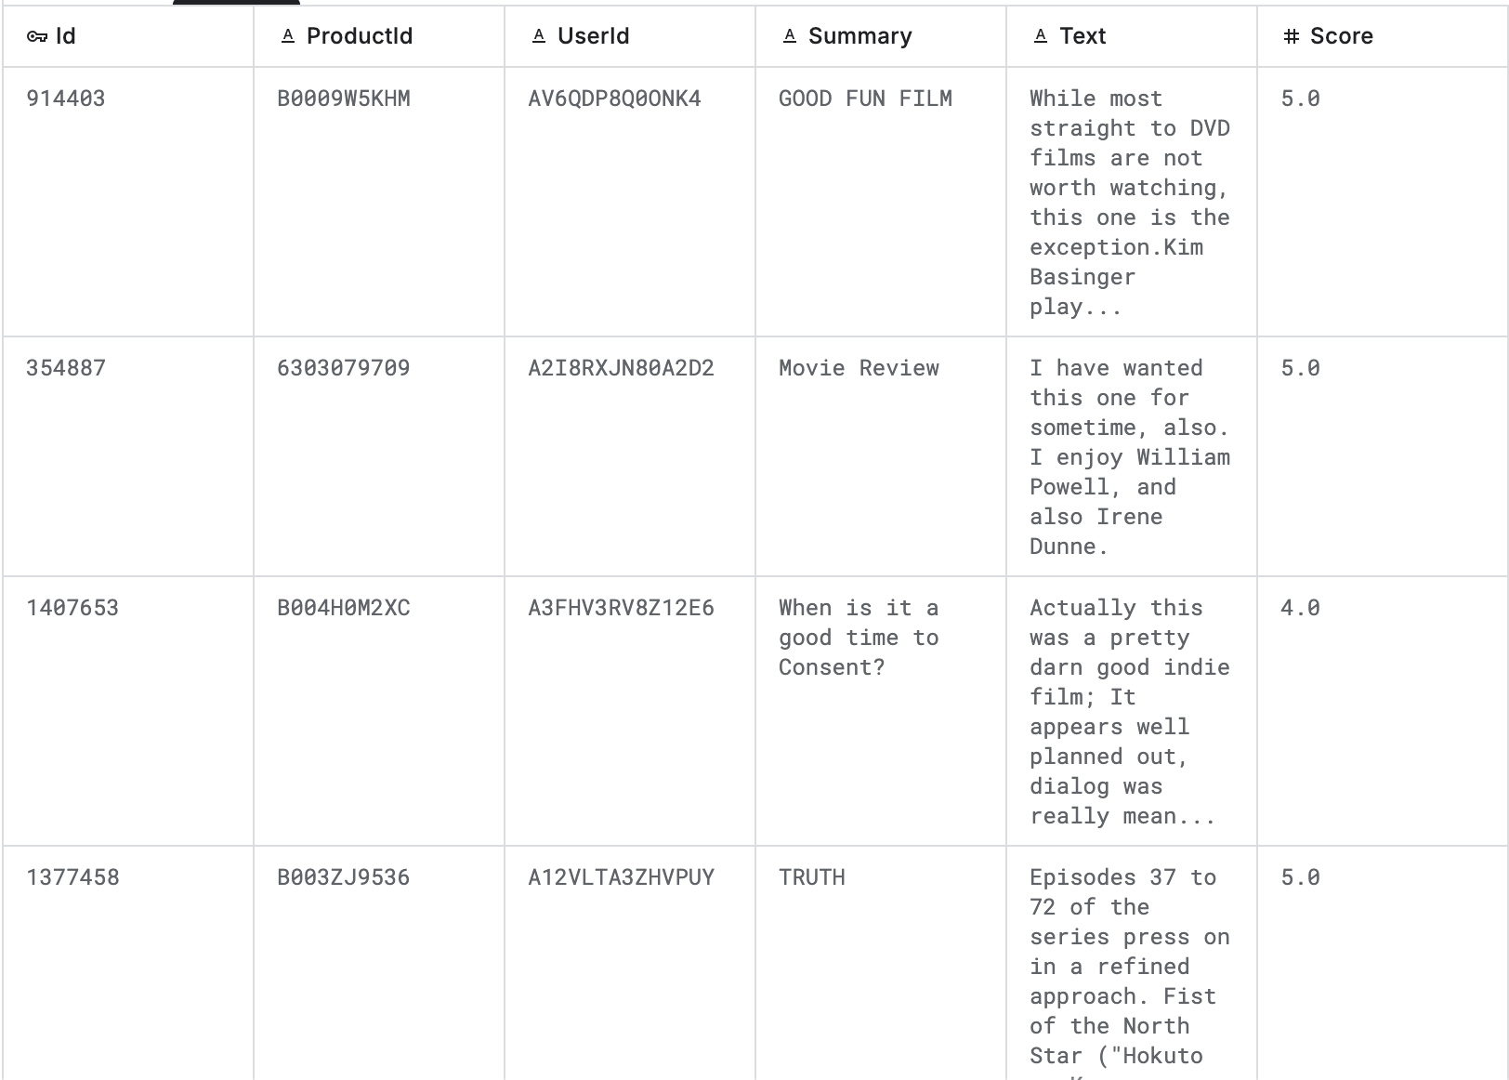
Example dataset: movie reviews
Notes:
Some scores are missing!

Slide 4
Goal of classification
Predict the scores of the movie reviews for the reviews where the scores are hidden.

Slide 5
Goal of classification
Predict the scores of the movie reviews for the reviews where the scores are hidden.
Training set – utilize some subset of the dataset (users with scores) to train our model.

Slide 6
Goal of classification
Predict the scores of the movie reviews for the reviews where the scores are hidden.
Training set – utilize some subset of the dataset (users with scores) to train our model.
Testing set – test the model on data it hasn’t seen before (i.e. the users with no scores attached to their reviews)

Slide 7
Goal of classification
Predict the scores of the movie reviews for the reviews where the scores are hidden.
Training set – utilize some subset of the dataset (users with scores) to train our model.
Testing set – test the model on data it hasn’t seen before (i.e. the users with no scores attached to their reviews)
Evaluate the model by comparing the results to the true values

Slide 8
Recall: types of classifiers
Instance-based classifier:
Use the stored training records to predict the class label of unseen cases
Rote-learners: perform classification only if the attributes of the unseen record exactly match a record in our training set.
There isn’t exactly a training step. The dataset itself is the model.

Slide 9
Recall: types of classifiers
Instance-based classifier:
Use the stored training records to predict the class label of unseen cases
Rote-learners: perform classification only if the attributes of the unseen record exactly match a record in our training set.
There isn’t exactly a training step. The dataset itself is the model.
Nearest neighbor classifier
Use similar records to perform classification

Slide 10

Recall: KNN Classifier
Requirements: training set, distance function, value for $k$
How to classify an unseen record:
Compute distance of unseen record to all training records
Identify the $k$ nearest neighbors (using the specified distance function)
Aggregate the labels of these $k$ nearest neighbors to predict the unseen record

Slide 11
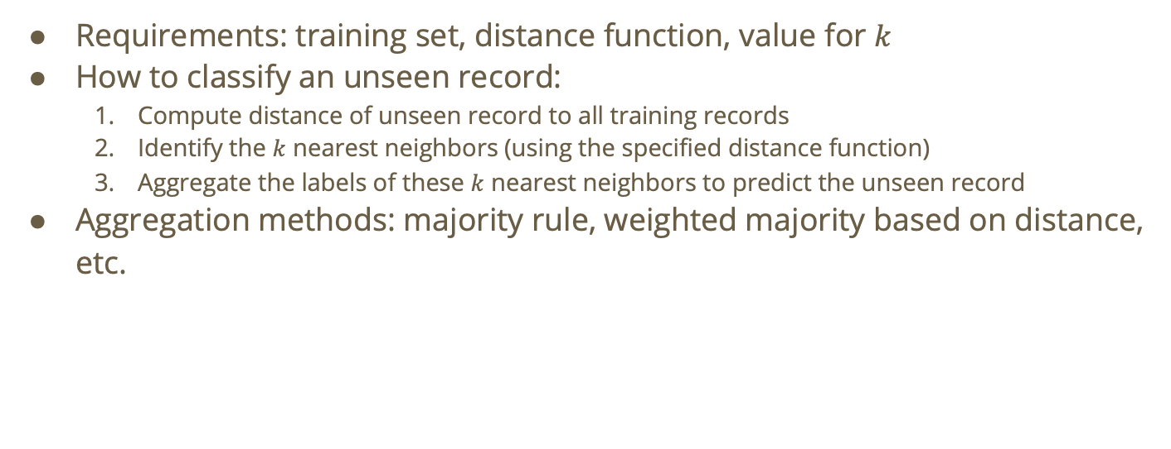
Recall: KNN Classifier
Requirements: training set, distance function, value for $k$
How to classify an unseen record:
Compute distance of unseen record to all training records
Identify the $k$ nearest neighbors (using the specified distance function)
Aggregate the labels of these $k$ nearest neighbors to predict the unseen record
Aggregation methods: majority rule, weighted majority based on distance, etc.

Slide 12
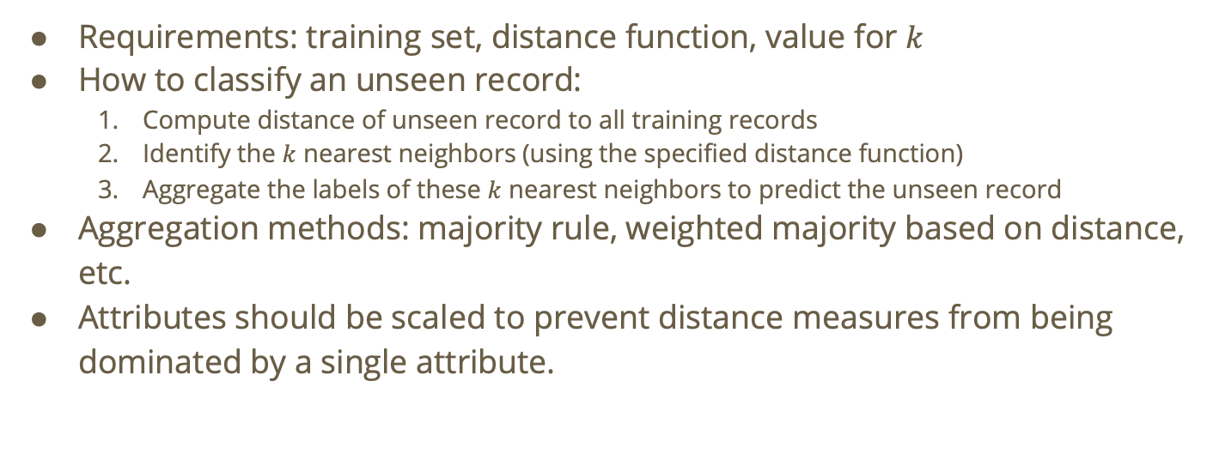
Recall: KNN Classifier
Requirements: training set, distance function, value for $k$
How to classify an unseen record:
Compute distance of unseen record to all training records
Identify the $k$ nearest neighbors (using the specified distance function)
Aggregate the labels of these $k$ nearest neighbors to predict the unseen record
Aggregation methods: majority rule, weighted majority based on distance, etc.
Attributes should be scaled to prevent distance measures from being dominated by a single attribute.

Slide 13
Do not edit How to change the design
True or false: KNN has a long training time
The Slido app must be installed on every computer you’re presenting from

Slide 14
Solution
KNN is a lazy learner. There isn’t any actual training or learning going on. The computational time comes from searching for the nearest neighbors.

Slide 15
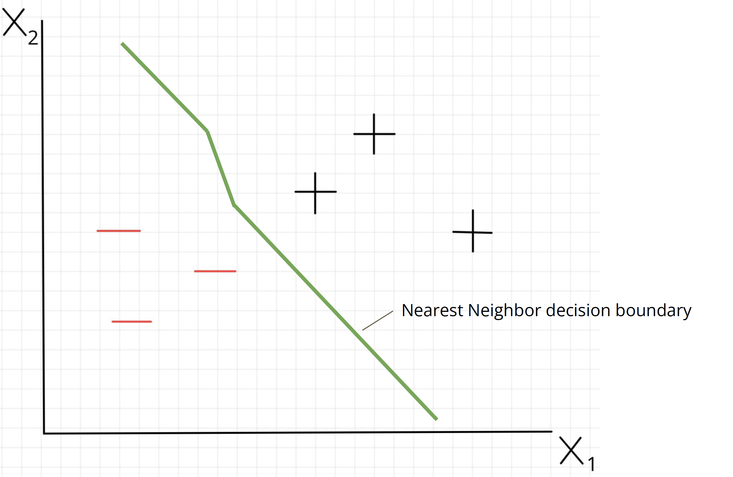
Decision Boundaries
A decision boundary is a line or curve such that if a point is on one side of the curve, it’ll be classified a particular way, and if it is on another, it’ll be classified another way.

Slide 16
Notes:
How will the orange point be classified?

Slide 17
Notes:
How will the orange point be classified?

Slide 18

Choosing $k$
If $k$ is too small: sensitive to noise points, doesn’t generalize well
If $k$ is too big: neighborhood may include points from other classes (outcomes)

Slide 19
Do not edit How to change the design
True or false: if k is too large in KNN, this can lead to underfitting
The Slido app must be installed on every computer you’re presenting from

Slide 20
Question: how can we apply KNN to the movie review example?
First, consider just the body of the review

Slide 21
Question: how can we apply KNN to the movie review example?
First, consider just the body of the review
We need to map the semantic significance of the words to a space where we can apply a distance function and use KNN!

Slide 22
Question: how can we apply KNN to the movie review example?
First, consider just the body of the review
We need to map the semantic significance of the words to a space where we can apply a distance function and use KNN!
Any ideas?

Slide 23
Do not edit How to change the design
What can we use to map the bodies of the reviews to a space where we can run KNN?
The Slido app must be installed on every computer you’re presenting from

Slide 24
Recall: Latent Semantic Analysis (LSA)
We can use LSA to create embeddings for the body of the training set movie reviews.

Slide 25
Recall: Latent Semantic Analysis (LSA)
We can use LSA to create embeddings for the body of the training set movie reviews.
Ideally, LSA will end up grouping together words by sentiment (positive, negative, neutral, etc.)

Slide 26
Recall: Latent Semantic Analysis (LSA)
We can use LSA to create embeddings for the body of the training set movie reviews.
Ideally, LSA will end up grouping together words by sentiment (positive, negative, neutral, etc.)
Once we have generated these embeddings, we can apply KNN to predict the outcomes of the testing set!

Slide 27
Recall: parameterizing KNN
Requirements:
Number of neighbors to examine per data point to classify
Distance function

Slide 28
Do not edit How to change the design
What distance function should we use to identify the semantic similarity of embeddings?
The Slido app must be installed on every computer you’re presenting from

Slide 29
Now, let’s do this!

