Slide 1
Review
CS 506

Slide 2
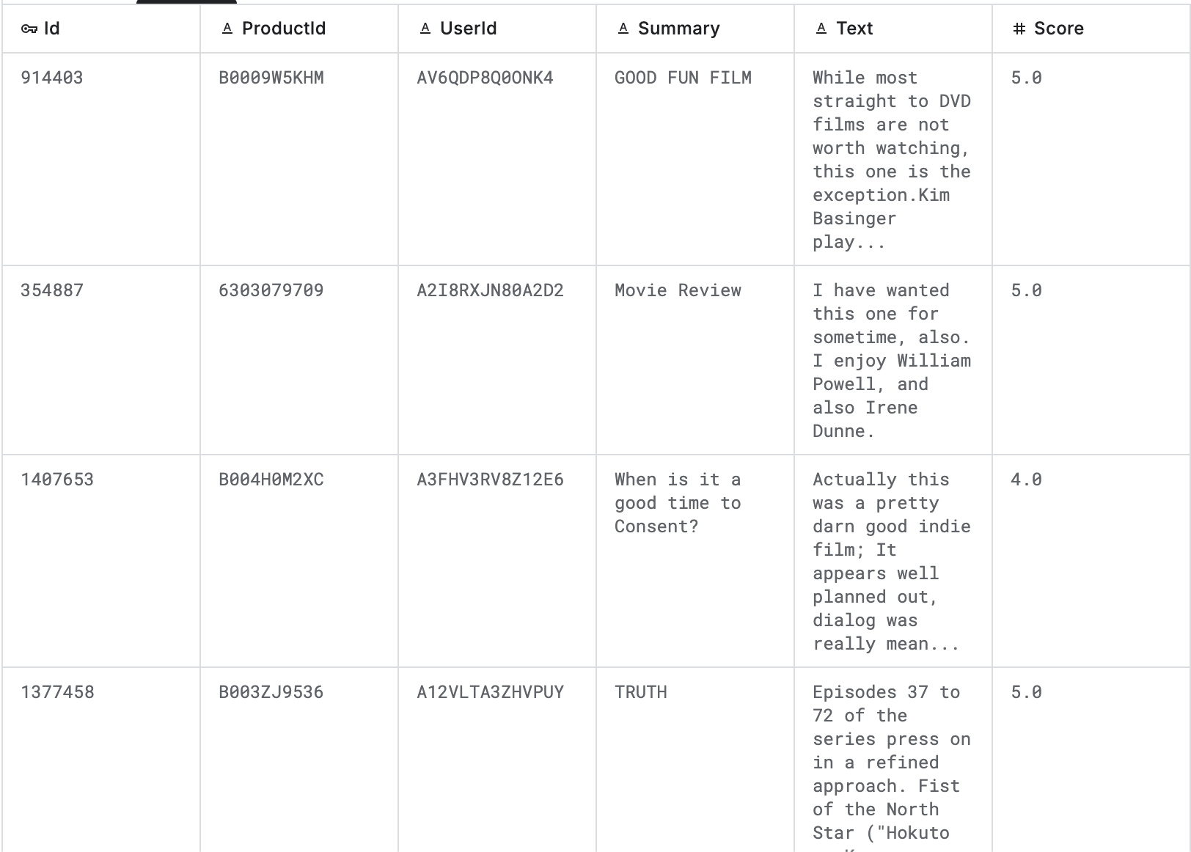
Dataset

Slide 3
Task: construct a model that can predict the score for a review given Id, ProductId, UserId, Summary, and Text.

Slide 4
Task: construct a model that can predict the score for a review given Id, ProductId, UserId, Summary, and Text.
How can we apply techniques we have learned in this class to this dataset?

Slide 5
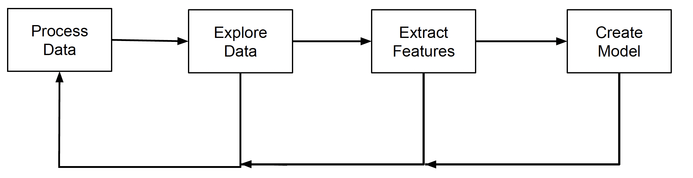
Recall: data science workflow

Slide 6
TFIDF Matrices

Slide 7
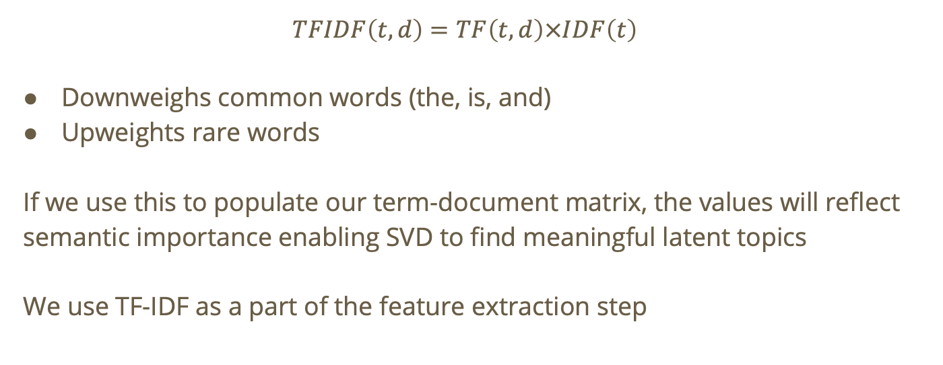
Recall: TF-IDF
$$TFIDF\left(t,d\right)=TF\left(t,d\right)×IDF\left(t\right)$$
Downweighs common words (the, is, and)
Upweights rare words
If we use this to populate our term-document matrix, the values will reflect semantic importance enabling SVD to find meaningful latent topics
We use TF-IDF as a part of the feature extraction step
Notes:
Read as “term frequency of word t in document d” times “inverse document frequency of term t”

Slide 8
TF-IDF for movie reviews
We can apply TF-IDF to our movie review dataset for processing the summary and text columns of the review.

Slide 9
TF-IDF for movie reviews
We can apply TF-IDF to our movie review dataset for processing the summary and text columns of the review.
If we use TF-IDF instead of just forming a term-document matrix, we can place emphasis on the more important words in the reviews which will eventually help us partition reviews by sentiment.

Slide 10
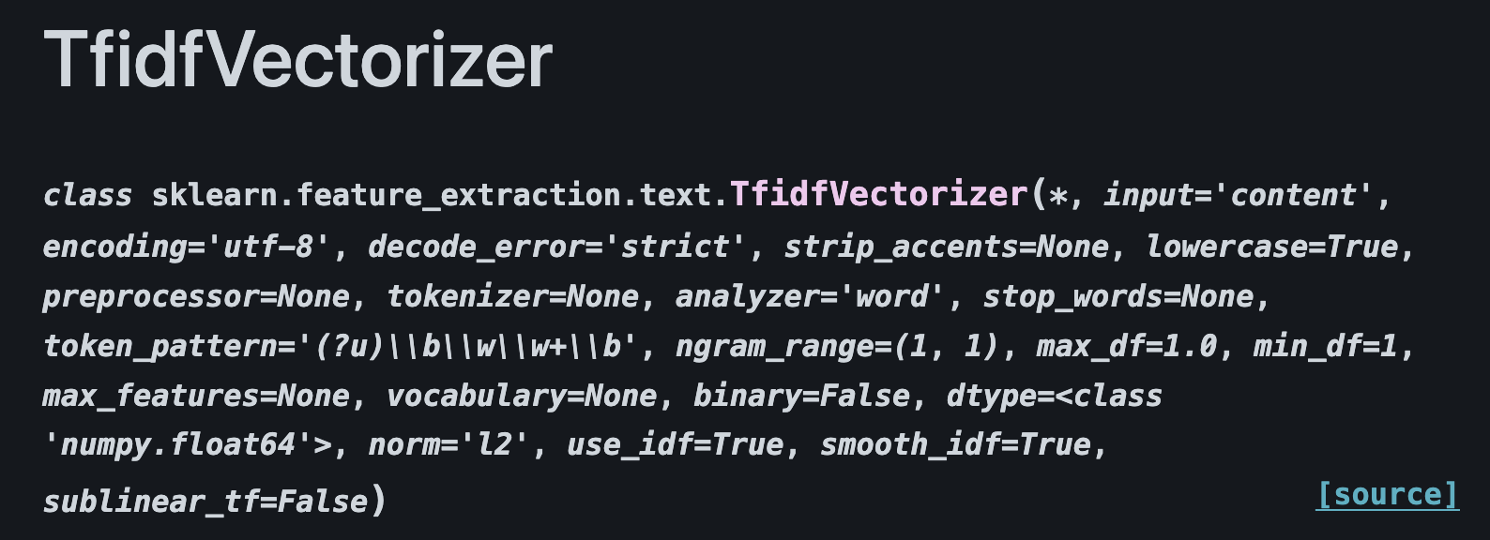
Parameterizing TFIDF

Slide 11
Parameterizing TFIDF
Looks like a lot of parameters!

Slide 12
Parameterizing TFIDF
Looks like a lot of parameters!
We can use tfidf on words and characters!

Slide 13
Parameterizing TFIDF
Looks like a lot of parameters!
We can use tfidf on words and characters!
For now, we’ll examine Tfidf on words, but I recommend you explore using characters!

Slide 14
Parameterizing TFIDF – lowercase: bool
Sometimes our documents will inconsistently contain capitalized words

Slide 15
Parameterizing TFIDF – lowercase: bool
Sometimes our documents will inconsistently contain capitalized words
Some people may write their reviews like this: “I Really Enjoyed This Movie It Was Very Fun To Watch”

Slide 16
Parameterizing TFIDF – lowercase: bool
Sometimes our documents will inconsistently contain capitalized words
Some people may write their reviews like this: “I Really Enjoyed This Movie It Was Very Fun To Watch”
Or like this: “this movie was AWESOME”

Slide 17
Parameterizing TFIDF – lowercase: bool
Sometimes our documents will inconsistently contain capitalized words
Some people may write their reviews like this: “I Really Enjoyed This Movie It Was Very Fun To Watch”
Or like this: “this movie was AWESOME”
Or even like this: “THIS MOVIE WAS AWFULLLLL”

Slide 18
Parameterizing TFIDF – lowercase: bool
Sometimes our documents will inconsistently contain capitalized words
Some people may write their reviews like this: “I Really Enjoyed This Movie It Was Very Fun To Watch”
Or like this: “this movie was AWESOME”
Or even like this: “THIS MOVIE WAS AWFULLLLL”

Slide 19
Parameterizing TFIDF – lowercase: bool
Sometimes our documents will inconsistently contain capitalized words
We must consider the following tradeoff:

Slide 20
Parameterizing TFIDF – lowercase: bool
Sometimes our documents will inconsistently contain capitalized words
We must consider the following tradeoff:
If we convert every word in a review to lowercase, we may lose important information about the sentiment of a given review!

Slide 21
Parameterizing TFIDF – lowercase: bool
Sometimes our documents will inconsistently contain capitalized words
We must consider the following tradeoff:
If we convert every word in a review to lowercase, we may lose important information about the sentiment of a given review!
Hmm… Maybe we can solve this by creating our own text preprocessor that leaves relevant adjectives as all-caps and converts everything else to lowercase?

Slide 22
Parameterizing TFIDF – stop_words: {‘english’}, list, default=None
“Stop words are words like “and”, “the”, “him”, which are presumed to be uninformative in representing the content of a text, and which may be removed to avoid them being construed as informative for prediction.” ¹
¹Scikit-learn feature extraction documentation

Slide 23
Parameterizing TFIDF – stop_words: {‘english’}, list, default=None
“Stop words are words like “and”, “the”, “him”, which are presumed to be uninformative in representing the content of a text, and which may be removed to avoid them being construed as informative for prediction.” ¹
We can add our own “domain-specific” stop words and pass it in as a parameter (see lab 7 Python Notebook example)
¹Scikit-learn feature extraction documentation

Slide 24
Parameterizing TFIDF – stop_words: {‘english’}, list, default=None
“Stop words are words like “and”, “the”, “him”, which are presumed to be uninformative in representing the content of a text, and which may be removed to avoid them being construed as informative for prediction.” ¹
We can add our own “domain-specific” stop words and pass it in as a parameter (see lab 7 Python Notebook example)
For example, a lot of movie reviews probably contain the word “movie”, but does this help us distinguish reviews at all?
¹Scikit-learn feature extraction documentation

Slide 25
Parameterizing TFIDF – ngram_range: tuple (min_n, max_n), default=(1,1)
When extracting features from documents, sometimes we may want to look like at bigrams too!

Slide 26
Parameterizing TFIDF – ngram_range: tuple (min_n, max_n), default=(1,1)
When extracting features from documents, sometimes we may want to look like at bigrams too!
Example: “this movie’s execution of a plot twist was a great disaster!”

Slide 27
Parameterizing TFIDF – ngram_range: tuple (min_n, max_n), default=(1,1)
When extracting features from documents, sometimes we may want to look like at bigrams too!
Example: “this movie’s execution of a plot twist was a great disaster!”
Unigrams: great, disaster

Slide 28
Parameterizing TFIDF – ngram_range: tuple (min_n, max_n), default=(1,1)
When extracting features from documents, sometimes we may want to look like at bigrams too!
Example: “this movie’s execution of a plot twist was a great disaster!”
Unigrams: great, disaster
Bigram: great disaster

Slide 29
Parameterizing TFIDF – ngram_range: tuple (min_n, max_n), default=(1,1)
When extracting features from documents, sometimes we may want to look like at bigrams too!
Example: “this movie’s execution of a plot twist was a great disaster!”
Unigrams: great, disaster
Bigram: great disaster
If we look at the unigram, the two words by themselves conflict, but the bigram gives us insight into the reviewers feeling about the movie.

Slide 30
Parameterizing TFIDF
Read through the scikit documentation for TfidfVectorizer to see how we can control the creation of the weight matrix!

Slide 31
Singular Value Decomposition

Slide 32
SVD on Movie Reviews
The movie review dataset may contain a lot of noise. People may use synonyms throughout the review, and directly using the Tfidf matrix for prediction may result in us looking at thousands of raw terms.

Slide 33
SVD on Movie Reviews
The movie review dataset may contain a lot of noise. People may use synonyms throughout the review, and directly using the Tfidf matrix for prediction may result in us looking at thousands of raw terms.
SVD will allow us to remove some of this noise from the Tfidf matrix and make predictions about scores based on the features that explain the most variance in our dataset.

Slide 34

Recall: Latent Semantic Similarity
Given term-document matrix $A$, we apply SVD to get the following decomposition:

Slide 35

Recall: Latent Semantic Similarity
Given term-document matrix $A$, we apply SVD to get the following decomposition:
$$A=UΣV^{T}$$

Slide 36




$$A=UΣV^{T}$$
$$U$$
doc-to-concept similarity matrix
0.18 | 0
0.36 | 0
0.18 | 0
0.90 | 0
0 | 0.53
0 | 0.80
0 | 0.27
“strength” of each concept
$$V^{T}$$
$$Σ$$
term-to-concept similarity matrix
9.64 | 0
0 | 5.29
0.58 | 0.58 | 0.58 | 0 | 0
0 | 0 | 0 | 0.71 | 0.71
Notes:
This is an SVD for our dataset. Keep in mind, concepts here refer to latent concepts/hidden concepts

Slide 37
Latent Semantic Similarity on Movie Reviews
Embeddings generated by a well-parameterized LSA model on the review bodies and summaries may show some separation by sentiment, because sentiment-related word usage can become aligned with latent semantic directions

Slide 38
Latent Semantic Similarity on Movie Reviews
Ideally, we may end up with embeddings like the following

Slide 39
Latent Semantic Similarity on Movie Reviews
Ideally, we may end up with embeddings like the following

Slide 40
Latent Semantic Similarity on Movie Reviews
Ideally, we may end up with embeddings like the following
Where each vector represents a movie review, and reviews with similar sentiment may cluster together

Slide 41
K Nearest Neighbors (KNN)

Slide 42
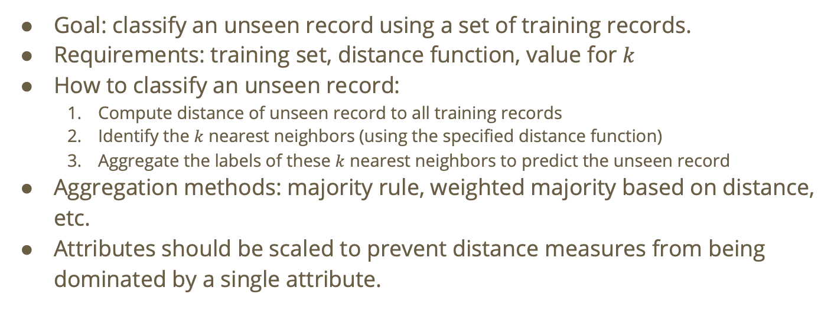
Recall: KNN Classifier
Goal: classify an unseen record using a set of training records.
Requirements: training set, distance function, value for $k$
How to classify an unseen record:
Compute distance of unseen record to all training records
Identify the $k$ nearest neighbors (using the specified distance function)
Aggregate the labels of these $k$ nearest neighbors to predict the unseen record
Aggregation methods: majority rule, weighted majority based on distance, etc.
Attributes should be scaled to prevent distance measures from being dominated by a single attribute.

Slide 43
KNN on Movie Reviews
We run KNN on movie reviews with any feature representation that turns each review into a numeric vector.

Slide 44
KNN on Movie Reviews
We run KNN on movie reviews with any feature representation that turns each review into a numeric vector.
One way we can turn the text of our reviews into numeric vectors is using LSA!

Slide 45
KNN on Movie Reviews
We run KNN on movie reviews with any feature representation that turns each review into a numeric vector.
One way we can turn the text of our reviews into numeric vectors is using LSA!
We can use LSA to generate embeddings (on the same space) for the training reviews (i.e., the reviews for which we already know the score) and the testing reviews.

Slide 46
KNN on Movie Reviews
We can use LSA to generate embeddings (on the same space) for the training reviews (i.e., the reviews for which we already know the score) and the testing reviews.
Once these embeddings are on the same space, we can run KNN to classify the testing reviews.

Slide 47
Each vector is an LSA embedding for a training review

Slide 48
Assign each training review its “true value” (true score)
1
1
1
4
4
4

Slide 49
Assign each training review its “true value” (true score)
1
Let this “cluster” be the 1-star class
1
1
4
Let this “cluster” be the 4-star class
4
4

Slide 50
Generate embeddings for the testing reviews (we’ll use one as an example)
1
1
1
4
4
4

Slide 51

Run KNN using a cosine distance function (since we are using LSA embeddings). We’ll use $k=2$ for the sake of this example
1
1
1
4
4
4

Slide 52
Identify the two nearest neighbors
1
1
1
4
4
4

Slide 53
Aggregate the labels of the 2 neighbors, and classify the testing point accordingly. We will use majority rules aggregation
1
1
1
4
4
4

Slide 54
Aggregate the labels of the 2 neighbors, and classify the testing point accordingly. We will use majority rules aggregation
1
1
1
1
4
4
4

Slide 55
Naïve Bayes

Slide 56

Recall: Naïve Bayes
Given features
$$\left(A_{1}=a_{1},A_{2}=a_{2},…,A_{n}=a_{n}\right)$$
Predict the class $C$ that maximizes
$$ℙ\left(C | A_{1}=a_{1},A_{2}=a_{2},…,A_{n}=a_{n}\right)$$

Slide 57

Recall: Naïve Bayes
Example: binary class {yes, no}
Compute $ℙ\left(Y | A_{1}=a_{1},…\right)$
Compute $ℙ\left(N | A_{1}=a_{1},…\right)$
Compare then predict the class with the highest conditional probability

Slide 58

Naïve Bayes: Assumptions
Note: $ℙ\left(C | A_{1}=a_{1},A_{2}=a_{2},…,A_{n}=a_{n}\right)$ = $\frac{ℙ\left(C | A_{1}=a_{1},…,A_{n}=a_{n}\right)ℙ\left(C\right)}{ℙ\left(C | A_{1}=a_{1},…,A_{n}=a_{n}\right)}$

Slide 59

Naïve Bayes: Assumptions
Note: $ℙ\left(C | A_{1}=a_{1},A_{2}=a_{2},…,A_{n}=a_{n}\right)$ = $\frac{ℙ\left(C | A_{1}=a_{1},…,A_{n}=a_{n}\right)ℙ\left(C\right)}{ℙ\left(C | A_{1}=a_{1},…,A_{n}=a_{n}\right)}$
To estimate $ℙ\left(C | A_{1}=a_{1},A_{2}=a_{2},…,A_{n}=a_{n}\right)$, we assume independence of features

Slide 60
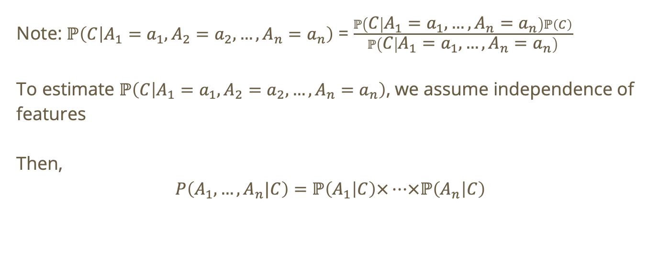
Naïve Bayes: Assumptions
Note: $ℙ\left(C | A_{1}=a_{1},A_{2}=a_{2},…,A_{n}=a_{n}\right)$ = $\frac{ℙ\left(C | A_{1}=a_{1},…,A_{n}=a_{n}\right)ℙ\left(C\right)}{ℙ\left(C | A_{1}=a_{1},…,A_{n}=a_{n}\right)}$
To estimate $ℙ\left(C | A_{1}=a_{1},A_{2}=a_{2},…,A_{n}=a_{n}\right)$, we assume independence of features
Then,
$$P\left(A_{1},…,A_{n}|C\right)=ℙ\left(A_{1} | C\right)×…×ℙ\left(A_{n} | C\right)$$

Slide 61
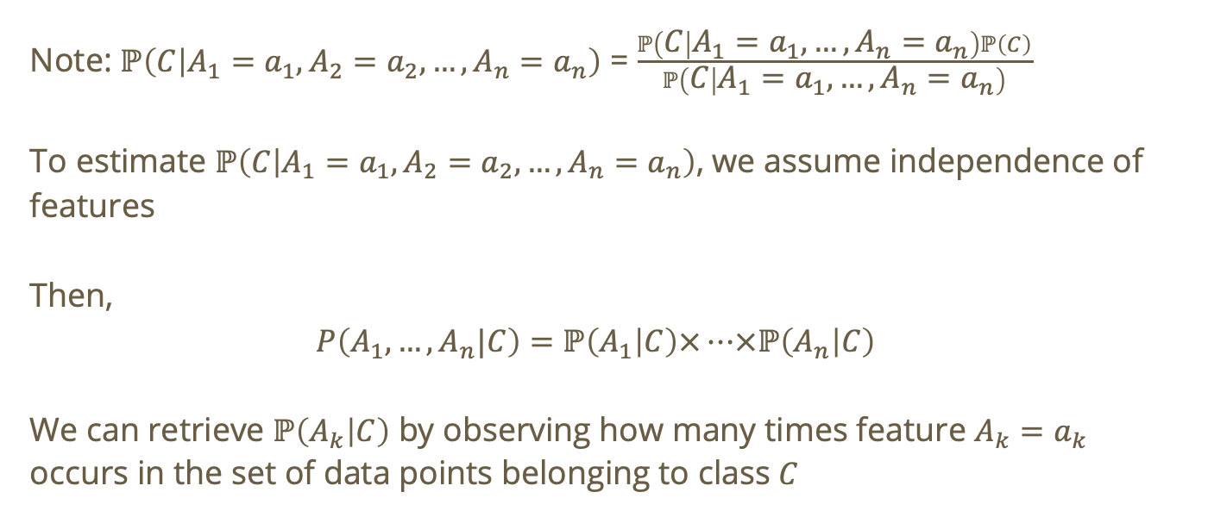
Naïve Bayes: Assumptions
Note: $ℙ\left(C | A_{1}=a_{1},A_{2}=a_{2},…,A_{n}=a_{n}\right)$ = $\frac{ℙ\left(C | A_{1}=a_{1},…,A_{n}=a_{n}\right)ℙ\left(C\right)}{ℙ\left(C | A_{1}=a_{1},…,A_{n}=a_{n}\right)}$
To estimate $ℙ\left(C | A_{1}=a_{1},A_{2}=a_{2},…,A_{n}=a_{n}\right)$, we assume independence of features
Then,
$$P\left(A_{1},…,A_{n}|C\right)=ℙ\left(A_{1} | C\right)×…×ℙ\left(A_{n} | C\right)$$
We can retrieve $ℙ\left(A_{k} | C\right)$ by observing how many times feature $A_{k}=a_{k}$ occurs in the set of data points belonging to class $C$

Slide 62
Naïve Bayes for movie reviews
Here is a potential high-level pipeline for using Naïve Bayes to classify movie reviews

Slide 63
Naïve Bayes for movie reviews
Here is a potential high-level pipeline for using Naïve Bayes to classify movie reviews
Create document-term matrix using Tfidf on review text

Slide 64
Naïve Bayes for movie reviews
Here is a potential high-level pipeline for using Naïve Bayes to classify movie reviews
Create document-term matrix using Tfidf on review text
Part of this step is parameterizing Tfidf (stop words, n_grams, min_df, max_df, etc.)

Slide 65
Naïve Bayes for movie reviews
Here is a potential high-level pipeline for using Naïve Bayes to classify movie reviews
Create document-term matrix using Tfidf on review text
Part of this step is parameterizing Tfidf (stop words, n_grams, min_df, max_df, etc.)
You can also include the summary in Tfidf by converting each document to: summary + “ “ + body

Slide 66
Naïve Bayes for movie reviews
Here is a potential high-level pipeline for using Naïve Bayes to classify movie reviews
Create document-term matrix using Tfidf on review text
Part of this step is parameterizing Tfidf (stop words, n_grams, min_df, max_df, etc.)
You can also include the summary in Tfidf by converting each document to: summary + “ “ + body
If you think the summary is particularly important, you can even do something like this: summary + “ “ + body + “ “ + summary

Slide 67
Naïve Bayes for movie reviews
Here is a potential high-level pipeline for using Naïve Bayes to classify movie reviews
Create document-term matrix using Tfidf on review text
Split the data into a training set, testing set, and validation set.

Slide 68
Naïve Bayes for movie reviews
Here is a potential high-level pipeline for using Naïve Bayes to classify movie reviews
Create document-term matrix using Tfidf on review text
Split the data into a training set, testing set, and validation set.
Train Multinomial Naïve Bayes on the document-term matrix

Slide 69
Naïve Bayes for movie reviews
Here is a potential high-level pipeline for using Naïve Bayes to classify movie reviews
Create document-term matrix using Tfidf on review text
Split the data into a training set, testing set, and validation set.
Train Multinomial Naïve Bayes on the document-term matrix
Multinomial allows us to account for the frequency of sentimental words (i.e., words we associate with positivity, negativity, neutrality, etc.)

Slide 70
Naïve Bayes for movie reviews
Here is a potential high-level pipeline for using Naïve Bayes to classify movie reviews
Create document-term matrix using Tfidf on review text
Split the data into a training set, testing set, and validation set.
Train Multinomial Naïve Bayes on the document-term matrix
Multinomial allows us to account for the frequency of sentimental words (i.e., words we associate with positivity, negativity, neutrality, etc.)
If we used Bernoulli NB, we would only be accounting for whether a given word occurs or not.

Slide 71
Naïve Bayes for movie reviews
Here is a potential high-level pipeline for using Naïve Bayes to classify movie reviews
Create document-term matrix using Tfidf on review text
Split the data into a training set, testing set, and validation set.
Train Multinomial Naïve Bayes on the document-term matrix
Predict on validation or test reviews

Slide 72
Naïve Bayes for movie reviews
Here is a potential high-level pipeline for using Naïve Bayes to classify movie reviews
Create document-term matrix using Tfidf on review text
Split the data into a training set, testing set, and validation set.
Train Multinomial Naïve Bayes on the document-term matrix
Predict on validation or test reviews
Evaluate performance

Slide 73
Naïve Bayes for movie reviews
Here is a potential high-level pipeline for using Naïve Bayes to classify movie reviews
Create document-term matrix using Tfidf on review text
Split the data into a training set, testing set, and validation set.
Train Multinomial Naïve Bayes on the document-term matrix
Predict on validation or test reviews
Evaluate performance
We can evaluate our performance on the validation set using different methods we have learned in class: confusion matrix, cost matrix, precision, recall, F-measure. Feel free to explore other model evaluation metrics!

Slide 74
Naïve Bayes for movie reviews
Here is a potential high-level pipeline for using Naïve Bayes to classify movie reviews
Create document-term matrix using Tfidf on review text
Split the data into a training set, testing set, and validation set.
Train Multinomial Naïve Bayes on the document-term matrix
Predict on validation or test reviews
Evaluate performance
Tune the pipeline

Slide 75
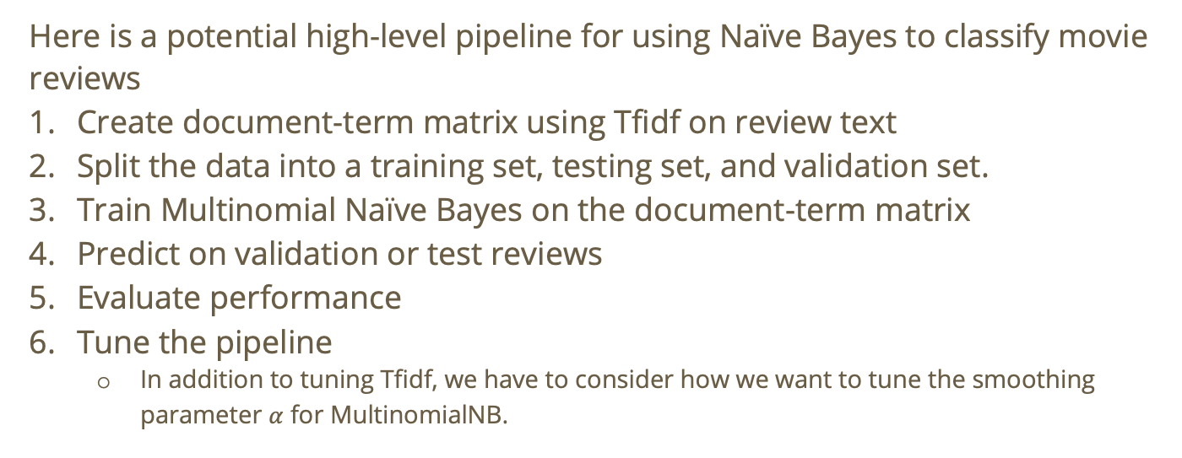
Naïve Bayes for movie reviews
Here is a potential high-level pipeline for using Naïve Bayes to classify movie reviews
Create document-term matrix using Tfidf on review text
Split the data into a training set, testing set, and validation set.
Train Multinomial Naïve Bayes on the document-term matrix
Predict on validation or test reviews
Evaluate performance
Tune the pipeline
In addition to tuning Tfidf, we have to consider how we want to tune the smoothing parameter $α$ for MultinomialNB.

Slide 76
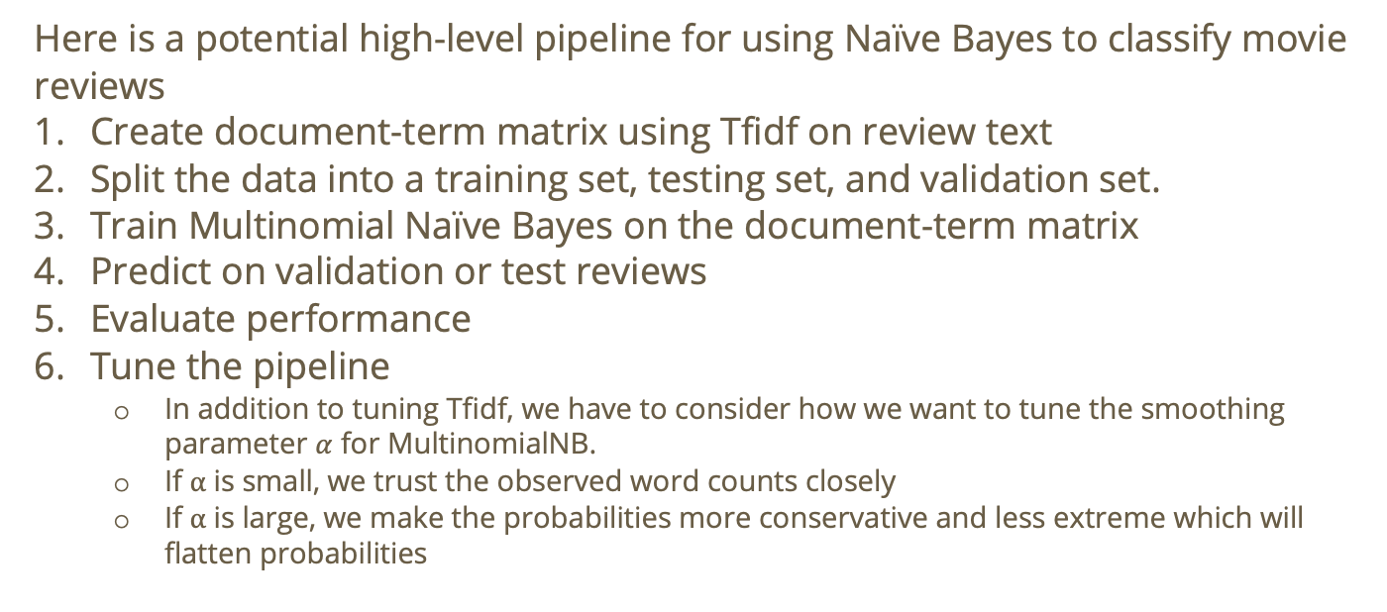
Naïve Bayes for movie reviews
Here is a potential high-level pipeline for using Naïve Bayes to classify movie reviews
Create document-term matrix using Tfidf on review text
Split the data into a training set, testing set, and validation set.
Train Multinomial Naïve Bayes on the document-term matrix
Predict on validation or test reviews
Evaluate performance
Tune the pipeline
In addition to tuning Tfidf, we have to consider how we want to tune the smoothing parameter $α$ for MultinomialNB.
If $α$ is small, we trust the observed word counts closely
If $α$ is large, we make the probabilities more conservative and less extreme which will flatten probabilities

Slide 77
Recommender Systems

Slide 78
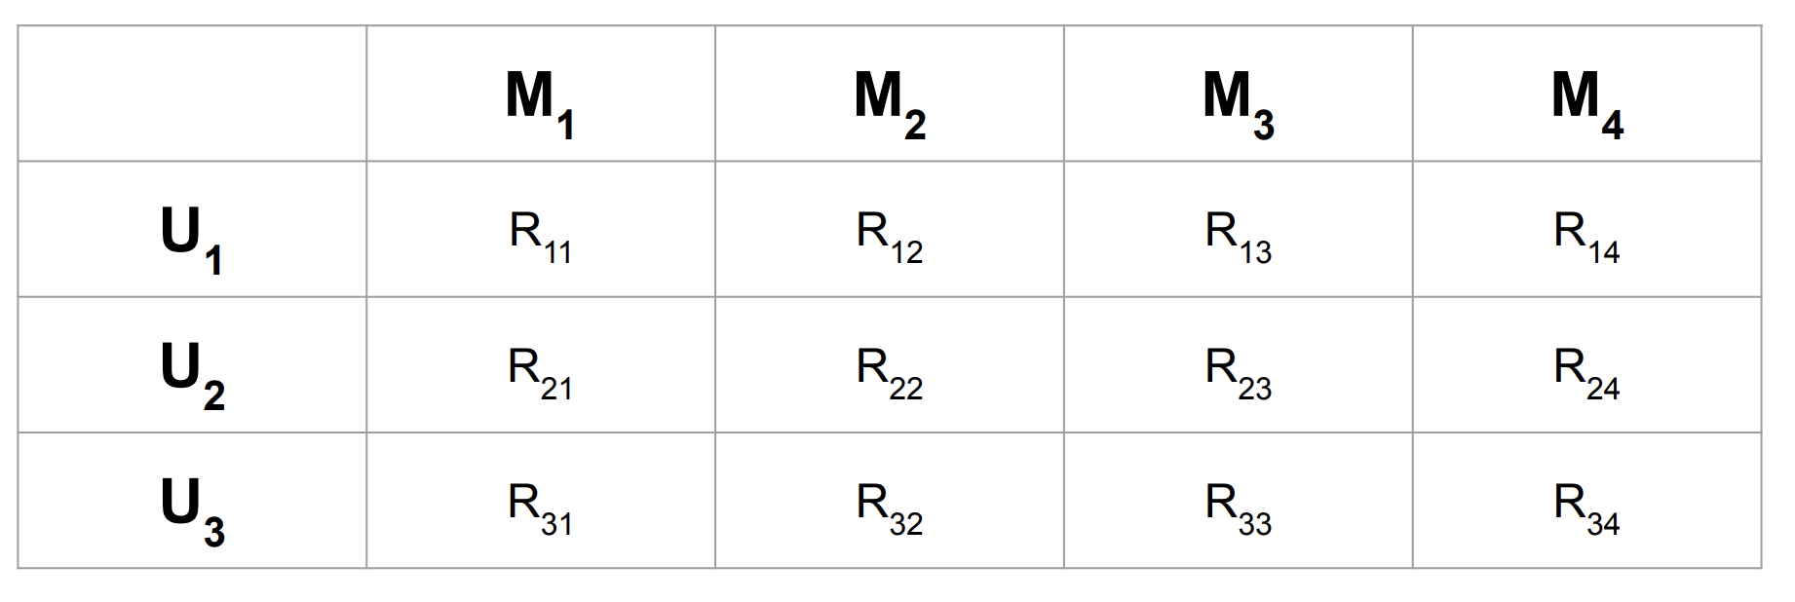

Recall: Recommender Systems
$R_{ij}$ = User $i$’s rating of Movie $j$

Slide 79

Recall: Recommender Systems
$R_{ij}$ = User $i$’s rating of Movie $j$
Call this the user-to-movie matrix

Slide 80
Content based filtering vs Collaborative filtering
Content-based: assume you have features for movies – want to learn features for users
Collaborative filtering: want to learn features for both users and movies

Slide 81
Content-based: Constructing the user-to-movie matrix
Assuming we have features for movies, we can construct the user-to-movie matrix by the following decomposition
user-to-feature x feature-to-movie = user-to-movie
User-to-feature could mean how much does each user prefer each genre of movie?

Slide 82
Content-based: Constructing the user-to-movie matrix
Assuming we have features for movies, we can construct the user-to-movie matrix by the following decomposition
user-to-feature x feature-to-movie = user-to-movie
User-to-feature could mean how much does each user prefer each genre of movie?
Feature-to-movie could mean how much is each “genre” represented in each movie?

Slide 83
Content-based: Constructing the user-to-movie matrix
user-to-feature x feature-to-movie = user-to-movie
User-to-feature could mean how much does each user prefer each genre of movie?
Feature-to-movie could mean how much is each “genre” represented in each movie?
But how do we find the user-to-feature matrix?

Slide 84

Content-based: Constructing the user-to-movie matrix
user-to-feature x feature-to-movie = user-to-movie
Let $P$ = user-to-feature matrix, $Q$ = feature-to-movie matrix

Slide 85
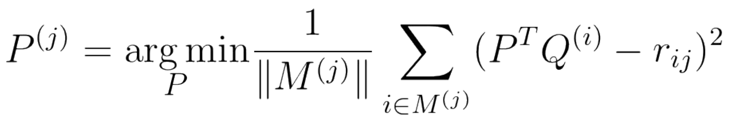
Content-based: Constructing the user-to-movie matrix
user-to-feature x feature-to-movie = user-to-movie
Let $P$ = user-to-feature matrix, $Q$ = feature-to-movie matrix

Slide 86
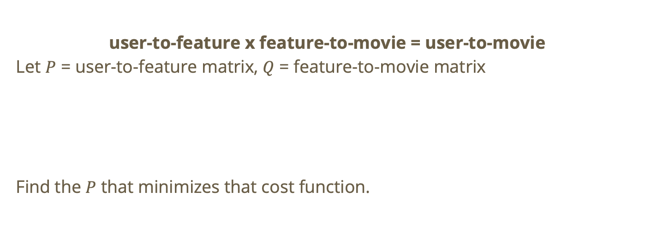
Content-based: Constructing the user-to-movie matrix
user-to-feature x feature-to-movie = user-to-movie
Let $P$ = user-to-feature matrix, $Q$ = feature-to-movie matrix
Find the $P$ that minimizes that cost function.

Slide 87

Collaborative-based: feature extraction
Given $R$ the user-to-movie matrix, we want to find

Slide 88

Collaborative-based: feature extraction
Given $R$ the user-to-movie matrix, we want to find
$$R = PQ$$
We can’t use SVD because $R$ is sparse so we can use something akin to the GMM EM algorithm.

Slide 89

Collaborative-based: feature extraction
Given $R$ the user-to-movie matrix, we want to find
$$R = PQ$$
Start with random $Q$
Get $P$
Improve $Q$
Repeat 2 & 3 until convergence.

Slide 90
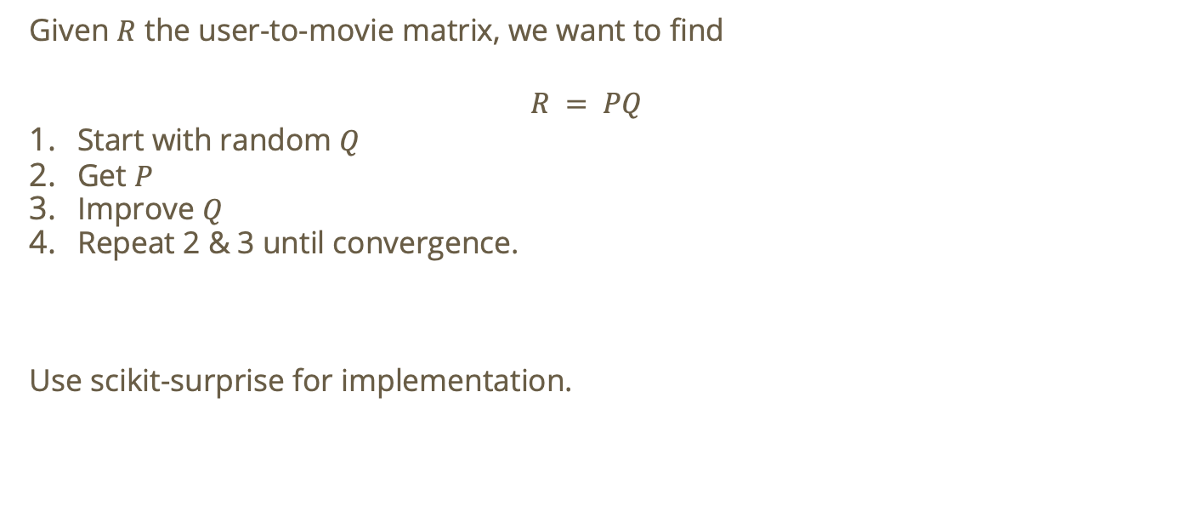
Collaborative-based: feature extraction
Given $R$ the user-to-movie matrix, we want to find
$$R = PQ$$
Start with random $Q$
Get $P$
Improve $Q$
Repeat 2 & 3 until convergence.
Use scikit-surprise for implementation.

Slide 91
How else can we use recommender systems for the movie review dataset?
We can also use recommenders directly on features like ProductId and UserId.

Slide 92
How else can we use recommender systems for the movie review dataset?
We can also use recommenders directly on features like ProductId and UserId.
Recommenders can help us account for skew. E.g., the fact that some users skew towards reviewing harshly, or maybe a movie is universally viewed as bad.

Slide 93
How else can we use recommender systems for the movie review dataset?
We can also use recommenders directly on features like ProductId and UserId.
Recommenders can help us account for skew. E.g., the fact that some users skew towards reviewing harshly, or maybe a movie is universally viewed as bad.
We can use recommenders to supplement our classification task!

Slide 94
Support Vector Machines (SVM)

Slide 95
Recall: SVM
SVM: find the widest street that separates our classes

Slide 96
Recall: SVM
SVM: find the widest street that separates our classes
Goals of SVM:

Slide 97
Recall: SVM
SVM: find the widest street that separates our classes
Goals of SVM:
Correctly classify data points
Data points cannot be in the street

Slide 98
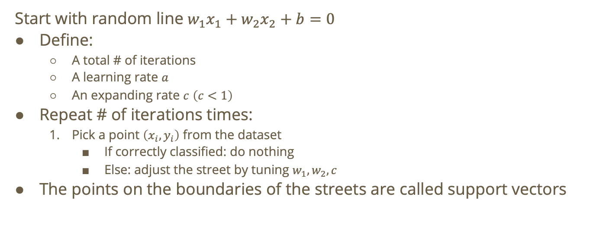
Recall: perceptron algorithm
Start with random line $w_{1}x_{1}+w_{2}x_{2}+b=0$
Define:
A total # of iterations
A learning rate $a$
An expanding rate $c$ $\left(c<1\right)$
Repeat # of iterations times:
Pick a point $\left(x_{i},y_{i}\right)$ from the dataset
If correctly classified: do nothing
Else: adjust the street by tuning $w_{1},w_{2},c$
The points on the boundaries of the streets are called support vectors

Slide 99
What if there is no clear line for a decision boundary?
Option 1: Soft margins
Allow some amount of error (i.e., some points are misclassified)
Option 2: Change perspective
Utilize a kernel function to specify closeness/similarity of points in a hypothetical transformed space.
This will hopefully allow us to create a decision boundary, even though we can’t immediately see one on our Euclidean plane.

Slide 100
How can we use SVMs for our problem?
SVM works well for sparse high-dimensional text data.

Slide 101
How can we use SVMs for our problem?
SVM works well for sparse high-dimensional text data.
Here are two possible pipelines we could use:

Slide 102
How can we use SVMs for our problem?
SVM works well for sparse high-dimensional text data.
Here are two possible pipelines we could use:
Tfidf(text, summary) → Linear SVM

Slide 103
How can we use SVMs for our problem?
SVM works well for sparse high-dimensional text data.
Here are two possible pipelines we could use:
Tfidf(text, summary) → Linear SVM
Tfidf(text, summary) → SVD → Linear SVM

Slide 104
How can we use SVMs for our problem?
SVM works well for sparse high-dimensional text data.
Here are two possible pipelines we could use:
Tfidf(text, summary) → Linear SVM
Tfidf(text, summary) → SVD → Linear SVM
If we don’t care about predicting exact scores but rather, we care about being close, we could use a linear SVR (support vector regression).

Slide 105
Data Exploration

Slide 106
Finding Noise
Like we mentioned before, words like “movie” probably occur very frequently and are useless in distinguishing reviews!

Slide 107
Finding Noise
Like we mentioned before, words like “movie” probably occur very frequently and are useless in distinguishing reviews!
We can use different methods for “manually” finding and removing noise in our dataset!

Slide 108
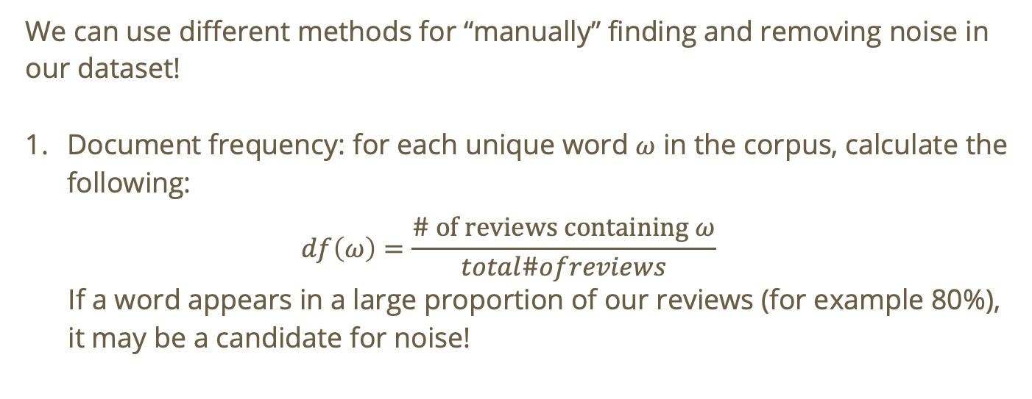
Finding Noise
We can use different methods for “manually” finding and removing noise in our dataset!
Document frequency: for each unique word $ω$ in the corpus, calculate the following:
$$df\left(ω\right)=\frac{\text{\# }\text{of} \text{reviews} \text{containing} ω}{total\#ofreviews}$$
If a word appears in a large proportion of our reviews (for example 80%),
it may be a candidate for noise!

Slide 109
Finding Noise
We can use different methods for “manually” finding and removing noise in our dataset!
Document frequency
Check class commonality
For a given word that you suspect of being noise, calculate the following:

Slide 110
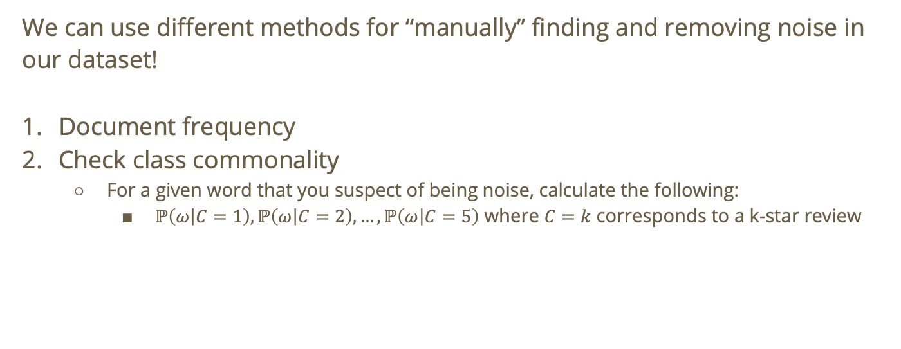
Finding Noise
We can use different methods for “manually” finding and removing noise in our dataset!
Document frequency
Check class commonality
For a given word that you suspect of being noise, calculate the following:
$ℙ\left(ω | C=1\right),ℙ\left(ω | C=2\right),…,ℙ\left(ω | C=5\right)$ where $C=k$ corresponds to a k-star review

Slide 111
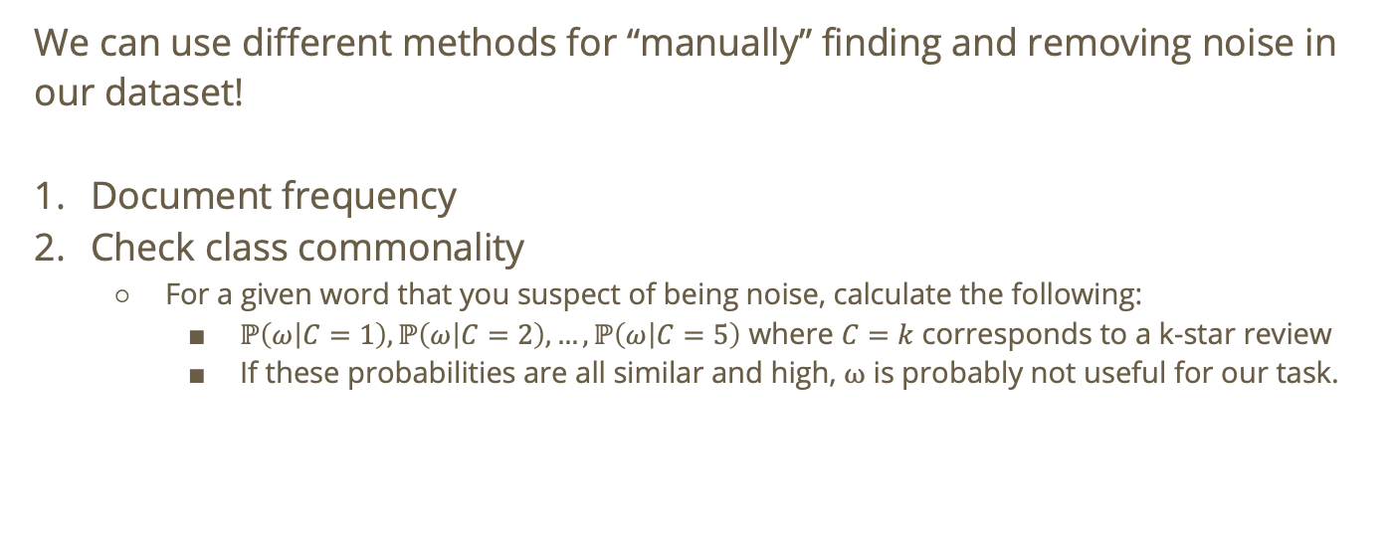
Finding Noise
We can use different methods for “manually” finding and removing noise in our dataset!
Document frequency
Check class commonality
For a given word that you suspect of being noise, calculate the following:
$ℙ\left(ω | C=1\right),ℙ\left(ω | C=2\right),…,ℙ\left(ω | C=5\right)$ where $C=k$ corresponds to a k-star review
If these probabilities are all similar and high, $ω$ is probably not useful for our task.

Slide 112
Finding Noise
We can use different methods for “manually” finding and removing noise in our dataset!
Document frequency
Check class commonality
Parameterization!

Slide 113
Finding Noise
We can use different methods for “manually” finding and removing noise in our dataset!
Document frequency
Check class commonality
Parameterization!
sklearn methods like TfidfVectorizer() allow us to specify min_df and max_df

Slide 114
Finding Noise
We can use different methods for “manually” finding and removing noise in our dataset!
Document frequency
Check class commonality
Parameterization!
sklearn methods like TfidfVectorizer() allow us to specify min_df and max_df
min_df is the minimum number of documents that a term must appear in to be considered a term
max_df is the maximum proportion of documents that a term can appear in to be considered a term.

Slide 115
Finding Noise
We can use different methods for “manually” finding and removing noise in our dataset!
Document frequency
Check class commonality
Parameterization!
sklearn methods like TfidfVectorizer() allow us to specify min_df and max_df
TfidfVectorizer() allows us to specify stop_words, too: i.e., words that will automatically be dismissed as noise!

Slide 116
Validating our feature choice
Typically, when we introduce features, we want to be able to measure whether those features positively contribute to our model.

Slide 117
Validating our feature choice
Typically, when we introduce features, we want to be able to measure whether those features positively contribute to our model.
We can compare our validation performance across feature sets, use some numeric to measure our classification, test ablations, inspect class separation visually, and more!

Slide 118
Validating features: Performance across feature sets
We can compare our model’s performance on a validation dataset using different candidate feature sets.

Slide 119
Validating features: Performance across feature sets
We can compare our model’s performance on a validation dataset using different candidate feature sets.
For example, we can compare performance for each of the following feature sets:
summary
text
summary, text
summary, text, numeric measure

Slide 120
Validating features: Performance across feature sets
We can compare our model’s performance on a validation dataset using different candidate feature sets.
For example, we can compare performance for each of the following feature sets:
summary
text
summary, text
summary, text, numeric measure
If the validation set performance gets better with each addition, we have evidence that the introduced feature contributes positively to the model!

Slide 121
Validating features: numerical measure
If we are looking at explicit class prediction, we can consider the following for different feature sets:

Slide 122
Validating features: numerical measure
If we are looking at explicit class prediction, we can consider the following for different feature sets:
Accuracy
Precision
Recall
F1-measure
Confusion Matrix
Cost Matrix

Slide 123
Validating features: numerical measure
If we want to prioritize being numerically close to the true value, we can compute the following for different feature sets:
RMSE (root mean squared error)

Slide 124
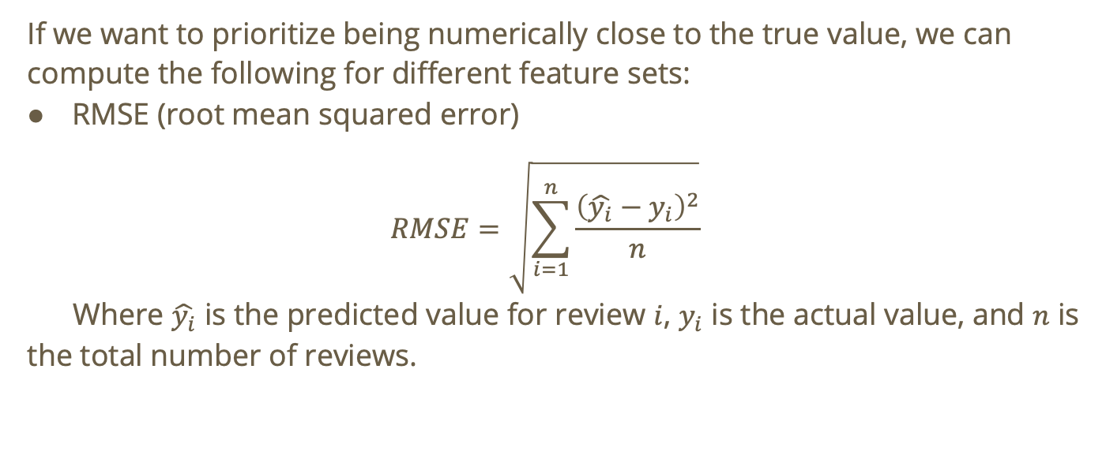
Validating features: numerical measure
If we want to prioritize being numerically close to the true value, we can compute the following for different feature sets:
RMSE (root mean squared error)
$$RMSE=\sqrt{\sum_{i=1}^{n}{\frac{{\left(\hat{y_{i}}−y_{i}\right)}^{2}}{n}}}$$
Where $\hat{y_{i}}$ is the predicted value for review $i$, $y_{i}$ is the actual value, and $n$ is the total number of reviews.

Slide 125
Validating features: numerical measure
If we want to prioritize being numerically close to the true value, we can compute the following for different feature sets:
RMSE (root mean squared error)
MAE (mean absolute error)

Slide 126
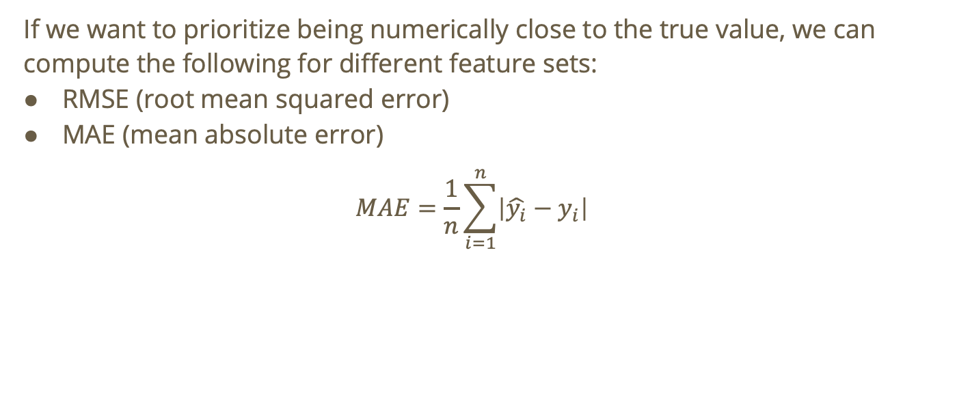
Validating features: numerical measure
If we want to prioritize being numerically close to the true value, we can compute the following for different feature sets:
RMSE (root mean squared error)
MAE (mean absolute error)
$$MAE=\frac{1}{n}\sum_{i=1}^{n}{\left|\hat{y_{i}}−y_{i}\right|}$$

Slide 127
Validating features: inspecting class separation visually
It can be supporting evidence to see that the introduction of a feature leads to stronger class separation. We can inspect this visually by projecting our data onto a 2D or 3D plane.

Slide 128
Validating features: inspecting class separation visually
It can be supporting evidence to see that the introduction of a feature leads to stronger class separation. We can inspect this visually by projecting our data onto a 2D or 3D plane.
For example, if we want to visually inspect the quality of LSA embeddings:

Slide 129
Validating features: inspecting class separation visually
It can be supporting evidence to see that the introduction of a feature leads to stronger visual class separation. We can inspect this visually by projecting our data onto a 2D or 3D plane.
For example, if we want to visually inspect the quality of LSA embeddings:
project data to 2D using PCA (principal component analysis)
color data by score
look for partial clustering or coherent structure

Slide 130
Working with a multi-class dataset

Slide 131
Multi-class classification tasks
In many cases, we aren’t doing binary classification (e.g., yes or no). Rather, there are many possible classes, ordinal or nominal.

Slide 132
Multi-class classification tasks
In many cases, we aren’t doing binary classification (e.g., yes or no). Rather, there are many possible classes, ordinal or nominal.
Our movie review dataset is an example of a multi-class dataset! We have reviews ranging from 1 star to 5 stars

Slide 133
Multi-class classification tasks
In many cases, we aren’t doing binary classification (e.g., yes or no). Rather, there are many possible classes, ordinal or nominal.
Our movie review dataset is an example of a multi-class dataset! We have reviews ranging from 1 star to 5 stars
Not all models handle multi-class classification tasks well. Additionally, there are different ways to tackle the multi-class problem

Slide 134
Method 1: problem reduction
We can turn our multi-class classification problem into multiple binary problems.

Slide 135
Method 1: problem reduction
We can turn our multi-class classification problem into multiple binary problems.
One vs. rest: for a new point, choose the class with the strongest score
1 star vs NOT 1 star
2 stars vs NOT 2 stars
3 stars vs NOT 3 stars

Slide 136
Method 1: problem reduction
We can turn our multi-class classification problem into multiple binary problems.
One vs. rest: for a new point, choose the class with the strongest score
One vs. one: train a classifier for ever pair of classes
1 star vs 2 stars
1 star vs 3 stars
1 star vs 4 stars
etc.
Then, combine all pairwise votes

Slide 137
Method 2: Changing how we treat the target
If the class labels are ordinal and we care about being close to the true value as opposed to spot on, we can use a regression model instead.

Slide 138
Method 2: Changing how we treat the target
If the class labels are ordinal and we care about being close to the true value as opposed to spot on, we can use a regression model instead.
For example, if predicting 4 stars instead of 5 stars isn’t that bad, we can use a regression model instead of a classification model.

Slide 139
Method 2: Changing how we treat the target
If the class labels are ordinal and we care about being close to the true value as opposed to spot on, we can use a regression model instead.
For example, if predicting 4 stars instead of 5 stars isn’t that bad, we can use a regression model instead of a classification model.
E.g., KNN regression, SVR, etc.

Slide 140
Method 2: Changing how we treat the target
If the class labels are ordinal and we care about being close to the true value as opposed to spot on, we can use a regression model instead.
For example, if predicting 4 stars instead of 5 stars isn’t that bad, we can use a regression model instead of a classification model.
E.g., KNN regression, SVR, etc.
Instead of forcing exact class prediction, we predict a numeric score.

Slide 141
Method 3: Handling class imbalance
Multiclass datasets may be imbalanced. For example, we may have mostly 5-star reviews and then fewer 1-, 2-, 3-, and 4-star reviews.

Slide 142
Method 3: Handling class imbalance
Multiclass datasets may be imbalanced. For example, we may have mostly 5-star reviews and then fewer 1-, 2-, 3-, and 4-star reviews.
Here are some approaches to deal with this bias:

Slide 143
Method 3: Handling class imbalance
Multiclass datasets may be imbalanced. For example, we may have mostly 5-star reviews and then fewer 1-, 2-, 3-, and 4-star reviews.
Here are some approaches to deal with this bias:
Class weights: e.g., weighing the rare classes heavier

Slide 144
Method 3: Handling class imbalance
Multiclass datasets may be imbalanced. For example, we may have mostly 5-star reviews and then fewer 1-, 2-, 3-, and 4-star reviews.
Here are some approaches to deal with this bias:
Class weights
Stratified train/test split: intentionally evening out the classes that we train on

Slide 145
Method 3: Handling class imbalance
Multiclass datasets may be imbalanced. For example, we may have mostly 5-star reviews and then fewer 1-, 2-, 3-, and 4-star reviews.
Here are some approaches to deal with this bias:
Class weights
Stratified train/test split
F1 measure or cost matrix as opposed to plain accuracy or confusion matrix

Slide 146
Method 3: Handling class imbalance
Multiclass datasets may be imbalanced. For example, we may have mostly 5-star reviews and then fewer 1-, 2-, 3-, and 4-star reviews.
Here are some approaches to deal with this bias:
Class weights
Stratified train/test split
F1 measure or cost matrix
If we take no precautions, we run the danger of the model favoring the biggest classes!

Slide 147
Working with many features

Slide 148
Why do we care about utilizing multiple features?
In our movie review dataset, when predicting a review, we may want to consider:

Slide 149
Why do we care about utilizing multiple features?
In our movie review dataset, when predicting a review, we may want to consider:
The reviewer’s historical bias AND

Slide 150
Why do we care about utilizing multiple features?
In our movie review dataset, when predicting a review, we may want to consider:
The reviewer’s historical bias AND the movie’s historical reviews AND

Slide 151
Why do we care about utilizing multiple features?
In our movie review dataset, when predicting a review, we may want to consider:
The reviewer’s historical bias AND the movie’s historical reviews AND the sentiment of the summary AND

Slide 152
Why do we care about utilizing multiple features?
In our movie review dataset, when predicting a review, we may want to consider:
The reviewer’s historical bias AND the movie’s historical reviews AND the sentiment of the summary AND the sentiment of the text

Slide 153
Why do we care about utilizing multiple features?
In our movie review dataset, when predicting a review, we may want to consider:
The reviewer’s historical bias AND the movie’s historical reviews AND the sentiment of the summary AND the sentiment of the text

Slide 154
Why do we care about utilizing multiple features?
In our movie review dataset, when predicting a review, we may want to consider:
The reviewer’s historical bias AND the movie’s historical reviews AND the sentiment of the summary AND the sentiment of the text
Instead of passing in just embeddings or just numerical values for user or product biases, we can form a feature matrix that encompasses all of these!

Slide 155

Feature matrix: concatenation
For example, we can construct a feature matrix that looks like the following:
$$X=\left[X_{\text{summary}},X_{\text{text}},X_{\text{user}\text{−}\text{bias}},X_{\text{product}\text{−}\text{bias}}\right]$$
Where each row is a review

Slide 156
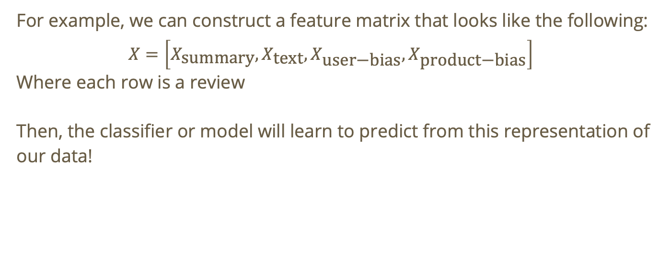
Feature matrix: concatenation
For example, we can construct a feature matrix that looks like the following:
$$X=\left[X_{\text{summary}},X_{\text{text}},X_{\text{user}\text{−}\text{bias}},X_{\text{product}\text{−}\text{bias}}\right]$$
Where each row is a review
Then, the classifier or model will learn to predict from this representation of our data!

Slide 157
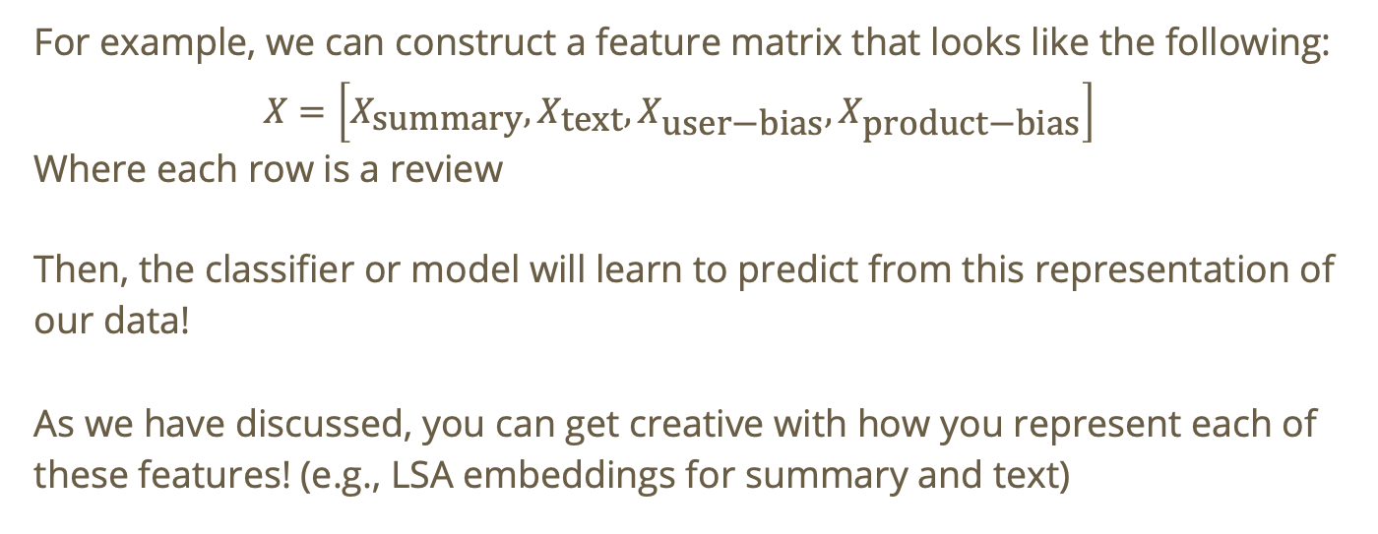
Feature matrix: concatenation
For example, we can construct a feature matrix that looks like the following:
$$X=\left[X_{\text{summary}},X_{\text{text}},X_{\text{user}\text{−}\text{bias}},X_{\text{product}\text{−}\text{bias}}\right]$$
Where each row is a review
Then, the classifier or model will learn to predict from this representation of our data!
As we have discussed, you can get creative with how you represent each of these features! (e.g., LSA embeddings for summary and text)

Slide 158
Feature matrix: combination
Going back to the example with summary and text, we can combine the two (total = summary + “ “ + text), extract features using LSA then include those extracted features in our feature matrix:

Slide 159

Feature matrix: combination
Going back to the example with summary and text, we can combine the two (total = summary + “ “ + text), extract features using LSA then include those extracted features in our feature matrix:
$$X=\left[X_{\text{summary}\text{−}\text{text}},X_{\text{numeric}}\right]$$

Slide 160
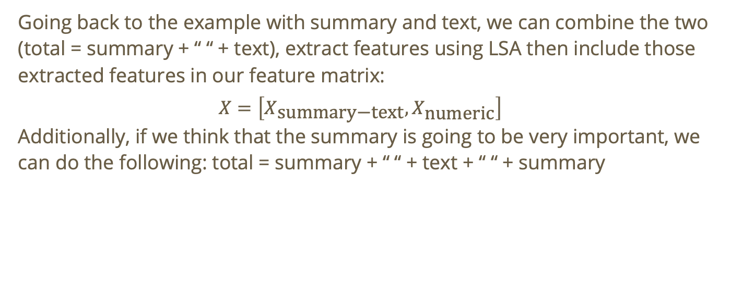
Feature matrix: combination
Going back to the example with summary and text, we can combine the two (total = summary + “ “ + text), extract features using LSA then include those extracted features in our feature matrix:
$$X=\left[X_{\text{summary}\text{−}\text{text}},X_{\text{numeric}}\right]$$
Additionally, if we think that the summary is going to be very important, we can do the following: total = summary + “ “ + text + “ “ + summary

Slide 161

Feature matrix: combination then dimension reduction
If we end up combining our features and making a very large feature matrix:
$$X=\left[X_{\text{summary}},X_{\text{text}},X_{\text{user}\text{−}\text{bias}},X_{\text{product}\text{−}\text{bias}}\right]$$

Slide 162

Feature matrix: combination then dimension reduction
If we end up combining our features and making a very large feature matrix:
$$X=\left[X_{\text{summary}},X_{\text{text}},X_{\text{user}\text{−}\text{bias}},X_{\text{product}\text{−}\text{bias}}\right]$$
We can run SVD after combination to compress our feature matrix then train our model on the reduced version!

Slide 163
Important consideration: scaling!
When combining different feature types with different scales, some features may end up dominating unintentionally!

Slide 164
Important consideration: scaling!
When combining different feature types with different scales, some features may end up dominating unintentionally!
We can avoid this problem by:

Slide 165
Important consideration: scaling!
When combining different feature types with different scales, some features may end up dominating unintentionally!
We can avoid this problem by:
build each feature block separately
normalize or scale each block in a sensible manner
combine them into a single matrix

Slide 166
Important consideration: scaling!
When combining different feature types with different scales, some features may end up dominating unintentionally!
We can avoid this problem by:
build each feature block separately
normalize or scale each block in a sensible manner
combine them horizontally into a single matrix
All of the features required to do this are easily found in scikit-learn and numpy!

Slide 167
Note about the midterm
It is critical that you do not try to spam submissions to Kaggle! This will not help you.
Utilize the evaluation and parameter-tuning techniques discussed in this slide show!
Please consider creating a validation set for your model so that you can test your model without uploading to Kaggle every time!
When you finalize your model or are ready to make a submission, you can train your model on the training set + validation set if you want!

