Slide 1
Monte Carlos Tree Search
A Case Study in Tic Tac Toe

Slide 2
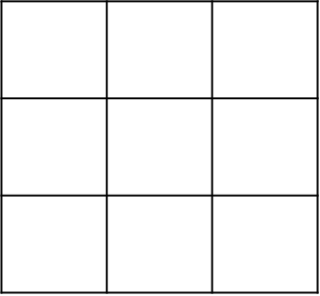
Tic-Tac-Toe

Slide 3
Naive AI to solve Tic-Tac-Toe
1
2
3
1
2
3
0.01
0.01
0.01
4
5
6
4
5
6
0.02
0.89
0.02
7
8
7
8
0.02
0.01

Slide 4
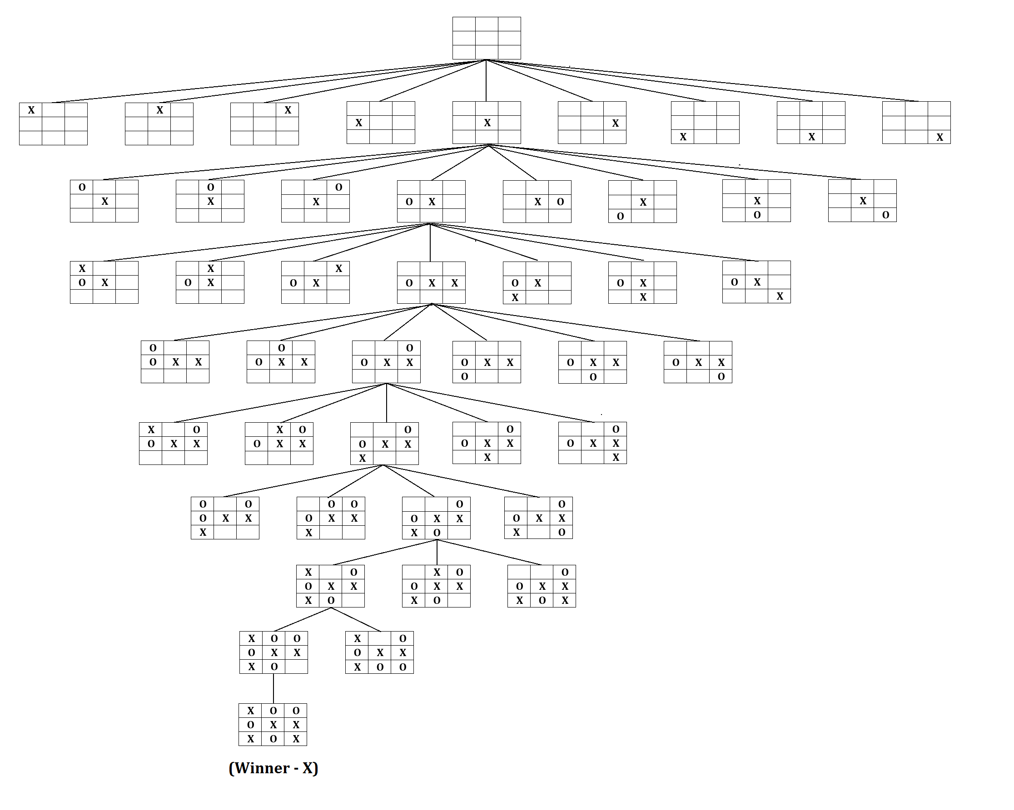
MCTS to solve Tic-Tac-Toe

Slide 5
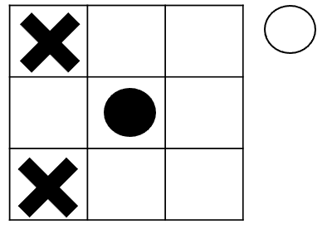
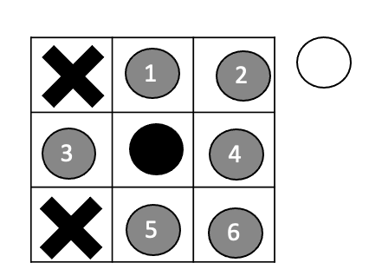
MCTS to solve Tic-Tac-Toe
1
2
1
2
3
4
5
6
3
4
5
6

Slide 6
MCTS to solve Tic-Tac-Toe
Edge (for action)
Node (for action)
1
2
3
4
5
6
Leaf Node (for node without child node)

Slide 7
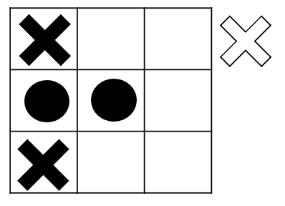
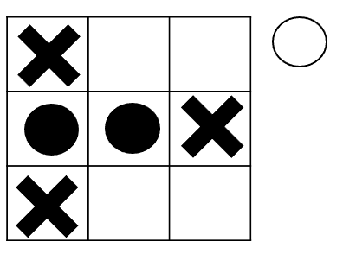
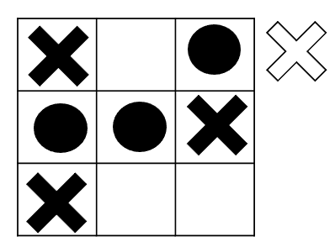
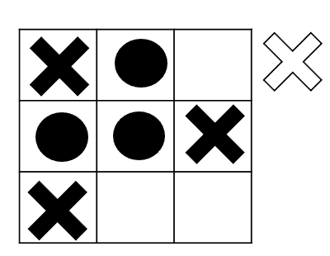
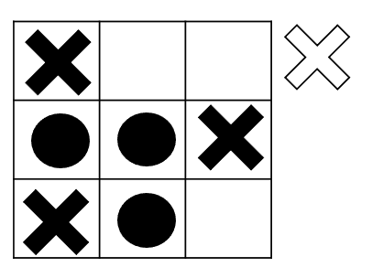
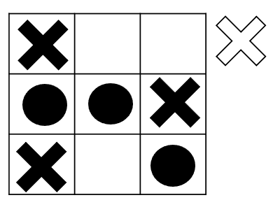
MCTS to solve Tic-Tac-Toe
1
1
2
3
4
5
6
0.5
0.1
0.1
0.1
0.1
0.1
0.2
0.1
0.2
0.3
0.3
0.2
0.2
0.3
0.3

Slide 8
MCTS to solve Tic-Tac-Toe

Slide 9
MCTS to solve Tic-Tac-Toe
1
Max
1
2
3
4
5
6
0.5
0.1
0.1
0.1
0.1
0.1
Min
0.2
0.1
0.3
0.2
0.3
Max
0.2
0.2
0.3
0.3

Slide 10
1
Max
1
2
3
4
5
6
0.5
0.1
0.1
0.1
0.1
0.1
Min
0.2
0.1
0.3
0.2
0.3
Max
0.2
0.2
0.3
0.3
0.0
0.0
0.0

Slide 11
0.15
t=85
n=550
1
2
3
4
5
6
1
2
3
4
5
6
0.5
0.1
t=20
n=100
t=10
n=100
t=10
n=100
0.1
0.1
0.1
t=10
n=100
t=25
n=50
t=10
n=100
0.1
0.1
t=3
n=10
0.2
0.2
t=2
n=10
t=3
n=10
t=1
n=10
t=2
n=10
0.3
0.3
t:
The number of winning times at the current state
n:
The number of Playing times at the current state

Slide 12
t=85
n=550
1
2
3
4
5
6
t=10
n=100
t=20
n=100
t=25
n=50
t=10
n=100
t=10
n=100
t=10
n=100
t=2
n=10
t=3
n=10
t=1
n=10
t=2
n=10
t=3
n=10
t=0
n=0
t=0
n=0
t=0
n=0
t=0
n=0
Rollout (against random policy)
Result

Slide 13
Selection
Expansion
t=85
n=550
t=85
n=550
Max
1
2
3
4
5
6
1
2
3
4
5
6
t=10
n=100
t=20
n=100
t=25
n=50
t=10
n=100
t=10
n=100
t=10
n=100
t=10
n=100
t=20
n=100
t=25
n=50
t=10
n=100
t=10
n=100
t=10
n=100
t=10
n=100
Min
t=2
n=10
t=3
n=10
t=1
n=10
t=2
n=10
t=3
n=10
t=2
n=10
t=3
n=10
t=1
n=10
t=2
n=10
t=3
n=10
t=0
n=0
t=0
n=0
t=0
n=0
t=0
n=0

Slide 14
t=85+1
n=550+1
t=85
n=550+1
1
2
3
4
5
6
1
2
3
4
5
6
t=10
n=100
t=20
n=100
t=25+1
n=50+1
t=10
n=100
t=10
n=100
t=10
n=100
t=10
n=100
t=20
n=100
t=25
n=50+1
t=10
n=100
t=10
n=100
t=10
n=100
t=2
n=10
t=3
n=10
t=1+1
n=10+1
t=2
n=10
t=3
n=10
t=2
n=10
t=3
n=10
t=1
n=10+1
t=2
n=10
t=3
n=10
t=0+1
n=0+1
t=0
n=0
t=0
n=0
t=0
n=0
t=0
n=0+1
t=0
n=0
t=0
n=0
t=0
n=0
Rollout (against random policy)
Rollout (against random policy)
Result=Win
Result=Lose

Slide 15
Rollout
t=85
n=550
1
2
3
4
5
6
t=10
n=100
t=20
n=100
t=25
n=50
t=10
n=100
t=10
n=100
t=10
n=100
t=2
n=10
t=3
n=10
t=1
n=10
t=2
n=10
t=3
n=10
t=0
n=0
t=0
n=0
t=0
n=0
t=0
n=0
Rollout (against random policy)
Result

Slide 16
Backpropagation
t=85+1
n=550+1
1
2
3
4
5
6
t=10
n=100
t=20
n=100
t=25+1
n=50+1
t=10
n=100
t=10
n=100
t=10
n=100
t=2
n=10
t=3
n=10
t=1+1
n=10+1
t=2
n=10
t=3
n=10
t=0+1
n=0+1
t=0
n=0
t=0
n=0
t=0
n=0
Rollout (against random policy)
Result=Win

Slide 17
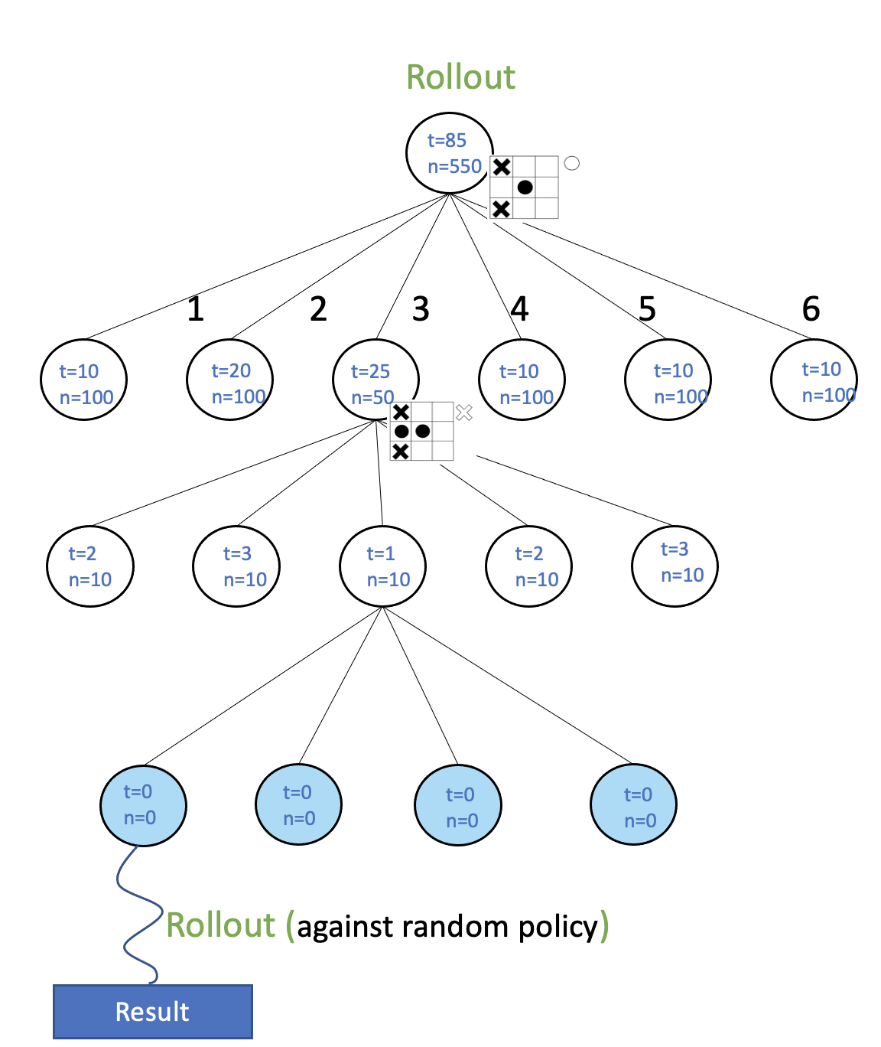
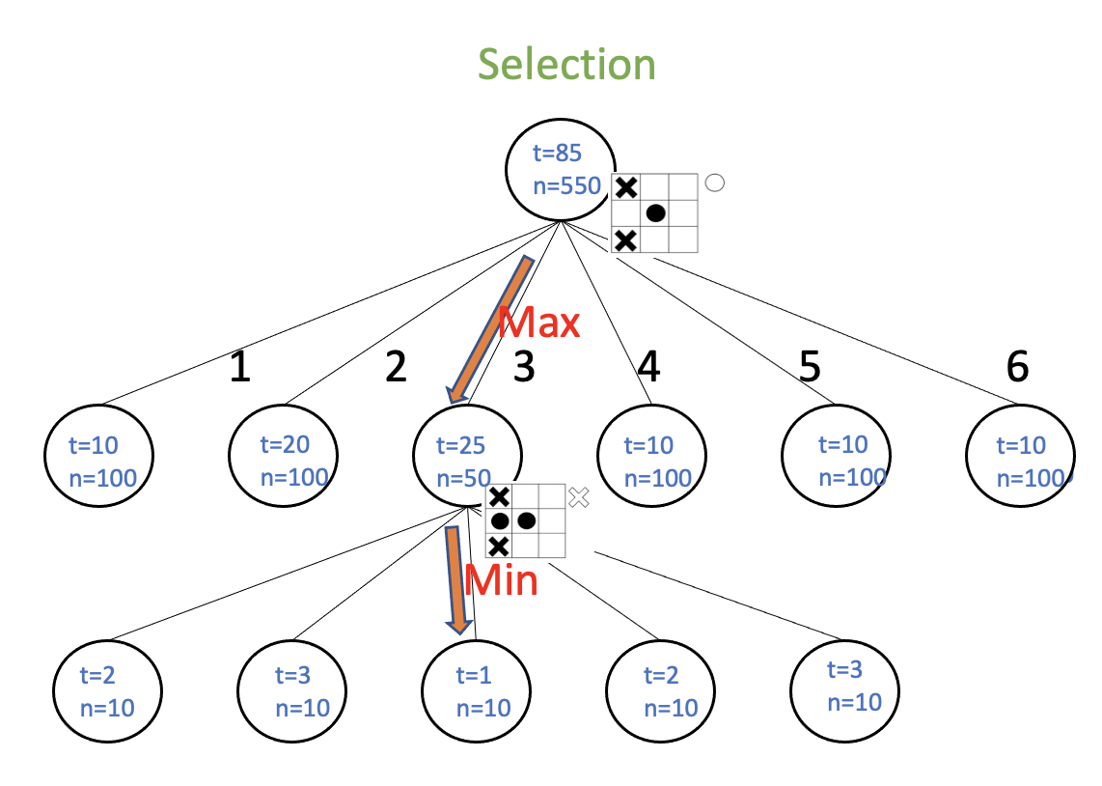
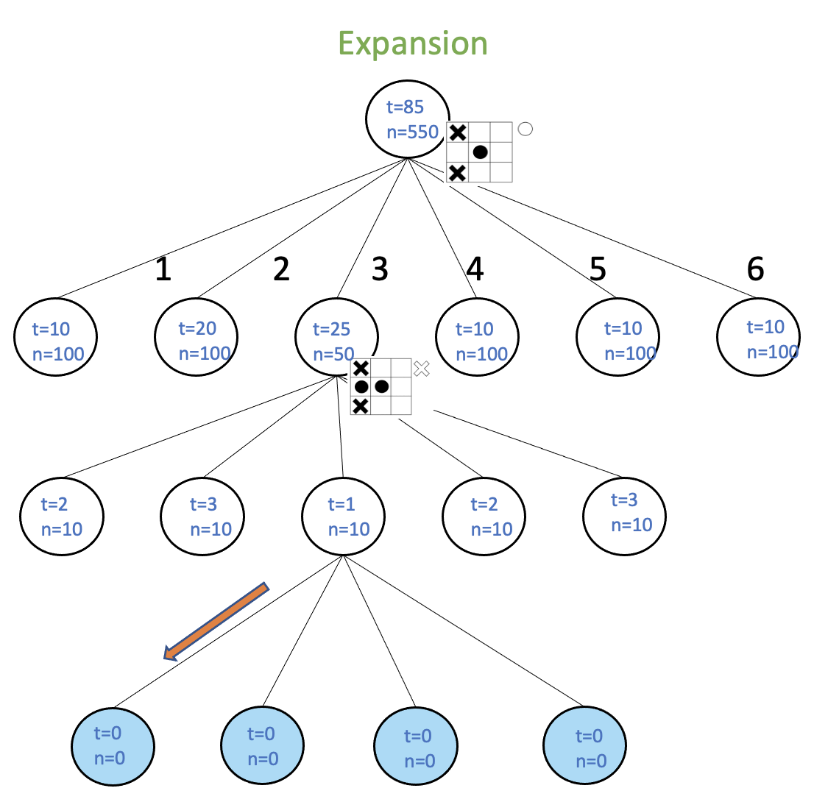
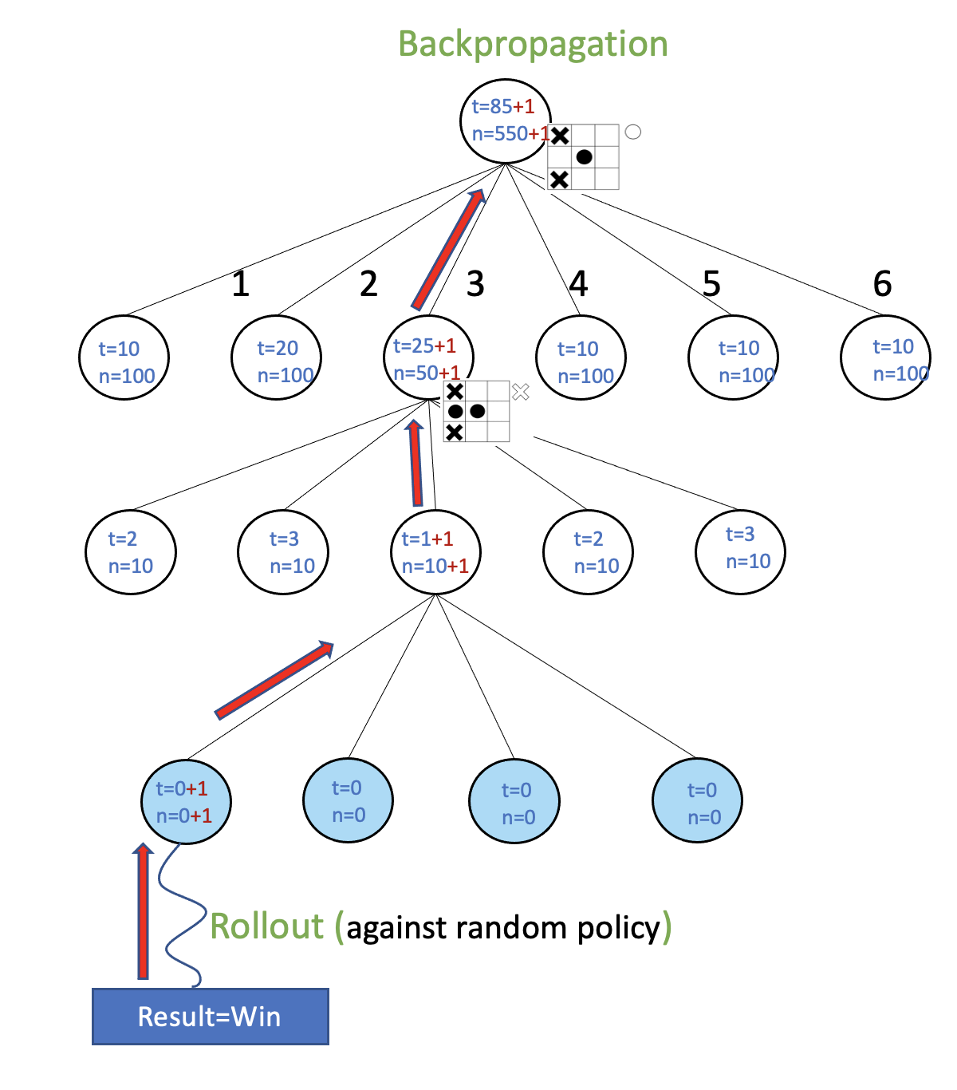

Slide 18
t=85
n=550
t=85
n=550
UCB=
1
2
3
4
5
6
1
2
3
4
5
6
t=10
n=100
t=20
n=100
t=25
n=50
t=10
n=100
t=10
n=100
t=10
n=100
t=10
n=100
t=20
n=100
t=25
n=50
t=10
n=100
t=10
n=100
t=10
n=100
t=2
n=10
t=3
n=10
t=1
n=10
t=2
n=10
t=3
n=10
t=2
n=10
t=3
n=10
t=1
n=10
t=2
n=10
t=3
n=10
t:
The number of winning times at the current state
t:
The number of winning times at the current state
n:
The number of Playing times at the current state
n:
The number of Playing times at the current state

Slide 19


Backpropagation
t=1
n=2
t=103
n=2000
t=0
n=0
UCB=+$∞$
t=0
n=1
UCB=1.67
t=1
n=1
UCB=2.67
t=0
n=0
UCB=+$∞$
K=1
t=1
n=500
UCB=0.24
t=1
n=500
UCB=0.24
t=100
n=500
UCB=0.45
t=1
n=500
UCB=0.24
K=1

Slide 20
t=85
n=550
1
2
3
4
5
6
3
t=10
n=100
t=20
n=100
t=25
n=50
t=10
n=100
t=10
n=100
t=10
n=100
t=25
n=50
t=2
n=10
t=3
n=10
t=1
n=10
t=2
n=10
t=3
n=10
t=2
n=10
t=3
n=10
t=1
n=10
t=2
n=10
t=3
n=10
tree
Sub-tree
Step into

