Slide 1
Short introduction to statistical inference in R

Slide 2

Null hypothesis and statistical significance
Null hypothesis (Ho) refers to the lack of differences between experimental groups.
Ho is rejected if the p-value of your test is lower than 0.05.
Ho depends on your statistical test.

Slide 3

Why do we reject the null hypothesis if p < 0.05 (Type-I error rate)
This is an arbitrary value that was established by Fisher in 1925. But what does it really mean?
> probs <- vector()
> for(i in 1:1000){ probs[i] <- t.test(rnorm(100), mu = 0)$p.value}
> sum(probs <= 0.05)
[1] 52

Slide 4
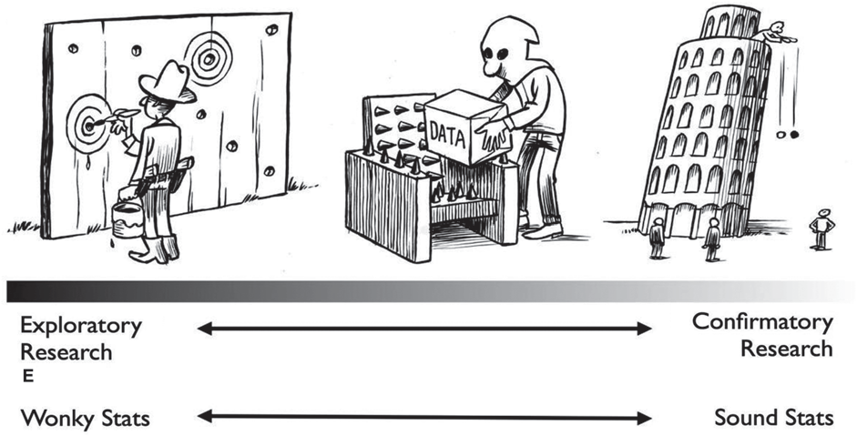
Statistical inference
Model the data.
Statistical inference usually assumes normality and homogeneity of variance.
From the experimental design, it is important to establish the best-suited model for the data.

Slide 5
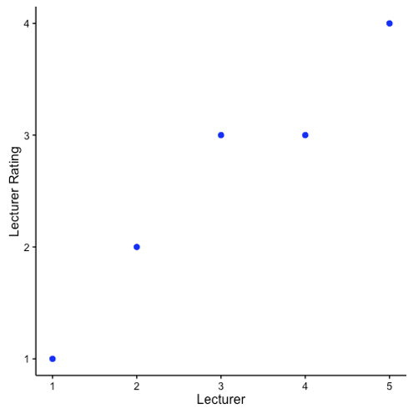
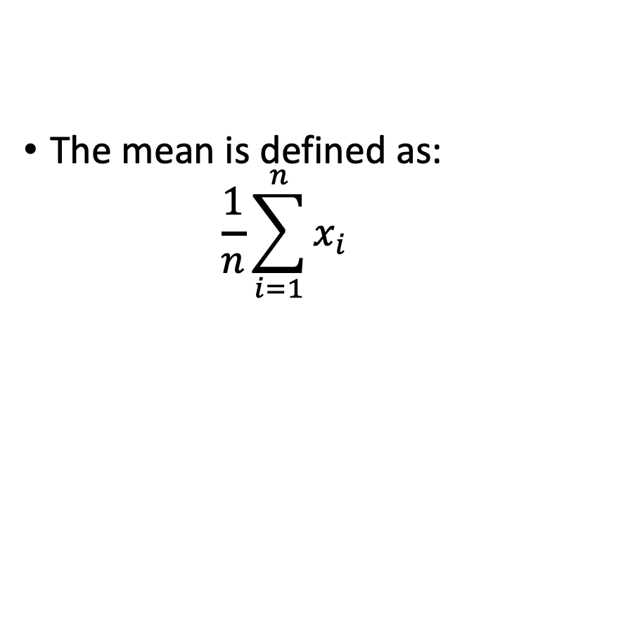
Mean: the simplest model on your data.
The mean is defined as:
$$\frac{1}{n}\sum_{i=1}^{n}{x_{i}}$$

Slide 6
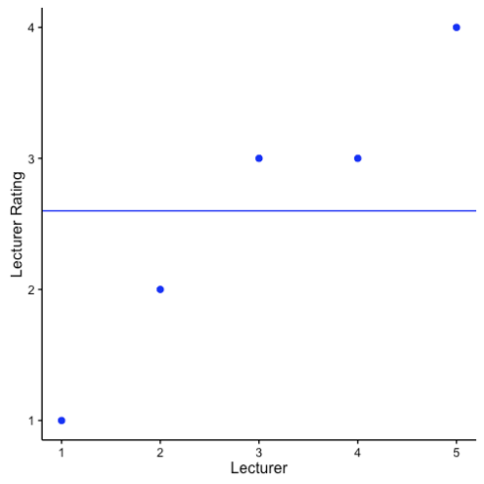
Mean: the simplest model on your data.
The mean is defined as:
$$\frac{1}{n}\sum_{i=1}^{n}{x_{i}}$$
2.6

Slide 7
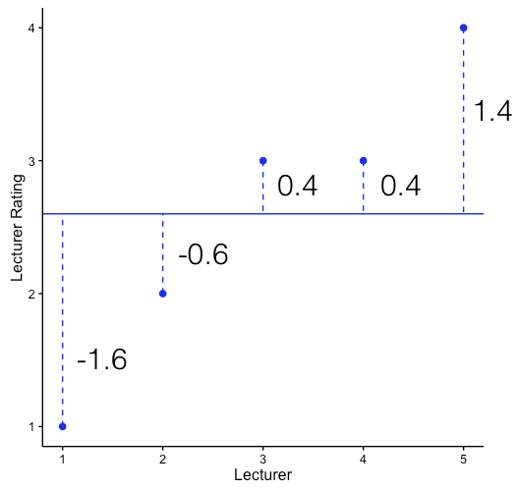
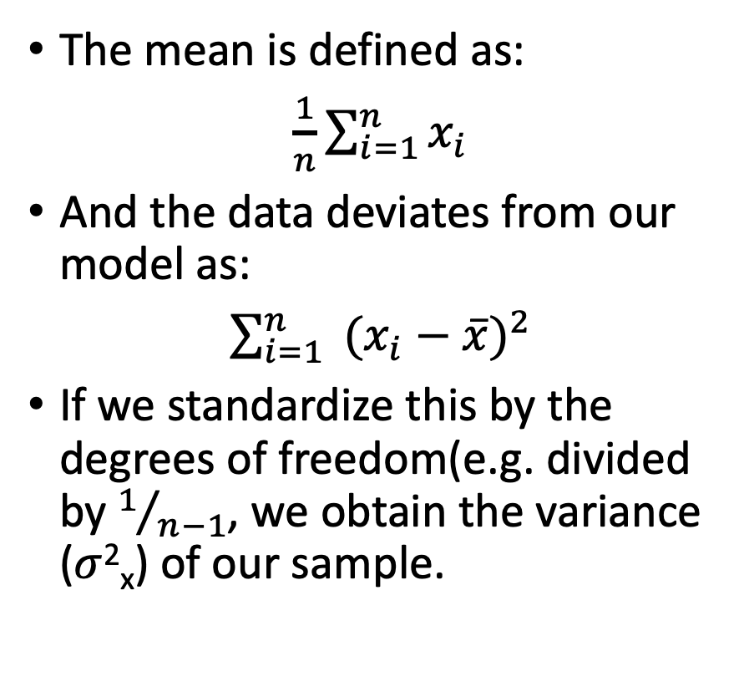
Mean: the simplest model on your data.
The mean is defined as:
$\frac{1}{n}\sum_{i=1}^{n}{x_{i}}$
And the data deviates from our model as:
$\sum_{i=1}^{n}{ {(x_{i}−\overline{x})}^{2}}$
If we standardize this by the degrees of freedom(e.g. divided by $1/{n−1}$, we obtain the variance ($σ$²_{x}) of our sample.
2.6

Slide 8
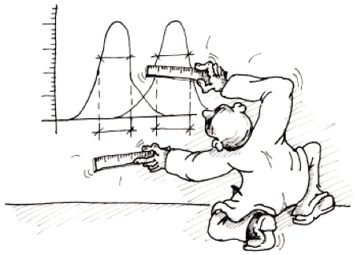
How can we compare two means?
Your data consists of two independent groups where the same response variable was measured.
Do you want to tell whether the mean of the two groups differ.
You might want to do a two sample t test.
Your data must be normally distributed, and variation is homogeneous.

Slide 9
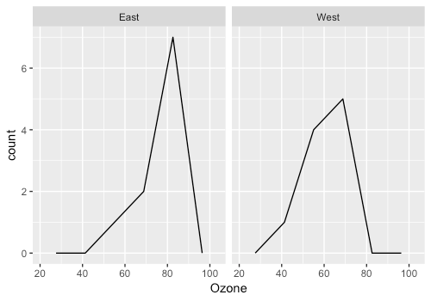
Ozone levels at two different locations of a city.
Researchers wondered whether ozone levels differed between gardens at the east and west of the city.
First, lets visualize our data:
ggplot(data = garden,
aes(x = Ozone)) +
geom_freqpoly(bins = 4) +
facet_wrap(.~Garden.location)

Slide 10
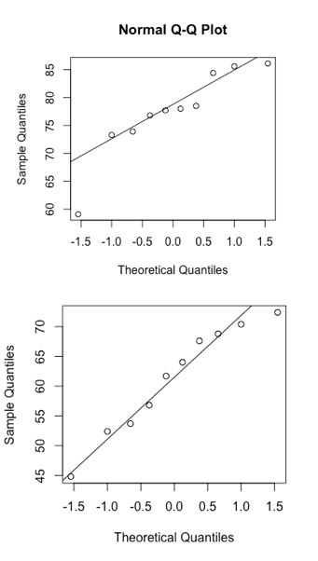
Ozone levels at two different locations of a city.
Second, lets test the assumptions.
qqnorm(garden$Ozone[garden$Garden.location == "East"])
qqline(garden$Ozone[garden$Garden.location == "East"])
qqnorm(garden$Ozone[garden$Garden.location == "West"])
qqline(garden$Ozone[garden$Garden.location == "West"])

Slide 11
Ozone levels at two different locations of a city.
Second, lets test the assumptions.
var.test(Ozone ~ Garden.location, data = garden)
F test to compare two variances
data: Ozone by Garden.location
F = 0.75503, num df = 9, denom df = 9, p-value = 0.6823
alternative hypothesis: true ratio of variances is not equal to 1
95 percent confidence interval:
0.1875386 3.0397437
sample estimates:
ratio of variances
0.7550293

Slide 12
Ozone levels at two different locations of a city.
Third, let’s build a model.
t.test(Ozone ~ Garden.location, data = garden, var.equal = T, alternative = “two.sided”)
Two Sample t-test
data: Ozone by Garden.location
t = 4.2363, df = 18, p-value = 0.0004966
alternative hypothesis: true difference in means is not equal to 0
95 percent confidence interval:
8.105323 24.054677
sample estimates:
mean in group East mean in group West
77.34 61.26

Slide 13
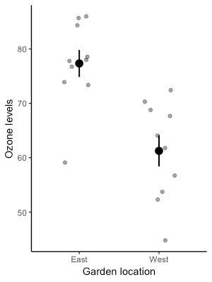
Ozone levels at two different locations of a city.
Last step, interpret and replot.
Gardens in the East of the city have significantly higher levels of ozone compared to those located in the West (t = 4.24, df = 18, p < 0.001)
ggplot(data = garden,
aes(y = Ozone,
x = Garden.location)) +
geom_jitter(width = 0.2, alpha = 0.4) +
stat_summary(fun.data = mean_se, geom = "pointrange", size = 0.7) +
xlab("Garden location") +
ylab("Ozone levels") +
theme_classic()

Slide 14
Exercise
In an experiment, a group of arachnophobes were exposed to a real tarantula while another group was exposed to a photo of a tarantula. The researchers measured the levels of anxiety of each participant. Test whether there is any difference in anxiety between those participants that saw the real tarantula or a photo of it.
The data is contained within the file Spiders.txt. Remember, plot your data, test assumptions, build a model, test, interpret, and replot.

Slide 15
How can you compare more than two means?
You design an experiement where you measure the same response variable in three or more experimental groups (e.g. control, treatment, placebo).
We can’t use the two sample t test anymore.

Slide 16
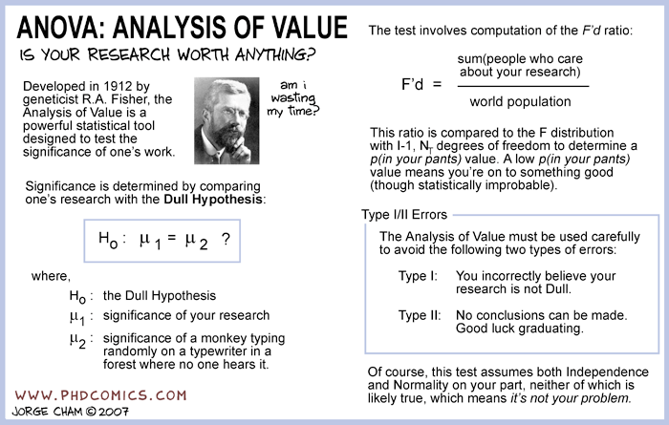
One-way analaysis of variance (ANOVA)
Assumes normality and homogeneity of variance in the errors of the model.
Our model is the mean of each group.

Slide 17
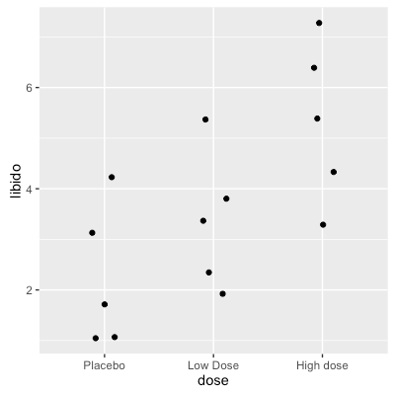
One-way analaysis of variance (ANOVA)
15 persons were given a viagra dose and ask to score their libido. Five received a placebo, five a low dose, and five a high dose.

Slide 18
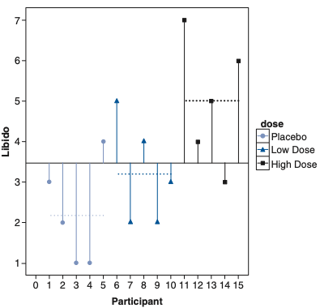
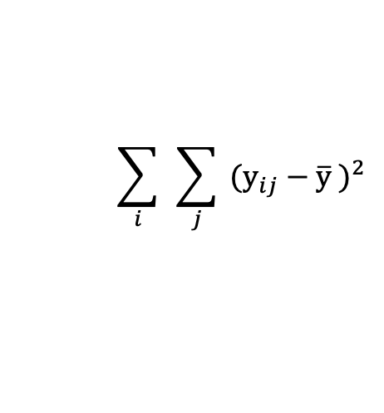
One-way ANOVA - Partitioning the variance
Notation | SS deviations of | Formula
SS total | Observed data from the grand mean
SS between | Group means from the grand mean
SS within | Group means to group observations
$$\sum_{i}{ }\sum_{j}{ (y_{ij}−{\overline{y}}_{ })^{2}}$$

Slide 19
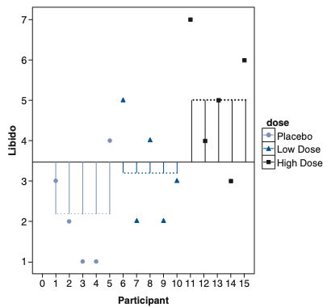
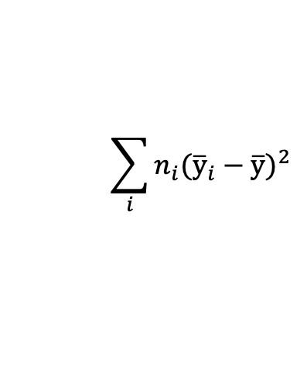
One-way ANOVA - Partitioning the variance
Notation | SS deviations of | Formula
SS total | Observed data from the grand mean
SS between | Group means from the grand mean
SS within | Group means to group observations
$$\sum_{i}{ }\sum_{j}{ (y_{ij}−{\overline{y}}_{ })^{2}}$$
$$\sum_{i}{n_{i}({\overline{y}}_{i}−\overline{y})^{2}}$$

Slide 20
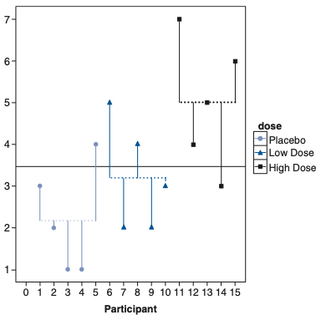
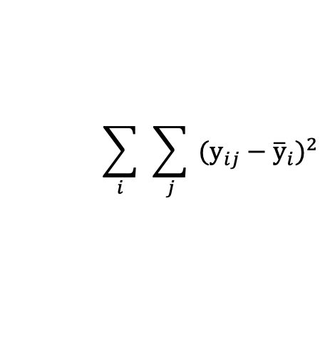
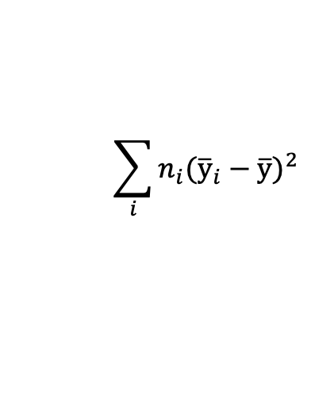
One-way ANOVA - Partitioning the variance
Notation | SS deviations of | Formula
SS total | Observed data from the grand mean
SS between | Group means from the grand mean
SS within | Group means to group observations
$$\sum_{i}{ }\sum_{j}{ (y_{ij}−{\overline{y}}_{ })^{2}}$$
$$\sum_{i}{n_{i}({\overline{y}}_{i}−\overline{y})^{2}}$$
$$\sum_{i}{ }\sum_{j}{ (y_{ij}−{\overline{y}}_{i})^{2}}$$

Slide 21
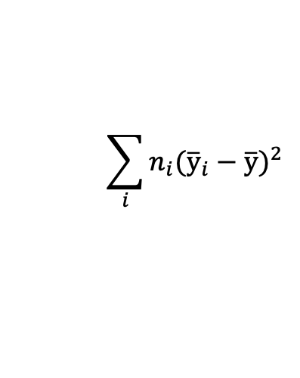
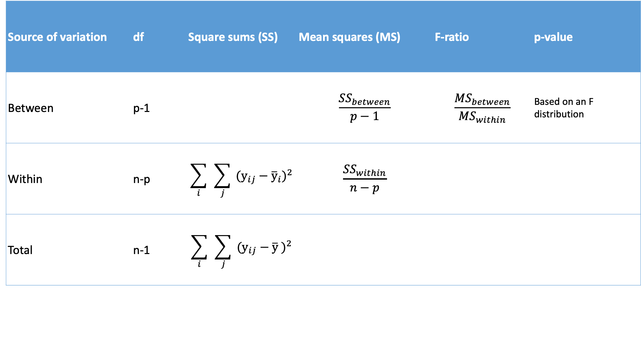
One-way ANOVA table
Source of variation | df | Square sums (SS) | Mean squares (MS) | F-ratio | p-value
Between | p-1 |  | $$\frac{{SS}_{between}}{p−1}$$ | $$\frac{{MS}_{between}}{{MS}_{within}}$$ | Based on an F distribution
Within | n-p | $$\sum_{i}{ }\sum_{j}{ (y_{ij}−{\overline{y}}_{i})^{2}}$$ | $$\frac{{SS}_{within}}{n−p}$$
Total | n-1 | $$\sum_{i}{ }\sum_{j}{ (y_{ij}−{\overline{y}}_{ })^{2}}$$
$$\sum_{i}{n_{i}({\overline{y}}_{i}−\overline{y})^{2}}$$

Slide 22
One-way analaysis of variance (ANOVA)
Second, let’s build a model.
model <- lm(libido ~ dose, data = viagra)
summary(model)
Call:
lm(formula = libido ~ dose, data = viagra)
Residuals:
Min 1Q Median 3Q Max
-2.0 -1.2 -0.2 0.9 2.0
Coefficients:
Estimate Std. Error t value Pr(>|t|)
(Intercept) 2.2000 0.6272 3.508 0.00432 **
doseLow Dose 1.0000 0.8869 1.127 0.28158
doseHigh dose 2.8000 0.8869 3.157 0.00827 **
Residual standard error: 1.402 on 12 degrees of freedom
Multiple R-squared: 0.4604, Adjusted R-squared: 0.3704
F-statistic: 5.119 on 2 and 12 DF, p-value: 0.02469

Slide 23
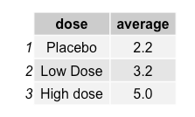
One-way analaysis of variance (ANOVA)
Second, let’s build a model.
model <- lm(libido ~ dose, data = viagra)
summary(model)
Call:
lm(formula = libido ~ dose, data = viagra)
Residuals:
Min 1Q Median 3Q Max
-2.0 -1.2 -0.2 0.9 2.0
Coefficients:
Estimate Std. Error t value Pr(>|t|)
(Intercept) 2.2000 0.6272 3.508 0.00432 **
doseLow Dose 1.0000 0.8869 1.127 0.28158
doseHigh dose 2.8000 0.8869 3.157 0.00827 **
Residual standard error: 1.402 on 12 degrees of freedom
Multiple R-squared: 0.4604, Adjusted R-squared: 0.3704
F-statistic: 5.119 on 2 and 12 DF, p-value: 0.02469
library(gridExtra)
viagra %>% group_by(dose) %>% summarise(average = mean(libido)) %>% grid.table()

Slide 24
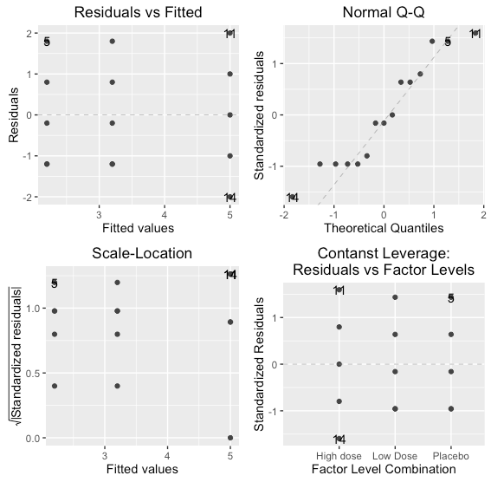
One-way analaysis of variance (ANOVA)
Third, lets check the assumptions of the model.
library(ggfortify)
autoplot(model, smooth.colour = NA)

Slide 25
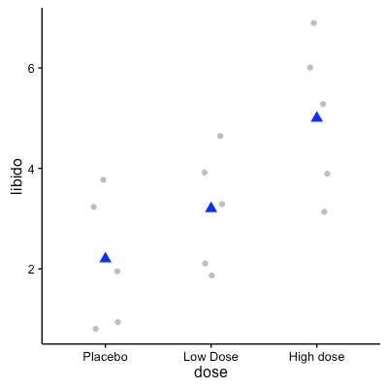
One-way analaysis of variance (ANOVA)
Now, we can test, interpret, and replot.
Viagra dose significantly increased the libido sensation (F = 10.1, df = 2,12, p = 0.025).
anova(model, test = “F”)
Analysis of Variance Table
Response: libido
Df Sum Sq Mean Sq F value Pr(>F)
dose 2 20.133 10.0667 5.1186 0.02469 *
Residuals 12 23.600 1.9667
---
Signif. codes: 0 '***' 0.001 '**' 0.01 '*' 0.05 '.' 0.1 ' ' 1

Slide 26
Exercise
Using the data from iris, test whether sepal width is a good character to separate the three species from each other.

