Slide 1
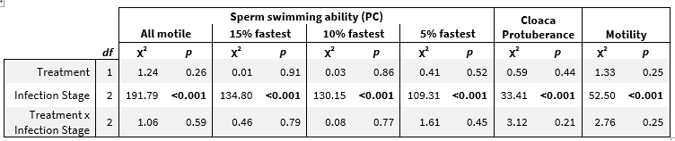
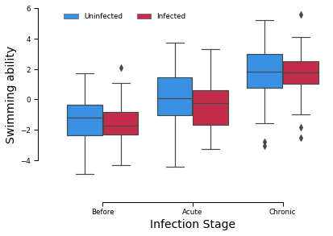
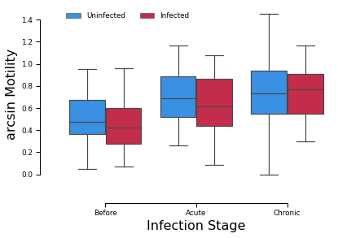

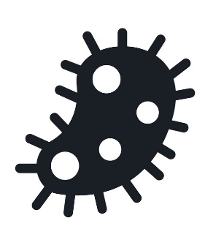
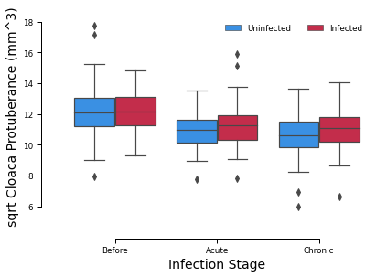
Do parasites affect male fertility in a common bird?
Sabrina Stöckli^{a,}, Alfonso Rojas Mora^{b}
ªUniversity of Bern, ^{b}University of Neuchâtel
Introduction
Results
Parasites are unavoidable natural enemies of all organisms, being costly to their hosts. Due to the trade-off between defense against parasites and bodily functions, it is expected that parasitism causes shortened lifespans and lowered fertility. Sperm production is deemed to incur in small costs, but recent research suggest that sperm is more costly than initially thought.
This research tests whether costs of parasitims affect male fertility.
Linear mixed models for the six fertility indicators (MOTILITY, PC100%, PC15%, PC10%, PC5%, Cloacal_Protuberance) with TREATMENT, INFECTION_STATE and their interaction as predictors, and ID as random effect.
Experiment
Day 0
n=30
n=30
Day 9
Day 18
Measures
Repeatability for cloaca height measurements: 0.81
Repeatability for cloaca width measurements: 0.89
Repeatability for cloaca length measurements: 0.84
TREATMENT
not infected vs. infected
INFECTION_STATE
before vs. acute vs. chronic
MOTILITY
% alive sperm
PC100%
PC15%
PC10%
PC5%
Cloacal_Protuberance
sperm quantity
ID
Conclusion
References
sperm swimming abiltiy
fertility indicators
Overall, we found that the parasite infection did not affect any of the fertility indicators. Yet, as the experiment progressed, all individuals increased their ejaculate swimming ability and motility. Further, sperm production was slightly decrease with time, as evidenced by the smaller cloacal protuberances.
All references are available upon request (alf.roja@gmail.com or Sabrina.stoeckli@imu.unibe.ch).

