Slide 1
EPFTOOLBOX DNN MODEL EVALUATION

Slide 2
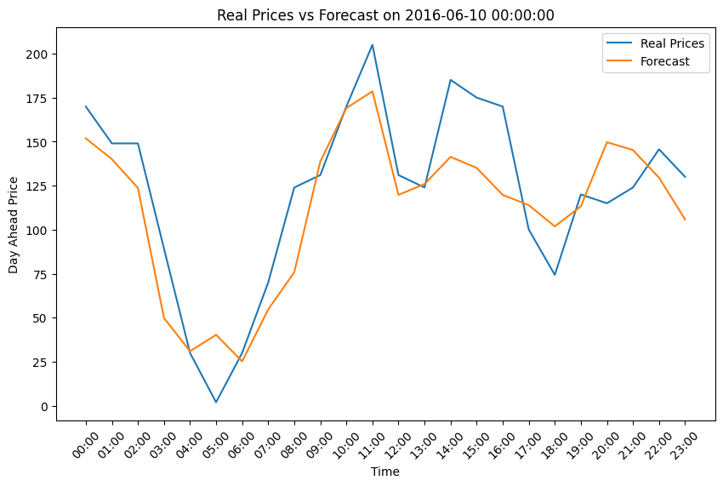
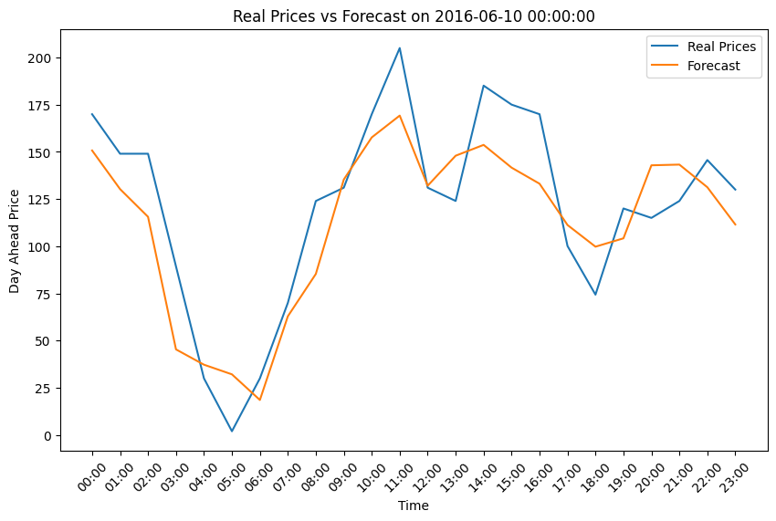
Evalution of TR Data 300 vs 1000 Iterations in Hyperparameter Optimization, Daily Graphs
300 Iterations
1000 Iterations

Slide 3
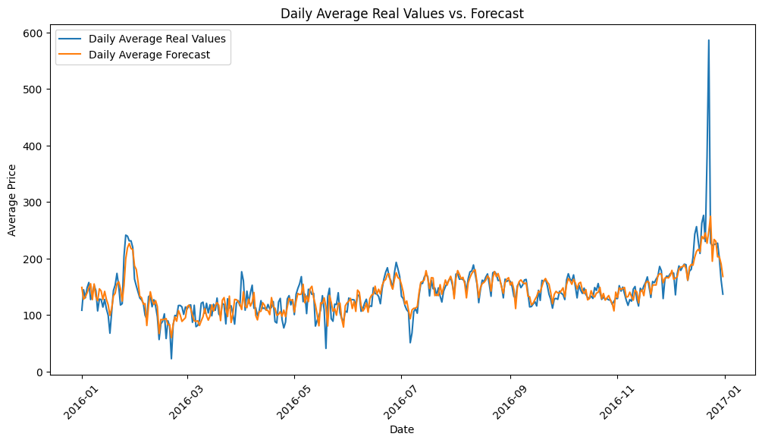
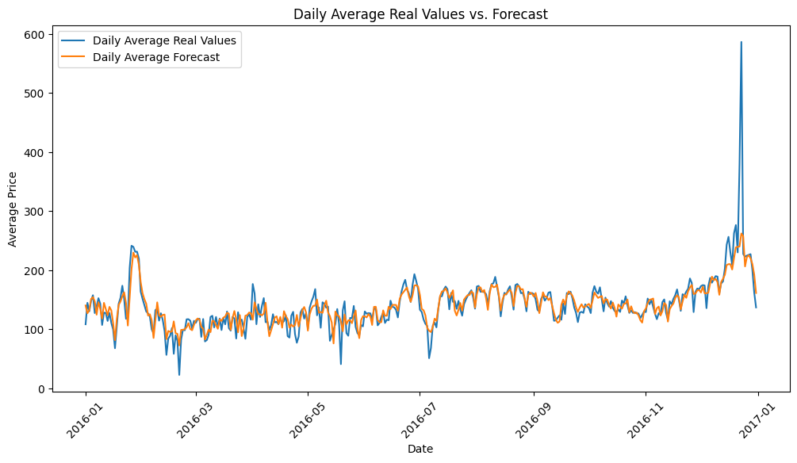
Evalution of TR Data 300 vs 1000 Iterations in Hyperparameter Optimization, Complete Graphs
300 Iterations
1000 Iterations

Slide 5
Evaluation metrics
 | 300 Iterations | 1000 Iterations
MAE | 21.8966 | 21.720629
RMSE | 26.650719 | 24.667309
MAPE | 24.118188 | 25.687769
sMAPE | 25.373286 | 26.531913
 | 300 iterations | 1000 iterations
MAE | 23.090235 | 22.491298
RMSE | 44.285112 | 42.94006
MAPE | 23.408669 | 20.714401
sMAPE | 25.224133 | 24.404314
Single Day Metrics
Complete Metrics
 | BE | DE | FR | NP | PJM
MAE | 5.869866 | 3.413456 | 3.86579 | 1.68338 | 2.862171
RMSE | 15.966266 | 5.927209 | 11.866605 | 3.318988 | 5.040493
MAPE | 24.892212 | inf | 13.601268 | 5.383525 | 27.477511
sMAPE | 13.44601 | 14.077548 | 10.812492 | 4.880306 | 11.330839
MASE | 0.687884 | 0.386407 | 0.429281 | 0.526905 | 0.346218
rMAE | 0.713092 | 0.423781 | 0.650655 | 0.531727 | 0.586735
Example Datasets Metrics

Slide 6
