Slide 1
EPFTOOLBOX DNN MODEL EVALUATION

Slide 2
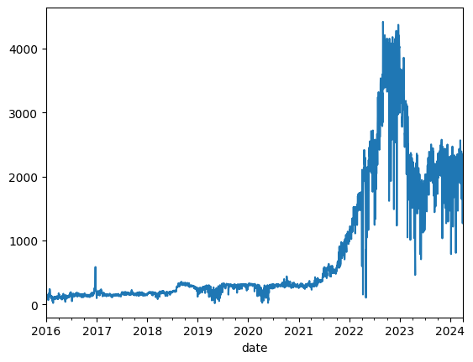
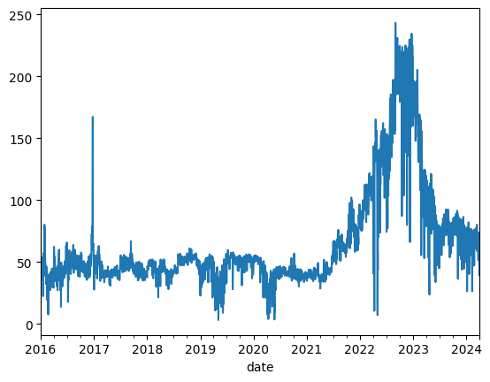
ELECTRIC PRICES IN TRY VS USD
PRICES IN TRY
PRICES IN USD

Slide 3
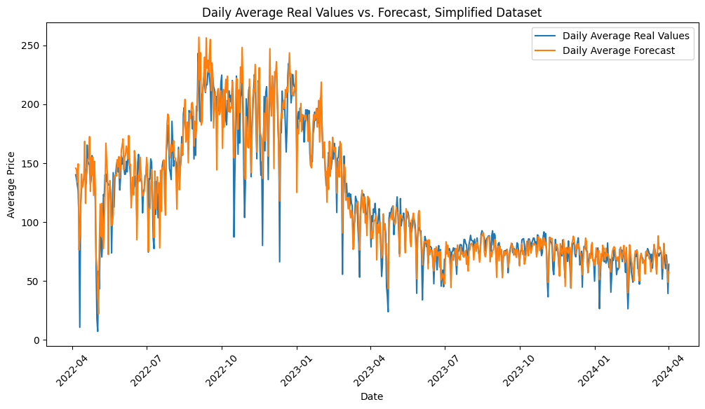
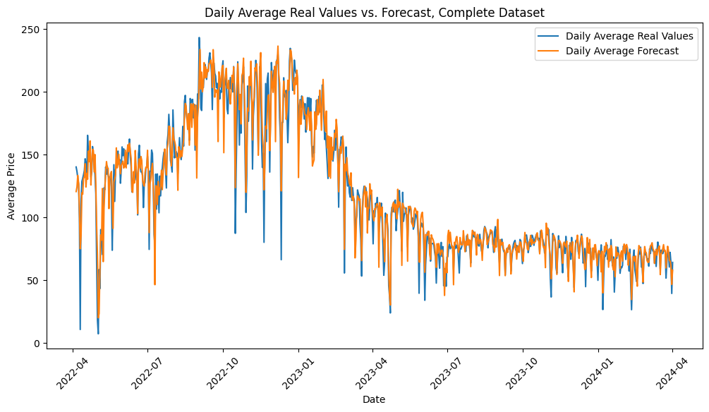
Complete DATASET COLUMNS: Price, BalancingMarketPrice, ForecastedDemandSupply, Day, Month, Year, Hour, Weekday, Holiday, Mod168
SIMPLIFIED DATASET COLUMNS: Price, BalancingMarketPrice, ForecastedDemandSupply

Slide 5
Evaluation metrics
Single Day | Complete Dataset | Simplified Dataset
MAE | 13.348935 | 12.885401
RMSE | 15.808736 | 15.536614
MAPE | 6.488891 | 6.624804
sMAPE | 6.488739 | 6.428444
Complete Test | Complete Dataset | Simplified Dataset
MAE | 14.805685 | 15.12377
RMSE | 21.470962 | 22.113196
MAPE | 15.155075 | 17.937585
sMAPE | 16.14154 | 16.23478
rMAE | 0.821549 | 0.785799

Slide 6
Comparison with other datasets
 | 2013-2016 TR Data | 2016-2024 TR Data | 2011-2016 BE Data | 2013-2018 NP Data
MAE | 22.491298 | 14.805685 | 5.869866 | 1.68338
RMSE | 42.94006 | 21.470962 | 15.966266 | 3.318988
MAPE | 20.714401 | 15.155075 | 24.892212 | 5.383525
sMAPE | 24.404314 | 16.14154 | 13.44601 | 4.880306
rMAE | - | 0.821549 | 0.713092 | 0.531727

Slide 7
