Slide 1
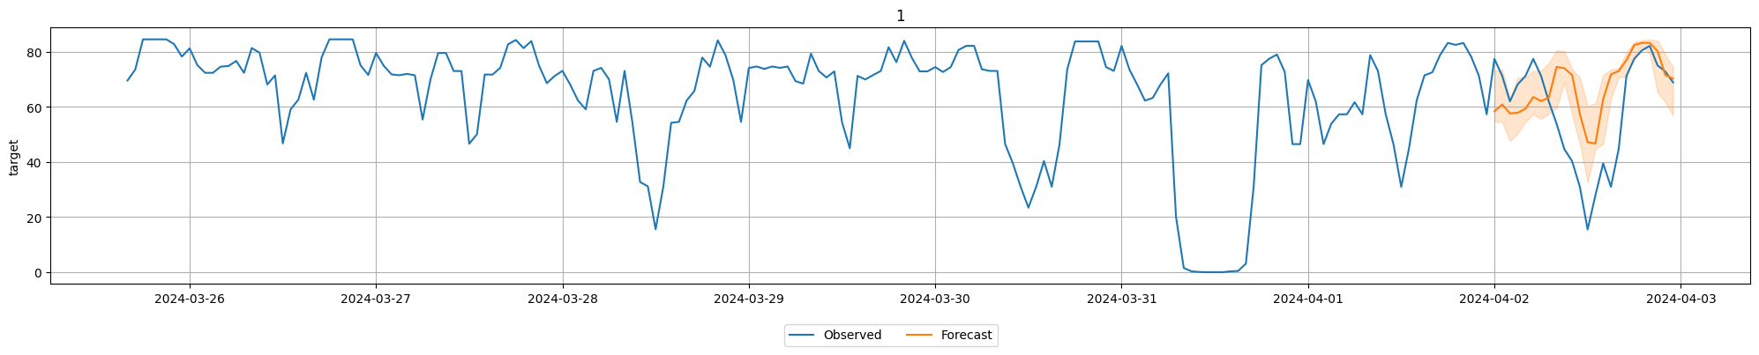
Autogluon chronos EVALUATION

Slide 2
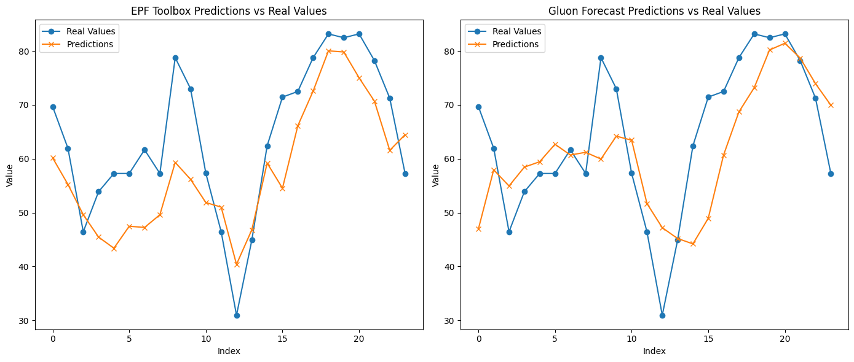
MAE: 8.42
MAE: 10.51

