Slide 1
EPFToolbox live model performance

Slide 2
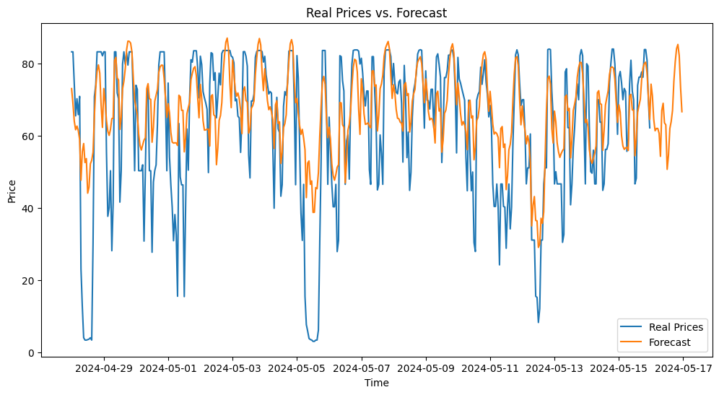
MAE | MAPE | MASE | rMAE | RMSE | sMAPE
10.5 | 65.59 | 0.93 | 1.01 | 14.53 | 22.55

Slide 3
