Slide 1
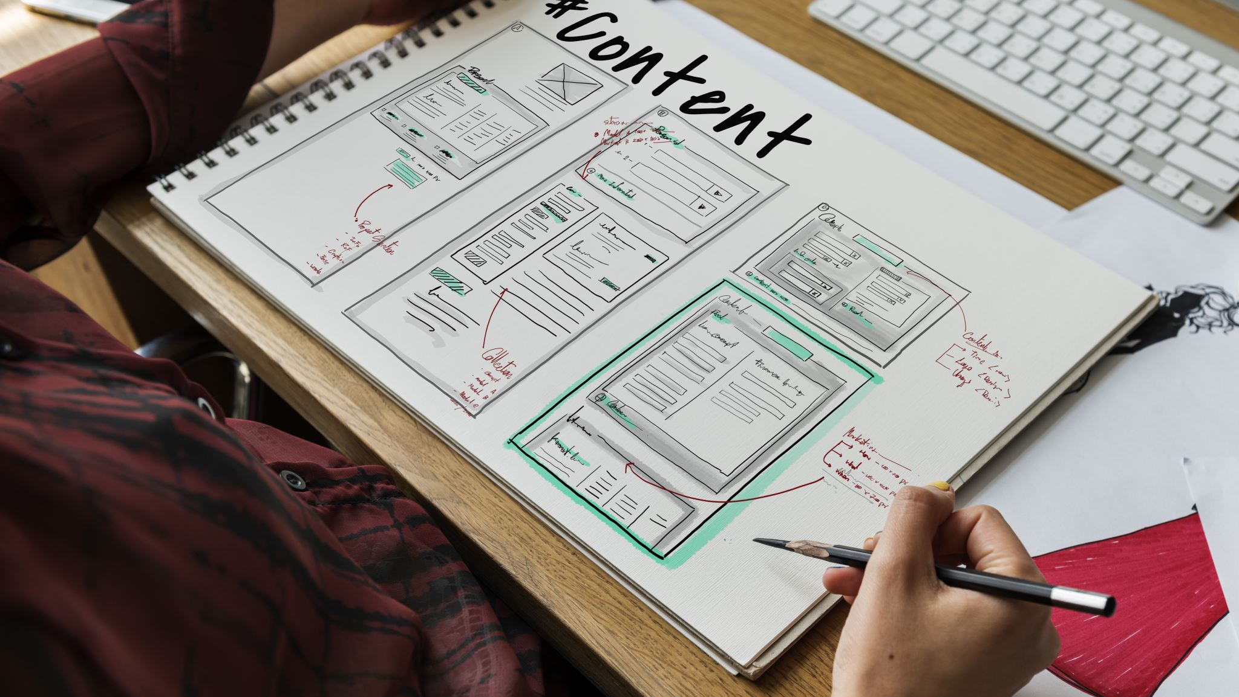
Gamified microlearning app for technical skills
by Rojin Singh Mahat
Student id: 2417733

Slide 2
Problems
E-learning = flexible, but low engagement & retention
01
Micro-skills (SQL, Excel, networking) → overlooked or outdated
02
Platforms often miss gamified progression + workplace relevance
03

Slide 3
Solution/Objectives
Web app with gamification (XP, badges, levels, streaks)
Bite-sized technical skills (SQL basics, Excel formulas, cybersecurity)
Animations & sound → engaging learning experience
Modular system → easy to expand

Slide 4
Academic Questions
Can gamification improve engagement & retention?
Which elements (points, badges, streaks) work best for micro-skills?
How effective is modular microlearning for workplace readiness?

Slide 5
Methodology
Agile Scrum: 2-week sprints
Incremental build:
Authentication
Gamification Engine
Skill Modules
Animations & Sound
Tools: React.js, Node.js, MongoDB, Figma, GitHub

Slide 6
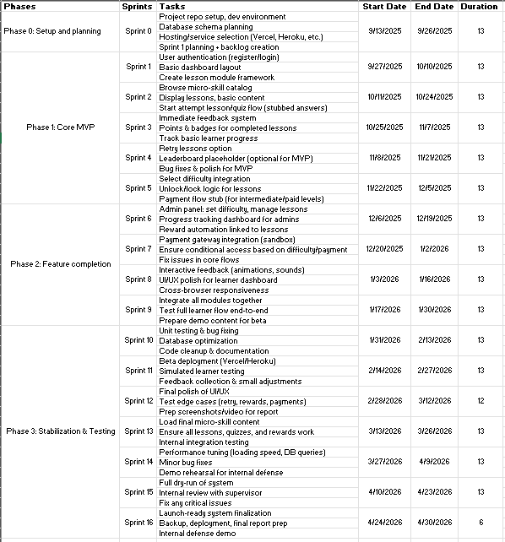
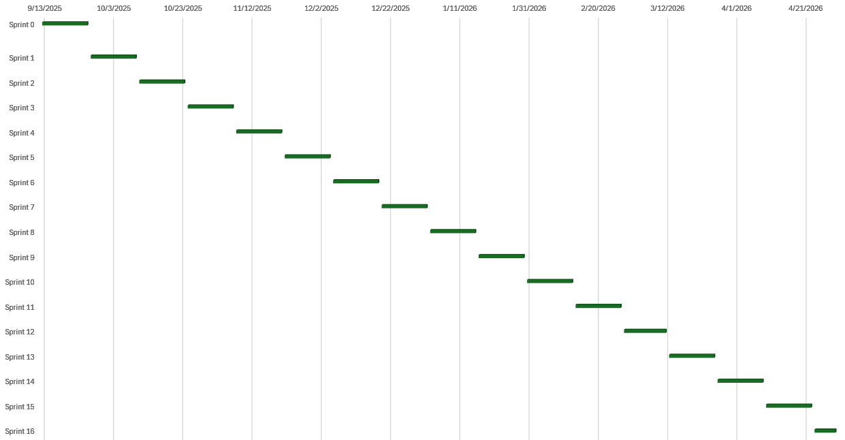
Gantt chart
Timeline of project tasks & milestones
Structured development phases

Slide 7
Artifacts
Authentication & User Management
Gamification Engine (XP, levels, badges)
Learning Modules (SQL, Excel, Cybersecurity)
UI/UX Layer with Animations

Slide 8
Expected outcomes
Boosted Engagement (XP, badges, streaks)
Better Retention via micro-challenges
Functional Prototype

