Slide 1
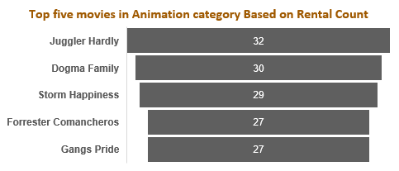
Which is the most popular category in Family-Friendly movies? Which films in this category are the top five most popular?
The above Bar chart: Displays the total number of rentals for each category in the Family-Friendly movie group. It indicates that the “Animation” category is the most common among Family-Friendly movies.
The below Funnel chart: This chart shows the top five movies in the “Animation” category based on their number of rentals.
Query in the attached file is indicated by :
«Slide 1 - Query - Question Set #1, Question 1»

Slide 2
Which category of Family-Friendly movies, is more popular in each quartile based on their rental duration?
The Clustered Column chart:
This chart shows that the "Animation" category is more common in the first quartile of the "Rental Duration" quartiles, followed by the "Children" category in the second quartile, the "Family" category in the third quartile, and the "Animation" and "Family" categories in the fourth quartile, respectively.
Query in the attached file is indicated by :
«Slide 1 - Query - Question Set #1, Question 3»

Slide 3
Who are the top 10 paying customers during 2007?
The Line chart:
This graph shows how much the top 10 buyers paid each month from February to May 2007.
The names of the top 10 buyers are listed on the right side of the chart.
Query in the attached file is indicated by :
«Slide 1 - Query - Question Set #2, Question 2»

Slide 4
Among the top 10 paying customers in 2007, who has the most difference in monthly payments?
The Line chart:
This graph displays, the difference in monthly payments for each top-paying customer. As shown, "Marion Snyder" has the greatest difference of -80.83 from April to May in 2007.
Query in the attached file is indicated by :
«Slide 1 - Query - Question Set #2, Question 3»

