Slide 1

A Study on NSL-KDD Dataset for Network Security
Rojina Deuja
NUID 71686680

Slide 2
NETWORK SECURITY
A set of rules, configurations or systems
Designed to enhance the protection of critical data in a network
Prevent loss, theft or unauthorized access of sensitive information

Slide 3
INTRUSION
An attempt to bypass the security mechanisms of a system
Compromise Confidentiality, Integrity and Availability (CIA)
INTRUSION DETECTION
Monitor various events that occur in a system
Analyze for signs of intrusions (flagged/anomalous behavior)

Slide 4
TYPES OF INTRUSION DETECTION
Signature-based Detection (SD)
Anomaly-based Detection (AD)
Stateful Protocol Analysis (SPA)
ANOMALY-BASED DETECTION
Monitor and evaluate regular activities, connections, hosts/users
Also called Behavior-based Detection

Slide 5
NSL-KDD DATASET
Released as new and improved version of KDD’99 dataset
Benchmark to evaluate intrusion detection systems
Train and test subsets (KDDTrain+ and KDDTest+)
43 total attributes (42 input features + Score + Attack)
Score = Difficulty level
Attack = Type of attack (Target column)

Slide 6
EXPLORATORY DATA ANALYSIS

Slide 7
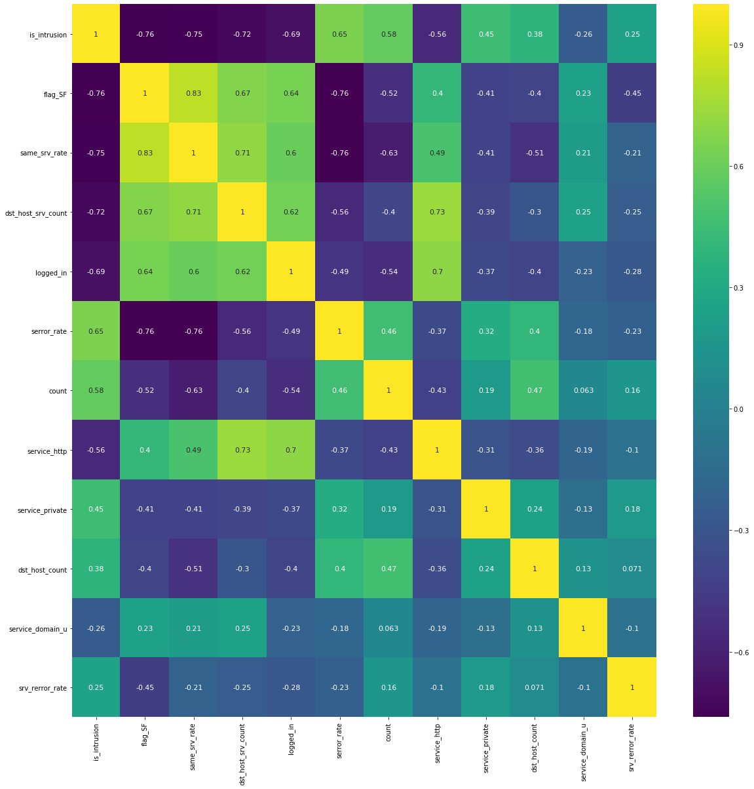
FEATURE SELECTION
Find most important characters for identifying intrusions in network
Analyze correlations with Attack
Analyze co-linearity with one another
Identify 11 features out of 42

Slide 8
CLASSIFICTION OF NETWORKS
Binary Classification (Normal or Intrusion)
Decision Tree Classifier
Train Accuracy: 97.97%
Test Accuracy: 77.45%
Precision: 0.8178
Recall: 0.777

Slide 9
FUTURE IMPROVEMENTS
Model found to be Overfitting
Increase Accuracy/Recall
Cross-validation, Regularization or Ensemble techniques

