Slide 1

A Study on NSL-KDD Dataset for Network Security
Rojina Deuja
NUID 71686680

Slide 2

NETWORK SECURITY
A set of rules, configurations or systems
Designed to enhance the protection of critical data in a network
Prevent loss, theft or unauthorized access of sensitive information

Slide 3
INTRUSION
An attempt to bypass the security mechanisms of a system
Compromise Confidentiality, Integrity and Availability (CIA)
INTRUSION DETECTION
Monitor various events that occur in a system
Analyze for signs of intrusions (flagged/anomalous behavior)

Slide 4
TYPES OF INTRUSION DETECTION
Signature-based Detection (SD)
Anomaly-based Detection (AD)
Stateful Protocol Analysis (SPA)
ANOMALY-BASED DETECTION
Monitor and evaluate regular activities, connections, hosts/users
Also called Behavior-based Detection

Slide 5
NSL-KDD DATASET
Released as new and improved version of KDD’99 dataset
Benchmark to evaluate intrusion detection systems
Train and test subsets (KDDTrain+ and KDDTest+)
43 total attributes (42 input features + Score + Attack)
Score = Difficulty level
Attack = Type of attack (Target column)

Slide 6
TYPES OF ATTACKS
DoS | Probe | Privilege | Access
apache2 | ipsweep | buffer_overflow | ftp_write
back | mscan | loadmodule | guess_passwd
land | nmap | perl | http_tunnel
neptune | portsweep | ps | imap
mailbomb | saint | rootkit | multihop
pod | satan | sqlattack | named
processtable |  | xterm | phf
smurf |  |  | sendmail
teardrop |  |  | snmpgetattack
udpstorm |  |  | spy
worm |  |  | snmpguess
 |  |  | warezclient
 |  |  | warezmaster
 |  |  | xclock
 |  |  | xsnoop
45927 | 11656 | 52 | 995

Slide 7
EXPLORATORY DATA ANALYSIS

Slide 8
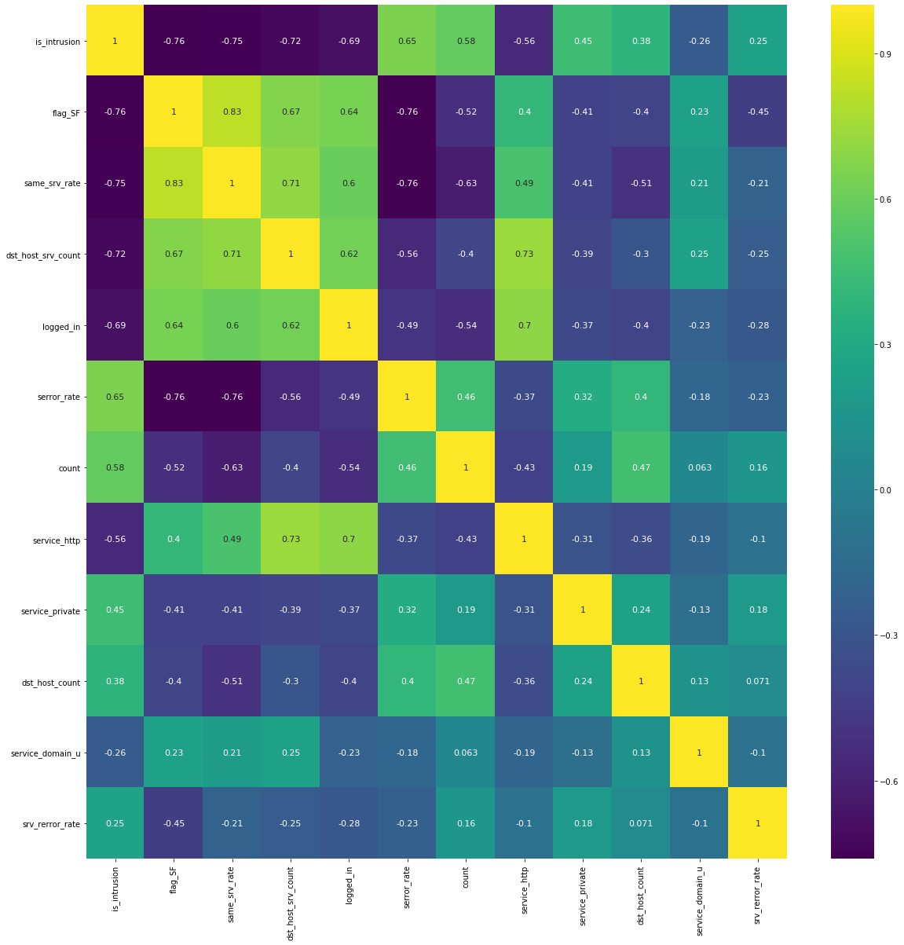
FEATURE SELECTION
Find most important characters to identify intrusions in network
Analyze correlations with Attack
Analyze co-linearity with one another
Identify 11 features out of 42

Slide 9
CLASSIFICTION OF NETWORKS
Binary Classification (Normal or Intrusion)
Decision Tree Classifier
Train Accuracy: 97.97%
Test Accuracy: 77.45%
Precision: 0.8178
Recall: 0.777

Slide 10
FUTURE IMPROVEMENTS
Model found to be Overfitting
Increase Accuracy/Recall
Cross-validation, Regularization or Ensemble techniques

