Slide 1
MA317: GROUP COURSEWORK
Data Analysis of Life Expectancy
Anmol Mahajan (2200735)
Rojitha Repalle (2201010)
Sharon Machado (2202055)

Slide 2
INTRODUCTION
Influence of socioeconomic growth on life expectancy is examined based on a variety of criteria such as mortality rate, total population, health expenditure, income, etc
Correlation is calculated between the response and predictor variables
Missing values are imputed using mice and median imputation
Using life expectancy as the response variable and other features as predictor variables, a fully reduced and best multiple regression model is built on the life expectancy dataset allowing us to predict the life expectancy of a child at birth

Slide 3
Descriptive Statistics
Data Summary and Plots
Dealing with Missing values
The Life Expectancy dataset used in this investigation contains information on 217 countries(observations) across different continents around the world having 26 World Development Indicators

Slide 4
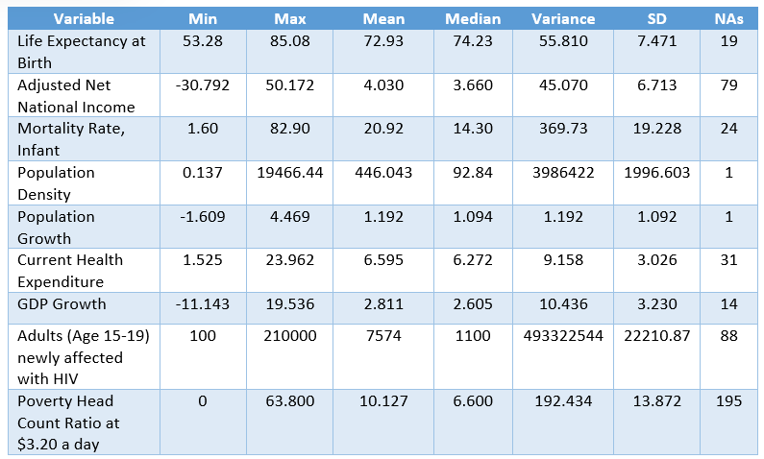
Descriptive Statistics
Data Summary and Plots
Life Expectancy at Birth is the response variable
The other features are the predictor variables
Categorical variables – Continent, Country Name, Country Code
Life Expectancy at Birth:
Mean - 72.93
Median - 74.23
Standard Deviation -7.471
Null values - 19
Descriptive Analysis of Predictor and Response Variables

Slide 5
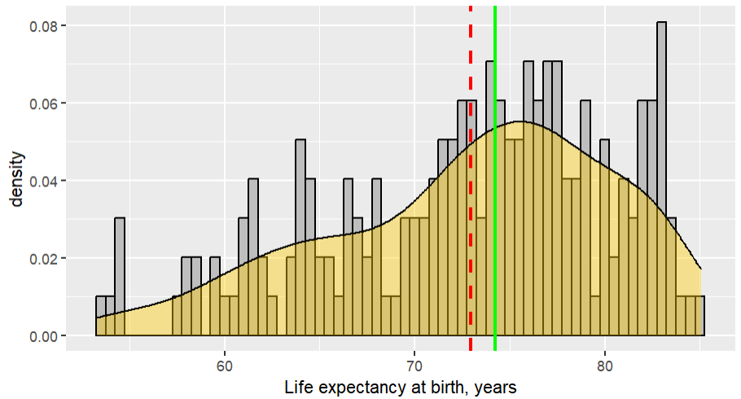
Descriptive Statistics
Data Summary and Plots
Figure represents the plot of the density function and histogram of the response variable
To understand the nature of distribution, Skewness and Kurtosis are used
Data is not normally distributed and is negatively skewed
Skewness: - 0.5874157
Kurtosis: 2.608043
Density Function and Histogram of the Response Variable

Slide 6
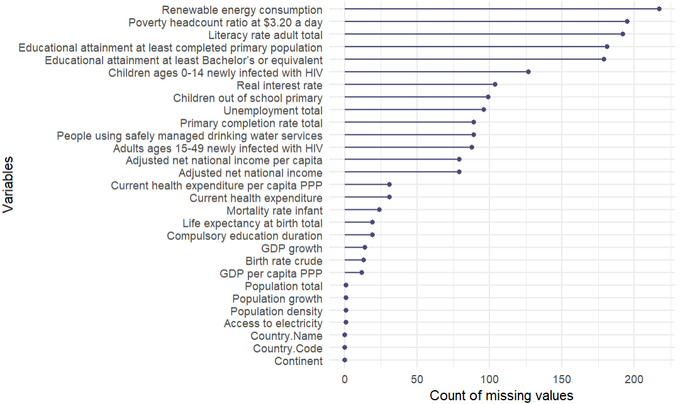
Descriptive Statistics
Handling Missing Values
Columns with Null values greater than 80% are dropped
Median imputation is applied to the predictor variables
Mice imputation is applied to the response variable

Slide 7
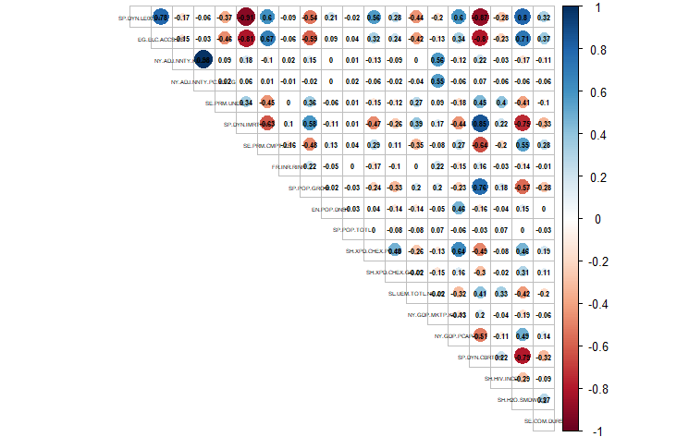
Investigation of Collinearity Between Predictor Variables
Correlation Matrix Plot for all features having negative correlation < - 0.5 and positive correlation > 0.4
Variance Inflation Factor (VIF) for the final predictor variables as shown below in the figure
Correlation Matrix Plot

Slide 8
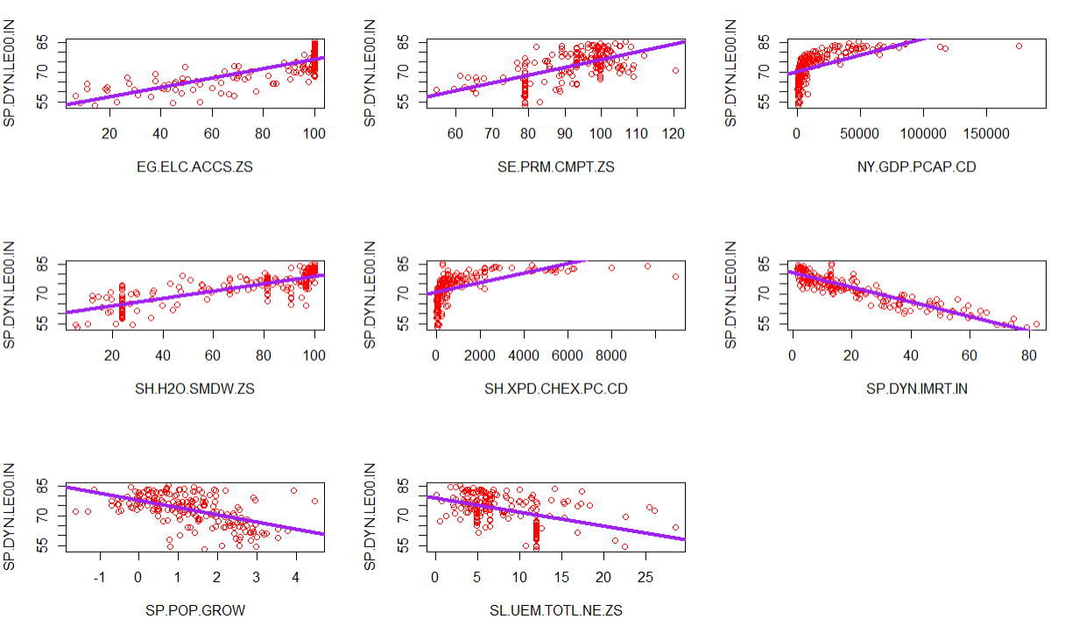
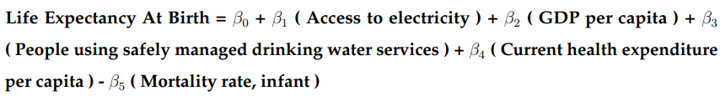
Linear Regression Model for Life Expectancy in 2020
Based on Backward Elimination Technique, following predictors are removed from the model - SE.PRM.CMPT.ZS, SE.PRM.UNER and SL.UEM.TOTL.NE.ZS
Best model is selected using AIC and Mallows’ Cp
Equation for best Multiple Regression Model:

Slide 9
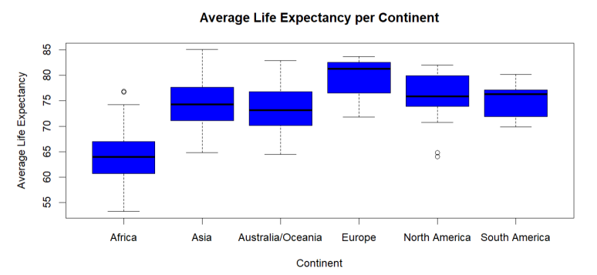
Experimental Design for Analysing Average Life Expectancy Across Continents
H0(Null Hypothesis): Average life expectancy across all the continents is same
H1 (Alternate Hypothesis): Average life expectancy across all the continents is not same

Slide 10
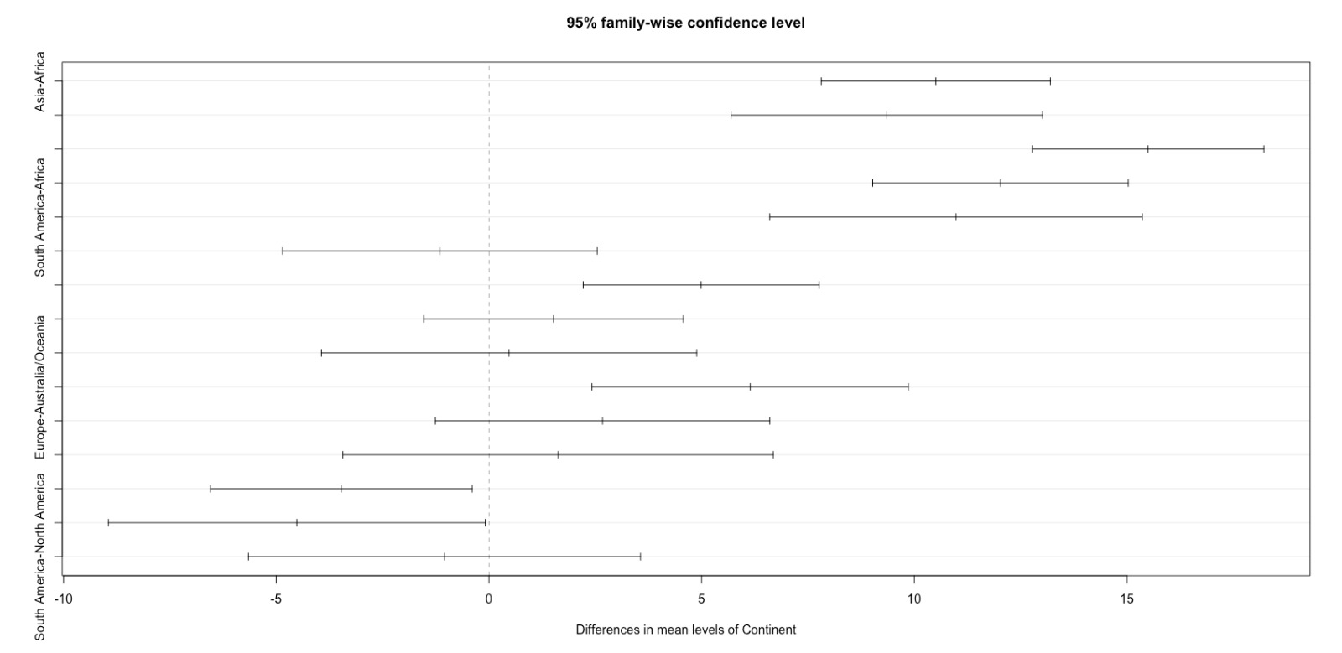
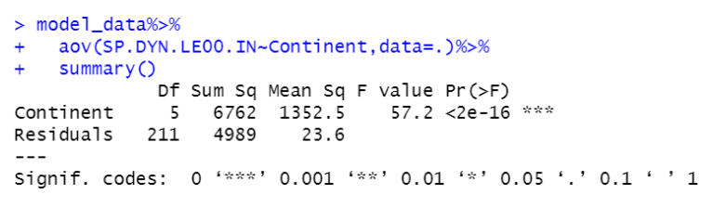
Descriptive Statistics
ANOVA ANALYSIS
One – way ANOVA
As the p-value is close to zero, the null hypothesis is rejected
Tukey’s Post Hoc Test shows the confidence interval for various continents
Tukey’s Post Hoc Test

Slide 11
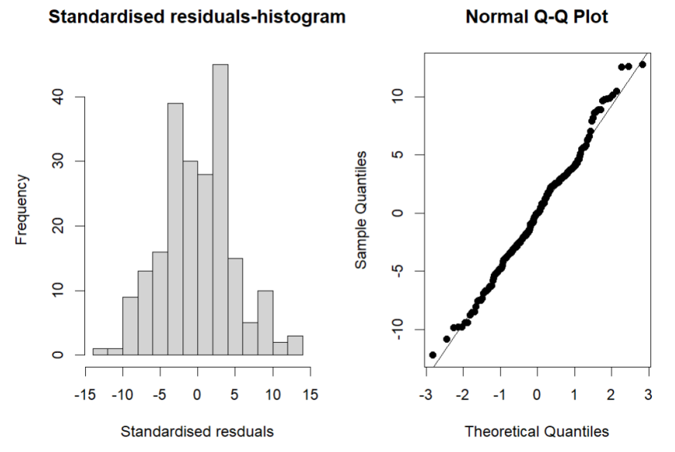
Descriptive Statistics
Standardised Residual Plot
Q-Q Plot
Standardised Residual Plot signifies that the residuals are normally distributed
Q-Q plot is approximately linear substantiating the condition that the residuals are normally distributed on the slope

Slide 12
THANK YOU !

