Slide 1

MA321 Group Coursework
Rojitha Repalle(2201010)
Sharon Machado (2202055)
Yash Mhatre (2201772)

Slide 2
INTRODUCTION
This report analyzes a dataset with 51 variables to predict the sale price and the condition and of houses based on factors such as the year built, overall quality, sale price
The primary aim is to classify the condition of a house as Poor, Good, or Average, and predict the sale price using various machine learning models.
To determine the category of new data, classification divides data into clear groupings
The dataset is carefully evaluated for missing values because null values contain important data. To preserve the dataset's structure, numerical values are imputed

Slide 3
Descriptive Statistics of Dataset
Numerical and Graphical Summary
Dealing with Missing values
The House dataset has 1460 records with 51 features, including the primary response variable, SalePrice, 28 character columns and 23 numeric columns are present Numeric columns are classified as continuous and categorical. Four variables have more than 75% missing values but contain meaningful information.

Slide 4
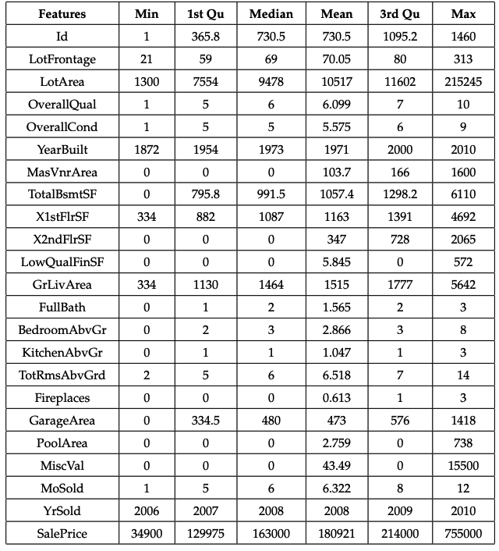
Numerical and Graphical Summary
It has 1460 records
51 Variable out of which ’SalePrice’ is the primary response variable
There are 23 numeric columns and 28 character columns
Few variables have more than 75% of missing values but these values are not null and carry meaningful information according to the descriptive description of the housing dataset
Descriptive Statistics of numerical columns

Slide 5
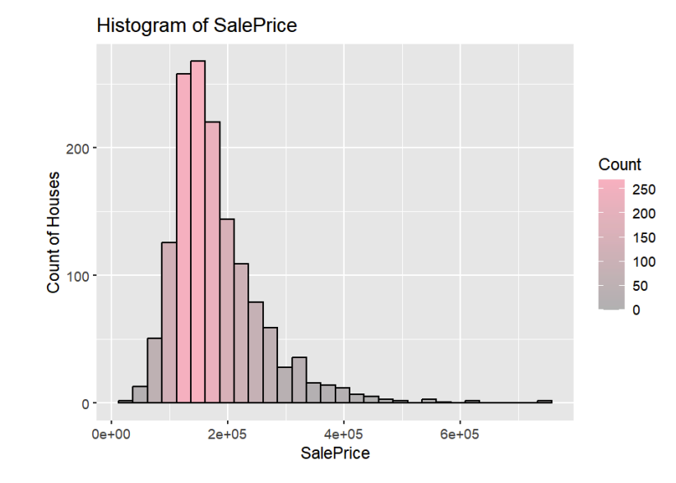
Data Summary and Plots
The dataset analysis shows that the majority of homes have a price under 200,000.The maximum sale price recorded in the dataset is 755,000 and the minimum is 34,900.
The number of houses decreases with the increase in price, especially after the 200,000 price point.
These insights can be valuable for decision-making by various stakeholders in the housing market.

Slide 6
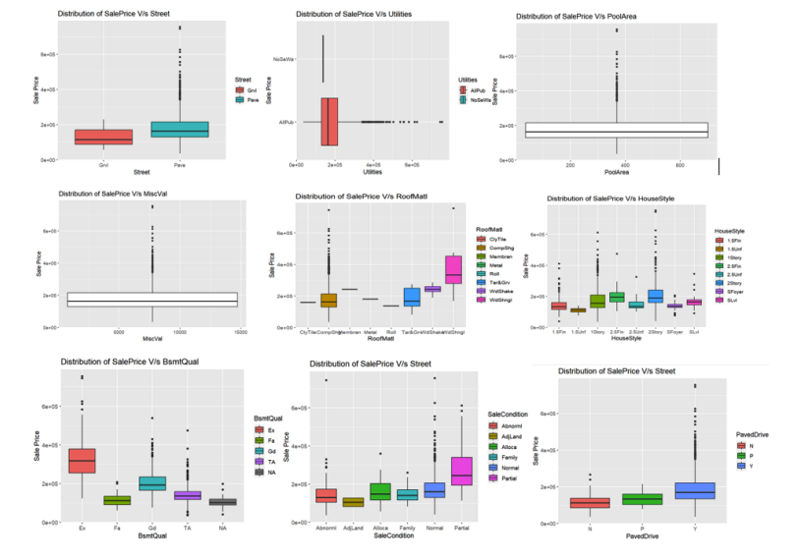
Dealing with Missing Values
Missing values are present in both character and numerical variables.
Mice imputation is performed for numerical columns
Street, PoolArea, MiscVal, Utilities, and RoofMat are category outliers and are dropped; the remaining features are taken into consideration for additional analysis

Slide 7
Dealing with Multicollinearity
Collinearity is when two or more variables are closely related to each other.
The highly correlated variables having a threshold 0.6 is discarded
Label encoding is used to convert categorical columns to numeric form for machine learning algorithms.
Chi-squared test is used to find significant variables and check relevance between them,It uses a p-value to determine the significance of features

Slide 8
Classification of Houses
TheClassification is used to determine the overall condition of the house based on the 'OverallCond' variable
The ordinal categorical variable "OverallCond" has a scale of 1 to 10 and describes the overall condition of the house, ranging from very poor to outstanding.
Poor if the overall condition is between 1 to 3.
Average if the overall condition is between 4 and 6.
Good if the overall condition is between 7 and 10
.
This classification methodology helps in simplifying the evaluation process and makes it easier to interpret the results. There are 1130 average, 299 good, and 31 poor condition houses after the classification as shown in Figure.

Slide 9
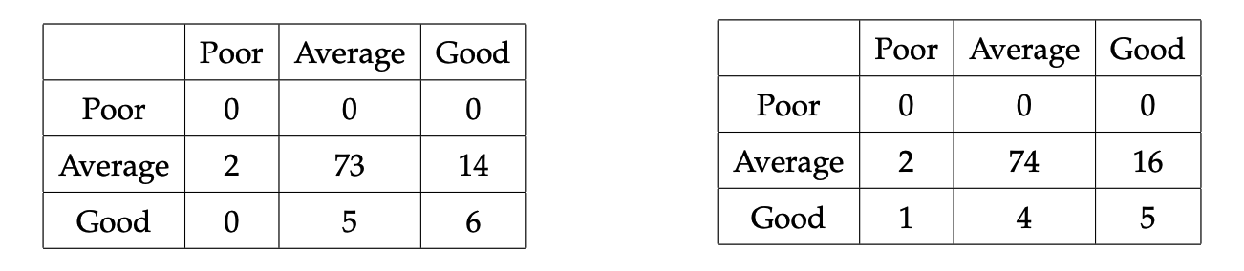
Logistic Regression Model
Decision Tree
The overfitting and size of the decision tree are controlled by the complex parameter(cp)
With 10-fold cross-validation and resampling without replacement, the decision tree model is applied, yielding accuracy of 79%. Table displays a confusion matrix.
The Logistic regression is used to estimate the probability of an event occurring, and multinomial logistic regression is implemented for models with more than two predictor variables.
To ensure the reliability of the model, bootstrapping resampling is employed to randomly select subsets of data from the original dataset and construct a model on each subset
Reference
Reference
Predicted
Predicted

Slide 10
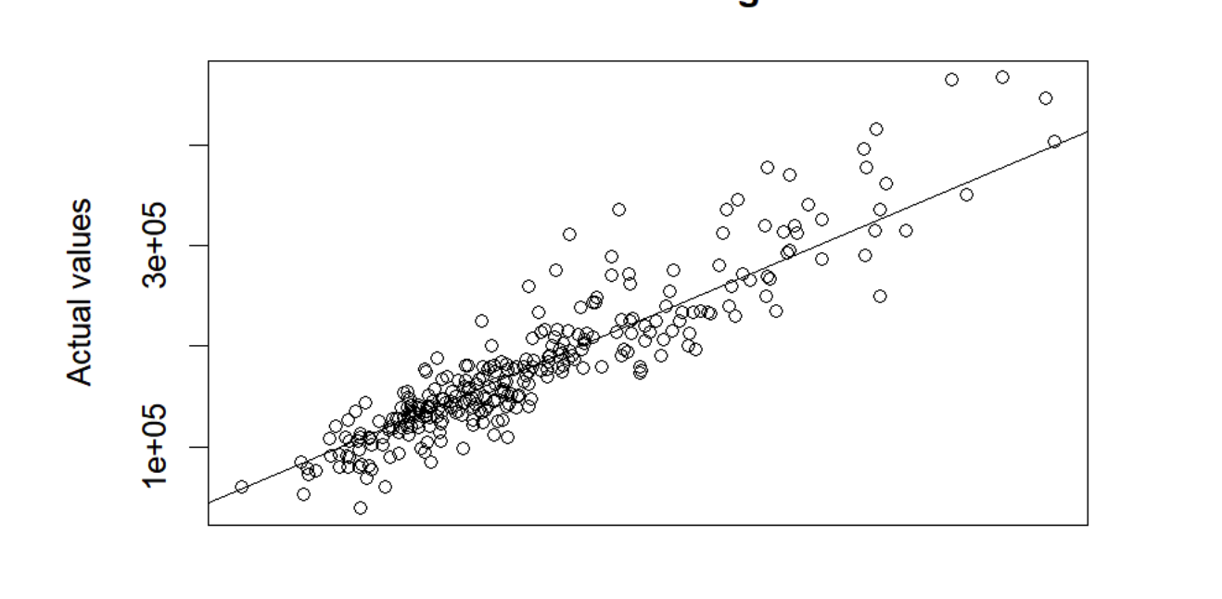
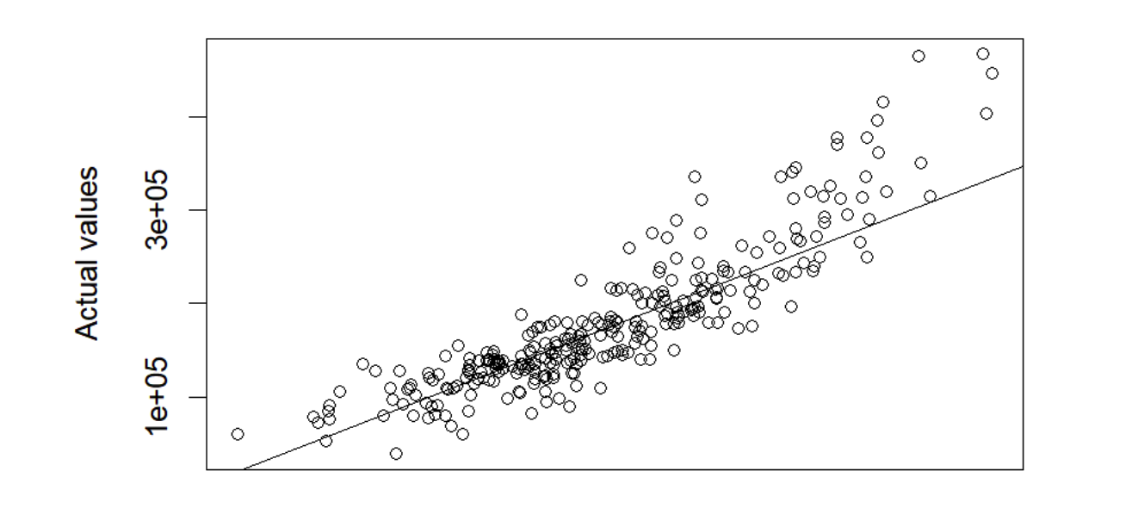
Prediction of House Prices
Random Forest Model
SVM
This algorithm creates several decision trees and averages their predictions to come up with a final prediction.
SVMs are useful when there are complex relationships between different features, making them a suitable choice for predicting house prices
SalePrice is the dependent variable and all the other variables in the dataset are independent variables.
The house prices for the test data is predicted using the trained model. The plot for the same is shown in figure.
SVM model uses a linear kernel to predict the SalePrice of houses based on various features in the training data.Ms are useful when there are complex relationships between different features, making them a suitable choice for predicting house prices.

Slide 11
Re-Sampling Methods to estimate test error
Cross-Validation(CV)
Error estimation using BootStrap
Cross-validation (CV) is a technique used in ML to evaluate the performance of a predictive model on an independent data set.
to perform k-fold cross-validation with k=10, which is set using the control.errorest() function
The function's output reveals that the RMSEs for the Random Forest and SVM models, which are estimated to be 34,869.22 and 40,649.4, respectively,But it still can improve
Bootstrap is a method for calculating a model's variability and prediction error.
Random forest regression model uses the "boot" estimator to perform bootstrap resampling
The error estimates for each bootstrap sample are calculated by the SVM model using the "lm" approach and the errorest() function. The SVM model's RMSE value is 41143.88. The estimated root mean squared error for Random Forest is 36238.1

Slide 12
THANK YOU !

