Slide 1
CE807: Assignment 2
Final Practical Text Analytics and Report
Rojitha Repalle (2201010)

Slide 2
INTRODUCTION
The project is based on the OLID dataset classification, where two of the best classifiers are chosen to perform text classification.
Their performance of them is evaluated after implementing the models.
The output files are then saved to the disk.
The graphs are plotted for test and valid files and represented.

Slide 3
2. Model Selection
The models which I selected were Logistic Regression and Support Vector Machines.
After studying, The F1 value of the SVM classifier reaches 86.26%, demonstrating the effectiveness of SVM as a machine-learning method for text classification.
Logistic Regression can generate better results in identifying and classifying text than any other methods like Naïve Bayes, Decision Tree, and others with 92%.

Slide 4
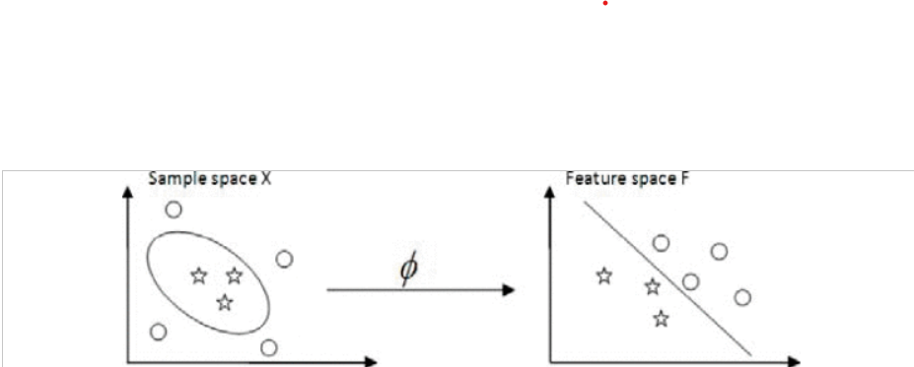
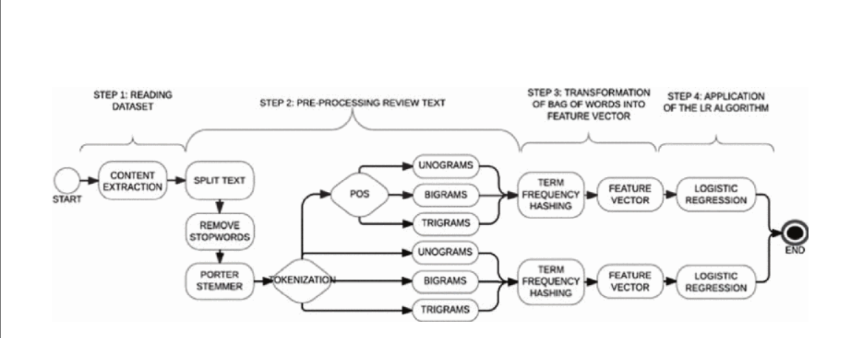
SVM and Logistic Regression
The pipelines of Logistic Regression and SVM are shown in the figures 1 and 2.

Slide 5
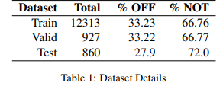
3. Design and Implementation of classifiers
The dataset details are shown in table 1. which shows offensive and not offensive tweets in the given dataset.
The models are then trained and implemented and then saved to the disk as output files.

Slide 6
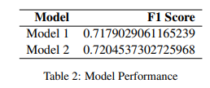
Performance of Model 1 and Model 2
The performance of the models are shown in table 2 as F1 scores.

Slide 7
4. Data Size Effect
The models are implemented on different sizes of the dataset as 25%, 50%, 75% and 100% and the performance is evaluated.

Slide 8
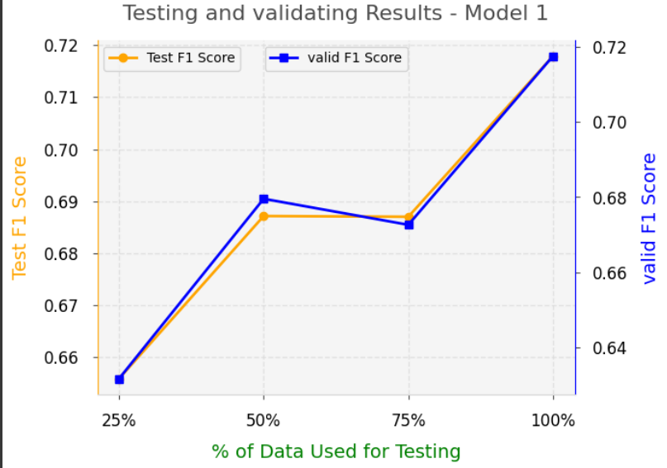
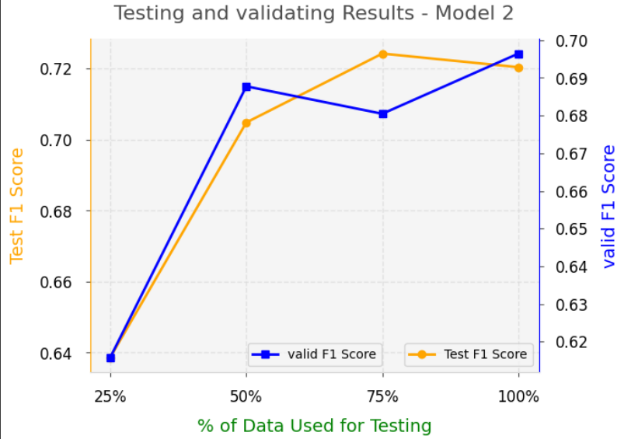
Comparison of Model 1 & Model 2 w.r.t train and valid dataset with F1 score.

Slide 9
Summary
The text classification is carried out after cleaning, preprocessing, and training the data. The performance is evaluated and recorded in the Google Collab as well as a report.
Major insights are drawn and recorded in the report.
It is observed that Logistic Regression has more F1 Score of 0.720453 and Accuracy than the SVM classifier which has 0.717902.

Slide 10
THANK YOU !

