Slide 1
CS0007 recitation
10:00a – 10:50a – lin rojtas

Slide 2
Overview
Method examples: replacing a number
Recursion
Base cases and recursive cases
Example: counting down

Slide 3
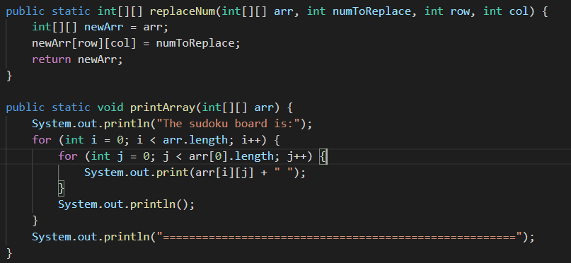
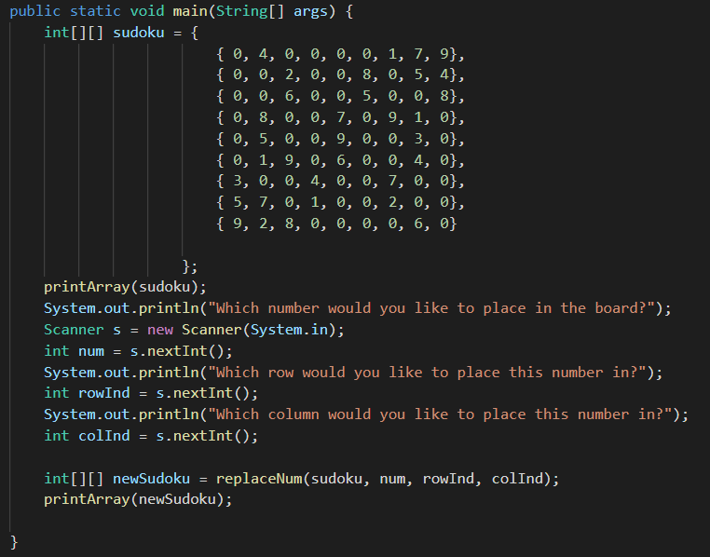
Three methods
main
replaceNum (non void)
printArray (void)
Let’s see how the two non-main methods work!

Slide 4
The first method that we call is printArray
The printArray method is a void method that takes in a two-dimensional array as a parameter
The code in the main method will stop until the printArray method is done running

Slide 5
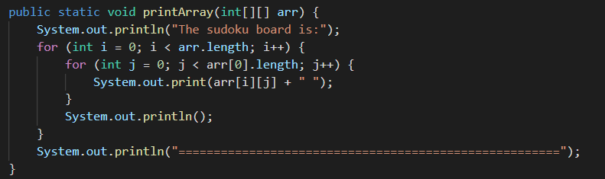
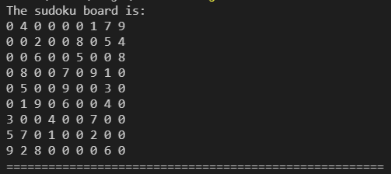
Within this method, we print out “The sudoku board is:” followed by each number in the array in the same way we display any other two-dimensional array.
This is a void method, so there is no return keyword. Also, we do not need to assign calls to this method to a new variable in main.

Slide 6
Now that printArray is done running, we pick up where we left off with these print statements and taking in user inputs.
A general note: Scanners can be reused! You don’t need to create a new one for each new user input

Slide 7
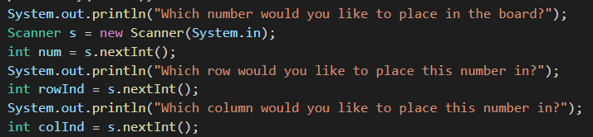
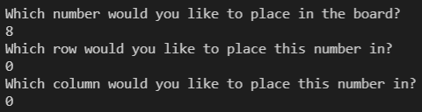
Nothing new is going on here, we are just declaring variables based on user input.
The integer num now stores 8
The integer rowInd now stores 0
The integer colInd now stores 0

Slide 8
The next method that we call is replaceNum
The replaceNum method is a non-void method that takes in a two-dimensional array and three integers as parameters
The code in the main method will stop until the replaceNum method is done running

Slide 9
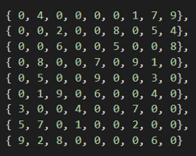
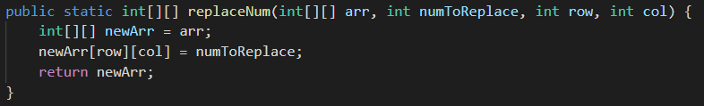
Note that you do not need to name the variables in your method call the same names as your parameters!
You can do this, but you do not have to. Just make sure you use the parameter variable names within the actual method’s code
We call the process of inputting specific values or variables into a method passing
i.e. here, we are passing the values of sudoku, num, rowInd, and colInd into the method replaceNum

Slide 10
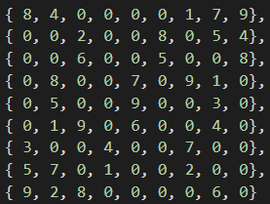
First, we create a new array called newArr that is equal to the array that we passed in.
Then, we use the inputted row and column value to replace whatever number was in that position before with the user-inputted number
Finally, we return the new array since this method is a non-void method; the return type is a two-dimensional array.
The return type and the type of variable in the return statement MUST be the same.
This is the new value of newArr, which is what we are returning to the main method and storing in variable newSudoku

Slide 11
Note again that since replaceNum is a non-void method, we need to store its return value in a variable in the main method
Finally, we call printArray on newSudoku so the new sudoku board with the updated number can be displayed.

Slide 12
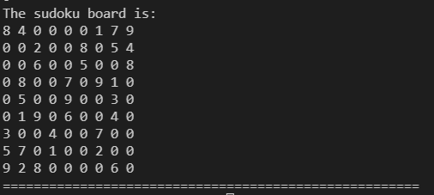
Within this method, we print out “The sudoku board is:” followed by each number in the array in the same way we display any other two-dimensional array.
This is a void method, so there is no return keyword. Also, we do not need to assign calls to this method to a new variable in main.
With this, we have reached the end of our program.

Slide 13
Recursion: an overview
Recursion is the process of making a method call itself
This provides a way to break larger problems down into simple subproblems.
When writing a recursive method, you must ensure that you have:
A base case, otherwise known as a halting case, that is attainable
A recursive case in which the method calls itself

Slide 14
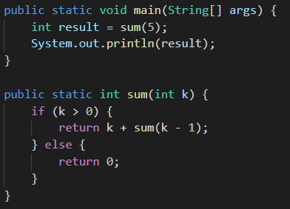
Recursion: an example
Recursion can be difficult to wrap your head around, so we’re going to explore this recursive method that adds a range of numbers together
(i.e. 5+4+3+2+1)
Recursive case
Base case

Slide 15
First, the sum method is called; sum is a non-void method that returns an integer as well as taking an integer in as a parameter.
We call sum(5), which takes us down to the sum method
In this situation, k = 5
If k > 0, we return k + sum(k-1)
In other words, we return 5 + sum(4)…

Slide 16
Since sum(4) was called in our last return statement, we go through sum again with k = 4.
We call sum(4), which takes us back to the sum method
In this situation, k = 4
If k > 0, we return k + sum(k-1)
In other words, we return 4 + sum(3)…

Slide 17
Since sum(3) was called in our last return statement, we go through sum again with k = 3.
We call sum(3)… this is getting repetitive
sum(3) will return 3 + sum(2)
sum(2) will return 2 + sum(1)
sum(1) will return 1 + sum(0)
When sum(0) is called, k = 0… which isn’t greater than 0!
We’ve hit our base case! Return 0!

Slide 18

We’re not done yet!!!!!
There is still the matter of all those other method calls to go…
sum(0) = 0
sum(1) = 1 + sum(0) = 1 + 0 = 1
sum(2) = 2 + sum(1) = 2 + 1 = 3
sum(3) = 3 + sum(2) = 3 + 3 = 6
sum(4) = 4 + sum(3) = 4 + 6 = 10
sum(5) = 5 + sum(4) = 5 + 10 = 15!
Thus, result = 15, so 15 will be printed.

Slide 19
Why recursion?
Despite it taking up more memory than iterative methods (i.e., ones that contain loops), recursion can reduce the amount of time that it takes to do certain problems
The most important of these is sorting; if you choose to move forward in your computer science career, you’ll learn about sorting algorithms in future classes. The fastest ones use recursion!
At its core, recursion is essentially dividing one large problem into several smaller subproblems until they are manageable; I’m sure you’ve done something similar on homework assignments!

Slide 20
For next week
Next week will be extended office hours in preparation for your final exam, but I’ll be bringing candy as a reward for your good work this semester
All the labs that you may be missing are due Monday, December 6th at 11:59PM.
Don’t forget to mask up and wash your hands! These new variants don’t mess around

