Slide 1
CS0007 Recitation
Thursdays 10:00A – 10:50A
Lin Rojtas – Adapted from Michael Bartlett

Slide 2
Overview
Reading Text Files
Writing Text Files
Exceptions
Arrays
Lab 6

Slide 3
Reading Text Files Using Scanner
First, we need to use the File Class to get a reference to the file that we want to read.
Then we use a Scanner to read the file and do something with the data.
Scanner has multiple methods that we can utilize to read the file.
Check out the Java API docs for Scanner

Slide 4
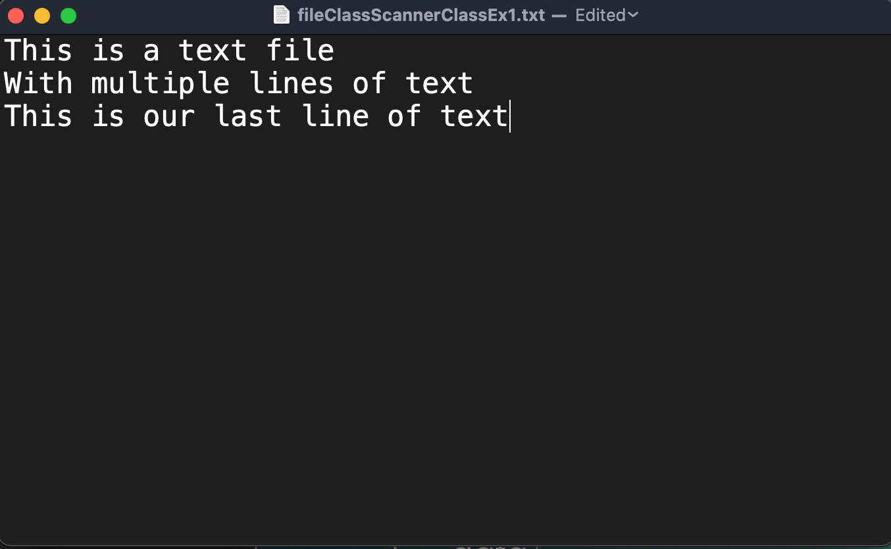
Notes:
Say we have a regular old text file (.txt extension)

Slide 5
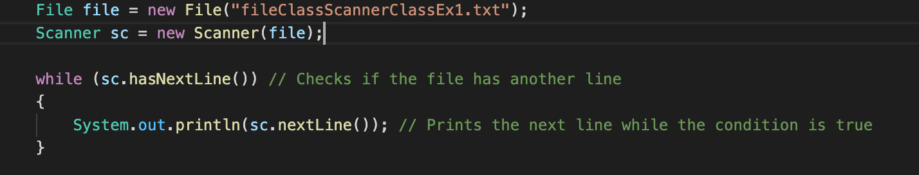

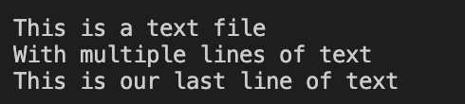
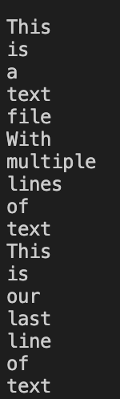
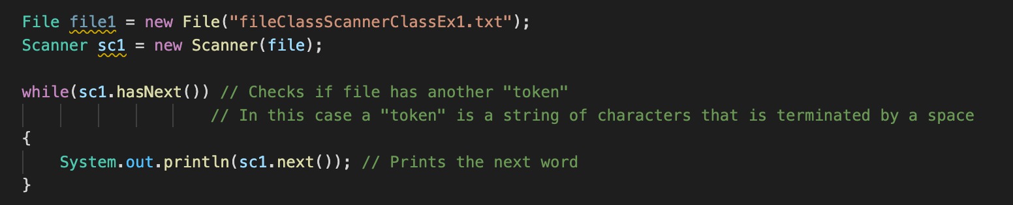
Reading Text Files Using Scanner
Notes:
We create a file object so that the computer knows it’s a file, and then feed it through a scanner
Difference
On top, we check for new lines (\n)
On bottom, we check for tokens (separated by space)
First, we need to use the File Class to get a reference to the file that we want to read.
Then we use a Scanner to read the file and do something with the data.
Scanner has multiple methods that we can utilize to read the file.

Slide 6
Reading Text Files Using BufferedReader
First, we need to use the File Class to get a reference to the file that we want to read.
Then we use a BufferedReader to read the file.
BufferedReader has multiple methods that we can utilize to read the file.
Check out the Java API docs for BufferedReader

Slide 7
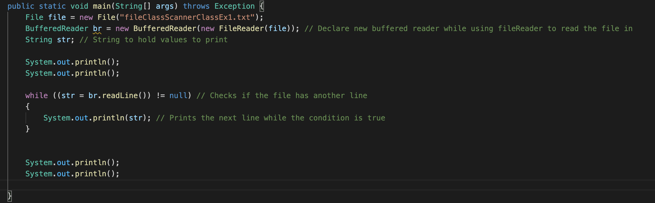
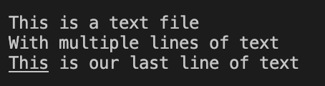
Reading Text Files Using BufferedReader
Notes:
Quite similar to scanner, but differences are covered ini the
First, we need to use the File Class to get a reference to the file that we want to read.
Then we use a BufferedReader to read the file.
BufferedReader has multiple methods that we can utilize to read the file.

Slide 8
Scanner Vs. BufferedReader
Scanner will parse every “token” in a file that way you can interpret all the “tokens” in a file
Parsing: Interpreting the given input as tokens (parts). It's able to give back you specific parts directly as int, string, decimal, etc.
See also all those next() methods in Scanner class.
BufferedReader will simply read the stream without doing any special parsing
Reading = Dumb streaming. It keeps giving back characters, which you in turn have to manually inspect if you'd like to match or compose something useful. But if you don't need to do that anyway, then reading is sufficient.

Slide 9
Writing to files Using PrintWriter
First, make a new PrintWriter object and set the file name.
Then, write your data.
Make sure to close it using writer.close();
Your data won’t write if you don’t do this.

Slide 10
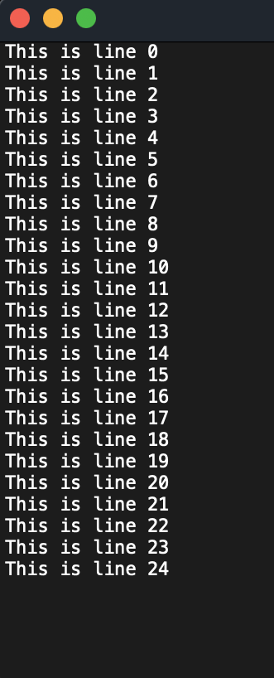
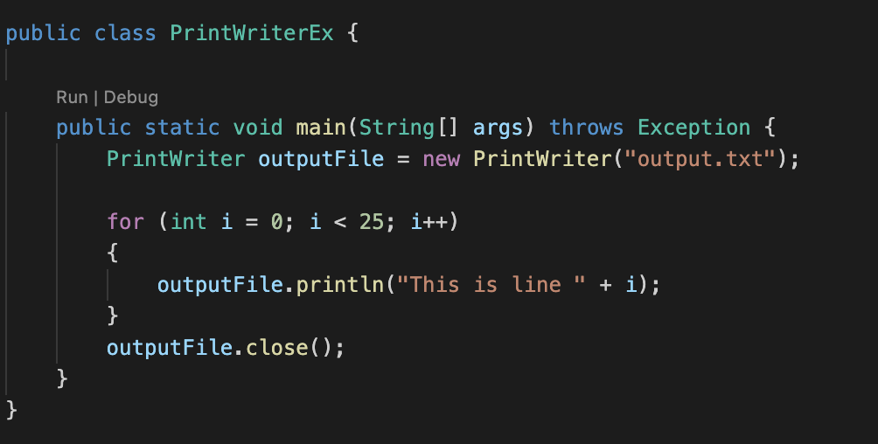
Writing Text Files Using PrintWriter
Notes:
First, make a new PrintWriter object and set the file name.
Then, write your data.
Make sure to close it using writer.close();
Your data won’t write if you don’t do this.

Slide 11
Appending Data To Existing File Using FileWriter
First, make a new File object
Then, make a new FileWriter object and set the file name.
Then, make a BufferedWriter object out of your FileWriter object
Write your data and then close the BufferedWriter and FileWriter objects.

Slide 12
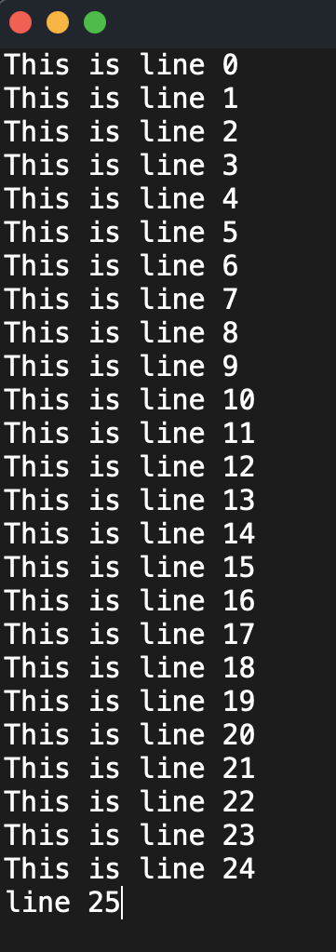
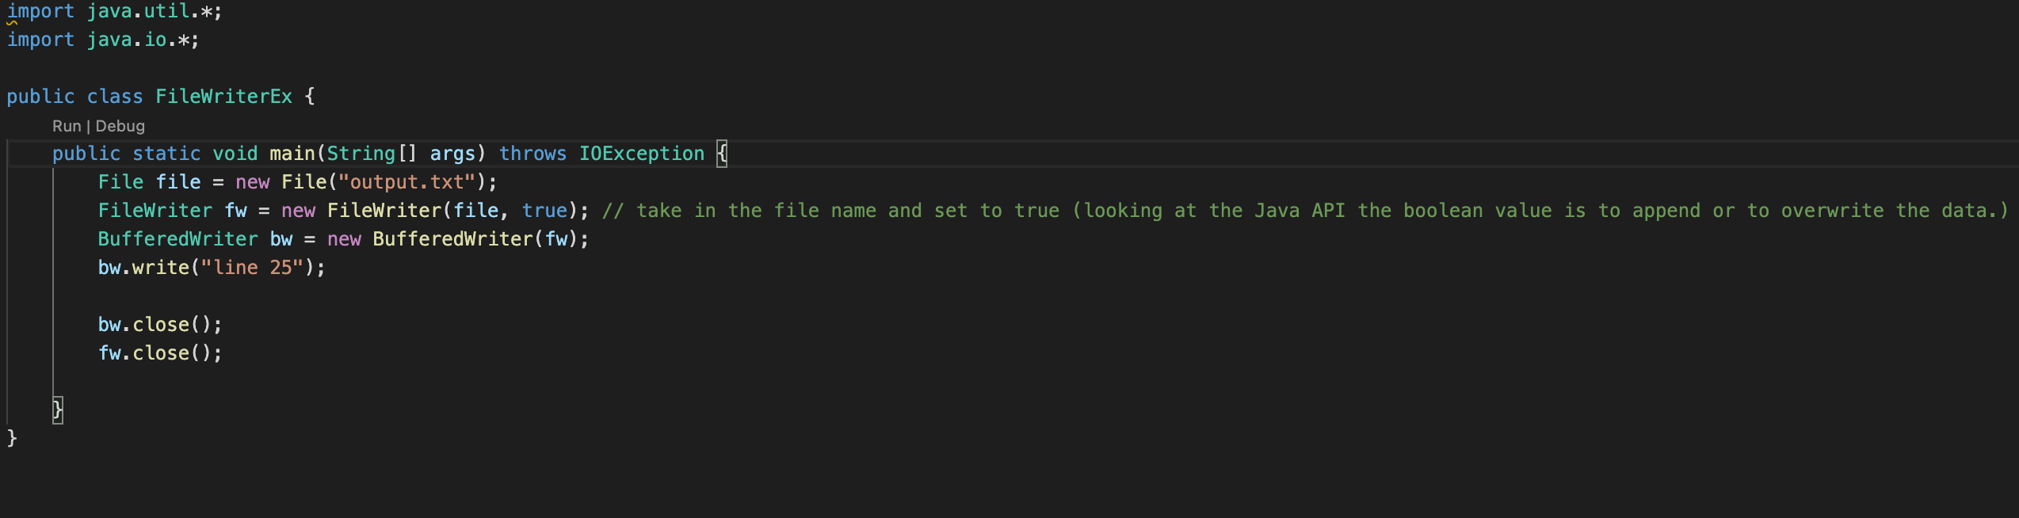
Appending Data To Existing File Using FileWriter
Notes:
First, make a new File object
Then, make a new FileWriter object and set the file name.
Then, make a BufferedWriter object out of your FileWriter object
Write your data and then close the BufferedWriter and FileWriter objects.

Slide 13
Handling Exceptions
Exceptions happen when we can’t 100% verify that the code will work while being compiled.
A good example of an exception would be trying to open a file that doesn’t exist.
If your program can’t find a file that you’re trying to open, a FileNotFoundException gets thrown by Java.
You could let Java know that your method may throw the exception (as seen in the previous examples)
Or, you could use a try catch block to handle an exception that may be thrown
You can then decide what happens if an exception happens instead of Java just stopping your program.

Slide 14
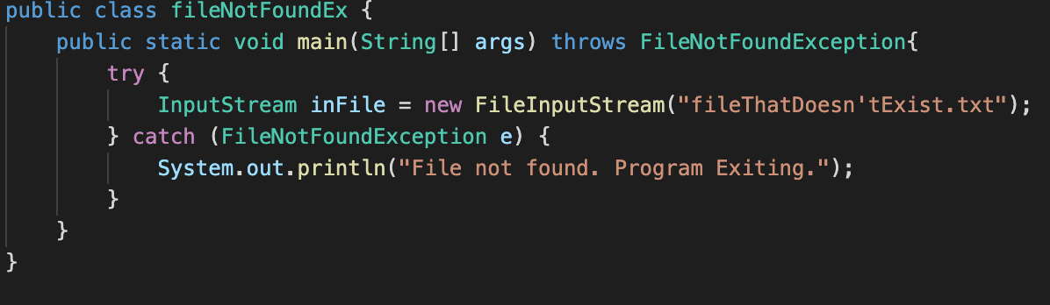
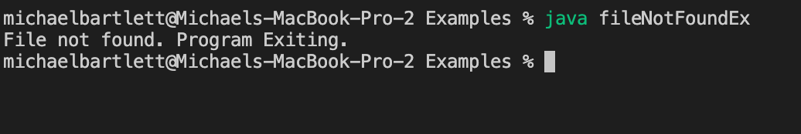
Handling Exceptions

Slide 15
Arrays
Arrays are used to store multiple values in a single variable, instead of declaring separate variables for each value.
When making an array, declare the type that’s going to be stored in it and name it. Then set the values that you want in the array.
Or you can declare an array that’s not equal to anything and just has its size in the square brackets.

Slide 16
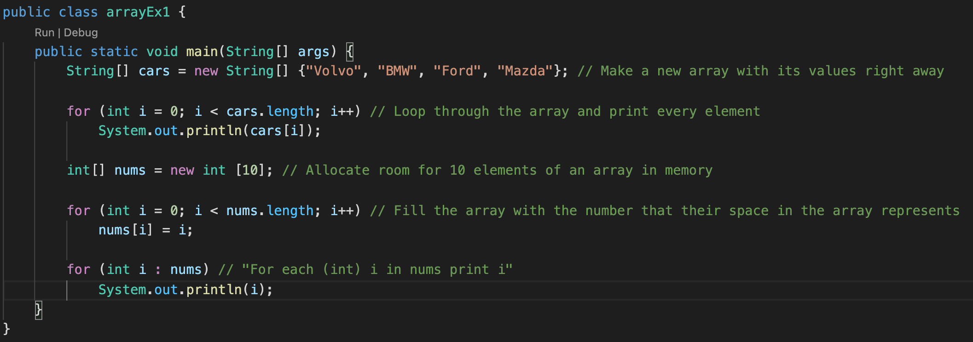
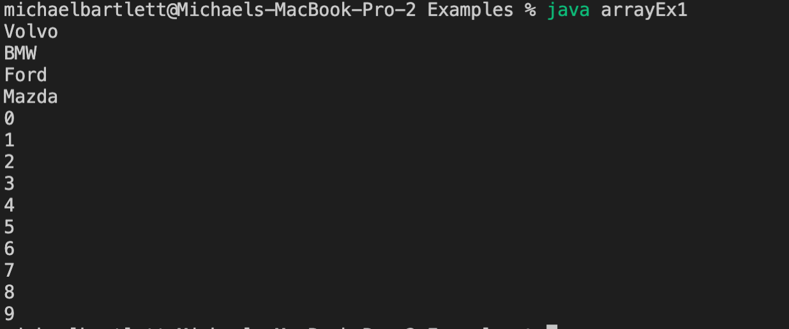

Creating Arrays

Slide 17
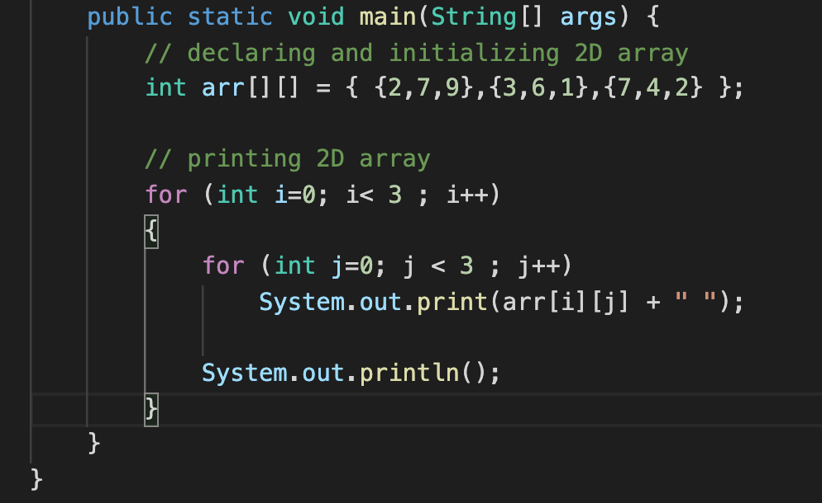
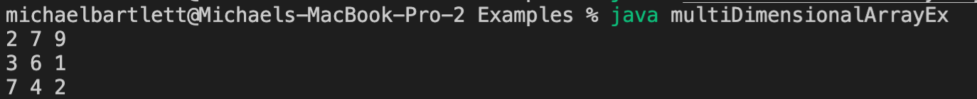
Multidimensional Arrays

Slide 18
ArrayLists in Java
ArrayLists provide us with dynamic arrays in Java.
Though, it may be slower than standard arrays but can be helpful in programs where lots of manipulation in the array is needed.

Slide 19
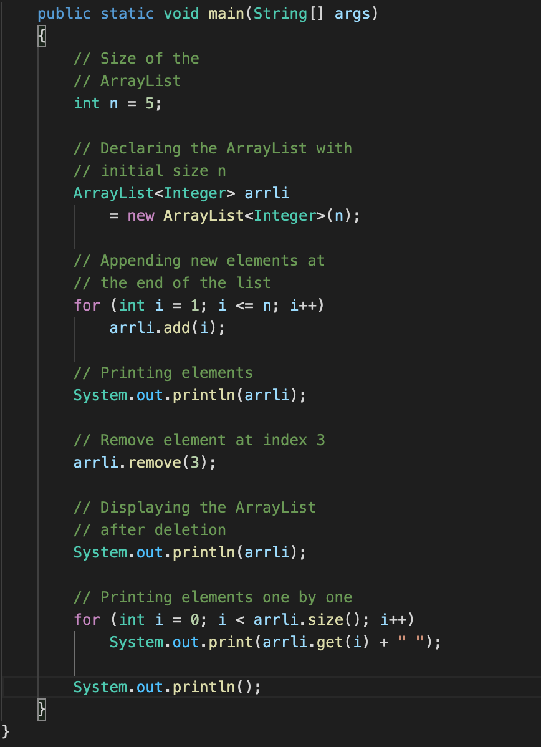
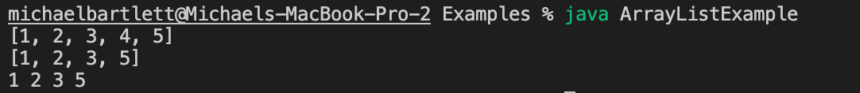
Arraylists in java

Slide 20
Arrays vs. Arraylists The Similarites:
Array and ArrayList both are used for storing elements.
Array and ArrayList both can store null values.
They can have duplicate values.
They do not preserve the order of elements.

Slide 21
Arrays vs. Arraylists Key Differences:
Arrays are static in size, meaning that if you need to upsize it, it has to be copied into a new array before you can add more elements.
You need to know the size of the array when declaring it.
This makes it faster though
ArrayLists are dynamic in size, meaning that you don’t need to make a new one to upsize it.
The size isn’t necessary when declaring it.
ArrayList is internally backed by the array in Java so the resize operation slows down the performance
Arrays can be multi-dimensional whereas ArrayLists can only be single dimensional.

Slide 22
Lab 6 (Due 10/20 at 11:59PM)
Check out Paulo’s videos for the explanations
Key Concepts:
Reading data from a textfile into an arraylist
Access arraylist elements based on user input
Validating user input

Slide 23
For next week
It looks like y’all will have an exam coming up so we’ll talk about that and any other concepts you learned that week
This lab will take awhile and is a lot more than you’ve done before.
Do it in small pieces and test as you go!
Please email me or if you’re having issues with submitting labs on time
Or if you’re having any issues with the labs/quizzes! If you don’t understand how to do something just ask!
We made a Discord server! https://discord.gg/23weGMFk
Joining is optional, but it’ll be a good point of contact with us

