Slide 1
CS 0007 Recitation – 10/7/21
Lin rojtas – 10:00a – 10:50a

Slide 2
overview
Midterm debrief
Loops!
While loops
Do while loops
For loops
Lab 4 hits and Q&A

Slide 3
Midterm…
How was it?
I’m not sure when they’ll be graded, but the grader is in the process! There’s a good amount of you, so be patient
When you get your grades back, direct questions to the grader (Mike Neumann) or Paulo

Slide 4
Loops
Exactly what it sounds like!
Avoids the need to write the same block of code over and over again
Loops will check to see if a condition is true and execute the code inside of it any number of times depending on whether the condition stays true
Almost like an if statement if it ran over and over…
Three types
While loop
Do-while loop
For loop

Slide 5

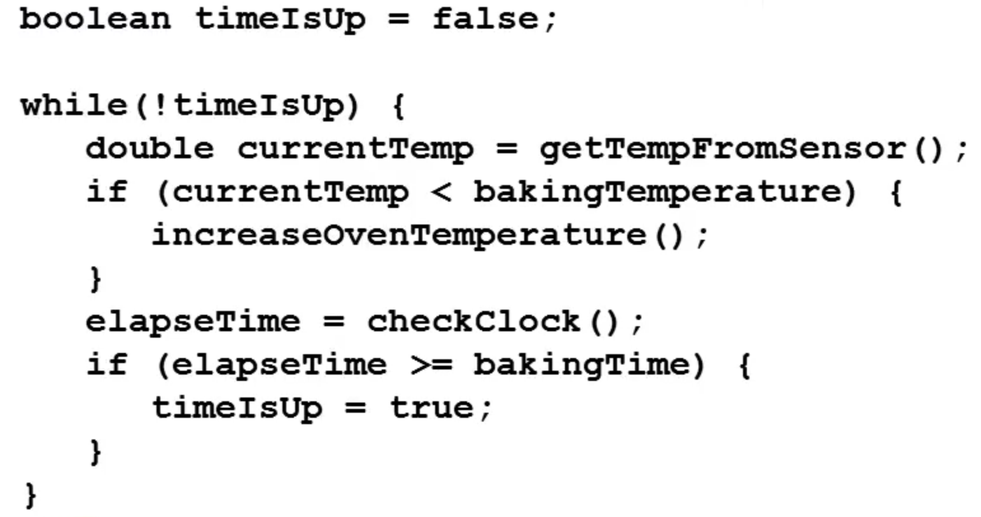
While loops
In plain English: “While this condition is true, do this action”
To unpack this example from the videos
Our condition is checking whether the time on the oven is up or not
While it isn’t, we elapse time and check to see if the elapsed time is equal to the baking time
If they’re equal, then we set timeIsUp to true.
The loop will stop when it goes back to check whether the while clause is true; since timeIsUp is true, !timeIsUp will be false, so we exit the loop

Slide 6
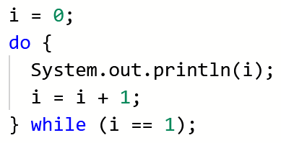
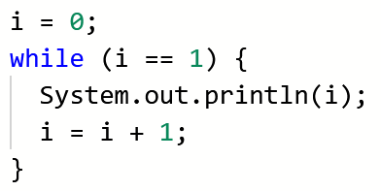
Do-while loops
In plain English: “Do this action, and while the condition is true, do it again”
Essentially… the same as a while loop, except the code inside of the loop always runs at least once
The loop on the left will print the numbers 0 and 1 (because it will always run at least once, and the second time it runs, the condition at the end is true), but the loop on the right will print nothing because the condition at the beginning is false

Slide 7
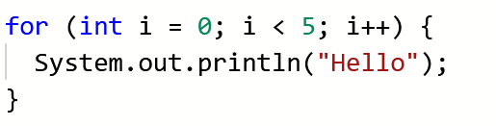
For loops
Initialization condition update
These are a little trickier…
There are three clauses in a for loop:
Initialization
Condition
Update
The convention when initializing a variable is to use the letter i as your variable name – it’s essentially the only time you should be using single-letter variables!
The above for loop will print “Hello” five times

Slide 8
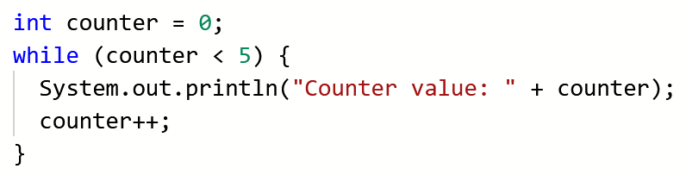
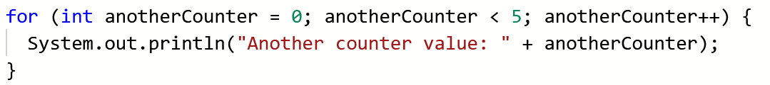
For loops
A bit harder to translate into plain English, so let’s compare to a while loop
Initialize a variable (1), create a Boolean condition (2), increment the variable (3)
1
2
3
1
2
3

Slide 9
Nested loops
Think nested if statements, but with loops!
A loop within a loop (within a loop, within a loop…)
These tend to be harder to debug since it’s two loops that can potentially go haywire and never stop… more on infinite loops in a bit
The convention for nested for loops specifically is to have your outer for loop’s variable be i and your inner for loop’s variable be j

Slide 10
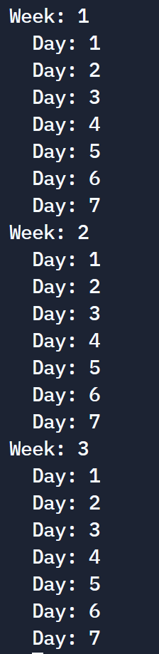
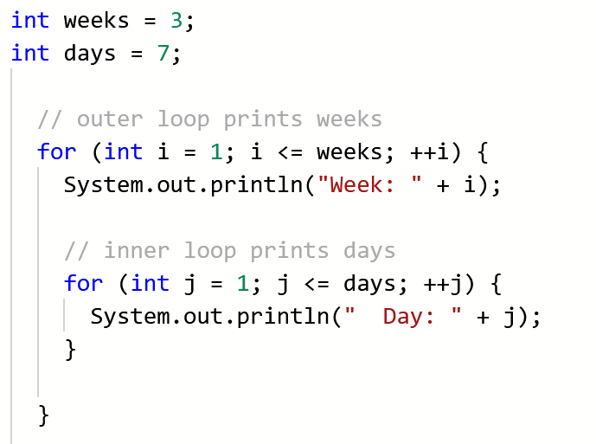
Nested loops
An example and its output…

Slide 11
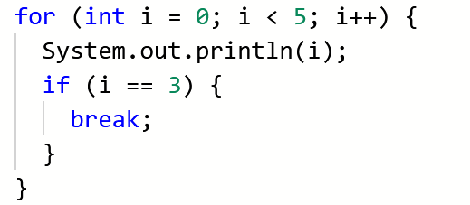
The break keyword
Remember this from switch cases?
The break keyword essentially “breaks” the loop
It stops the loop exactly where it is in its tracks; code will continue to run, but outside of the for loop
Very helpful in debugging infinite loops!
Outputs 0 1 2 3 AND THEN STOPS!

Slide 12
Lab 4 part 1
This is a longer one… don’t freak out if you end up with 100+ lines and lots of print statements!
You will not use loops in this part of the lab, just if-structures
Pay attention to how the user could possibly input things; String methods will be your friend here
DO NOT hard-code in the user’s answer to the quiz. You’ll need to use the scanner class to actually take user input!

Slide 13
Lab 4 part 2
Loop time!
Each activity in this lab builds upon itself
first you’ll randomly generate a number and print it
Then you’ll prompt the user to guess the secret number
Then you’ll check to see if the input is valid (i.e. only accept numbers 1 through 10)
Then you’ll add a maximum number of guesses
Try not to get trapped in infinite loops… (the break keyword will be useful!)

Slide 14
For next week
Next time: possibly more on loops, reading from text files, arrays…?
These labs are hefty; start early and do not hesitate to reach out (email or Discord) if you need help with anything regarding the labs!
Please email me or message me on Discord if you’re having issues with submitting labs on time
We made a Discord server! https://discord.gg/23weGMFk
Joining is optional, but it’ll be a good point of contact with us and hopefully a place to make some friends ☺
WEAR A MASK AND BE SAFE!

