Slide 1
CS 0007 Recitation – 9/23/21
Lin rojtas – 10:00a – 10:50a

Slide 2
overview
OneDrive Review
A Note on Primitives
If structures
Boolean operations
Switch case
Printf
Midterm Q&A

Slide 3
Onedrive… thoughts?
Submitting things for us UTAs to grade is hard ☹
This was our solution
You should have received an email from OneDrive… let me know if you didn’t!
Save that link so you can submit things later (or just go to the Shared tab in your own OneDrive)
If you had any specific troubles with it, I’m gonna be lenient about lab submissions. Technically the lab was due last night, but I won’t start actually grading until sometime Friday afternoon…

Slide 4
A Note on primitives
Sometimes in the lab it can be difficult to decide which variable to use for what… here’s some notes
Primitive Type | Notes
byte | Possible values: [-128 thru 127]
short | Possible values: [-32,768 thru 32,767]
char | Make sure you use single quotes! (char letter = ‘A’;)
int | Possible values: -2,147,483,648 thru 2,147,483,647
long | Possible values: [(-2^63) thru (2^63)-1] Add an l when defining! (long num = 3000000l;)
float | Add an f when defining! (float num = 2.50f;)
double | Ultra precise decimals!

Slide 5
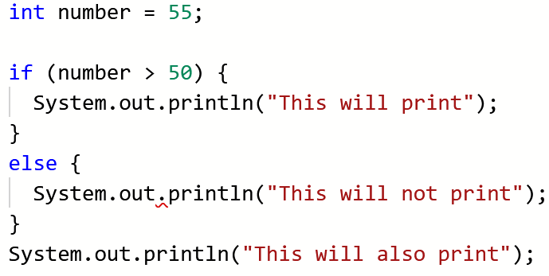
If structures
Simpler than you might think…
If this is true, do this. Otherwise, do that.

Slide 6
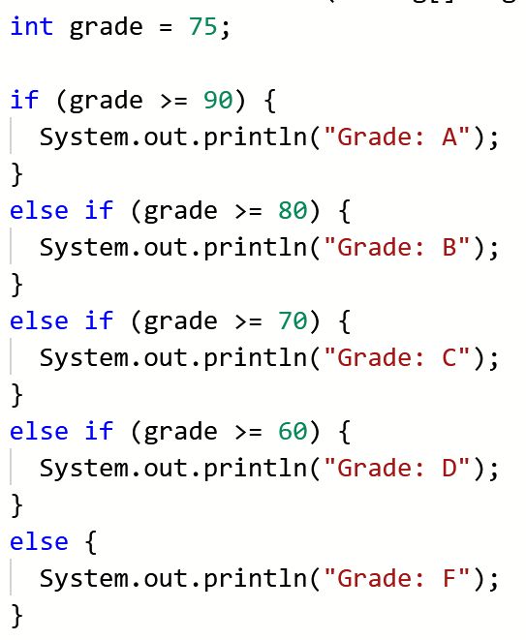
Extended if statements

Slide 7
What goes in an if statement?
Condition | Meaning
a == b | Equal to
a > b | Greater than
a < b | Less than
a >= b | Greater than or equal to
a <= b | Less than or equal to
a != b | Not equal to
str1.equals(str2) | Seeing if strings are equal
str1.equalsIgnoreCase(str2) | Seeing if strings are equal while ignoring case sensitivity

Slide 8
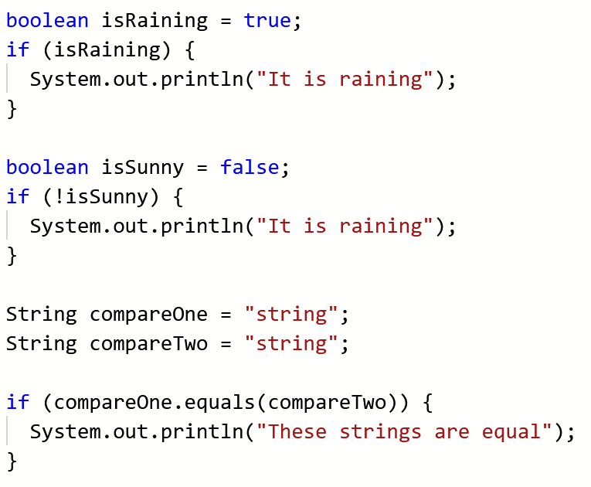
What goes in an if statement?

Slide 9
Boolean operations: Not, and, or
A | B | A && B
TRUE | TRUE | TRUE
TRUE | FALSE | FALSE
FALSE | TRUE | FALSE
FALSE | FALSE | FALSE
A | B | A || B
TRUE | TRUE | TRUE
TRUE | FALSE | TRUE
FALSE | TRUE | TRUE
FALSE | FALSE | FALSE
A | !A
TRUE | FALSE
FALSE | TRUE

Slide 10
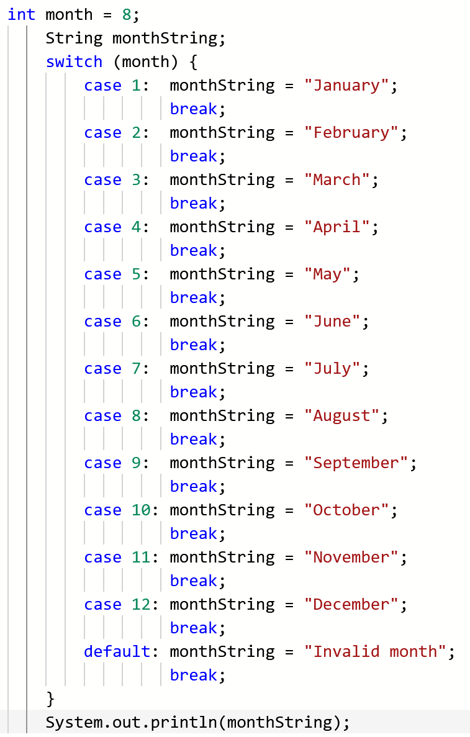
SWITCH CASE
The default keyword is similar to a final “else” in a chain of if statements
MAKE SURE YOU INCLUDE BREAKS!!!
Without the break keyword, monthString keeps getting reassigned and will end up as “Invalid month”

Slide 11
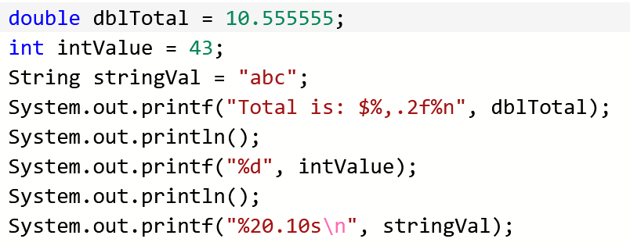
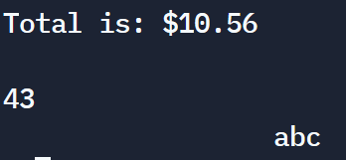
Printf/formatting
Lots of other easy examples here: https://www.jquery-az.com/10-examples-learn-java-string-formatting-printf-method/

Slide 12
MIDTERM Q&A

Slide 13
For next week
Not sure what I’ll do about recitation next week exactly, but make sure you come because I’ll have a little surprise for getting through the first exam ;)
No lab this week – study!!
Come to office hours if you’re struggling!!! I don’t bite
We made a Discord server! https://discord.gg/23weGMFk
Joining is optional, but it’ll be a good point of contact with us and hopefully a place to make some friends ☺
WEAR A MASK AND BE SAFE!

