Slide 1
CS 0007 Recitation – 9/9/21
Lin rojtas – 10:00a – 10:50a

Slide 2
Agenda
Introductions (again)
Review of the command line
Review of Java API
Variables and arithmetic

Slide 3

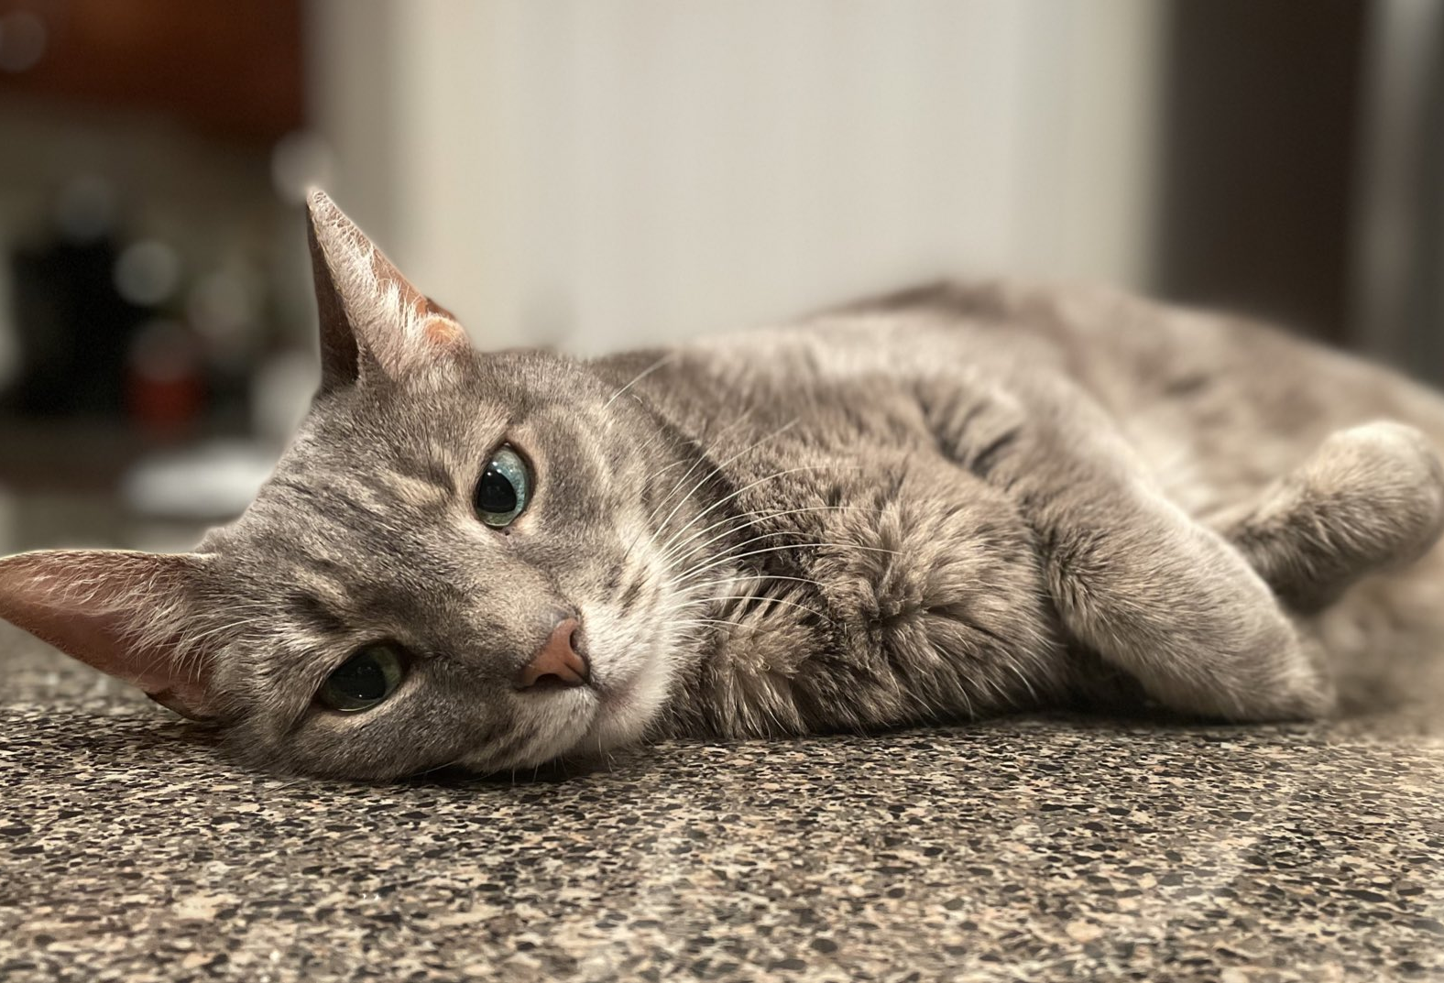
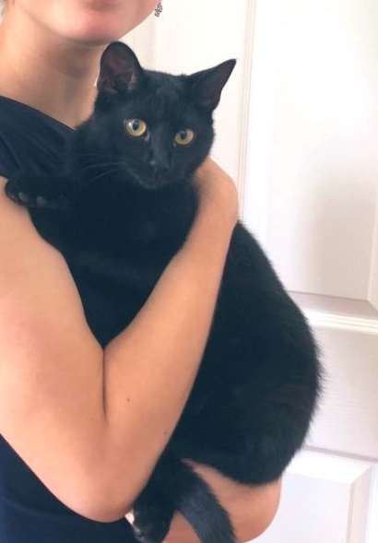
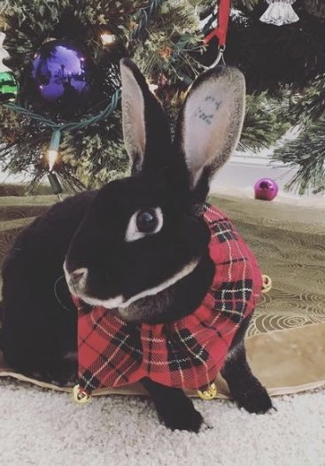
About me!
My name is Lindsey, but you can call me Lin ☺
Any pronouns, I always like to say “whatever makes a joke funnier”
Junior – CS Major, Linguistics Minor
Born and raised 30 minutes south of Pittsburgh (Thomas Jefferson High School, WJHSD)
I like rhythm games, stuffed animals, cooking shows, and my fur babies

Slide 4
About this recitation
I’m the one that determines grades and due dates for the labs, so don’t reach out to Paulo about them without talking to me about it first
Recitations will be held here, 10a-10:50a
Will likely let out early most weeks
Office hours
2832 Cathedral of Learning, Mon 6:00p-8:00p, Wed 7:00p-8:30p
Also by appointment, both virtually and in person

Slide 5
policies
Attendance is not mandatory, but is strongly recommended as I will go over concepts from the class and hints for the labs
Labs will be due every Wednesday at 11:59p
I’m not picky about specific solutions – if it works, it works!
Cheating is for losers – don’t do it
If you have an issue with this or need an extension, let me know!
However, if everyone turns in their labs on time (barring DRS accommodations and major real-life events) for the whole term, I might buy you guys donuts…
Slides will be posted on my Github
https://github.com/rojtas/cs7-fall2021-recs

Slide 6
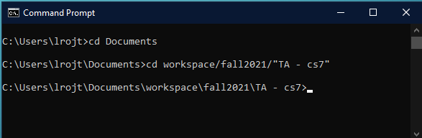
Command line review
USEFUL COMMAND: cd (folder name) – go into a folder in your current directory
Use cd .. to go to a folder outside the current directory (ex. Say I want to go to fall2021)
Try not to use spaces in your folder names, but if you do, use quotes in the command prompt!

Slide 7
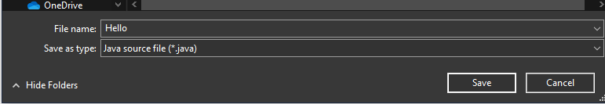
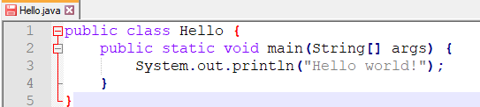
Command line review
Before we run our program, we need to make sure that:
We are saving as a .java file
The name of our program is the same as the word that follows public class in that program.

Slide 8

Command line review
USEFUL COMMAND: javac (file name).java – compiles our written code into bytecode
USEFUL COMMAND: java (file name) – runs the machine code that was compiled
ALWAYS javac BEFORE YOU java!!!
When using javac, make sure you include .java at the end of your file name!

Slide 9
Java api – math examples
With APIs, Google is your friend!!
https://docs.oracle.com/javase/7/docs/api/java/lang/Math.html
Highlights
Math.sqrt(double a) – returns the square root of a number a.
Math.sqrt(4) returns 2.0
Math.pow(double a, double b) – returns the value of a number a raised to the power of another number b (or a^{b})
Math.sqrt(3, 2) returns 9.0
Feel free to explore and test on your own!

Slide 10

Java api – Scanner
The Scanner API is typically used for accepting user input
Asking for two numbers to be added together, entering your first name, etc.
Unlike the Math class, you need to import this class into your program by including import java.util.Scanner; at the very top of your program (above your class!)
Note: you can import all the classes in java.util with import java.util.*;

Slide 11
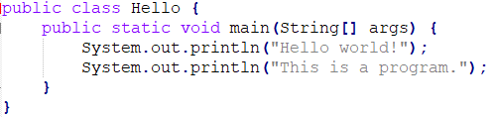
Parts of a program
1
2
3
Comments can be formatted
// like this
/ * like this */
/* and
* like
* this */
1 – Class
2 – Method
3 – method delimiter

Slide 12
Data types
Primitives vs. objects
Primitive examples: boolean, byte, short, long, int, double, float, char (all lowercase!)
boolean: true/false value
char: character (‘a’.,‘x’)
short, long, int, double, float, and byte are all numbers of varying lengths
Most of the time, you’ll use int and double of these six
Only double and float can be decimal values
Object examples: String, Scanner, and many… many more (capital first letter!)

Slide 13
Variable naming conventions
It’s important to name your variables in ways that both you and anyone else that may see your programs (Paulo, myself, the grader) will understand.
DO NOT use single letters or non-descriptive names!!!
DO NOT use Java built-in keywords!!! (List: https://en.wikipedia.org/wiki/List_of_Java_keywords)
Variable names are case-sensitive (myVariable is not the same as myvariable)
Variables cannot start with numbers or special symbols (except for _ and $).
In this class (and in any other coding classes unless you are told otherwise), avoid the use of anything non-alphanumeric.

Slide 14
Variable naming conventions
If you’re naming your variable one word, you’ll typically name your variable that word in all lowercase
Examples: height, movie, speed
If your variable name is more than one word, the first word will be lowercase with the subsequent words’ first letter capitalized
Examples: myHeight, username, correctAnswer, myFavoriteClass

Slide 15

Variable naming conventions
Format: (variable type) (variable name) = (variable value);
System.out.println(myNumber); will print 7

Slide 16
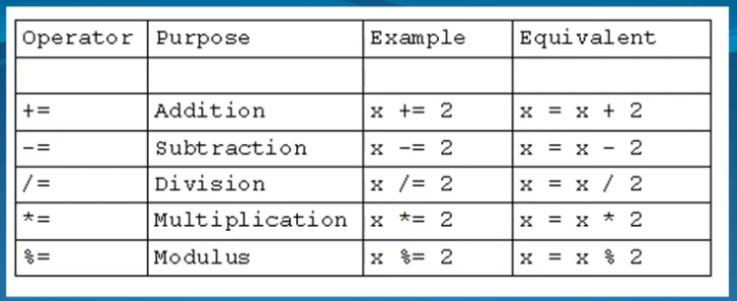
Operations and operator precedence
There are shorthand ways of using these operations!

Slide 17
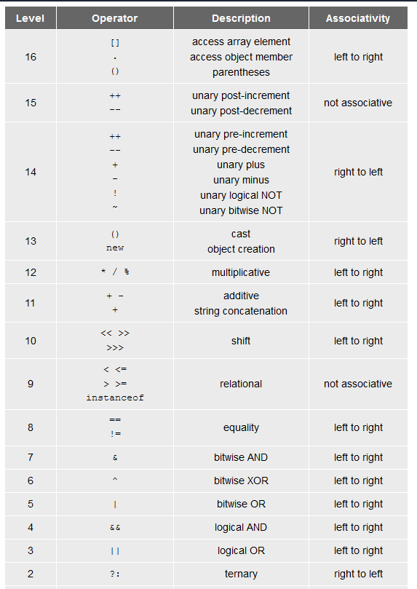
Operations and operator precedence
You don’t need to know all of these!!
The most important ones are additive (+, -) and multiplicative (*, /, %)
You may end up using some of the other ones in the future, but… we’ll cross that bridge when we get there ☺

Slide 18
For next week
Lab 1 is out…!
It’s a really easy one. All you have to do is show me that you have Java installed and can print “Hello world.” Due next Wednesday at 11:59!
Keep an eye on Canvas; it’ll be posted some time tonight (email me if Friday comes and I forgot to post the assignment).
Next week: casting, the final keyword, strings and input, and style!
Wear a mask, wash your hands, get vaccinated, and be safe!

