Slide 1
Cs7 recitation
1:00p-1:50p
Lindsey rojtas

Slide 2
Overview
Objects
The stack and the heap
Duplicate objects
Arrays
2D arrays
Array Lists
For-each loops
Boxing/unboxing
Assignment 5 hints
Project 1 Q&A

Slide 3
objects
Objects are non-primitive data types
Primitives being ints, doubles, etc.
We’ve seen these before….
String object, Random object
Objects are made of primitives and other objects
Objects have their own special sets of instructions!
Recall String methods
There are lots of different objects that Java has pre-built, but you can also build your own!
More on how to do this later

Slide 4
The stack and the heap
There are two areas of memory in Java: the stack and the heap
When we create primitives, the variable stores the actual value
These are stored on the stack
When we create objects, the variable stores a reference to the actual objects
The reference is stored on the stack
The object itself is stored on the heap
References are like house addresses; you can write down the address of a house on a piece of paper, and that address will take you to the house itself, but the actual address (that has been written down on paper) and the house are not the same

Slide 5
Arrays
So far, we’ve created separate values for each item we wanted to store…
What if we wanted to store a bunch of stuff into one variable?
We can do this with arrays, which are groups of items stored contiguously
Arrays are objects (not primitives!), but they can store pretty much anything
These are the only objects (that you’ll see, probably) that aren’t really declared with a capital letter at the beginning

Slide 6
Declaring and initializing arrays
There are a couple
int[] numbers = new int[5]; → creates an array of ints called numbers that has five slots
These slots will be initialized to 0 in the case of integers, but may be 0.0, false, null, or something else depending on what your array is
int[] counting = {1, 2, 3, 4, 5}; → creates an array of ints called counting that has five slots
These slots will be initialized to store 1, 2, 3, 4, and 5 respectively; this is what happens when we know right off the bat what values we want stored in which places
numbers | 0 | 0 | 0 | 0 | 0
(index) | 0 | 1 | 2 | 3 | 4
counting | 1 | 2 | 3 | 4 | 5
(index) | 0 | 1 | 2 | 3 | 4

Slide 7
Accessing and replacing an array’s elements
We can access a specific index of an array using square brackets
Note: array indexing starts at ZERO, not one, so counting[0] will hold the value 1
Say we wanted to replace a value in this array
Let’s change the element at index 2 to a different number…
We do this by doing something like counting[2] = 0;
counting | 1 | 2 | 3 | 4 | 5
(index) | 0 | 1 | 2 | 3 | 4
counting | 1 | 2 | 3 | 4 | 5
(index) | 0 | 1 | 2 | 3 | 4
counting | 1 | 2 | 0 | 4 | 5
(index) | 0 | 1 | 2 | 3 | 4
Find the array in memory and go to index 2…
And change that value to 0!

Slide 8
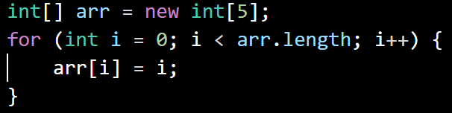
Say we want to access each element of the array with a loop…
Let’s trace this code and see what happens

Slide 9
Say we want to access each element of the array with a loop…
First, we’re declaring and initializing an array of integers
There are going to be five integers in this array
The array will be named arr
arr | 0 | 0 | 0 | 0 | 0
(index) | 0 | 1 | 2 | 3 | 4

Slide 10
Say we want to access each element of the array with a loop…
We now go through each part of the for loop
Initialize i to 0, run the loop while the value of i is less than the length of the array, and increment i every time we go through the loop
arr | 0 | 0 | 0 | 0 | 0
(index) | 0 | 1 | 2 | 3 | 4
i | 0

Slide 11
Say we want to access each element of the array with a loop…
In the body of the for loop, we find the index of whatever i is equal to and set the value in that index equal to whatever i is at that moment
So… arr[0] = 0
arr | 0 | 0 | 0 | 0 | 0
(index) | 0 | 1 | 2 | 3 | 4
i | 0

Slide 12
Say we want to access each element of the array with a loop…
Then, increment i since we’ve reached the end of the for loop
Check the condition; i is less than the length of the array, so we loop again
arr | 0 | 0 | 0 | 0 | 0
(index) | 0 | 1 | 2 | 3 | 4
i | 1

Slide 13
Say we want to access each element of the array with a loop…
In the body of the for loop, we find the index of whatever i is equal to and set the value in that index equal to whatever i is at that moment
So… arr[2] = 2
arr | 0 | 1 | 0 | 0 | 0
(index) | 0 | 1 | 2 | 3 | 4
i | 1

Slide 14
Say we want to access each element of the array with a loop…
Then, increment i since we’ve reached the end of the for loop
Check the condition; i is less than the length of the array, so we loop again
arr | 0 | 1 | 0 | 0 | 0
(index) | 0 | 1 | 2 | 3 | 4
i | 2

Slide 15
Say we want to access each element of the array with a loop…
In the body of the for loop, we find the index of whatever i is equal to and set the value in that index equal to whatever i is at that moment
So… arr[2] = 2
arr | 0 | 1 | 2 | 0 | 0
(index) | 0 | 1 | 2 | 3 | 4
i | 2

Slide 16
Say we want to access each element of the array with a loop…
Then, increment i since we’ve reached the end of the for loop
Check the condition; i is less than the length of the array, so we loop again
arr | 0 | 1 | 2 | 0 | 0
(index) | 0 | 1 | 2 | 3 | 4
i | 3

Slide 17
Say we want to access each element of the array with a loop…
In the body of the for loop, we find the index of whatever i is equal to and set the value in that index equal to whatever i is at that moment
So… arr[3] = 3
arr | 0 | 1 | 2 | 3 | 0
(index) | 0 | 1 | 2 | 3 | 4
i | 3

Slide 18
Say we want to access each element of the array with a loop…
Then, increment i since we’ve reached the end of the for loop
Check the condition; i is less than the length of the array, so we loop again
arr | 0 | 1 | 2 | 3 | 0
(index) | 0 | 1 | 2 | 3 | 4
i | 4

Slide 19
Say we want to access each element of the array with a loop…
In the body of the for loop, we find the index of whatever i is equal to and set the value in that index equal to whatever i is at that moment
So… arr[4] = 4
arr | 0 | 1 | 2 | 3 | 4
(index) | 0 | 1 | 2 | 3 | 4
i | 4

Slide 20
Say we want to access each element of the array with a loop…
Then, increment i since we’ve reached the end of the for loop
Check the condition; i is no longer equal to the length of the array, so that was the last time we’d be running the loop
arr | 0 | 1 | 2 | 3 | 4
(index) | 0 | 1 | 2 | 3 | 4
i | 5

Slide 21
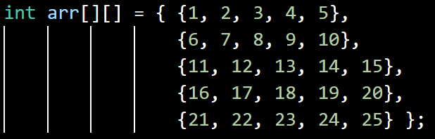
2d arrays
It’s possible to have an array of arrays!
We’d declare them like this if we wanted, say, a 5x5 array of integers
Or if we knew what values we wanted in the slots, we could do this:
You can have arrays with more than 2 dimensions (int arr[][][]), but you probably won’t need to work with them
Just know how to declare them!

Slide 22
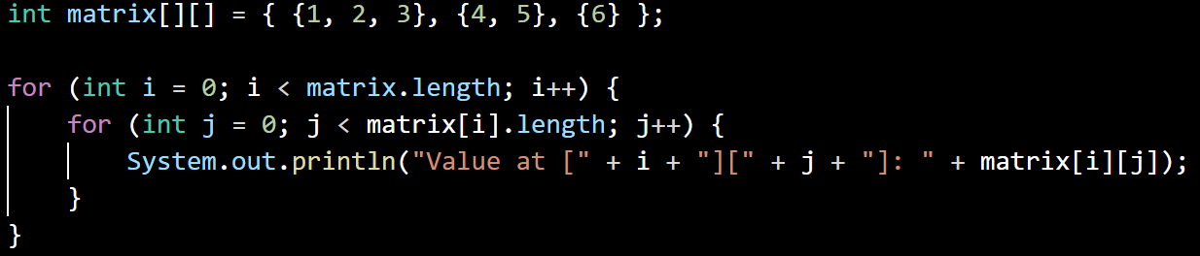
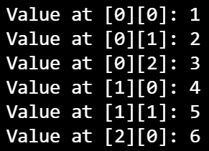
Traversing a 2d array
A for loop within a for loop:
Indexing is kinda like (row, column)
First index: which array?
Second index: which element in that array?

Slide 23


Boxing and unboxing
When we’re working with certain objects in Java’s Collections library (the only one of these you’ve seen so far is ArrayList), we have to do a little bit of a workaround to store primitives
This workaround is called having a wrapper class → almost like a costume for a primitive to wear to look like an object…
Boxing: creating a wrapper from a primitive
Unboxing: creating a primitive from a wrapper
Java usually does this automatically when you’re working with a Collections object:

Slide 24
Arraylists
Working with regular arrays can have its issues, with a big one being that you can’t resize an array once you make it
ArrayLists can do this!
To create an ArrayList containing elements of some type TYPE, you’ll do something like this:
ArrayList<TYPE> arrList = new ArrayList<TYPE>();
So if you wanted an ArrayList of Strings…
ArrayList<String> strings = new ArrayList<String>();

Slide 25
Useful arraylist methods
To retrieve an element at a specific index, we use .get()
arrList.get(3) ← returns element at index 3
To get the size of an ArrayList, we use size()
arrList.size() ← returns total number of elements
To add an element to the end, we can use add()
arrList.add(“element”) ← adds “element” to the end of the ArrayList
There are a lot of other ArrayList methods… too many to cover here!
If you’re curious, come ask me or Google the ArrayList documentation!

Slide 26
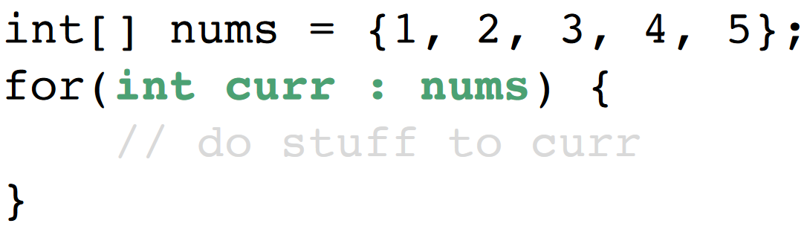
For each loops
A common part of many programs you’ll write with arrays in them will be to do something with each element of the array
Doing all of that business with creating for loops can be repetitive, so we can shorten things up a little by using a for each loop:
For each element in nums, we will do something with the element that we’re currently on (curr)

Slide 27
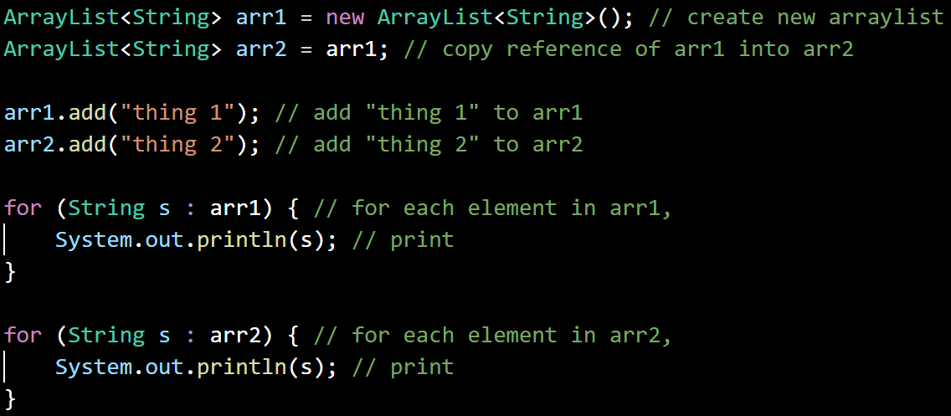
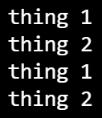
Duplicate objects
We can assign one primitive variable to another and have them both be independent with identical values
int y = x; → x and y are two different variables that happen to hold the same value
This isn’t quite the case for objects…

Slide 28
Assignment 5 hints
For this one, you’ll wanna revisit your loop-writing notes
You’ll be writing loops for five questions
Most of the questions require that you use one loop, but for the last one, you’ll use two
Recall the break and continue keywords, you’ll need them for some of the questions
Some of these might not be straightforward at first…
Look for patterns in the things you’re supposed to print
System.out.print() and System.out.println() are different → don’t confuse them!

Slide 29
Project 1 q&a
I’ll stick around until 1:50 in case any of you have questions!
If I don’t get to you, my office hours today are from 4pm to 6pm in 2832CL (or message me on slack!

