Slide 1
Cs7 recitation
1:00-1:50
Lindsey rojtas

Slide 2
agenda
Recap from last week
Primitives
Variables
Strings
Printing
Assignment 1 practice
Common mistakes in code
Practice with determining what primitive data type to use when

Slide 3
Quick recap: primitives
Primitive data types are the lowest-level ways we can represent data in Java
bytes, shorts, ints, longs for integers/whole numbers
floats and doubles for numbers with decimals in them
booleans store true/false values
chars store a single character
We also saw Strings!
Strings are not primitive… more on that soon

Slide 4
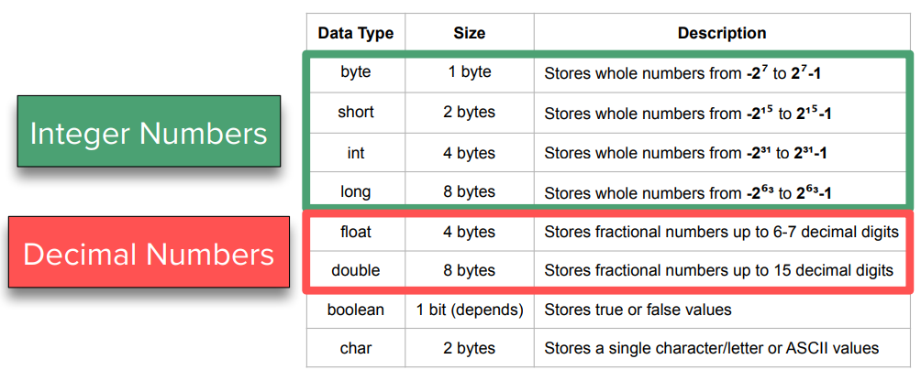
Quick recap: primitives
Recall this chart from lecture – it’s helpful!
2^7 = 128, so bytes store from -128 to 127
2^15 = 32,768, so shorts store from -32,768 to 32,767
… and so on

Slide 5
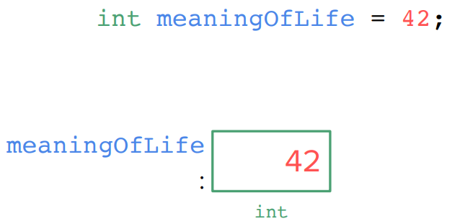
Quick recap: declaring variables
When we want to actually store some data in a program, we declare and initialize variables!
Declaring a variable is specifying the name of the variable and type of thing that the variable will store
Initializing a variable is actually assigning data to that variable
You can do both of these in one line:

Slide 6

Quick recap: strings
Strings aren’t primitive types
They’re objects with their own special instructions!
Recall message.length(), message.charAt(i), and message.replace(a, b)
When you’re declaring Strings, you need to begin with a capital S in String, unlike the rest of the primitive types
Strings’ values must have double quotes around them!

Slide 7
Quick recap: printing
Because most code runs quietly, we need to tell the computer if we want to see something
System.out.print(“Hello”); → prints Hello
System.out.println(“Hello”); → prints Hello and adds a new line
You might also have to deal with escape characters, which are
\n = newline
\’ = single quote mark within a String
\” = double quote mark within a String
\t = tab
\\ = backslash within a String

Slide 8
Common mistakes and how to fix them
The first part of Assignment 1 has you looking at samples of code and picking out what’s wrong with them
These are mistakes that you’ll end up making, whether accidentally or on purpose (I’ll forget a semicolon here and there!), so it’s good to know what to look for when you’re writing your own code and you run into issues
The examples I’m about to give will be similar to your assignment; some questions may have one error to spot, with others having two
This will be specified in the assignment!

Slide 9


Common mistake #1: forgetting a semicolon
At the end of every line of Java code (a statement, in other words), you see a semicolon
The semicolon tells the compiler (the translator from human-readable code to machine-readable code) when one statement ends and another begins
(kind of like end-punctuation in a sentence)
Lucky for us, the Java compiler will tell us when we’re missing a semicolon and where:

Slide 10


Common mistake #2: wrong variable type
Sometimes you can get away with working with, say, an int instead of a byte
Take the case of storing a variable that holds a human age; the best option is to use a byte since we won’t see anything above 127(…?), as it saves the most space, but the computer won’t yell at you if you were to use an int.
However, we can’t initialize a double with the value being false; make sure your variable types and the values you assign to them are compatible!

Slide 11


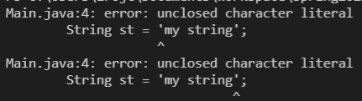
Common mistake #3: (mis)using quotes
It matters whether you use single or double quotes depending on what you’re doing!
Single quotes should surround chars
Double quotes should surround Strings
This includes when we do something like System.out.print(“Hello”); !! “Hello” is just a String that we’re printing without storing it anywhere.
Either way, make sure every open quote has a closed quote!
Do this for parentheses and brackets as well…

Slide 12
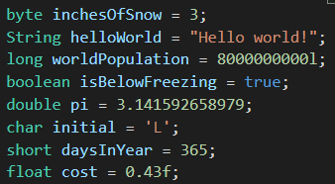
Variable practice!
1
Here, we’re gonna go one-by-one and decide which variable type would go best with these values
2
3
4
5
6
7
8

Slide 13
Variable practice!
The first variable is best as a byte
Recall that bytes can be anywhere from -128 to 127
2
3
4
5
6
7
8

Slide 14
Variable practice!
The second variable is a String
Note the double quotes around both ends!
3
4
5
6
7
8

Slide 15
Variable practice!
The third variables is a long
You might’ve guessed this from the l at the end… there’s a reason for this
Without the l at the end, the computer thinks we’re working with an integer and it’ll tell us that this number is too large to be an integer
The l at the end tells the computer that this value is supposed to be that long!
longs are used for values between -2^31 and 2^31 – 1 (a little over two billion)
4
5
6
7
8

Slide 16
Variable practice!
The fourth variable is a boolean
Recall that booleans only store true and false as values
This is the smallest primitive type, only taking up one bit (mind that a byte is 8 bits)
5
6
7
8

Slide 17
Variable practice!
The fifth variable is a double
doubles are used for decimal values with up to 15 decimal digits
Pi or other repeating/long decimal numbers are best represented as doubles
6
7
8

Slide 18
Variable practice!
The sixth variable is a char
Note the single quotes with only ONE character in it!
Don’t use double quotes for chars (or single quotes for Strings!)
7
8

Slide 19
Variable practice!
The seventh variable is a short
Shorts are going to be between -2^15 and 2^15 -1 (around 30,000ish)
8

Slide 20
Variable practice!
The eighth variable is a float
Similar to what we saw with the long a few slides ago, the computer is going to get confused as to whether we mean a float or a double
The f at the end of the number indicates that it’s a float!
Floats will typically have around up to 7 decimal places

Slide 21
Questions? Muddiest points?
Also, does anyone still need help installing Java?
(if you’re all good, you’re free to go ☺)

