Slide 1
Cs7 recitation
1:00p-1:50p
Lindsey rojtas

Slide 2
Agenda
Methods!
Parts of a method
Parameters and arguments
Memory models
Garbage collection
Method overloading
Print vs return

Slide 3
Methods? Functions? Procedures?
All 3 of these words describe a block of code that is run when it is called
What’s the difference between these 3 words?
A function returns a value, but a procedure does not
A method is like a function, but it’s part of a class (this term is primarily used in OOP)
In reality, though, there really is no difference...
“Method” is used almost exclusively in OOP, though

Slide 4
But like… why?
Solve a bigger problem by dividing it into subproblems, essentially!
Think about adding multiple-digit numbers… instead of just adding them together in your head, we add the ones, then the tens, etc…
It also makes debugging easier
Debugging is… a pain. We can take what we can get when it comes to ways to make it easier
It was probably a pain debugging your project, right? Part of this may have been because it was one long block of code as opposed to breaking it up into smaller parts
We can reuse bits of code over and over
Sort of like with loops – it’s convenient!

Slide 5
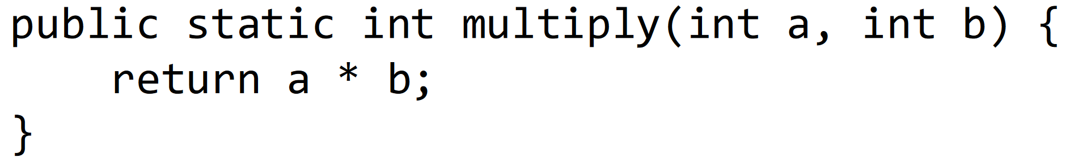
Parts of a method
2
3
4
5 6
5 6
1
7
Access modifier – don’t worry about this yet
Static keyword – don’t worry about this yet
Return type – this is what the method will spit back out at us when we call it (if anything)
Method name – same naming conventions as stuff like variables!
Parameter type – what type of thing are we sending to the method?
Parameter name – same naming conventions as stuff like variables!
Method body – code that actually goes in the method!

Slide 6
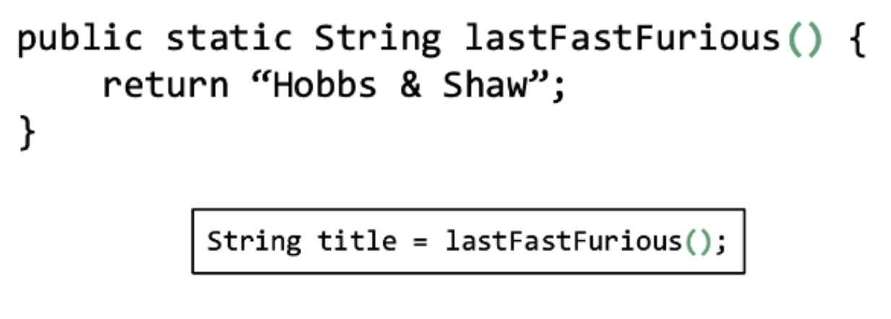
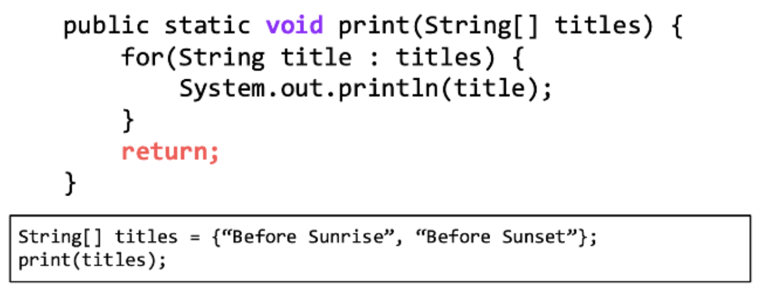
Other types of methods
Some of the parts of the method are optional… the two we’ll look at now are parameter types/names and return types
With parameter types/names, sometimes methods may not take in any input data. If this is the case, then we can just have nothing in the parentheses
With return types, you can’t just leave things blank. You have to specify that the method will not return anything with the void keyword in place of a return type

Slide 7
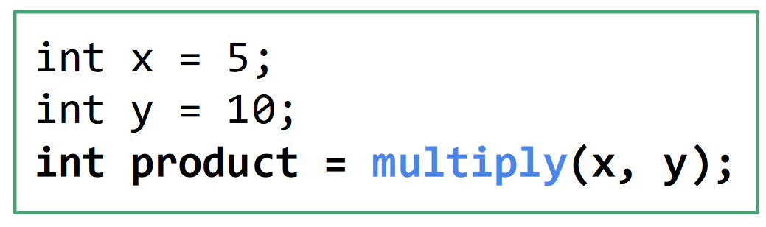
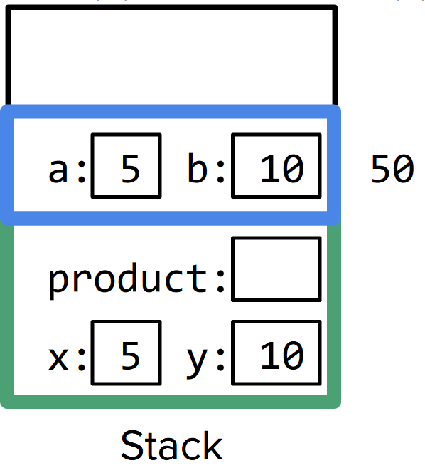
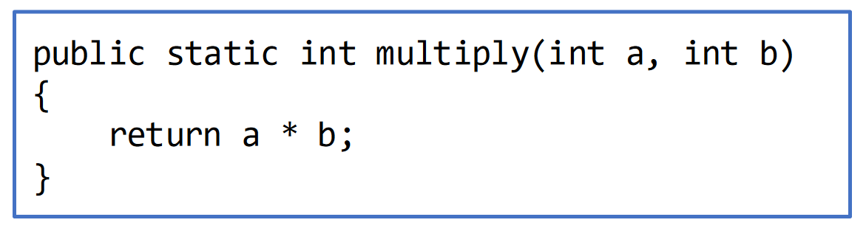
Parameters vs arguments
Parameter(s): The input value(s) specified in a method declaration
Argument(s): The variable(s) passed into the method at runtime

Slide 8
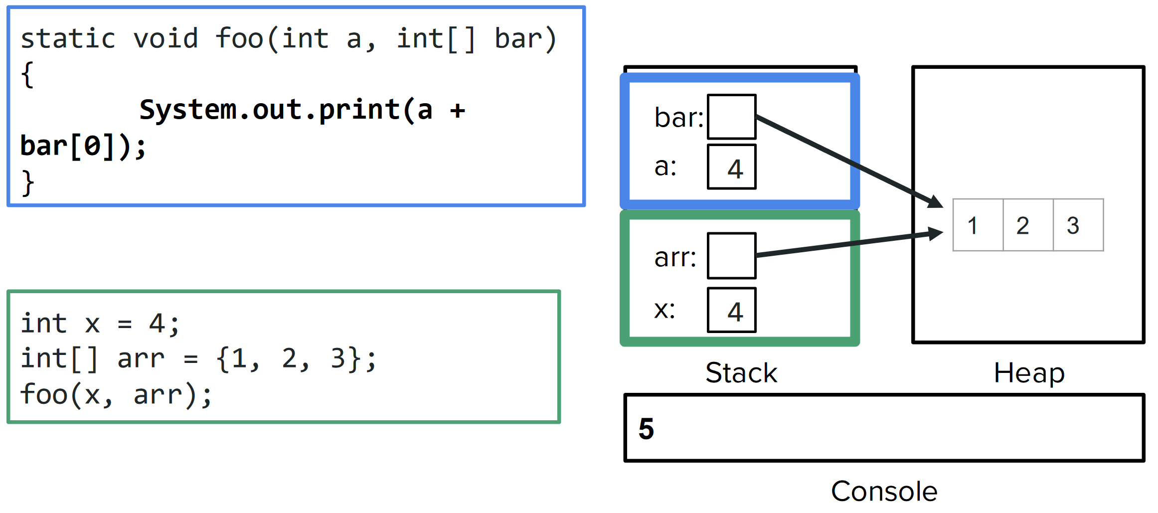
Memory models
The stack is split up into different stack frames
Every method has a separate stack frame, to keep track of the variables being used by that method
When we pass a variable as an argument, the method creates a copy of that variable in its stack frame
If that variable is a primitive, then we just make a copy of its value
If that variable is a reference to an object, then we make a copy of its reference
The new variable points to the same heap object as the original variable

Slide 9
Garbage collection
In Java, garbage means unreferenced objects.
Garbage collection is process of reclaiming the runtime unused memory automatically. In other words, it is a way to destroy the unused objects.
This is essentially tying up any loose ends. When we’re done running the program, the garbage collector will pick up anything that remains in the heap so that we can start fresh again the next time we run the program

Slide 10
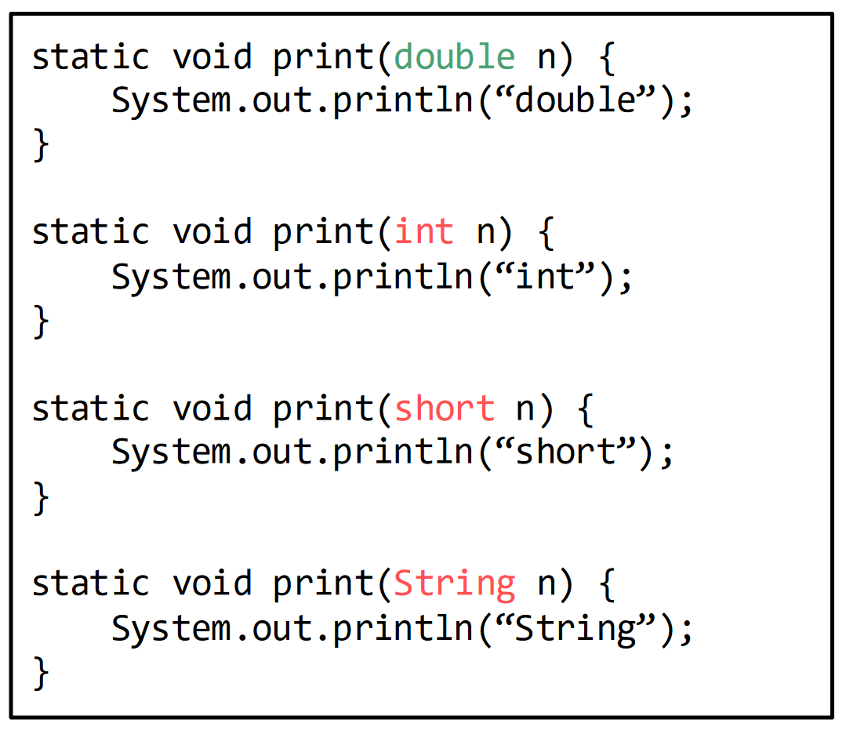
Method overloading
What if a method we want to write could have different input types?
Overloading: Multiple methods with the same name, but different signatures
They can have different numbers of parameters
They can have different parameter types
They can have different return types (as long as the parameters differ)
They can have any/all the above

Slide 11
Printing vs returning
PRINTING AND RETURNING ARE TWO DIFFERENT THINGS!!!!!!!!!!!!!
Printing is outputting something to your terminal so that you as a user can see it
We can see it in the terminal!
Returning is a method’s way of outputting something to the rest of the program
We CANNOT see it in the terminal when this is done
Aside: make sure you use the return keyword when you are returning something from a non-void method
If you confuse these things, we will be very sad

Slide 12
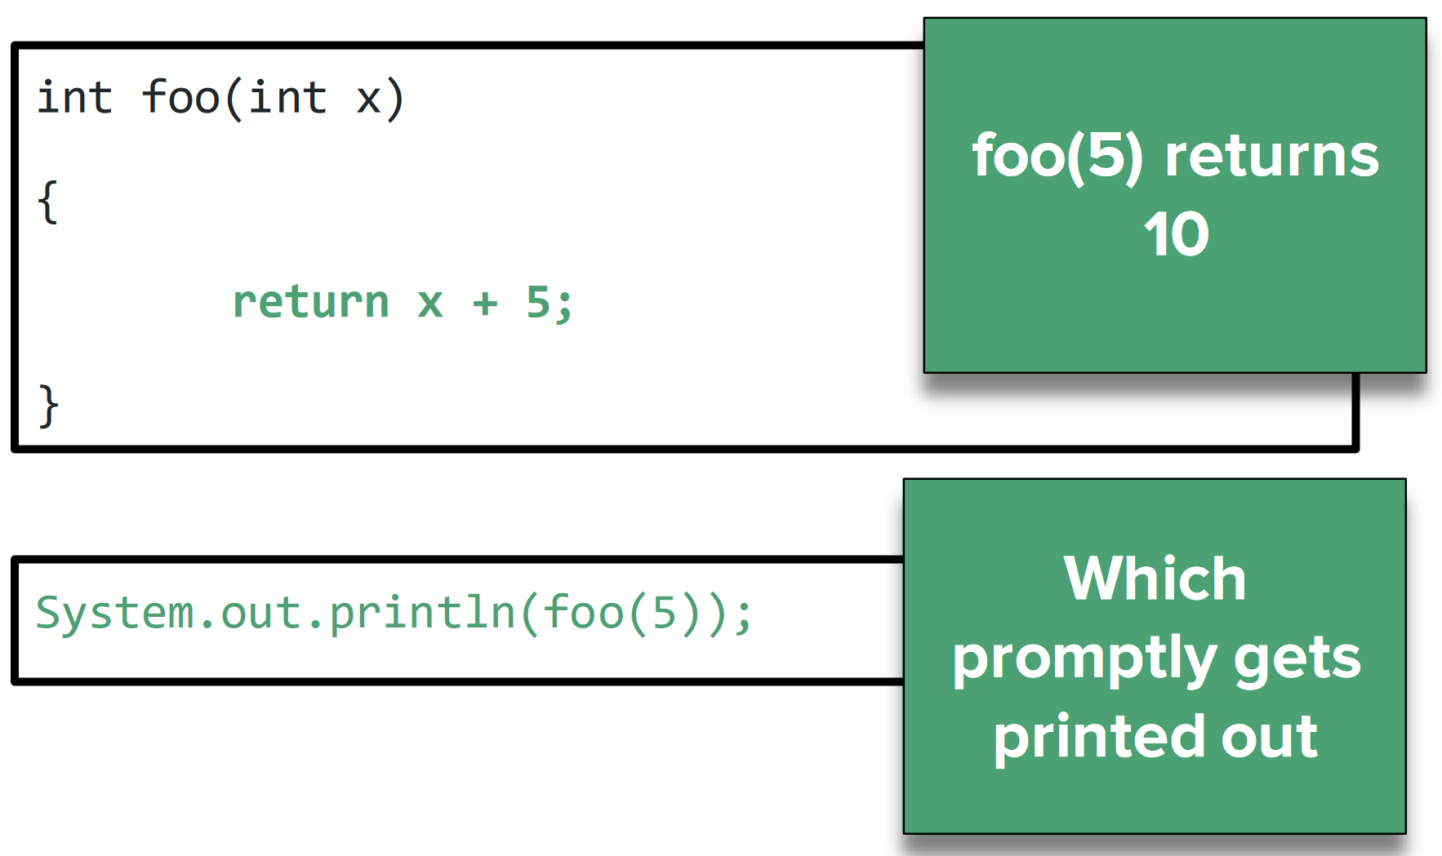
Printing vs returning

Slide 13
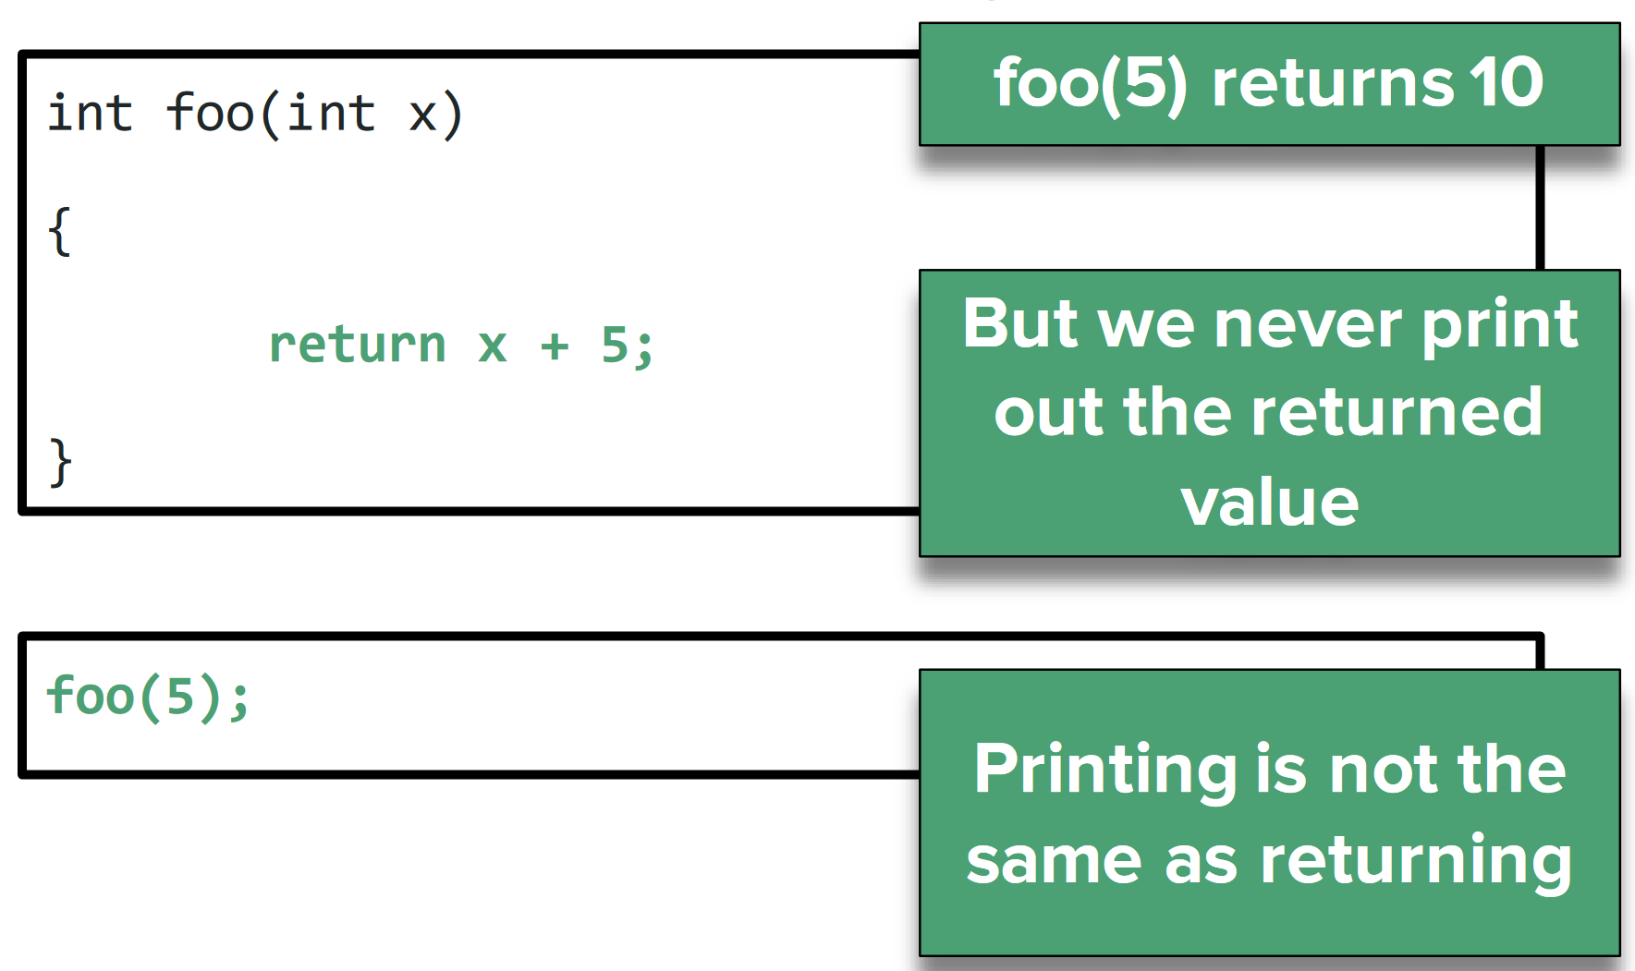
Printing vs returning

