Slide 1
Cs7 recitation
1:00-1:50
Lindsey rojtas

Slide 2
agenda
Conditionals
If statements
Else statements
Else-if statements
Switch cases
Short circuit evaluation

Slide 3
recall
Operators allow us to compare, analyze, and manipulate variables
Some operators take precedence over others (but we usually use parentheses for clarity)
We can use casting to convert a bigger data type to a smaller one
We can use relational and boolean operators to construct Boolean expressions

Slide 4
conditionals
Until now, we’ve been running code sequentially, but this isn’t always viable
Sometimes we only want to run certain blocks of code when certain statements are true, etc.,
This is where conditionals come in!
If statements, else statements, else-if statements, switch statements

Slide 5
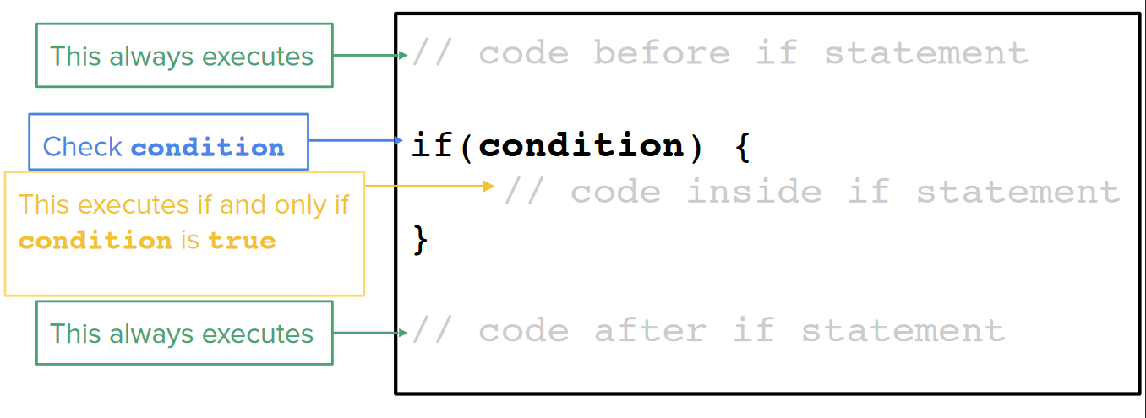
If statements
If statement: a segment of code that is executed if something is true

Slide 6
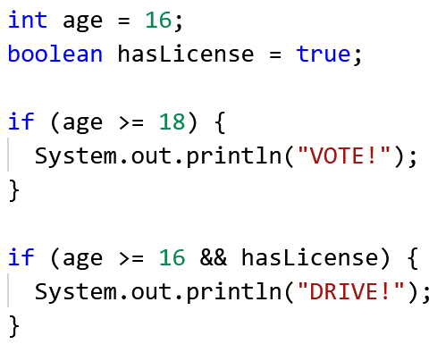
If statements
Inside the if clause (aka the condition in if (condition)), you’ll have a statement that evaluates to true!
You can have as many conditions as you want, as long as it eventually evaluates to a possible boolean value!
The first if statement will not execute because age is not greater than or equal to 18
The second if statement will execute because age is greater than or equal to 16 and hasLicense is true!

Slide 7
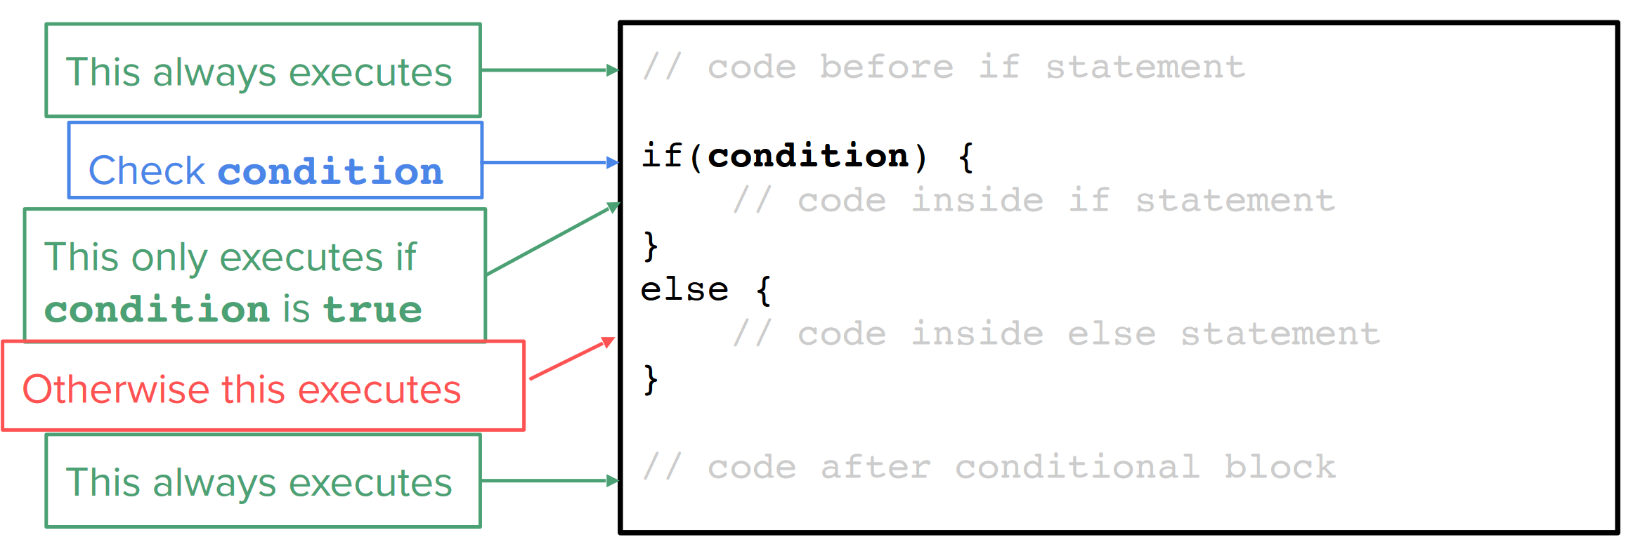
Else statements
Else statements can complement if statements!
These statements will run a different segment of code if the code in the corresponding if statement doesn’t execute (i.e. if the condition is false)

Slide 8
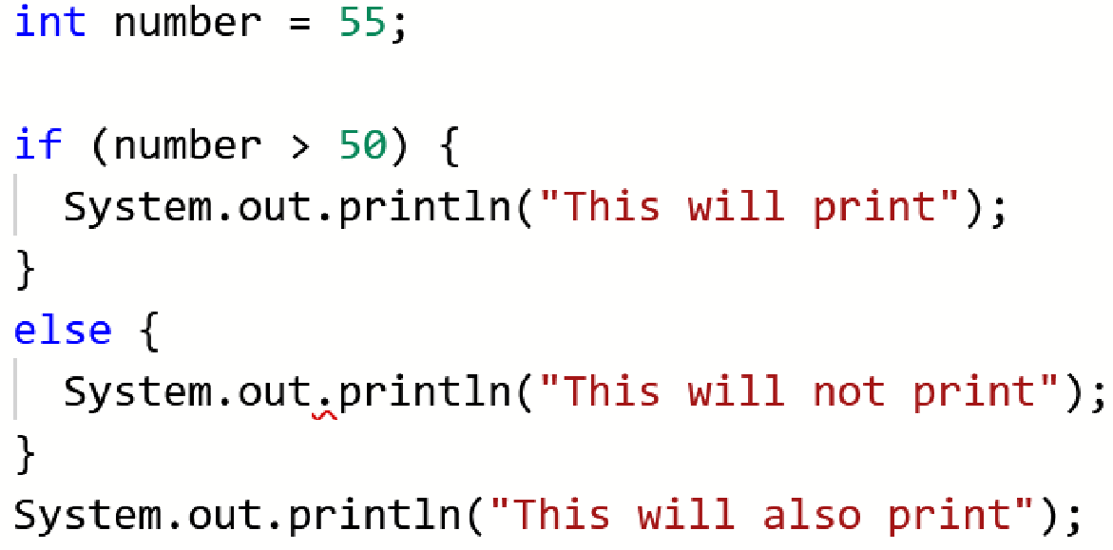
Else statements
You don’t need to provide a clause for the else statement to check because it’ll just be the opposite of the clause in the if statement
Here, number is greater than 50, so that first print statement will execute
Keep curly brackets in mind! They’re important delimiters so the computer knows when that block of code begins and ends

Slide 9
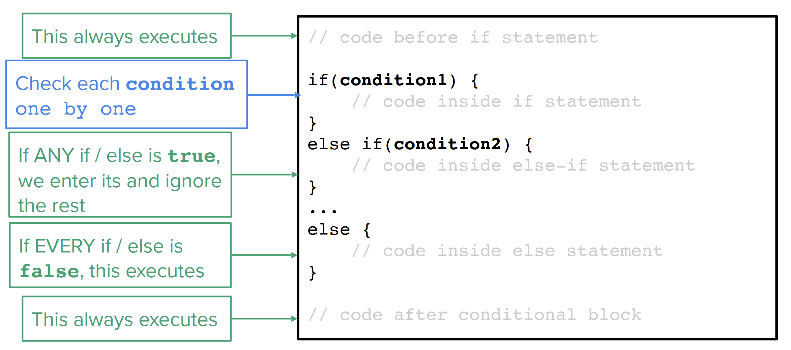
Else-if statements
With an If Statement, we can execute certain code only if a condition is met
With an Else Statement, we can execute other code if the condition isn’t met
What if we want more than just these 2 possible outcomes?
This is where else-if statements come in!

Slide 10
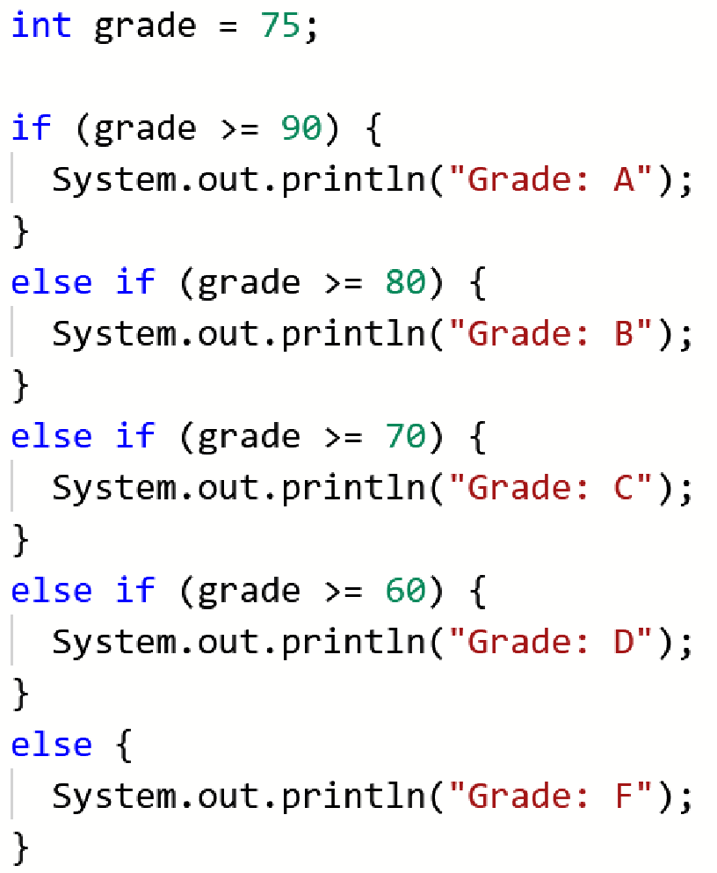
Else-if statements
Else-if statements mark a segment of code that is run if the condition of the corresponding If Statement is false, but a different condition is true
We can add as many Else-If Statements to an If Statement as we want
We can also add an Else Statement to the end to execute a segment of code if none of the conditions (If and all Else-If Statements) are met
What will print in the code segment to the right?
Only one of them is going to print…

Slide 11
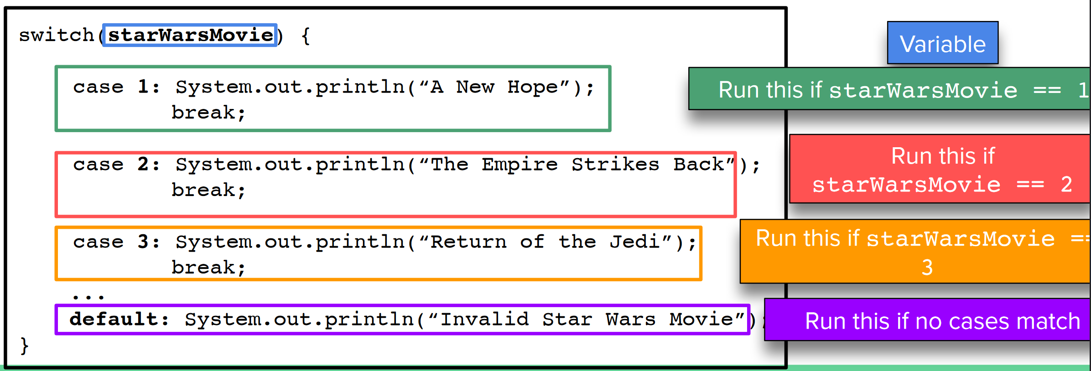
Switch statements
Switch Statements are condition statements that, given a variable, defines a specific code block for each possible value of that variable

Slide 12
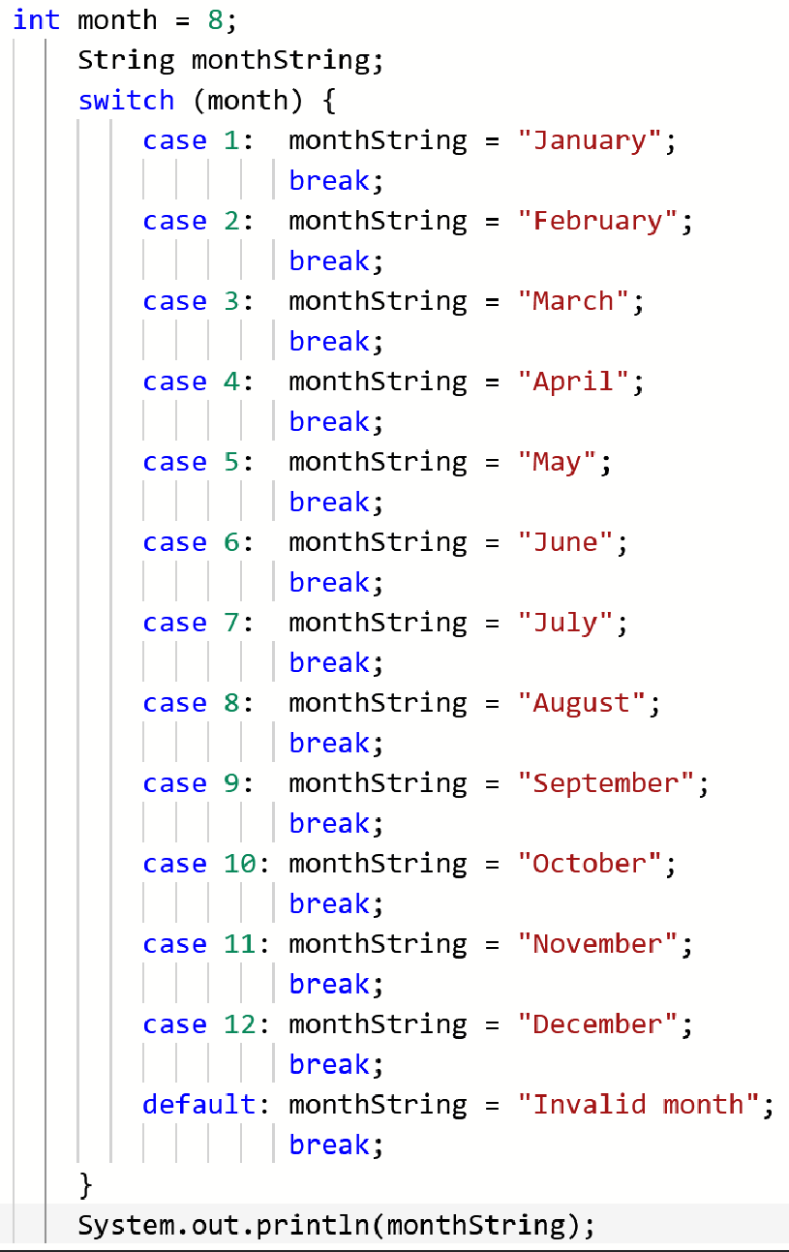
Switch statements: cases
Cases are similar to the clauses in if statements
So with the first case, we’d be checking if month == 1
If it is, we set monthString equal to “January”!
In this case, month == 8, so the switch statement will check each case and when we find a case 8, we’ll set monthString equal to “August”

Slide 13
Switch statements: default
The default case is important because it functions as a final “else” statement, if we compare switch statements to a series of else-if statements
This takes care of any kind of value that we’re handling that isn’t covered by a specific case
So if month was equal to, say, 13…. That would be covered by the default statement!

Slide 14
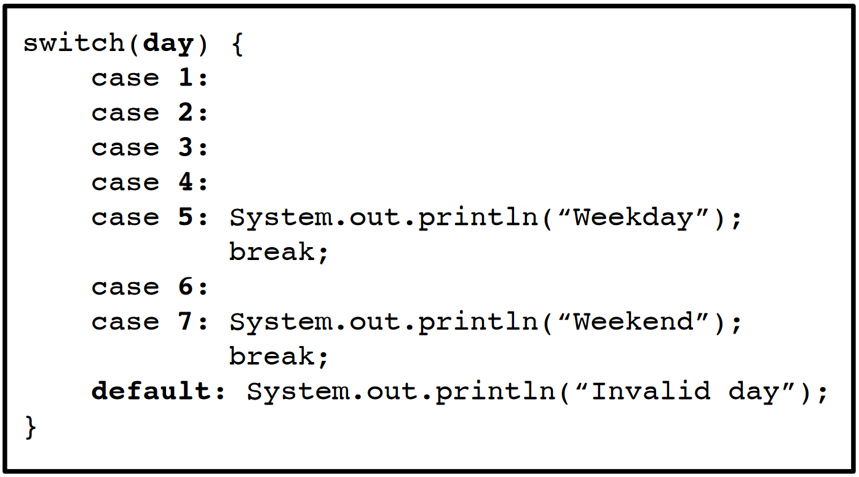
Switch cases: break and falling through
The break keyword is important because it tells us where we want to jump out of the switch statement
Otherwise, we fall through
Sometimes you can use this to your advantage, like in the code to the right, but if you were classifying based on the specific day of the week, this could spell trouble

Slide 15
Short circuit evaluation
Once we know the first boolean, do we always need to know the second?
In an AND (&&) operation, if the first boolean is false, the second boolean is completely ignored
In an OR (||) operation, if the first boolean is true, the second boolean is completely ignored

Slide 16
Assignment 3 hints
A lot of this is stuff we’ve discussed already! Specifically…
Think about the different types of conditional operators (>, <, etc.)
Review boolean logic
Recall math operations in Java, including assignment-arithmetic operators like +=
Remember pre and post-increment operators too!!!
There’s a small amount of if statement coverage as well
I can’t see your Canvas page, but I’ve heard you get unlimited attempts, etc.
Don’t be afraid to write/draw things out! It helps!

