Slide 1
Cs7 recitation
Friday, March 25
1:00p-1:50p

Slide 2
overview
Objects vs Classes
Instance variables and instance methods
this keyword
Constructors
Modifiers
Some notes for project 2

Slide 3
Methods: a brief review
Methods organize your code!
Easier debugging
Taking a bigger problem and breaking it down into smaller subproblems
Methods can call other methods!
public static void main(String[] args) is a method…!
Some objects (String, Random, etc.) come with their own methods
Objects are things with special instructions specifically for them… methods are these instructions!
Ultimately, they are new ways to manipulate data

Slide 4
Objects vs primitives
A bit of review!
Primitives are the basic building blocks of data
bytes, shorts, longs, floats, doubles, chars, and booleans
Keep in mind that these data types store a value
Objects are more complex ways of storing data, creating somewhat of a new data type
Strings, arrays, ArrayLists, Randoms, Scanners, and maaaany more
Keep in mind that these data types store a reference
Remember the address to a house example?

Slide 5
classes
Classes are the blueprint from which objects are created
The class definition lays out the attributes and functionality of the objects
Java has many built in classes
String and ArrayList, to name a couple… many more!
Objects are individual instances of a class
More on instancing in a bit…
Just like being able to create our own methods and objects, we can create our own classes!
Let’s go back through the Book example from class…

Slide 6
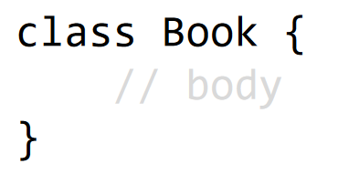

Class declaration
Book class
When we want to create an instance of a Book (i.e. creating an individual Book from the blueprint in the Book class), we do so in the main method
Don’t forget: Book has a capital B because it is an OBJECT!
Also, be sure to remember the parentheses when declaring an instance of an object
Remember ArrayList<Type>();?
main method

Slide 7
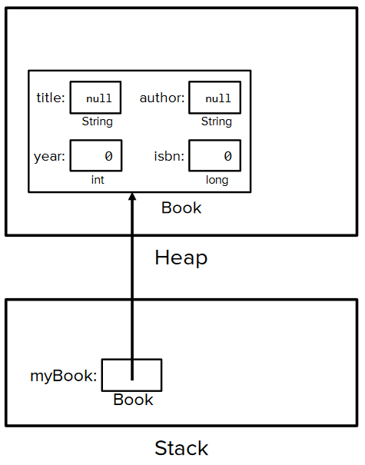
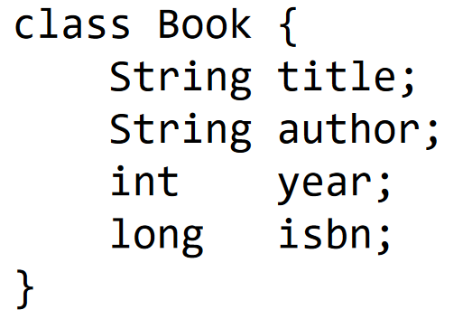
Instance variables
Instance variables are variables that are part of a specific instance of an object
These pieces of data are unique to each instance of that object
Each book that we create will have a title, an author, a year, and an ISBN unique to that specific book
When making your own classes, think about what exactly you want to be unique from each other instance of that class
Book class
main method

Slide 8
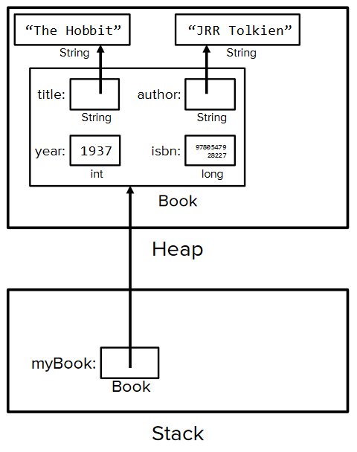
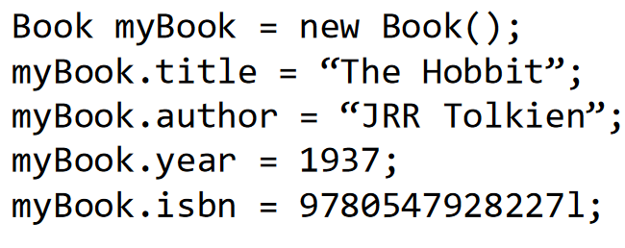
Modifying instance variables
Since you’re trying to modify only one specific book, you’ll want to make these modifications in the main method
If you put them in the Book class, it’d apply to every instance of Book instead of just 1; we don’t want this!
The general format will be something like:
objectName.instVar = value;

Slide 9
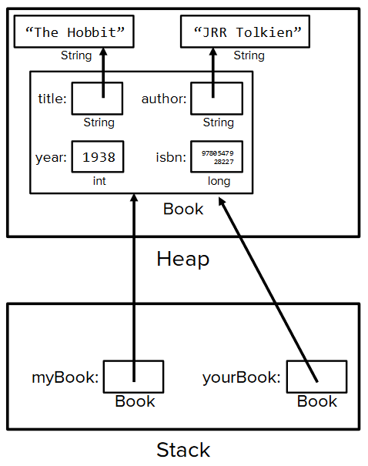
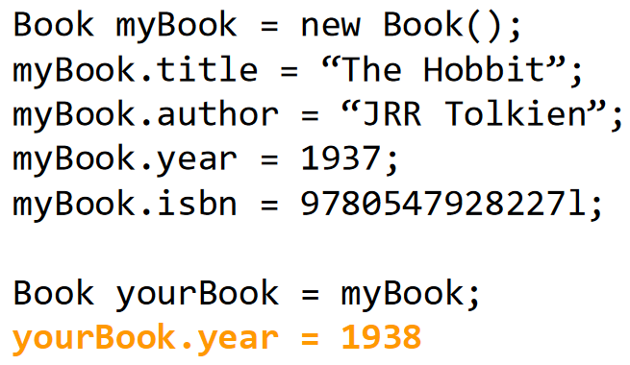
Duplicate objects
This can cause some issues…
We talked about this earlier with ArrayLists…
The point is, be careful when creating duplicate objects
In general it’s safer to just make a new Book (with the new keyword!)

Slide 10
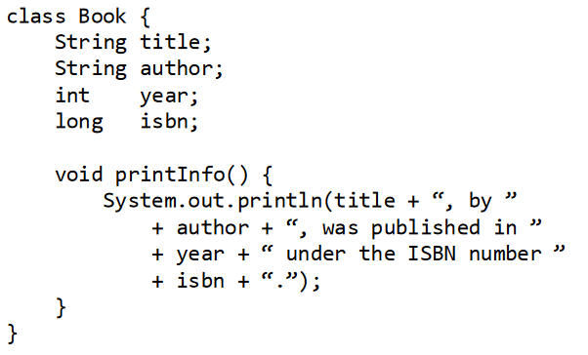
Instance methods
Instance methods are methods that are called on an instance of a class
We’re not doing stuff, we’re telling an object to do stuff
Let’s look at an instance method for Book: printInfo()
This method is void, so it won’t return anything, but we can put some print statements in there!
This is what our Book class looks like now:

Slide 11
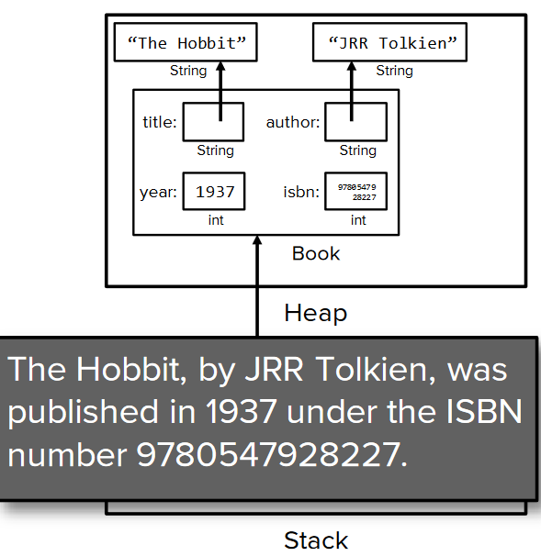
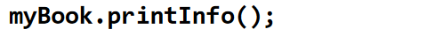
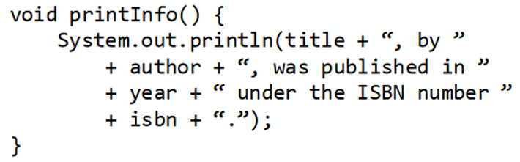
Instance methods
We’ll actually call these methods in our main class/method

Slide 12
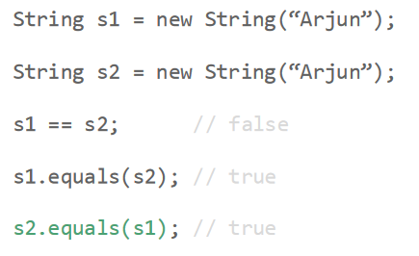
Comparing non-primitives
With all variables, using the == operator compares what’s in the variables
For primitives, this is perfect because the data are stored in the variable
This is NOT the case for objects, because variables for objects just store the address of the non-primitives
Therefore, we’ll use the equals method any time we want to compare two non-primitives to each other
If you don’t define your own equals method, Java will default to checking memory addresses

Slide 13
Printing objects
You can’t just System.out.println(myBook);… this will give you an error
A couple of ways to mitigate this:
Have a print method specifically for your object
Have a toString method to convert your object into a String object
Both of these are pretty simple to implement… just be aware that you cannot print objects using System.out.print because the variables refer to the address of the object, not the object itself
What you can do, though, is something like System.out.println(myBook.year);
myBook.year is an int, so we can SOPL that just fine!

Slide 14
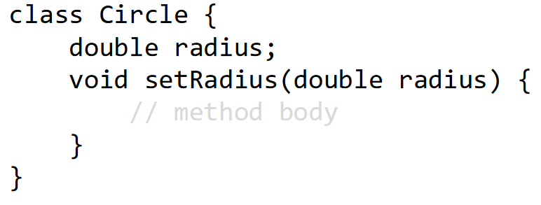
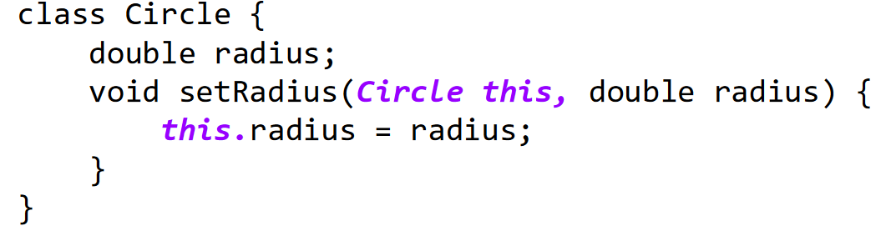
The this keyword
All instance methods have a secret first argument: this
this is a reference to the calling object

Slide 15
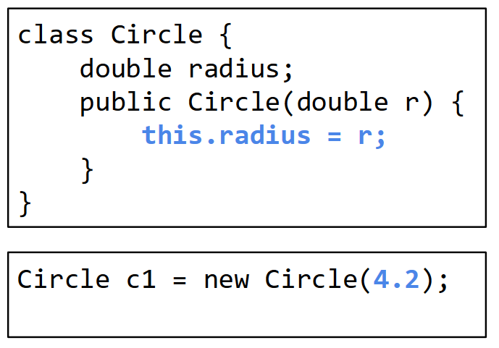
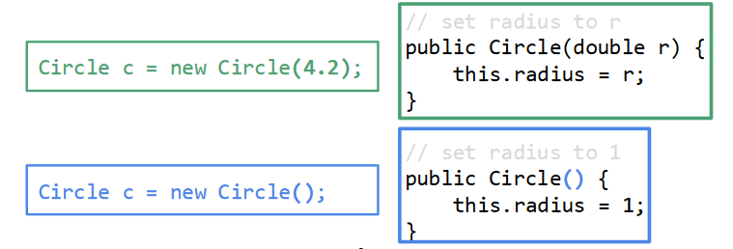
constructors
Constructors are special methods that are used to initialize objects
We can write constructors that initialize our values as desired
Just like with methods, we can overload constructors!

Slide 16
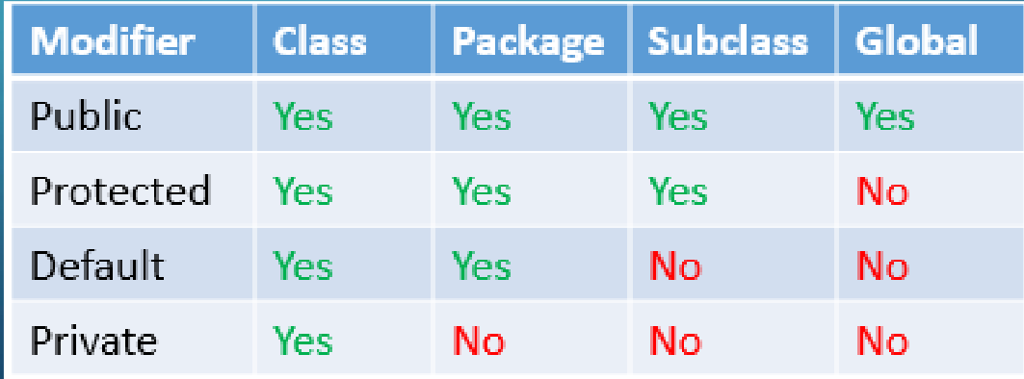
modifiers
Modifiers are keywords used to modify the meaning of a class, method, or variable declaration
We have access modifiers and non-access modifiers
For the access modifiers, you really only need to know public and private for now
The two non-access modifiers that you should know are:
static → belongs to the class (as opposed to an instance of a specific object)
final → cannot be overridden/modified

Slide 17
Project 2!
You will be using loops and methods to code a makeshift ATM machine that can deposit and withdraw money, as well as show a transaction history
The professor gave you skeleton code for this project – PLEASE use it!!!
Also included in the skeleton code are more specific instructions and hints to help guide you through the project
My best tips for this project:
As always, start early!!!
Take things one step at a time (or one method at a time!)
How would we deposit money into a real ATM? What happens behind the scenes?
The comments in the skeleton code are there for a reason… they should be your first line of defense if you’re not sure what to do!
Of course, feel free to reach out if you’re having trouble understanding anything ☺

