Slide 1
Cs7 recitation
Friday 1:00 – 1:50
Lindsey Rojtas

Slide 2
agenda
Introductions
Installing Java
Check: Do I already have Java installed?
Writing and saving source code
Using the command line
Compile → run → profit!

Slide 3

A little about me!
My name is Lindsey, but you can call me Lin if you’d like ☺
Any pronouns, I always like to say “whatever makes a joke funnier”
I’m a junior at Pitt; computer science major and linguistics minor
I’m from around here, about 30min south of Pittsburgh
In what little free time I have, I like to go on Wikipedia deep dives, play rhythm games, fine-tune my Spotify so I have a decent Wrapped at the end of the year, and think about my pets that I have back at my parents’ house

Slide 4
Let’s get into it: installing java
There’s a good chance that Java isn’t installed on your computer yet; let’s double check!
First, we need to open your command line interface
Mac users: Navigate to the search icon on the top right of your screen and search for “terminal” – it should be your top hit. Click on it!
Windows users: Click on the Windows icon in the bottom right and type “cmd” in the search bar – an application called “Command Prompt” should show up. Click on it!
In the application, type javac –version
Chances are, an error saying that javac isn’t a recognizable command will pop up. Let’s fix that!
If you get an actual version, you can sit back and relax for a bit.

Slide 5

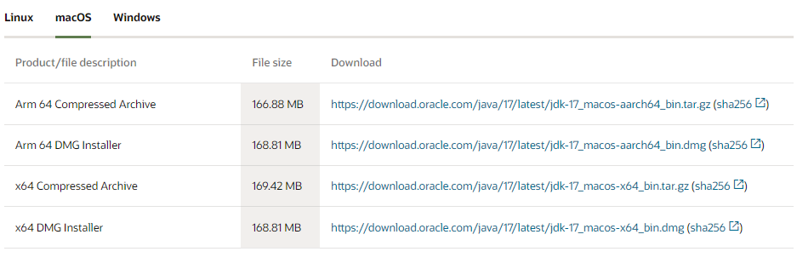
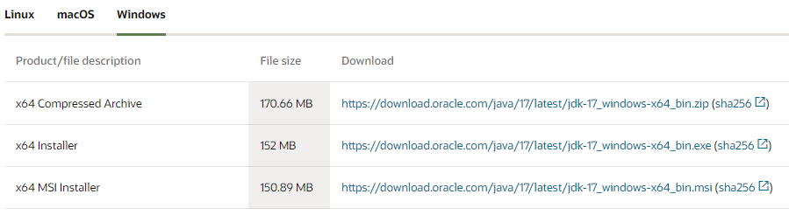
Let’s get into it: installing java
Open your preferred web browser and go to this link: https://www.oracle.com/java/technologies/downloads/
Mac users: click on the macOS tab and click on the link in the “x64 DMG Installer” row
Windows users: click on the Windows tab and click on the link in the “x64 Installer” row
Once you’ve downloaded the file, find it in your downloads folder (or wherever you saved it to) and click on it to run the file and install Java!
Mac users can take a break for a moment while we address a Windows issue in the next slide…

Slide 6
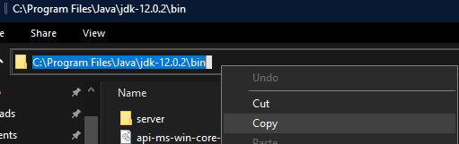
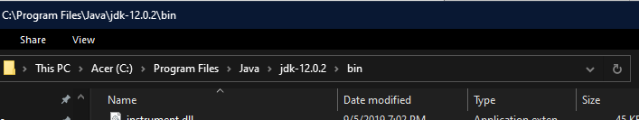
Windows only: changing the file path
In short, Windows is mean and likes making things more difficult. We need to take an extra step to tell the computer where to find Java on your computer.
First, find where Java was installed; it should be somewhere in C:\Program Files\Java\jdk1.8.0_144\bin
The numbers after the “jdk” part will probably be different, but that isn’t important.
There’s gonna be lots of things in this bin folder but there should be the files javac.exe and java.exe – scroll down and find them to make sure you’re in the right place
Once you’ve confirmed that you’re in the right directory, we need to copy the directory.
Click on the folder icon above the list of all the files and copy the text using Ctrl+C (or right click and select “Copy”)

Slide 7
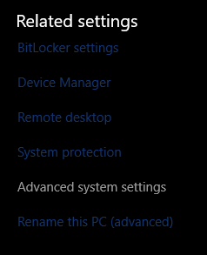
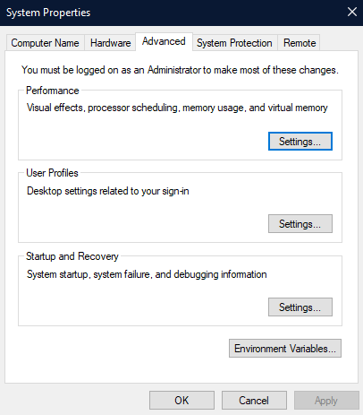
Windows only: changing the file path
Next, go to the Windows icon on the bottom left of your PC and then click on the little gear above the power icon. This will open up your settings menu.
On the left sidebar, click on About, then scroll down to the Related Settings heading. Click on Advanced System Settings. This should open a small window called System Properties
In the System Properties window, click on the Advanced tab at the top and then click on the Environment Variables… button

Slide 8
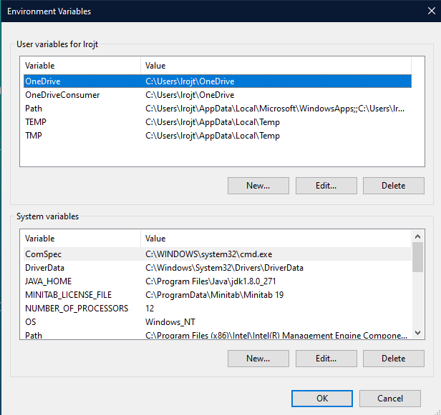
Windows only: changing the file path
We then end up with yet another window for the Environment Variables. This is what mine looks like:

Slide 9
Windows only: changing the file path
Under the “System Variables” section, find the Path variable and click on it.
For Windows 10…
Click “new” on the side and then paste in the path we copied at the beginning into the new text box.
For older versions
Click “edit”, and then press (and hold if necessary) the right arrow key so your cursor is at the very end of that long string of text. DO NOT BACKSPACE ANYTHING SIMILAR!!!!!!
Add a semicolon to the end of the string, and then paste in the path we copied at the beginning
Make sure you click OK/apply when you’re done with everything!!! Otherwise it won’t save
Now, check to see if Java is installed again by opening your command line application and type in javac –version to see if it works!
Let me know in some way or another if this isn’t the case

Slide 10
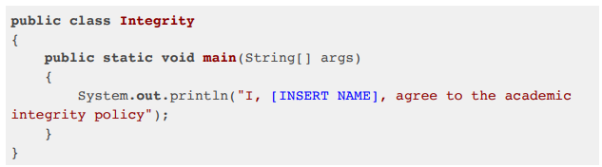
Time to program!
Before anything else, you’re going to want to make sure you have a text editor open.
You can use any text editor, including Notepad, but I prefer Visual Studio Code or Notepad++ because it makes coding a lot easier.
Paste/type in the following code – this is from the assignment description
Replace [INSERT NAME] with your name!
Be careful with the quotes – you may want to delete them and re-enter them because sometimes the copy/paste function is weird

Slide 11
Saving your code
Save your file as Integrity.java
It’s important that you name the file the same thing as what comes after “public class” in the file; otherwise, it won’t compile! Java is case sensitive, so don’t forget to have the proper letters capitalized.
You can save the file to any location you want, but it’s good practice to have a specific folder to save all your code files in so that it’s easy to find your code to submit

Slide 12
Using the command line
There are three important commands for the command line that you’ll use when compiling and running your code
cd [DIRECTORYNAME] → move from one directory/folder to another within it
[DIRECTORYNAME] is the name of a folder
cd .. → move from one directory/folder to the parent directory/folder
The next one is different between Mac users and Windows users
ls → Mac only, list all files in current directory/folder
dir → Windows only, list all files in current directory/folder

Slide 13
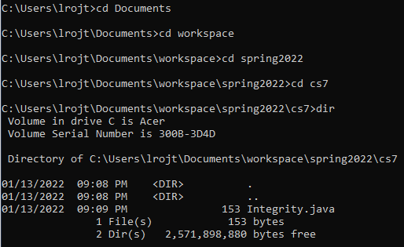
Compiling and running the code
Using the cd command where appropriate, navigate to wherever you saved your file on the command line
When you’re there, use ls/dir to check to see if the file is really in there

Slide 14
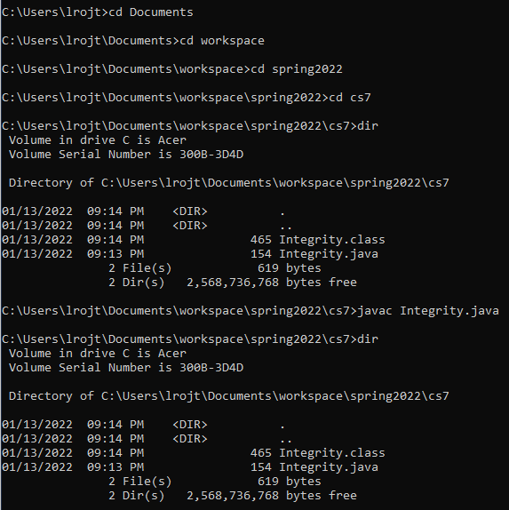
Compiling and running the code
Once we’re in the same directory that our code file is in, we can run the code!
In your command line, type javac Integrity.java
Take a screenshot of your command prompt showing that you navigated through the folders you needed to and ran the command; it should look something like this! You’ll need it to submit your assignment.
You probably won’t have as many folders as I do (I have… lots of folders). That’s fine, as long as you show your process

Slide 15
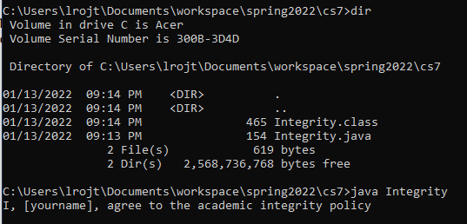
Compiling and running the code
We’re almost there! If your code compiled without issue, we can now run it!
To run the code, type java Integrity into the command prompt
The result should look something like this, with your name in it, of course!
Take another screenshot for your assignment submission

Slide 16
We did it!
Congrats, you just ran a program!
Here’s what to submit
A screenshot of steps 2.3-2.4 (navigating to the folder and compiling your code)
A screenshot of step 2.5 (running the code)
Your Integrity.java file
Make sure the file is named Integrity.java and make sure you submit that specific file itself! Screenshots of the code itself will not be accepted
If any submission instructions are unclear, ask the professor about them in an email or on Slack.
If anything else about the coding process confused you, let me know! I’m here to help

Slide 17
Some final notes
There is a Slack for this class! The professor as well as myself and the other 3 TAs are in it. Join and feel free to ask us or each other questions ☺
https://join.slack.com/t/introtojavaspring2022/shared_invite/zt-11vsvtx00-2VmWRPnNr204pB0Gq405cg
(…I’ll paste the link in chat)
Don’t be afraid to ask myself or the other TAs for help when you need it – it’s what we’re here for!
People tend to be afraid to ask for help or ask questions in CS. Don’t be. No question is a dumb question and chances are I’ve come across the same issue you have.
Have a great long weekend – see you next week!

