Slide 1
Cs7 recitation
1:00pm – 1:50pm
Lindsey rojtas

Slide 2
agenda
Logarithms
Loops
Do while loop
While loop
For loop
Break and continue
Assignment 4 hints
Project 1 hints

Slide 3
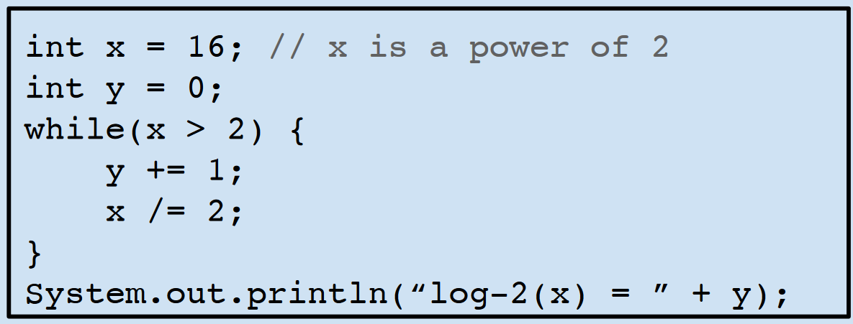
logarithms
The (base-2) logarithm of x is the number y such that: 2^{y} = x
log₂(16) = 4
Because 2⁴ = 16
In other words, if we’re trying to find the base-2 logarithm of a number, we’re trying to figure out how many times we can divide that number by 2
This can be a little weird with decimals (as I’m sure some of you know), but this is how we would do such a logarithm in Java:

Slide 4
loops
Exactly what it sounds like!
Avoids the need to write the same block of code over and over again
Loops will check to see if a condition is true and execute the code inside of it any number of times depending on whether the condition stays true
Almost like an if statement if it ran over and over…
Three types
While loop
Do-while loop
For loop

Slide 5
While loops
In plain English: “While this condition is true, do this action”
This is a loop that you’ll want to use when you’re not entirely sure how many times you want to run it
We check for a condition, and while that condition is true, we execute the code within the while loop (in the curly brackets!)
When the condition is false, we jump out of the loop and run the code that comes after
// code before while loop
while (condition) {
// code inside the while loop
}
// code after while loop

Slide 6
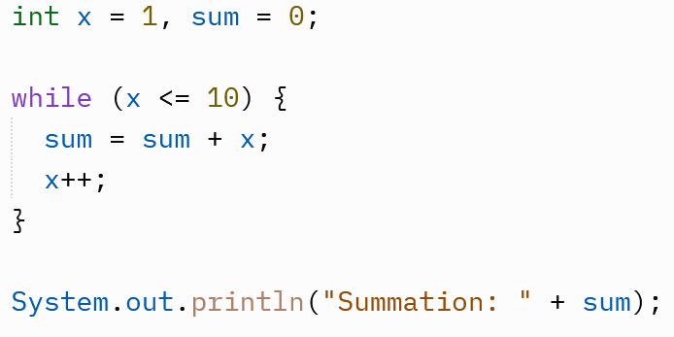
While loops
Let’s look at an example together
We initialize two variables: x = 1 and sum = 0
Our condition is while the value stored in x is greater than or equal to 10
If this is true, we will add x to sum and then increment x
When x is equal to 10, we jump out of the loop and execute that line of code
What will sum equal at the end?
Let’s trace it!

Slide 7
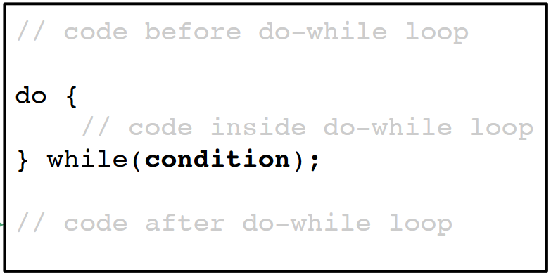
Do while loops
In plain English: “Do this action, and while the condition is true, do it again”
A variant of a while loop that always runs at least once
Works just like the while loop except for the fact that the first condition evaluation happens after the first iteration of the loop

Slide 8
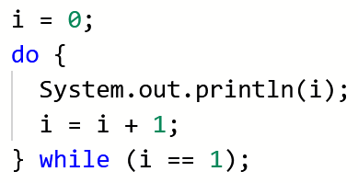
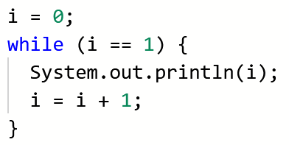
Do while vs while loops
Let’s compare: below, we have two loops. One is a do-while loop and another is a while loop.
The loops have the same code in them and they check for the same condition
What will each one print out? Will they print the same thing?
Let’s trace them!

Slide 9
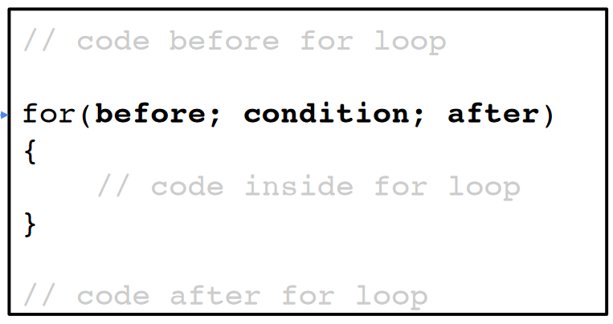
For loops
While loops are all well and good when you don’t know how many times you’ll loop, but what if you do know?
For loops are better for this
With for loops, you initialize a variable, check a condition, then modify that variable…
This sounds confusing… we’ll get into it a bit more

Slide 10
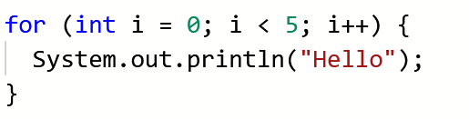
For loops
A little bit more specifically…
The “before” part of the for loop will typically initialize a variable
Note that this only happens once!
Again, in the middle is our condition
The “after” part of the for loop will modify the variable we initialized after each iteration of the for loop
For example, this loop will print Hello five times!
Initialization condition update

Slide 11
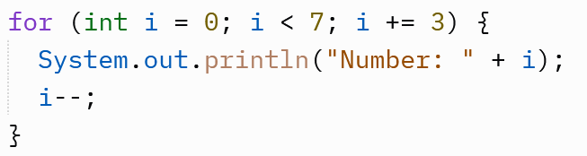
For loops
Let’s trace this for loop together…
What is initialized?
What is the condition?
What do we do to the variable every time the loop iterates?
What will be printed?

Slide 12
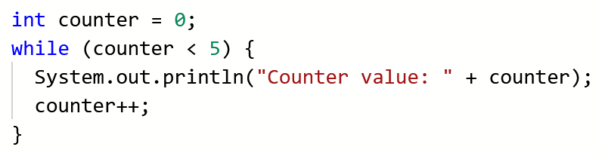
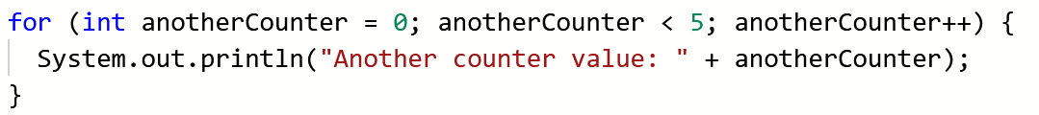
For loops vs. while loops
1
2
3
1
2
3
Initialize a variable (1), create a Boolean condition (2), increment the variable (3)

Slide 13
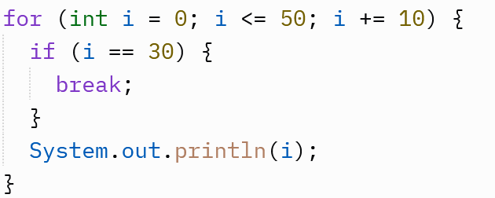
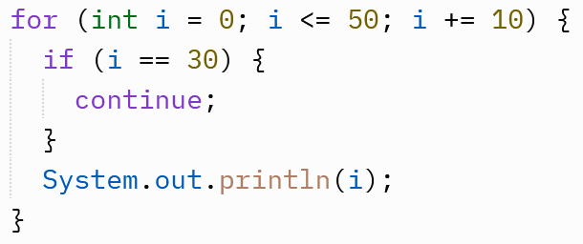
Break and continue
The break keyword will stop the loop in its tracks
No matter where we are in the loop, the break keyword breaks us out of the loop before it can do anything else
The continue keyword will stop the current iteration in its tracks rather than the whole loop
In essence, if we encounter a continue, we jump to the very end of the for loop and go back to checking the condition and then continue with other iterations
Let’s trace these!

Slide 14
Assignment 4: things to review
Recall short circuit evaluation!
In an AND statement (&&), if one clause is false, the whole statement is false
In an OR statement (||), if one clause is true, the whole statement is true
The pre-increment and post-increment operators are still very important!
Make sure you know the difference… could be detrimental!
You’ll also be tracing some while loops
These are pretty straightforward, but make sure you know what you’re doing as far as mathematical operations go

Slide 15
Project time!
Now it’s YOUR turn to write code!
This seems intimidating, but it’s really not that bad once you get into it
This first assignment will have you simulate the Monty Hall problem
You’ll be putting together everything that you’ve learned so far, so make sure to have notes handy when you get to work

Slide 16


Random numbers
In order to generate random numbers, we have to create a Random object:
In order to get a random number and store it into a variable, we’ll do something like this:
This will generate a random integer as low as zero but as high as 9
The number we put in the nextInt() bit is EXCLUSIVE, so it won’t be included in the range of numbers we could generate
If we wanted to include 10, we would set that number to 11

Slide 17
The actual problem…
Suppose you're on a game show, and you're given the choice of three doors
Behind one door is a car; behind the others, goats.
You pick a door, say No. 1, and the host, who knows what's behind the doors, opens another door, say No. 3, which always has a goat.
He then says to you, "Do you want to pick door No. 2?"
Is it to your advantage to switch your choice?
Your actual task will be to simulate this scenario… over and over again!

Slide 18
The doors
The professor recommends using three boolean variables to represent each of the doors
You’ll have to use the Random object we talked about a couple of slides ago to determine which door will have a car (true) and which doors will have goats (false)
If statements might be useful here in conjunction with Random
You should also have some variable for the player to randomly select a door for the player to choose

Slide 19
Switching and the result
Before we decide whether to switch or stay, we have to eliminate one of the doors that the player did not pick that contains a goat
The player can either stay with their first choice or switch to the other door that remains
If the player picks the door with the car, this is counted as a win, but if the player picks a door with the goat, this is a loss.
After you get the process figured out, you’ll have to simulate it 5,000 times with the player staying and another 5,000 times with the player switching!
This sounds like a lot, but…. loops!
You’ll want to keep track of the total number of wins and divide it by the total number of times you looped through the program

Slide 20
My general advice!
First and foremost, don’t be afraid to ask for help
You’re all in the Slack – use it! You can ask the professor, myself, any of the other TAs, or each other any questions you need answered
No question is a dumb question!
Take it step by step and don’t try to do it all at once
Start early! You’ll regret it if you don’t (and I speak from experience…)
Go through the problem on paper a couple of times so you understand how it works, and do your best to translate your process into code
READ THE PROJECT DESCRIPTION CAREFULLY!
Seriously… words can’t express how much easier it gets when you sit down and read

