Slide 1
Cs7 recitation
1:00p-1:50p
Lindsey rojtas

Slide 2
agenda
Operators
String Concatenation
Operator Precedence
Casting
Boolean logic

Slide 3
Operators
Operators are used to perform operations on variables and values
The values of the operation are the operands
The operation itself is defined by an operator
This is sort of like doing math…
1 + 2 → 1 and 2 are operands, + is the operator, addition is the operation we’re performing!
There are a few different types of operators
Assignment operators, comparison operators, arithmetic operators, arithmetic assignment operators, increment/decrement operators

Slide 4
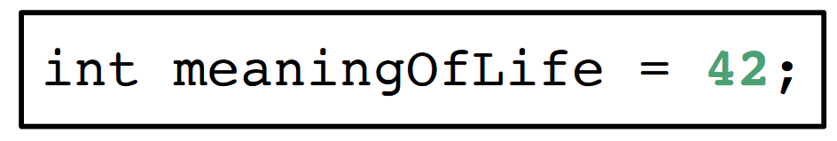
Assignment operators
There’s only one, really: the equals sign (=)!
We’ve seen this before; we use it when we initialize and assign values to variables!

Slide 5
Comparison operators
a == b → Check to see if a and b are equal
THIS IS DIFFERENT FROM THE ASSIGNMENT OPERATOR!!! = assigns a value, == checks for equality
a != b→ Check to see if a and b are not equal
a > b → Check to see if a is greater than b
a >= b → Check to see if a is greater than or equal to b
a < b → Check to see if a is less than b
a <= b → Check to see if a is less than or equal to b
When we assign these expressions to a variable, it will return a Boolean value
If a = 3 and b = 4 and we declare boolean check = (a != b);, check will store the value true

Slide 6
Arithmetic operations
a + b → adds values of a and b together
a – b → subtracts value of b from value of a
a * b → multiplies a and b together
a / b → divides a by b (without remainder if we’re dealing with integers!)
a % b → takes the remainder of a / b (if we’re dealing with integers!)
When we assign these expressions to a variable, the result of these operations will be stored in it
If a = 3 and b = 4 and we declare int sum = (a + b);, sum will store the value 7

Slide 7
What if we want to assign and do math at the same time?: arithmetic assignment variables
a += b → adds values of a and b together and stores the result in a
a -= b → subtracts value of b from value of a and stores the result in a
a *= b → multiplies a and b together and stores the result in a
a /= b → divides a by b (without remainder if we’re dealing with integers!) and stores the result in a
a %= b → takes the remainder of a / b (if we’re dealing with integers!) and stores the result in a
If a = 3 and b = 4 and we assign a *= b;, a will store the value 12

Slide 8
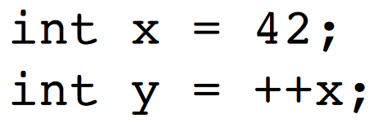
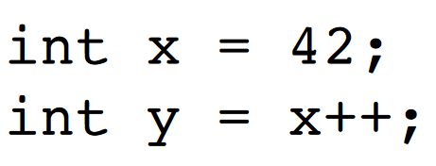
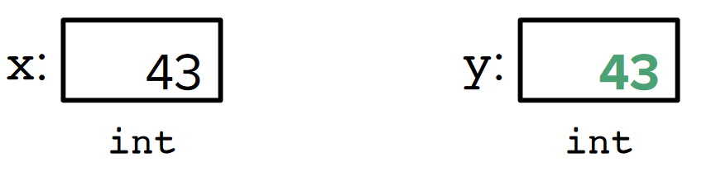
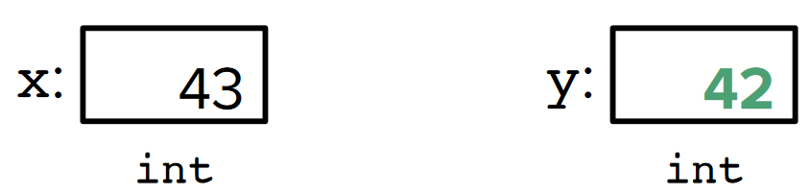
Increment/decrement operators
We can use the increment/decrement operators to increase or decrease a variable’s value by 1!
Pre-increment (++a;) → increment, then use the resulting value
Pre-decrement (--a;) → decrement, then use the resulting value
Post-increment (a++;) → use the resulting value, then increment
Post-decrement (a--;) → use the resulting value, then decrement

Slide 9
String concatenation
We can “add”, or concatenate Strings together!
String hello = “Hello”; String world = “World”;
String helloworld = hello + world;
“HelloWorld” !
You can add escape characters or even numbers to Strings!
String hello = “Hello”; String world = “World”;
String hellotabworldone = hello + “\t” + world + 1;
“Hello World1” !

Slide 10
Operator precedence: the pemdas of java
Similar to actual math, Java has an order of operations that you should follow!
Post-increment and post-decrement (a++ and a--)
Pre-increment and pre-decrement (++a and –a)
Multiplication, division, modulo (*, /, and %)
Addition and subtraction (+ and -)
Relational operators (<, >, <=, and >=)
Equality and inequality (== and !=)
Assignment and assignment-arithmetic (=, +=, -=, *=, /=, and %=)

Slide 11
Type casting
Remember how we said types are forever?
Noooot exactly…
If we find that we want a variable we have to be a different type than it is, we can use type casting → doing so will convert the variable into that type
This can be done by putting the desired type in parentheses before the variable/value
PRIMITIVES ONLY! We can’t do this with Strings (for now…)

Slide 12
Explicit casting (narrowing)
In explicit casting, we explicitly specify the target type in parentheses
If we want to cast from a larger type to a smaller type, we must do it explicitly or we’ll end up with an error
Double → float → long → int → short → byte
So if we want to cast a double to an int, for example, we’d have to do it explicitly
double a = 6.7;
int b = (int)a;
b will hold the value 6

Slide 13
Implicit casting (widening)
When we go from a smaller to a larger type, we can cast implicitly, as in we don’t have to use parentheses when type casting
Java will do this automatically!
Byte → short → int → long → float → double
So if we want to cast a short to a long, we can do that implicitly!
int a = 6;
double b = a;
b will hold the value 6.0

Slide 14
Boolean logic
Computers think in ones and zeros (or in other words, trues and falses, ons and offs, etc.)
This is called boolean logic!
A boolean expression is an expression that returns a boolean value
Relational operators are used to create boolean expressions
We can also use logical operators…

Slide 15
Logical operators
There are three types of logical operators
AND (a && b) → evaluates to true if both a and b are true ONLY
OR (a || b) → evaluates to true if either a or b are true, or both, but not neither
NOT(!a) → evaluates to true if a is false
A | B | A && B
TRUE | TRUE | TRUE
TRUE | FALSE | FALSE
FALSE | TRUE | FALSE
FALSE | FALSE | FALSE
A | B | A || B
TRUE | TRUE | TRUE
TRUE | FALSE | TRUE
FALSE | TRUE | TRUE
FALSE | FALSE | FALSE
A | !A
TRUE | FALSE
FALSE | TRUE

Slide 16
Logical operator precedence
The precedence order for logical operators is as follows:
NOT (!)
AND (&&)
OR (||)
Use parentheses to make your boolean logic statements easier to read – you’ll thank yourself later and it’ll be easier to trace if something goes wrong!

Slide 17
Assignment 2 hints
There are two sections to this assignment
Formatting output
Review escape characters and String rules!
Math in Java
Review operator precedence, implicit casting, and boolean logic!

Slide 18
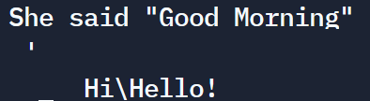
Assignment 2 part 1: printing
In this part of the assignment, you’ll be putting a singular string into the System.out.println(); statement in order to get the desired output
For this, you’ll want to recall your escape characters:
\n → new line
\t → tab
\’ → single quote within a String
\” → double quote within a String
\\ → backslash within a String

Slide 19
Assignment 2 part 2: math in java
When you get to this part of the assignment, make sure you review operator precedence and implicit casting; it’ll be important!
There’s a chance that the arithmetic given may result in an error; watch out for that!
Some examples:
12 + 2.4 → ?
3.0 / 4 → ?
21 / 11 → ?
23 % 11 + 5 → ?
true && (true || false) && (false || false) → ?
‘x’ + 42 → ?
“x” + 42 → ?

Slide 20
Assignment 2 part 2: math in java
When you get to this part of the assignment, make sure you review operator precedence and implicit casting; it’ll be important!
There’s a chance that the arithmetic given may result in an error; watch out for that!
Some examples:
12 + 2.4 → 14.4 (the 12 is an integer, but it is implicitly cast to a double)
3.0 / 4 → ?
21 / 11 → ?
23 % 11 + 5 → ?
true && (true || false) && (false || false) → ?
‘x’ + 42 → ?
“x” + 42 → ?

Slide 21
Assignment 2 part 2: math in java
When you get to this part of the assignment, make sure you review operator precedence and implicit casting; it’ll be important!
There’s a chance that the arithmetic given may result in an error; watch out for that!
Some examples:
12 + 2.4 → 14.4 (the 12 is an integer, but it is implicitly cast to a double)
3.0 / 4 → 0.75 (4 is implicitly cast to a double; no integers, so decimal division)
21 / 11 → ?
23 % 11 + 5 → ?
true && (true || false) && (false || false) → ?
‘x’ + 42 → ?
“x” + 42 → ?

Slide 22
Assignment 2 part 2: math in java
When you get to this part of the assignment, make sure you review operator precedence and implicit casting; it’ll be important!
There’s a chance that the arithmetic given may result in an error; watch out for that!
Some examples:
12 + 2.4 → 14.4 (the 12 is an integer, but it is implicitly cast to a double)
3.0 / 4 → 0.75 (4 is implicitly cast to a double; no integers, so decimal division)
21 / 11 → 1 (we’re working with integers, so use integer division! no decimals or rounding)
23 % 11 + 5 → ?
true && (true || false) && (false || false) → ?
‘x’ + 42 → ?
“x” + 42 → ?

Slide 23
Assignment 2 part 2: math in java
When you get to this part of the assignment, make sure you review operator precedence and implicit casting; it’ll be important!
There’s a chance that the arithmetic given may result in an error; watch out for that!
Some examples:
12 + 2.4 → 14.4 (the 12 is an integer, but it is implicitly cast to a double)
3.0 / 4 → 0.75 (4 is implicitly cast to a double; no integers, so decimal division)
21 / 11 → 1 (we’re working with integers, so use integer division! no decimals or rounding)
23 % 11 + 5 → 6 (23 % 11 is 1 (because 23/11 is 2 remainder 1), then add 5)
true && (true || false) && (false || false) → ?
‘x’ + 42 → ?
“x” + 42 → ?

Slide 24
Assignment 2 part 2: math in java
When you get to this part of the assignment, make sure you review operator precedence and implicit casting; it’ll be important!
There’s a chance that the arithmetic given may result in an error; watch out for that!
Some examples:
12 + 2.4 → 14.4 (the 12 is an integer, but it is implicitly cast to a double)
3.0 / 4 → 0.75 (4 is implicitly cast to a double; no integers, so decimal division)
21 / 11 → 1 (we’re working with integers, so use integer division! no decimals or rounding)
23 % 11 + 5 → 6 (23 % 11 is 1 (because 23/11 is 2 remainder 1), then add 5)
true && (true || false) && (false || false) → false (true && true && false evals to false!)
‘x’ + 42 → ?
“x” + 42 → ?

Slide 25
Assignment 2 part 2: math in java
When you get to this part of the assignment, make sure you review operator precedence and implicit casting; it’ll be important!
There’s a chance that the arithmetic given may result in an error; watch out for that!
Some examples:
12 + 2.4 → 14.4 (the 12 is an integer, but it is implicitly cast to a double)
3.0 / 4 → 0.75 (4 is implicitly cast to a double; no integers, so decimal division)
21 / 11 → 1 (we’re working with integers, so use integer division! no decimals or rounding)
23 % 11 + 5 → 6 (23 % 11 is 1 (because 23/11 is 2 remainder 1), then add 5)
true && (true || false) && (false || false) → false (true && true && false evals to false!)
‘x’ + 42 → ERROR (kinda… you can’t concatenate a char to a number!)
“x” + 42 → ?

Slide 26
Assignment 2 part 2: math in java
When you get to this part of the assignment, make sure you review operator precedence and implicit casting; it’ll be important!
There’s a chance that the arithmetic given may result in an error; watch out for that!
Some examples:
12 + 2.4 → 14.4 (the 12 is an integer, but it is implicitly cast to a double)
3.0 / 4 → 0.75 (4 is implicitly cast to a double; no integers, so decimal division)
21 / 11 → 1 (we’re working with integers, so use integer division! no decimals or rounding)
23 % 11 + 5 → 6 (23 % 11 is 1 (because 23/11 is 2 remainder 1), then add 5)
true && (true || false) && (false || false) → false (true && true && false evals to false!)
‘x’ + 42 → ERROR (kinda… you can’t concatenate a char to a number!)
“x” + 42 → “x42” (this is what we wanted from the last expression!)

