Slide 1

Pemrograman Web
Sirojul Munir | rojulman@nurulfikri.ac.id

Slide 2
PHP - Database
Sirojul Munir | rojulman@nurulfikri.ac.id

Slide 3
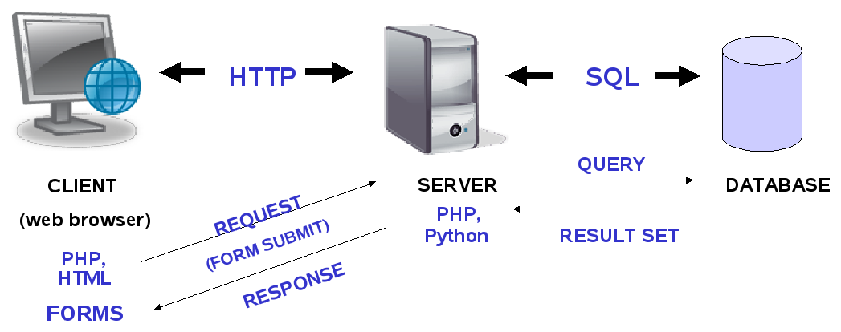
Client – Server - Database

Slide 4
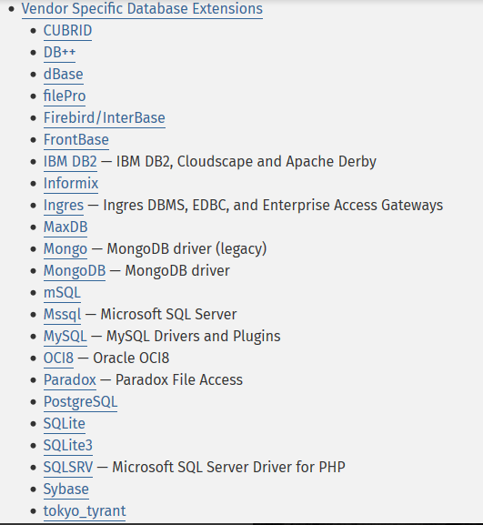
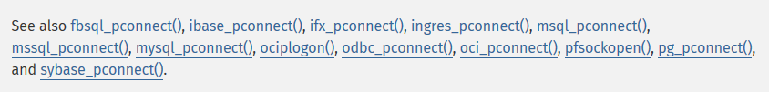
PHP – Database Support
Native Library
php-mysql
php-pgsql
php-oci
php-odbc
…
http://php.net/manual/en/refs.database.php

Slide 5
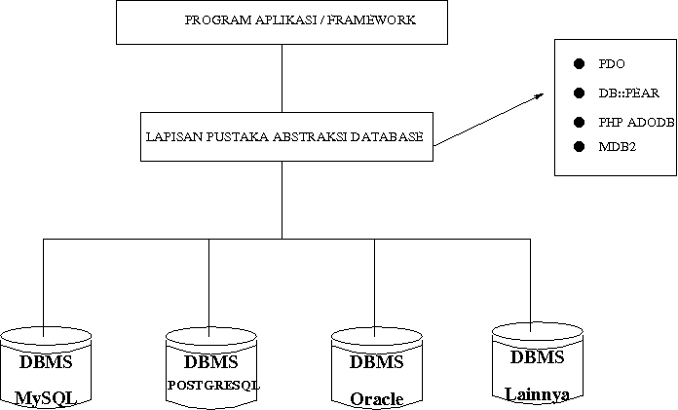
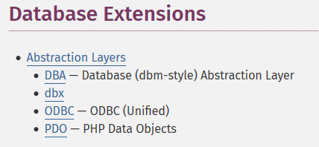
PHP – Database Abstraksi
http://php.net/manual/en/refs.database.php

Slide 6

PHP – PDO (PHP Data Object)
Mulai PHP 5.0 , PDO menjadi Library default untuk koneksi/akses database
PDO Database Driver Support:
1. PDO_DBLIB, support database FreeTDS / Microsoft SQL Server / Sybase 2. PDO_FIREBIRD , Firebird/Interbase 6 3. PDO_IBM , IBM DB2 4. PDO_INFORMIX , IBM Informix Dynamic Server 5. PDO_MYSQL , MySQL 3.x/4.x/5.x 6. PDO_OCI , Oracle Call Interface 7. PDO_ODBC , ODBC v3 (IBM DB2, unixODBC and win32 ODBC) 8. PDO_PGSQL , PostgreSQL 9. PDO_SQLITE , SQLite 3 and SQLite 2
<?php
print_r(PDO::getAvailableDrivers());
?>

Slide 7
PDO :: Data Source Name (DSN)
Konfigurasi untuk akses database :
database driver, host, db (schema) name and charset, as well as less frequently used port and unix_socket go into DSN;
username and password go to constructor;
all other options go into options array.

Slide 8
PDO :: Data Source Name (DSN)
Konfigurasi untuk akses database :
database driver, host, db (schema) name and charset, as well as less frequently used port and unix_socket go into DSN;
username and password go to constructor;
<?php
$host = '127.0.0.1'; $db = 'dblatihan'; $user = 'root'; $pass = ''; $charset = 'utf8mb4'; $dsn = "mysql:host=$host;dbname=$db;charset=$charset";
?>

Slide 9
PDO :: Data Source Name (DSN)
all other options go into options array.
$opt = [ PDO::ATTR_ERRMODE => PDO::ERRMODE_EXCEPTION, PDO::ATTR_DEFAULT_FETCH_MODE => PDO::FETCH_ASSOC, PDO::ATTR_EMULATE_PREPARES => false, ];

Slide 10
PDO Object :: new PDO()
Create Connection :: PDO Instance Class
<?php
$host = '127.0.0.1'; $db = 'dblatihan'; $user = 'root'; $pass = ''; $charset = 'utf8mb4'; $dsn = "mysql:host=$host;dbname=$db;charset=$charset";
$opt = [ PDO::ATTR_ERRMODE => PDO::ERRMODE_EXCEPTION, PDO::ATTR_DEFAULT_FETCH_MODE => PDO::FETCH_ASSOC, PDO::ATTR_EMULATE_PREPARES => false, ];
$dbh = new PDO($dsn, $user, $pass, $opt);
?>

Slide 11
PDO Exception
<?php
try{
// Database MySQL dengan PDO_MYSQL
$host = '127.0.0.1'; $dbname = 'dblatihan'; $dbuser = 'root'; $dbpass = '';
$dbh=new PDO("mysql:host=$host;dbname=$dbname",$dbuser,$dbpass);
$dbh->setAttribute(PDO::ATTR_ERRMODE,PDO::ERRMODE_EXCEPTION);
}catch(PDOException $e){
echo $e->getMessage();
}
?>

Slide 12
PDO Connection Database
// Database Postgresql dengan PDO_POSTGREQL
$dbh=new PDO("pgsql:host=$host;dbname=$dbname",$dbuser,$dbpass);
// Database SQLite
$dbh =new PDO("sqlite:my/database/path/database.db");
// Database Ms.Access
$dbh= new PDO('odbc:Driver={Microsoft Access Driver(*.mdb)};
DBQ=C:\database.mdb;Uid=Admin');

Slide 13
PDO::Function
Fungsi : exec( )
Digunakan untuk eksekusi perintah SQL, jika SQL sukses dilakukan akan mengembalikan nilai 0
$sql1 = " CREATE TABLE prodi( id integer auto_increment primary key, kode varchar(2) UNIQUE,nama varchar(50) not null ) ";
$dbh->exec( $sql1 );
$sql2 = " INSERT INTO prodi (kode,nama) VALUES (‘TI’,’Informatika’) ";
$dbh->exec( $sql2 );

Slide 14
PDO::Function
Fungsi : query ( )
Digunakan untuk eksekusi perintah SQL dan mengembalikan hasil query berupa object ResultSet (kumpulan baris data/record )
$sql = " SELECT * FROM prodi ";
$rs = $dbh->query( $sql );
foreach($rs as $row) {
echo '<br/>'$row['id'] . ' – ' . $row[‘nama’] ;
}

Slide 15
PDO::Function
Fungsi : prepare() & execute ( )
Digunakan untuk eksekusi perintah SQL menggunakan prepareStatement
$sql = " INSERT INTO prodi (kode,nama) VALUES (?,?) ";
$statement1 = $dbh->prepare( $sql );
$ar_data = ['TE', 'Teknik Elektro ']; // array
$statement1->execute( $ar_data );
$statement2 = $dbh->prepare(" DELETE FROM prodi WHERE id=? " );
$statement2->execute( array(2) );

Slide 16
PDO::Function
Fungsi : fetch( )
Digunakan untuk eksekusi perintah SQL menggunakan prepareStatement yaitu untuk mengambil satu baris hasil query
$sql = " SELECT * FROM prodi WHERE id=? ";
$statement1 = $dbh->prepare( $sql );
$statement1->execute( array(2) );
$row = $statement1->fetch();
echo 'ID : '. $row['id']. ' -- ' . $row['nama'];

Slide 17
PDO::Function
Fungsi : fetch( )
Dapat memiliki opsi argumen
PDO::FETCH_NUM returns enumerated array
PDO::FETCH_ASSOC returns associative array
PDO::FETCH_BOTH - both of the above
PDO::FETCH_OBJ returns object
PDO::FETCH_LAZY allows all three (numeric associative and object) methods without memory overhead.
$statement = $dbh->prepare(“SELECT * FROM produk”);
$row = $statement1->fetch(PDO::FETCH_OBJ);
echo $row->id . ‘ – ‘ . $row->nama;

Slide 18
PDO::Function
Fungsi : fetchAll( )
Digunakan untuk eksekusi perintah SQL menggunakan prepareStatement yaitu untuk mengambil kumpulan baris hasil query (resulset)
$sql = " SELECT * FROM prodi ";
$statement1 = $dbh->prepare( $sql );
$statement1->execute( );
$rows = $statement1->fetchAll();
echo 'ID : '. $row['id']. ' -- ' . $row['nama'];

Slide 19
PDO::Function
Fungsi : rowCount( )
Digunakan untuk mendapakan jumlah baris dari hasil query (affected rows) dari perintah SQL : INSERT, UPDATE atau DELETE
$sql = " DELETE FROM prodi ";
$statement1 = $dbh->prepare( $sql );
$statement1->execute( );
$jml = $statement->rowCount();
echo 'Jumlah Data Yang DIHAPUS : '. $jml;

Slide 20
PDO::Function
Fungsi : fetchColumn( )
Dapat digunakan untuk mengambil data dari fungsi aggregate : COUNT, MAX, MIN, AVG pada perintah query
$sql = "SELECT COUNT(id) FROM prodi";
$jumlah = $dbh->query($sql)->fetchColumn();
echo 'Jumlah Data : ' . $jumlah ;

Slide 21


PDO :: Transaction
Kumpulan query dapat di eksekusi dalam block transaction
Pada transaction harus dipastikan perintah query tidak terjadi kesalahan (error exception)
Berikut method untuk transaction menggunakan PDO
beginTransaction() to start a transaction
commit() to commit one
rollback() to cancel all the changes you made since transaction start.

Slide 22
PDO :: Transaction
try {
$dbh->beginTransaction();
$stmt = $dbh->prepare("INSERT INTO users (name) VALUES (?)");
foreach (['Indra','Rio‘, 'Edo'] as $name)
{
$stmt->execute([$name]);
}
$dbh->commit();
}catch (Exception $e){
$dbh->rollback();
throw $e;
}

Slide 23
Referensi
http://php.net/manual/en/book.pdo.php
https://phpdelusions.net/pdo

