Slide 1

Convolutional Neural Networks Made Simple
How machines learn to see, recognize, and understand the visual world

Slide 2

1. What is a CNN?
Understanding the biological inspiration and fundamental purpose of visual AI

Slide 3


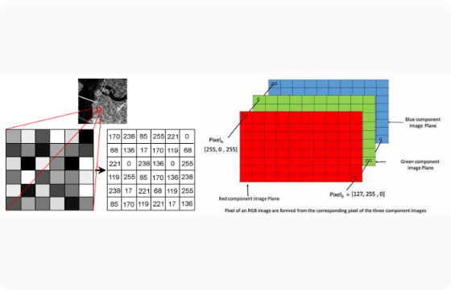
How Computers See Images
Images are Numbers: To a computer, a photograph is simply a 2D grid of pixel numbers ranging from 0 (black) to 255 (white).
Color Channels: Color images consist of three overlapping grid layers: Red, Green, and Blue (RGB).
Spatial Relationships: Nearby pixels form meaningful patterns like edges, curves, and textures.
The Challenge: Small changes in lighting or angle alter raw pixel numbers entirely, requiring smart algorithms.

Slide 4


Traditional Networks vs CNNs
Standard Neural Network (MLP)
Convolutional Neural Network (CNN)
Flattens the Input: Flattens 2D images into 1D arrays, destroying spatial context and pixel relationships.
Preserves 2D Structure: Processes pixels in local grid neighborhoods, keeping visual spatial relationships intact.
Too Many Parameters: A 1000x1000 image generates millions of inputs, leading to slow training and severe overfitting.
Parameter Efficiency: Uses small sliding filters repeatedly across the image, dramatically reducing weight count.

Slide 5
2. Building Blocks of a CNN
A step-by-step tour through the core architectural layers

Slide 6
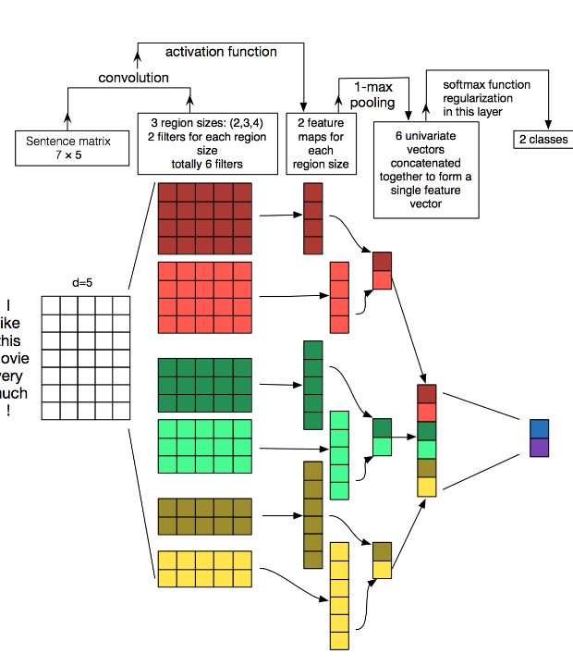
The Convolution Layer
Scanning with Filters
The convolution layer is the primary engine of a CNN. A small matrix called a filter (or kernel) slides across the image pixel by pixel.
At each position, it computes mathematical dot products to detect specific visual features like horizontal lines, vertical edges, or sharp color contrast.
The output is a simplified Feature Map highlighting where key patterns exist in the photo.

Slide 7







Key Layers Inside a CNN
1. Convolution
2. ReLU Activation
3. Pooling
4. Fully Connected
Applies sliding filters to detect local features like edges, textures, and simple geometric shapes.
Introduces non-linearity by replacing negative values with zero, enabling complex pattern learning.
Downsamples feature maps to reduce size, save computation, and make detection position-invariant.
Combines all extracted high-level features to make the final prediction or classification output.

Slide 8

Efficiency of Parameter Sharing
Why CNNs Scale So Effectively
99%
Instead of learning unique weights for every individual pixel position, a CNN reuses the same filter weights across the entire image.
Because an edge detector filter works equally well in the top-left or bottom-right corner, parameter sharing drastically lowers memory needs and prevents overfitting.
Parameter Reduction

Slide 9




How an Image Passes Through a CNN
Step 2: Low-Level
Step 4: Decision
Early layers detect simple lines, curves, and color gradients.
Final dense layer computes final scores (e.g., "Cat: 98%").
Step 1: Input
Step 3: High-Level
Raw pixel matrix enters the network (e.g., 224x224 RGB image).
Deeper layers combine edges into ears, eyes, or wheel shapes.

Slide 10

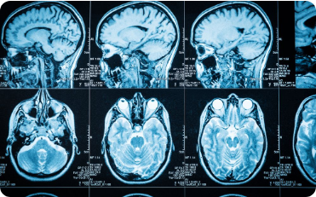

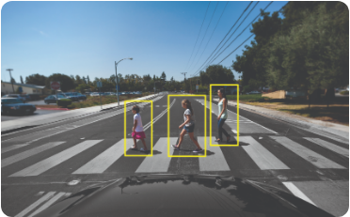

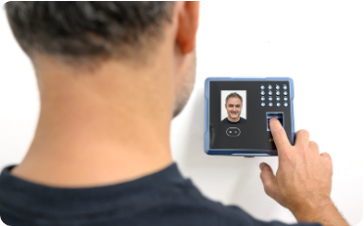
Real-World CNN Applications
Medical Diagnostics
Self-Driving Cars
Facial Recognition
Detects tumors, lesions, and anomalies in X-rays, CT scans, and MRIs with high precision.
Identifies pedestrians, lane markers, traffic signs, and obstacles in real-time video feeds.
Powers biometric security unlocking, photo tagging, and surveillance verification systems.

Slide 11
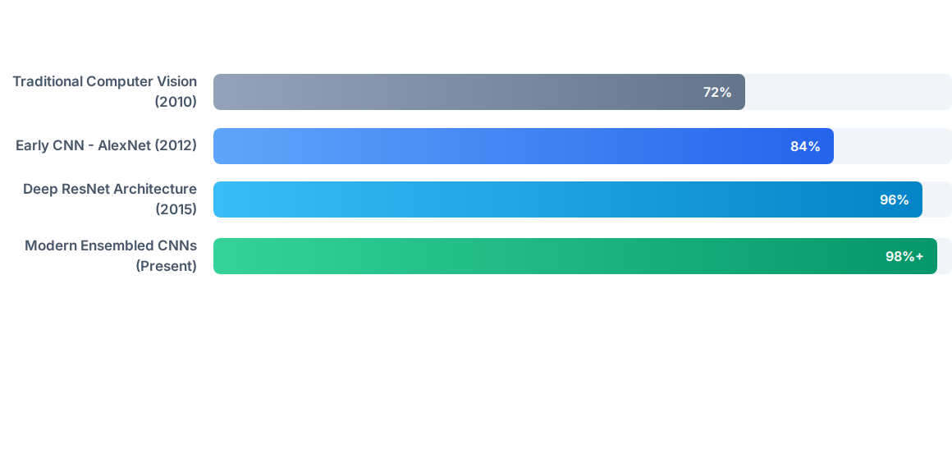
Image Recognition Accuracy Growth
Key Takeaway: The introduction of CNNs in 2012 revolutionized computer vision, quickly surpassing human-level accuracy (95%) in standard image classification benchmarks.

Slide 12
Questions & Discussion
Thank you! You now understand the basic building blocks of modern computer vision.
Convolutional Neural Networks • Artificial Intelligence Fundamentals

Slide 13





Image Sources
https://miro.medium.com/v2/resize:fit:1400/1*f4kA40PHOrdytAcFvtSIeQ.png
Source: medium.com
https://dennybritz.com/wp-content/uploads/2015/11/Screen-Shot-2015-11-06-at-12.05.40-PM.png
Source: dennybritz.com
https://www.labellerr.com/blog/content/images/2023/04/C7xbmzZX0AE5VXQ.jpg
Source: www.labellerr.com
https://blogs.nvidia.com/wp-content/uploads/2019/04/ADAS-IMG_0052.jpg
Source: blogs.nvidia.com
https://aussietimesheets.com.au/cdn/shop/files/AussieTimeSheets-8_2ba188b7-2b11-450e-8b7e-f8537436c07d_2048x.jpg?v=1741584975
Source: aussietimesheets.com.au

