Slide 1


Springboard Final Capstone Predicting the Length of Stay in Hospital among Schizophrenic and other Psychotic Disorders Patients Using Machine Learning
By Ranjana Roka

Slide 2


Contents
Problem Statement and Objective
Data Wrangling
Exploratory Data Analysis
Machine Learning Models
Model Performance
Conclusions and Recommendations

Slide 3
Problem Statement and Objective
Problem Statement
Length of stay (LOS) is a critical measure in healthcare
Importance of LOS prediction in psychiatry
Impacts on healthcare costs, resource allocation, and patient outcomes
Objective
To develop a predictive model for LOS to improve resource management and personalized care planning

Slide 4

Data Wrangling
1. Data Collection
NY State SPARCS Dataset
2.3 million rows, 33 columns
Key features: Demographics (age, gender, race, ethnicity), diagnosis, severity of illness, length of stay (target variable), and others
Missing value analysis
2. Data Cleaning
Removed columns with >50% missing values
Dropped irrelevant features
Handled missing values: Imputed numeric fields with median values, encoded categorical fields

Slide 5
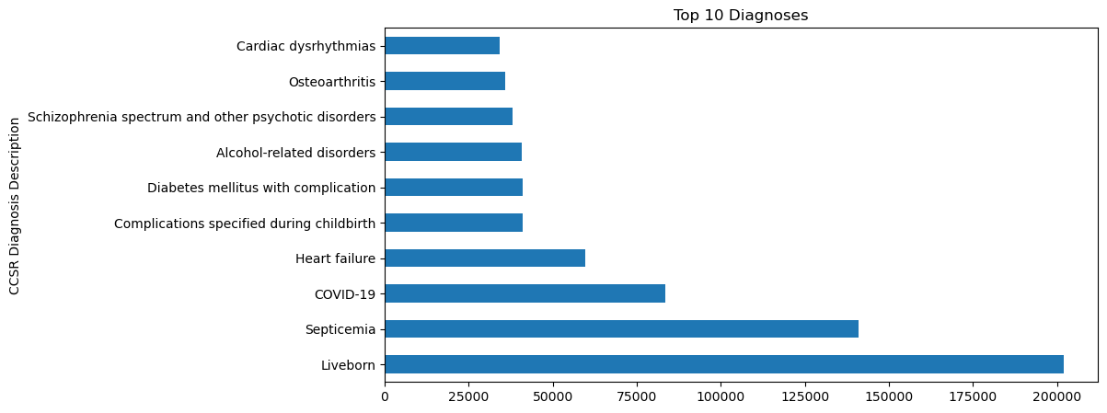
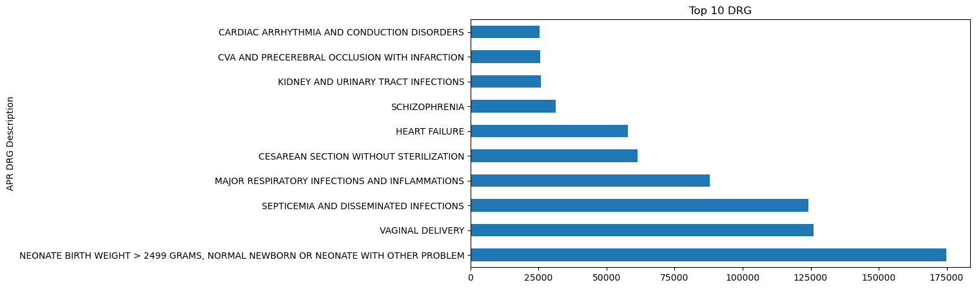
Exploratory Data Analysis
Notes:
This bar chart shows the top 10 diagnoses from the SPARCS healthcare dataset, measuring the frequency of each condition.
Liveborn (newborns) is by far the most frequent diagnosis with nearly 200,000 cases Septicemia (blood infection) is the second
Schizophrenia spectrum and other psychotic disorders appears in the top 10, with around 40,000 cases which is a significant portion of hospital admissions
This distribution helps provide context for why predicting length of stay for schizophrenia patients is important, as it represents a significant portion of hospital admissions

Slide 6
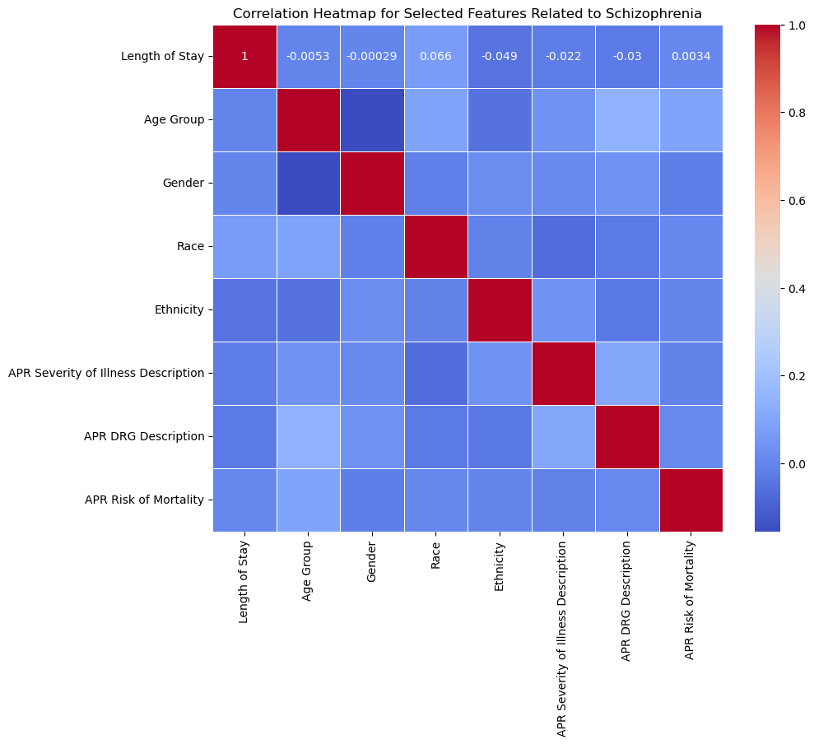
Correlation Matrix
The features are relatively independent of each other (mostly weak correlations)
Demographic factors (Age Group, Gender, Ethnicity) show very weak correlations
Slight positive correlation with Race (0.066)
Other health metrics (Severity of Illness, DRG Description, Risk of Mortality) show minimal correlation with Length of Stay
Notes:
This is a correlation heatmap showing the relationships between different features related to schizophrenia patients' hospital stays
There don't appear to be any strong predictive relationships between individual features and Length of Stay
This visualization suggests that predicting Length of Stay will likely require more complex, non-linear modeling approaches since no single feature shows a strong linear correlation with the target variable.

Slide 7
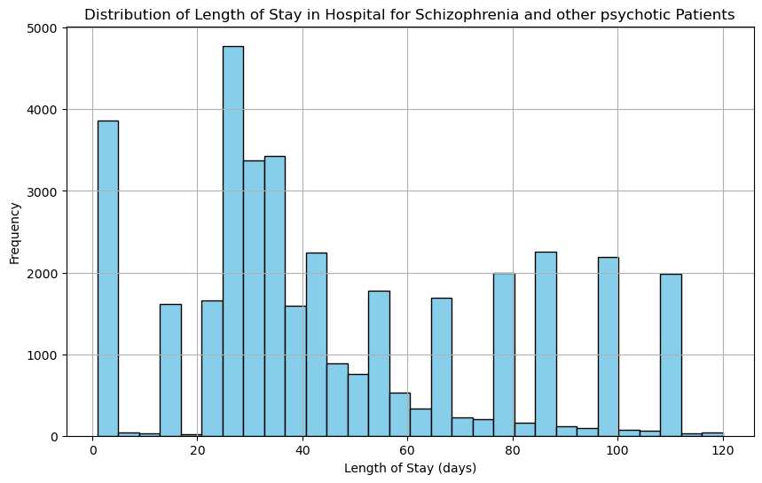
Length of Stay Distribution
This visualization provides useful insights into how long patients with these conditions typically remain in the hospital.
Most patients with schizophrenia and psychotic disorders stay 20-40 days, with a few staying beyond 100 days
Notes:
The X-axis represents the number of days patients with schizophrenia and other psychotic disorders stayed in the hospital.
The Y-axis shows the number of patients (or occurrences) for each bin of days in the X-axis.

Slide 8
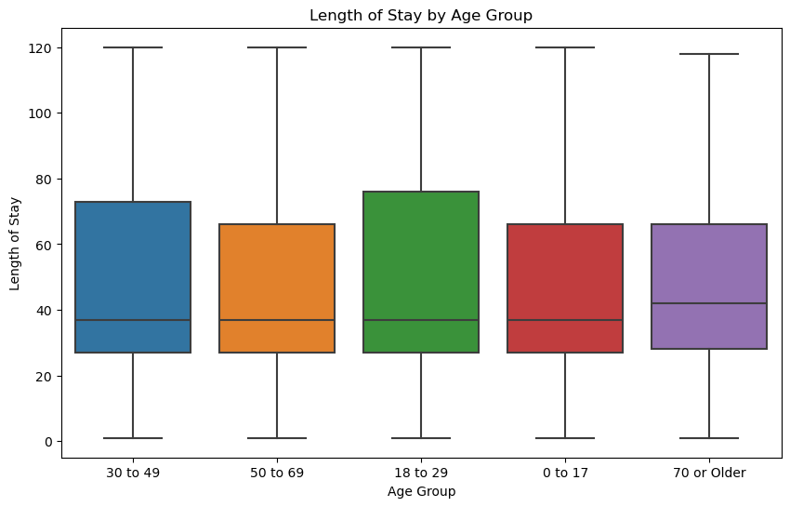
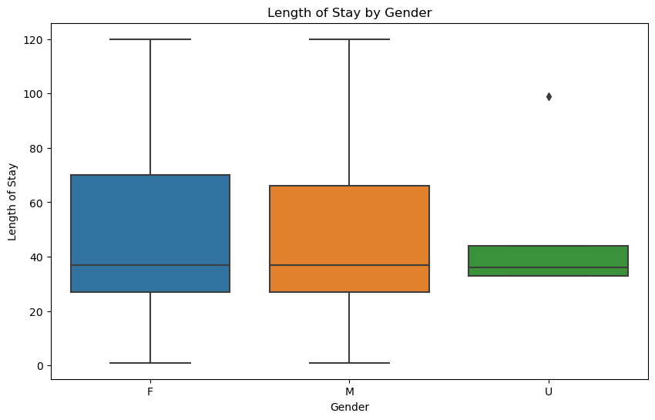
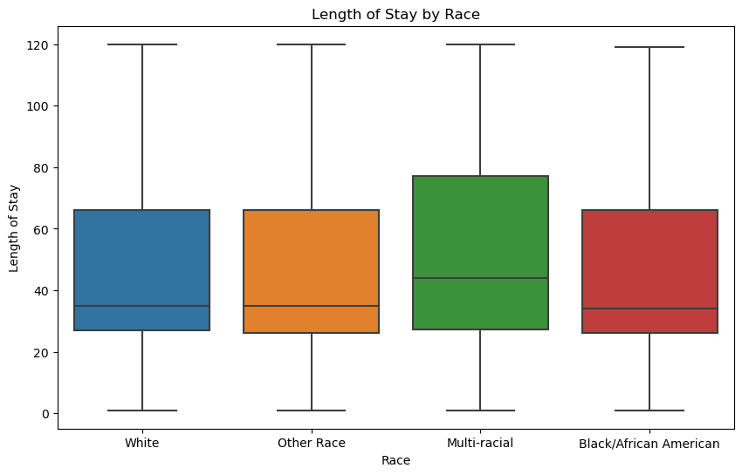
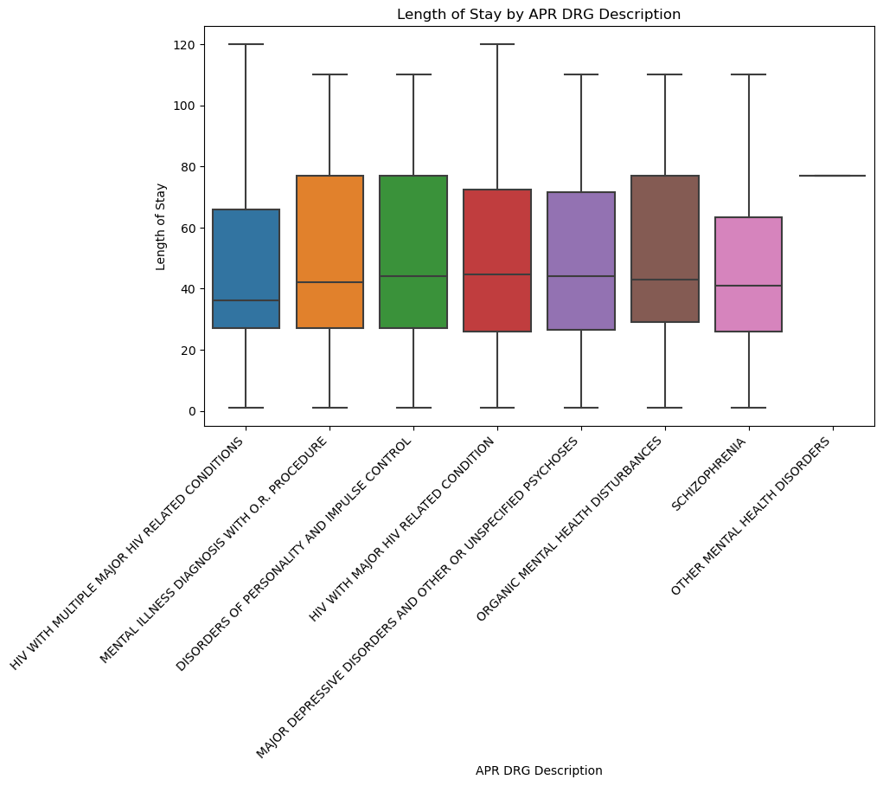
Visualization of LOS across Key Features

Slide 9
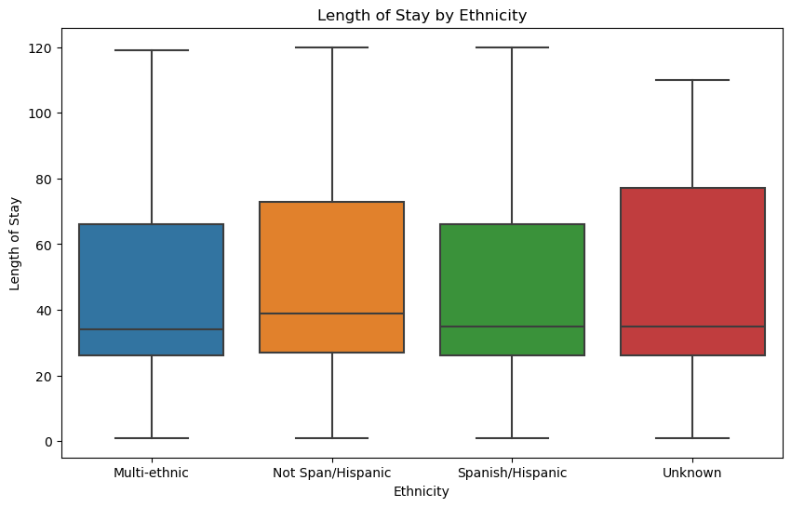
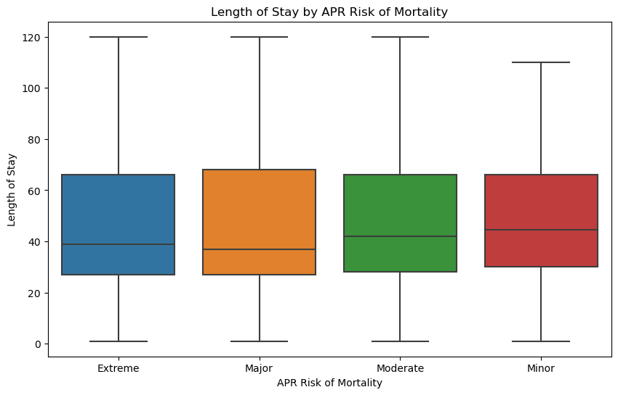
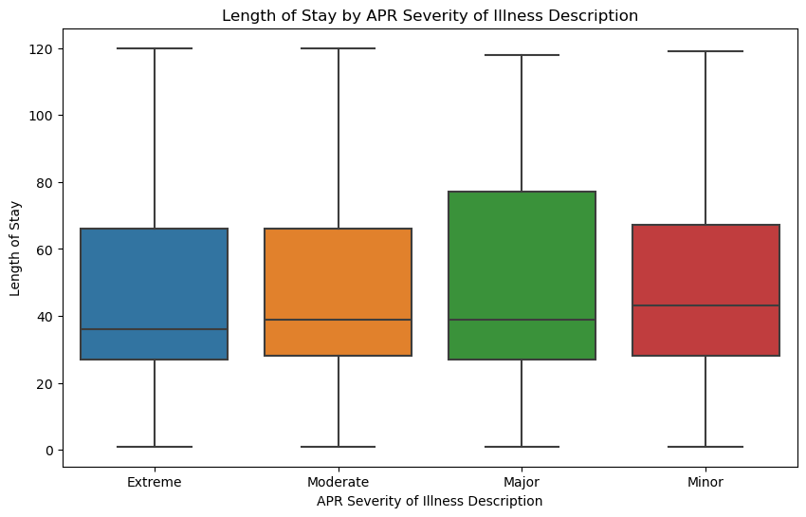
Factors like age, gender, race, ethnicity, diagnosis-related groups, risk of mortality, and illness severity do not show strong individual influences on LOS in this dataset. This reinforces the need to explore complex, multi-factor interactions in predictive modeling.

Slide 10
Machine Learning Models
Models tested:
Logistic Regression,
Decision Tree,
Random Forest,
Gradient Boosting
Splitting the Data:
- 80-20 train-test split
Scaling the Data:
Standard scaler applied

Slide 11
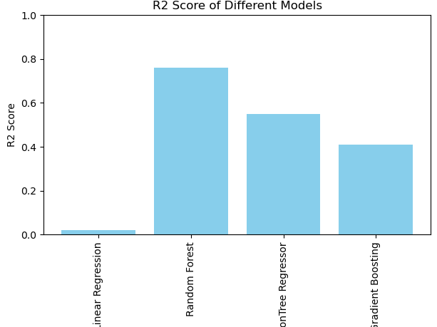
Model Performance Comparison (R² Scores)
Linear Regression: 0.02
Decision Tree: 0.55
Random Forest: 0.76
Gradient Boosting: 0.41
Notes:
The Random Forest Regressor performed the best with an R² score of 0.76, indicating that it captured the most variance in the LOS data compared to the other models.

Slide 12

Evaluating Models with Error Metrics
Model | MAE | MSE | RMSE
Logistic Regression | 24.98 | 921.75 | 30.36
Decision Tree | 7.46 | 426.03 | 20.64
Random Forest | 6.84 | 229.75 | 15.16
Gradient Boosting | 16.97 | 560.98 | 23.69
Notes:
Random Forest, showing the highest R² score and lowest error metrics, was chosen as the final model.

Slide 13
Hyperparameter Tuning
Used RandomizedSearchCV for tuning Random Forest and Gradient Boosting models
After tuning:
The Random Forest Regressor achieved the best parameters with an MSE of approximately -301.91 (negated for scoring).
The Gradient Boosting Regressor achieved an MSE of approximately -370.40.

Slide 14

Final Model Evaluation
Final predictions on the test set and calculated MAE, MSE, and RMSE again
Tuned Random Forest:
MAE: 9.16
MSE: 280.12
RMSE: 16.73
Tuned Gradient Boosting:
MAE: 11.44
MSE: 347.60
RMSE: 18.64
Notes:
The tuned Random Forest showed better performance in terms of lower errors, making it the final chosen model for this problem.

Slide 15
Evaluating Prediction Accuracy
 | Actual Length of Stay | Predicted Length of Stay | Absolute Error
0 | 26 | 25.0550 | 0.945
1 | 2 | 74.5400 | 72.54
2 | 86 | 73.5650 | 12.435
3 | 99 | 84.2300 | 14.77
4 | 88 | 79.7475 | 8.2525
5 | 58 | 57.6550 | 0.345
6 | 29 | 31.4600 | 2.46
7 | 99 | 68.1900 | 30.81
8 | 27 | 34.1100 | 7.11
9 | 88 | 76.3300 | 11.67
Threshold for Accuracy: Predictions within ±10 days
Result: 73.31% of predictions within the threshold
Notes:
The Random Forest model provides more accurate predictions with an average error of about 9-17 days.

Slide 16
Conclusion
The Tuned Random Forest model is the best for predicting LOS, with lower MAE, MSE, and RMSE
73.31% of the model’s predictions were within 10 days of the actual Length of Stay (LOS)
Although this is a good level of performance, there is still room for improvement, especially if further reduction in days is desirable
May assist healthcare professionals in planning resources and discharge schedules more accurately

Slide 17

Thank You
Questions???

