Slide 1

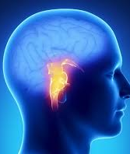
Springboard Final Capstone Project: Predictive Modeling for Stroke Risk Assessment Using Machine Learning
By Ranjana Roka

Slide 2




Thank You
Questions???

Slide 3
Contents
Introduction and Problem Statement
Data Wrangling
Exploratory Data Analysis
Machine Learning Models
Model Performance
Conclusions and Recommendations

Slide 4

Problem Statement and Objective
Strokes are a leading cause of death and disability globally
Millions affected each year
Accurate prediction of stroke risk remains challenging
Project Objective
Develop a predictive model that:
Accurately assesses the risk of stroke in individuals
Based on various health-related features
Utilizes machine learning techniques

Slide 5
Data Wrangling
Dataset: 5110 rows, 12 columns
Numerical Features: Id, Age, Hypertension, Heart disease, Avg glucose level, BMI, Stroke
Categorical Features: Gender, Ever married, Work type, Residence type, Smoking status
Handled missing values in BMI (4.1%)

Slide 6
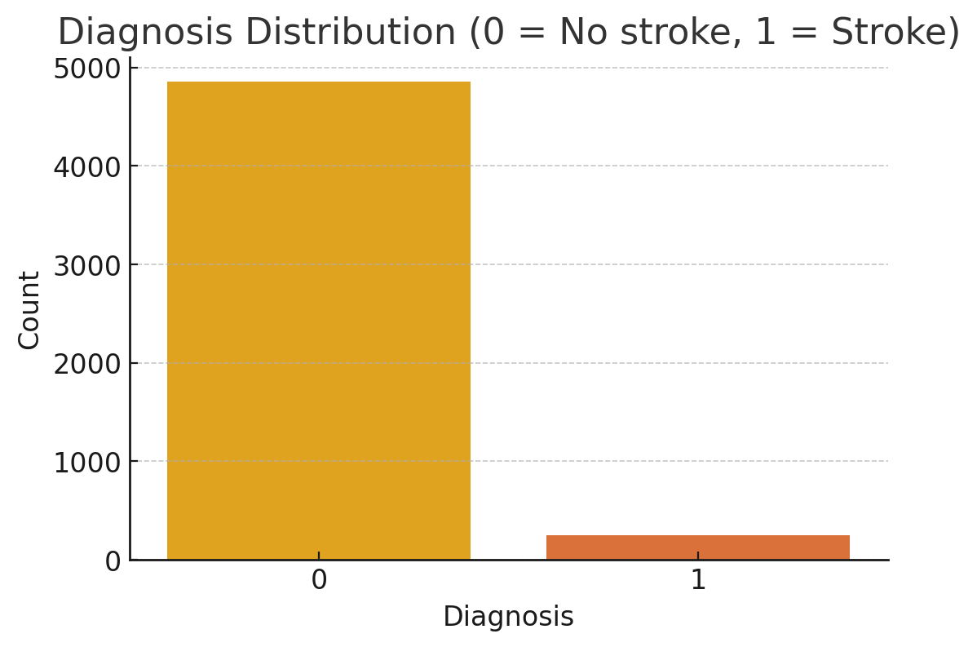
Distribution of stroke diagnoses in the dataset
The majority of individuals in the dataset did not experience a stroke
A much smaller number of individuals experienced a stroke
Imbalanced dataset

Slide 7
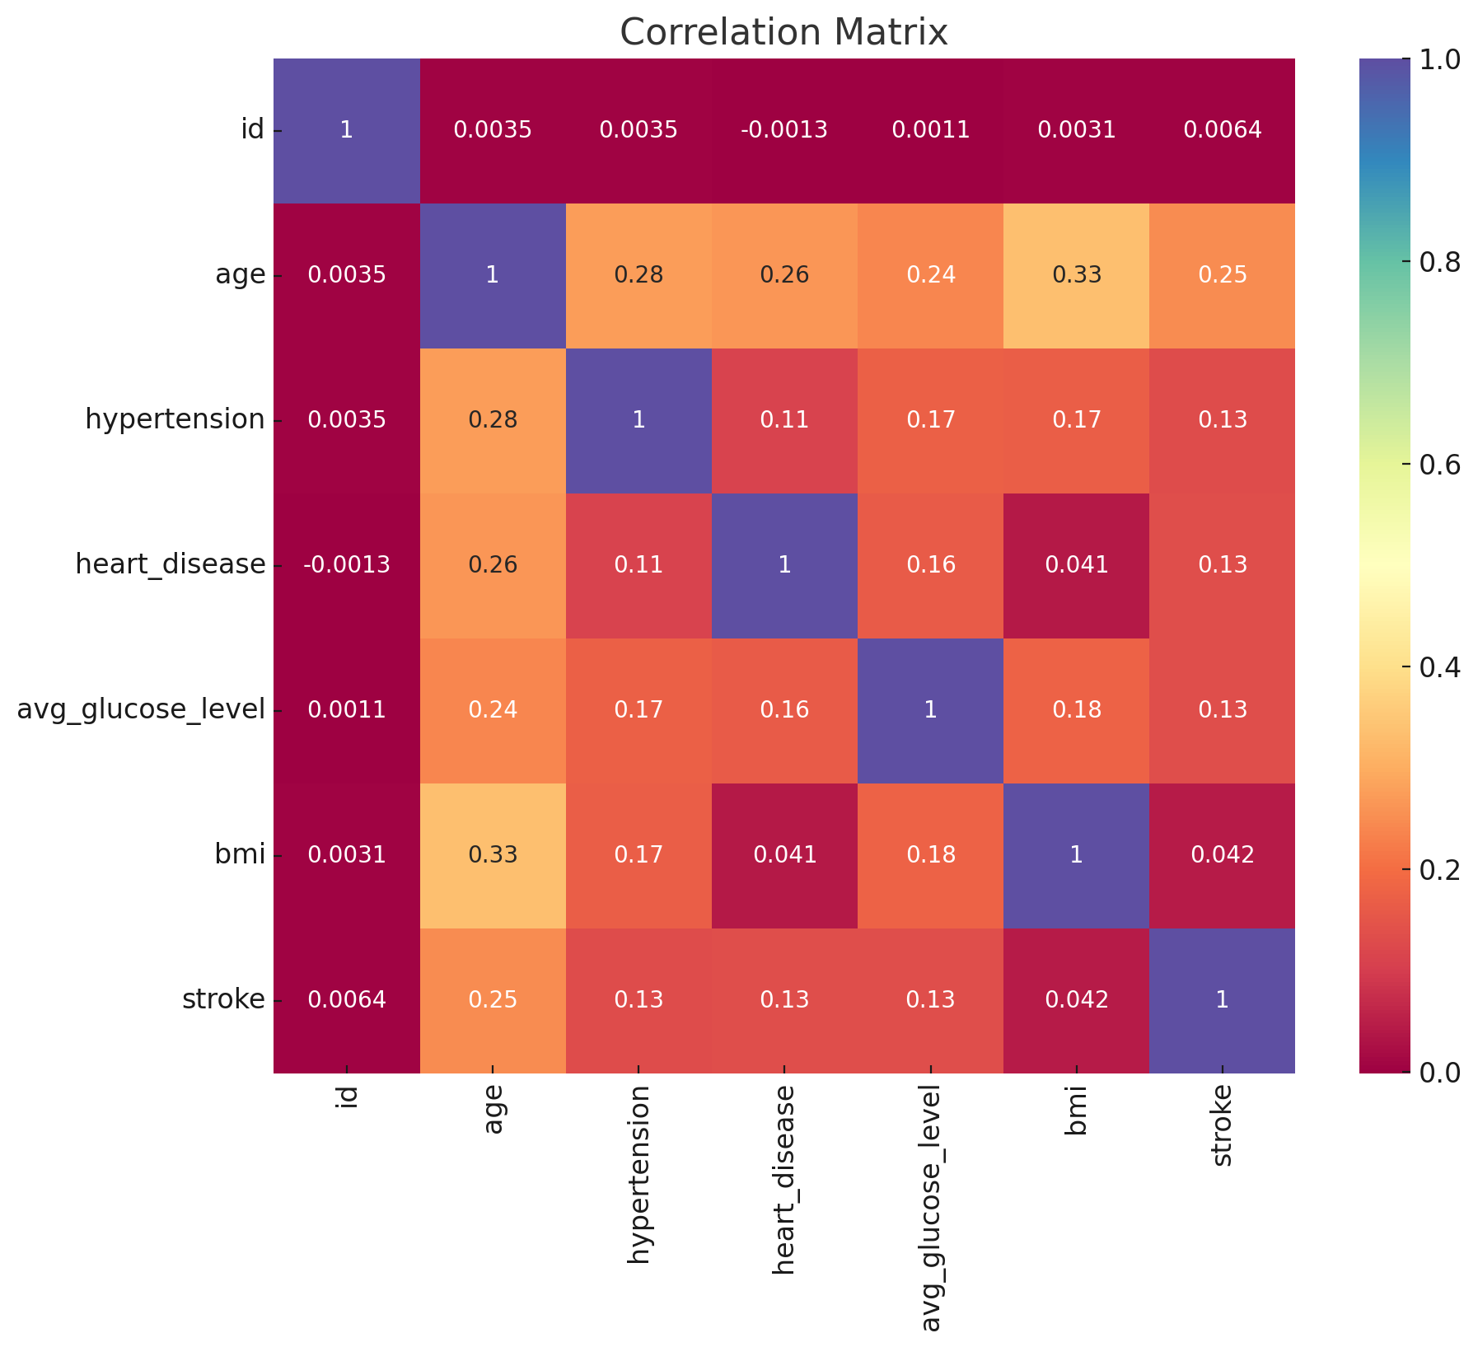
Exploratory Data Analysis
Correlation Matrix with Heatmap
Age has a moderate positive correlation with stroke
Heart disease and Hypertension have a small positive correlation with age and stroke
Correlation is low between BMI, avg_glucose_level and stroke

Slide 8
Machine Learning Models
Models tested:
Logistic Regression,
Decision Tree,
Random Forest,
Gradient Boosting
Initial challenge: Imbalanced dataset

Slide 9
Confusion Matrix (Before SMOTE)
Model | True Negatives (TN) | False Positives (FP) | False Negatives (FN) | True Positives (TP)
Logistic Regression | 1452 | 0 | 81 | 0
Decision Tree | 1452 | 0 | 81 | 0
Random Forest | 1452 | 0 | 81 | 0
Gradient Boosting | 1452 | 0 | 80 | 1

Slide 10
Classification Report (Before SMOTE)
Model | Accuracy | Precision (1) | Recall (1) | F1-score (1)
Logistic Regression | 0.947162 | 0.00 | 0.00 | 0.00
Decision Tree | 0.947162 | 0.00 | 0.00 | 0.00
Random Forest | 0.947162 | 0.00 | 0.00 | 0.00
Gradient Boosting | 0.947162 | 0.50 | 0.01 | 0.02

Slide 11
Model Performance Summary on Accuracy and ROC AUC
Model | Accuracy | ROC AUC
Logistic Regression | 0.737769 | 0.821583
Decision Tree | 0.662753 | 0.793818
Random Forest | 0.720157 | 0.792436
Gradient Boosting | 0.875408 | 0.777901

Slide 12
Confusion Matrix table (After SMOTE)
Model | True Negatives (TN) | False Positives (FP) | False Negatives (FN) | True Positives (TP)
Logistic Regression | 1067 | 385 | 17 | 64
Decision Tree | 952 | 500 | 17 | 64
Random Forest | 1044 | 408 | 21 | 60
Gradient Boosting | 1321 | 131 | 60 | 59

Slide 13
Classification Report (After SMOTE)
Model | Accuracy | Precision (1) | Recall (1) | F1-score (1)
Logistic Regression | 0.737769 | 0.14 | 0.79 | 0.24
Decision Tree | 0.662752 | 0.11 | 0.79 | 0.20
Random Forest | 0.720156 | 0.13 | 0.74 | 0.22
Gradient Boosting | 0.875407 | 0.14 | 0.72 | 0.18

Slide 14
Conclusion
All models achieved high accuracy scores before applying SMOTE, around 94.7%
Applied SMOTE technique to create a more balanced dataset
Gradient boosting achieved highest accuracy score (87.54%) and ROC AUC score (0.82)
Best model: Gradient Boosting

Slide 15

Recommendation
Improve early stroke detection:
Integrate the model in the health monitoring system for early detection
Timely intervention
Data-driven decision making:
Clinical support system or insurance risk can benefit
Balancing the dataset is crucial
Optimizing resources in Healthcare:
Optimize healthcare resources by prioritizing the high-risk patients
Better patient outcomes and reduced healthcare costs

