Slide 1
Designing and optimizing your React-Redux application
Rokas Mikalkevičius @ Wix

Slide 2
Why are we using react-redux?
We want to display our data from redux store in React components
It gives an API to connect our store and actions to React components as props
It optimizes the React components to render only when necessary

Slide 3
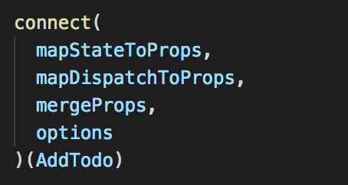
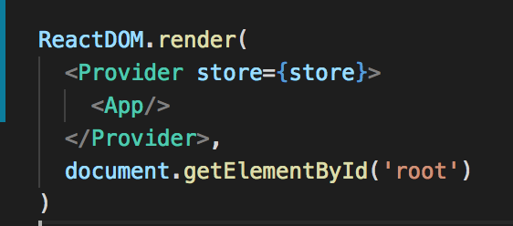
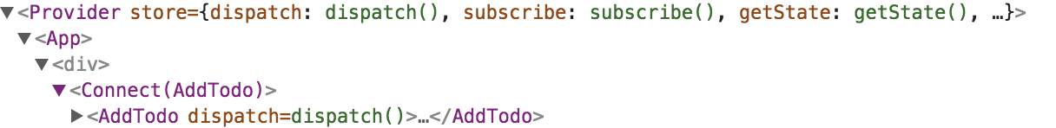
React-Redux API

Slide 4
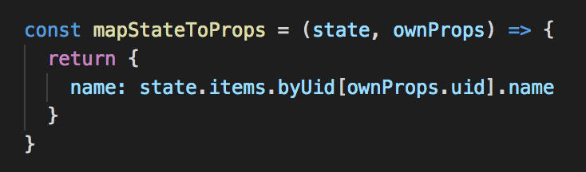
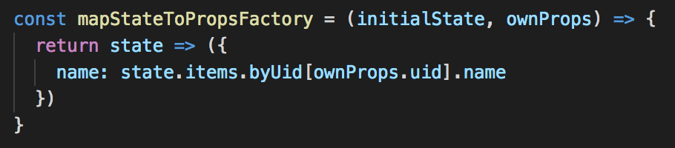
mapStateToProps
Provides the redux state and container component props - allows to calculate connected component props.
Executes every time the state has changed!

Slide 5
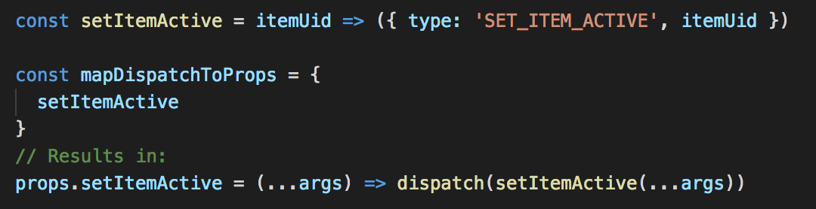
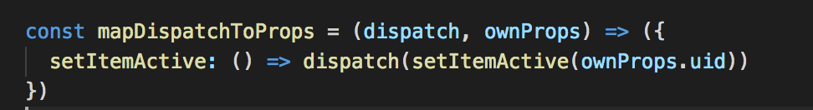
mapDispatchToProps
Provides the redux state dispatch and container component props - allows to calculate connected component.
Wraps given action creators to dispatch automatically when object is provided

Slide 6
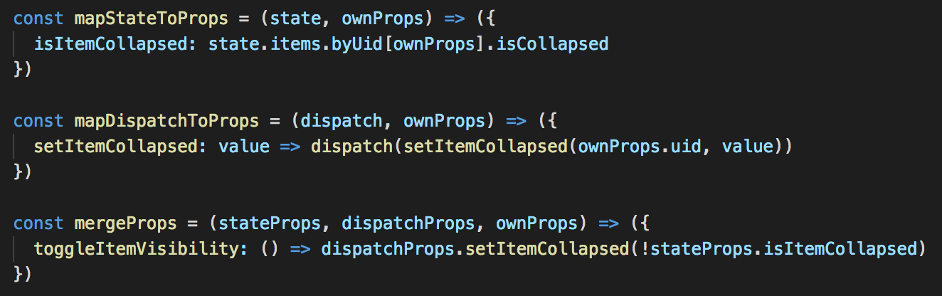
mergeProps
Allows to combine mapStateToProps result with mapDispatchToProps result
Allows to combine many dispatchProps into one prop

Slide 7
options
pure - when false, will disable react-redux optimization
areStatesEqual, areOwnPropsEqual, areStatePropsEqual, areMergedPropsEqual allows to customize the equality checking function. Shallow equal is default (===)
storeKey - allows to have multiple stores, is not recommended

Slide 8
What not to do in react-redux
Do not pass irrelative props to connected components
This can cause unnecessary component renderings when irrelative info is changing
This can lead towards bad application design where everything knows about everything

Slide 9
What not to do in react-redux
Do not return a new instance of an object, array or a function in mapStateToProps
This will cause the connected component to render every time the state changes as shallow prop check will fail every time

Slide 10
What not to do in react-redux
Do not connect everything in one container
Makes the react-redux rendering optimization useless, something will change every time the store changes
One huge connect with a lot of responsibilities to maintain
One container means more passing of props and deeper dependencies between connected components, which increases the complexity in the view layer
One container at the top was a mistake https://redux.js.org/docs/faq/ReactRedux.html

Slide 11
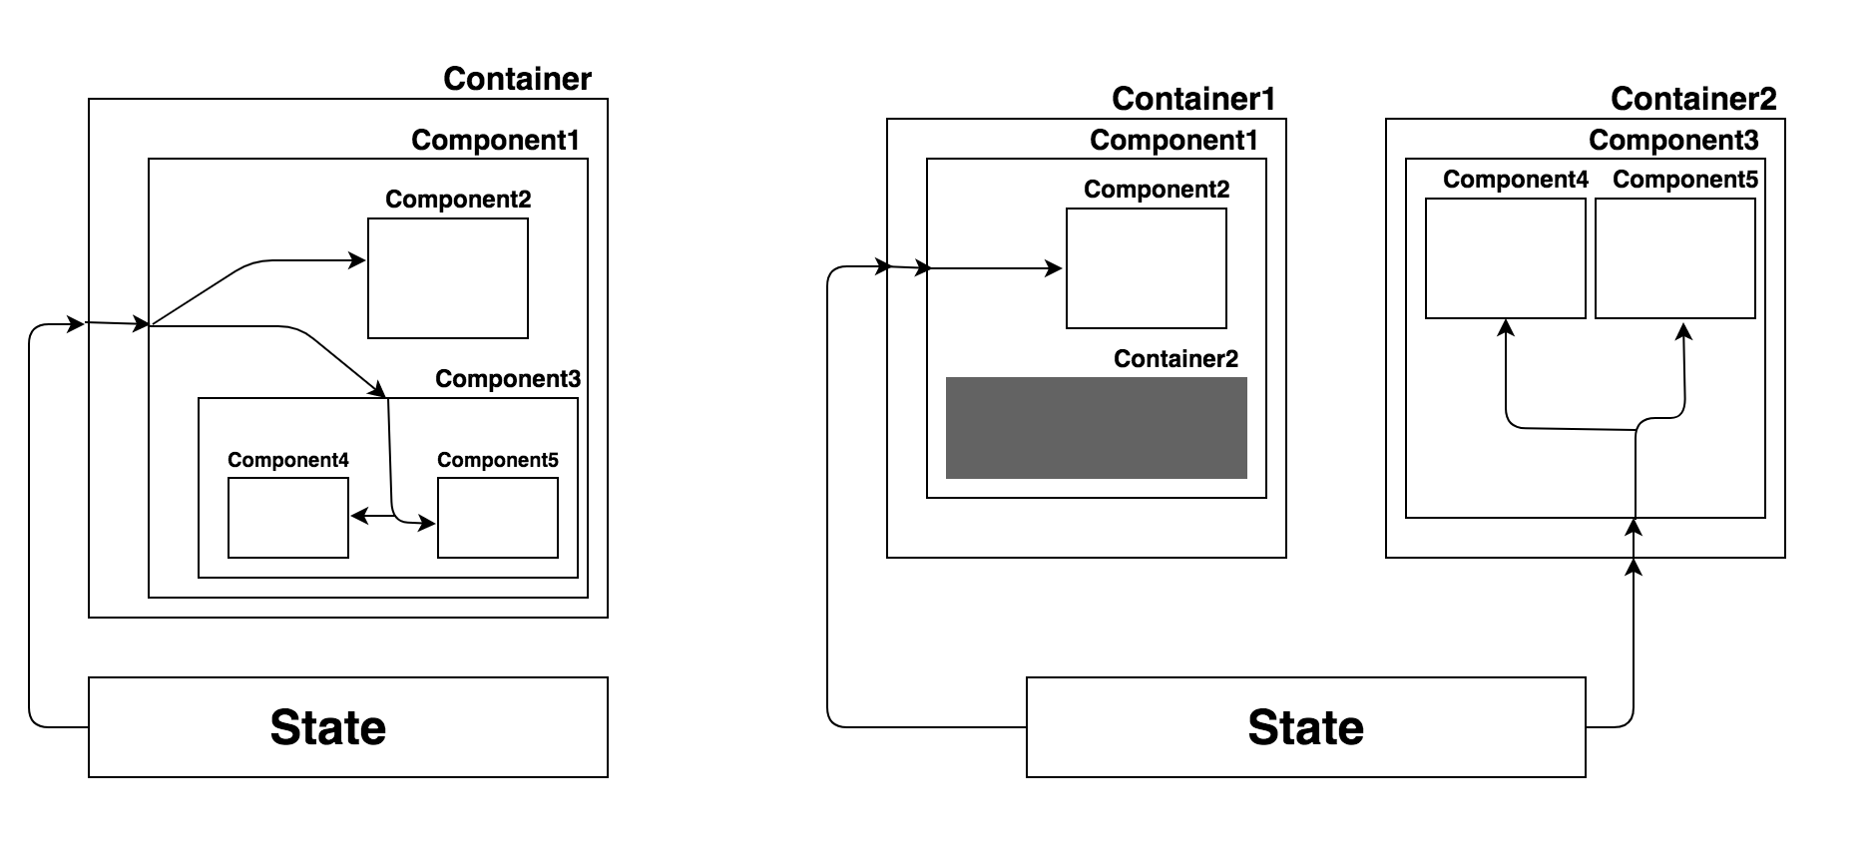
Containers allows to flatten the depth of data inheritance

Slide 12
Separation of concerns between React & Redux
Recommended to write pure / stateless react components
To read data – read data from props
To change data – invoke callbacks from props
Easy to test
One source of truth
Reusable components

Slide 13
Avoid logic in React components
More props needs to be connected for logic inside the components
Components imports functions and business logic which makes them not reusable
Store no longer represents the actual state of the application
More lifecycles you might not be aware of to maintain

Slide 14
Memoization
Optimization technic to prevent difficult calculations when the input does not change
Helps to connect object & array type props in React-Redux

Slide 15
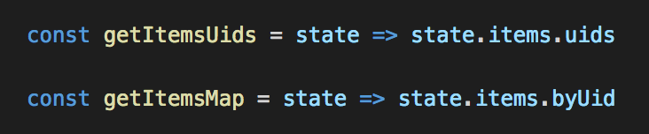
Getters
Used for memoization input
Does no calculations
Returns references or primitive values

Slide 16
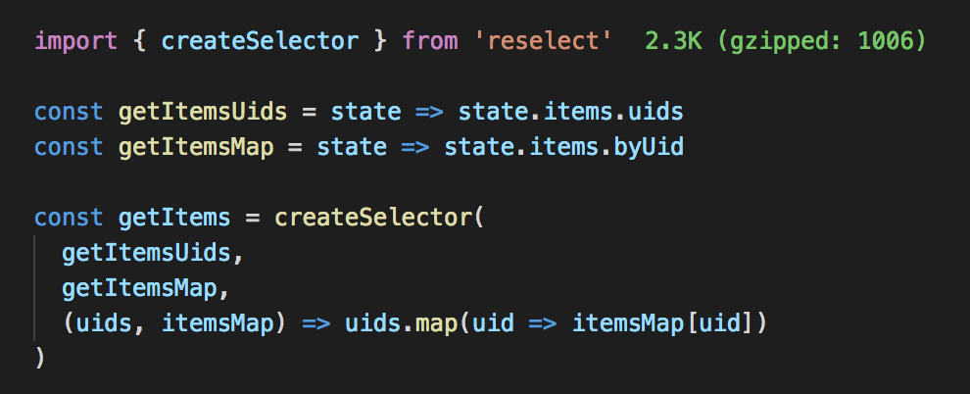
Selectors & reselect
Allows to store less state in Redux
Caches the result of getters and result function
Returns cached result when getters input does not change
Allows to not return a new instance of object or array every time mapStateToProps is calculating

Slide 17
Selectors & reselect
Are composable
Selectors & getters encapsulates the logic and allows easy refactoring
A good place to store business logic calculations

Slide 18
Examples

